Slide 1
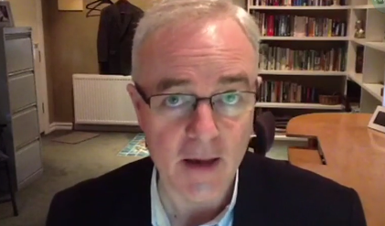
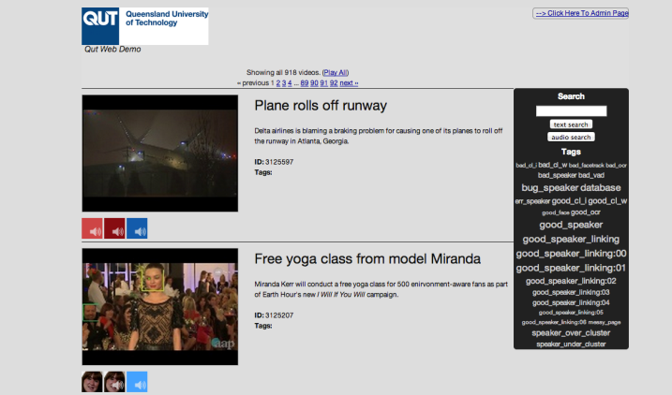
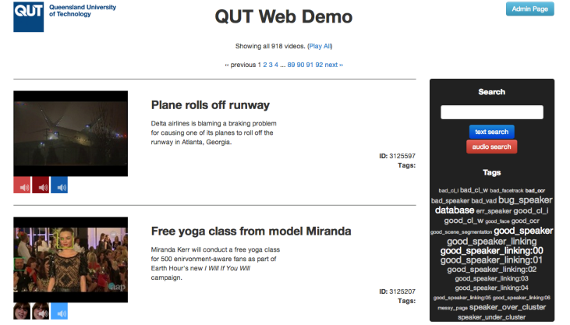
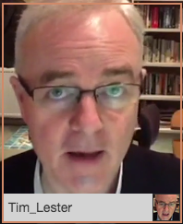
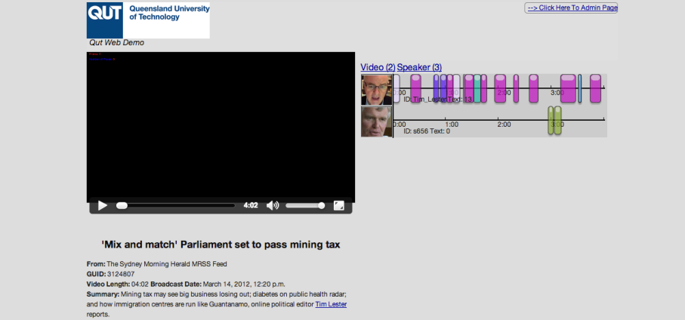
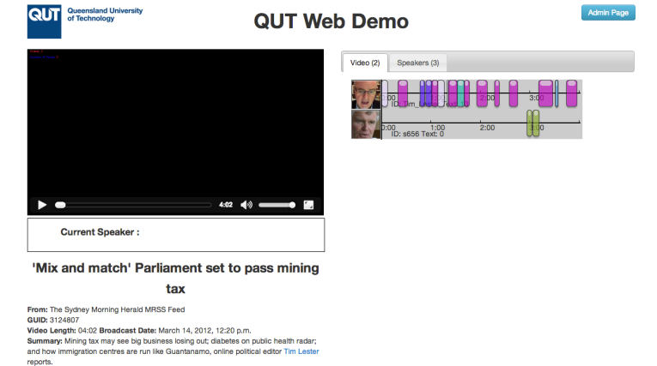
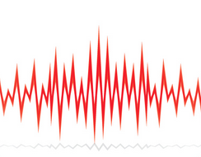
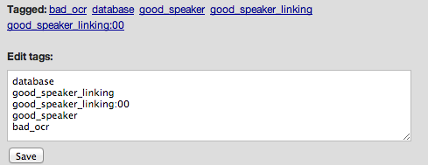
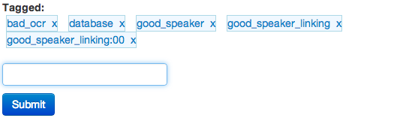
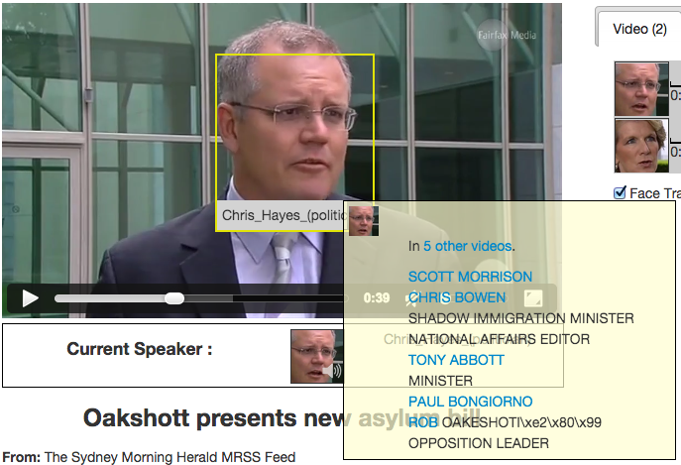
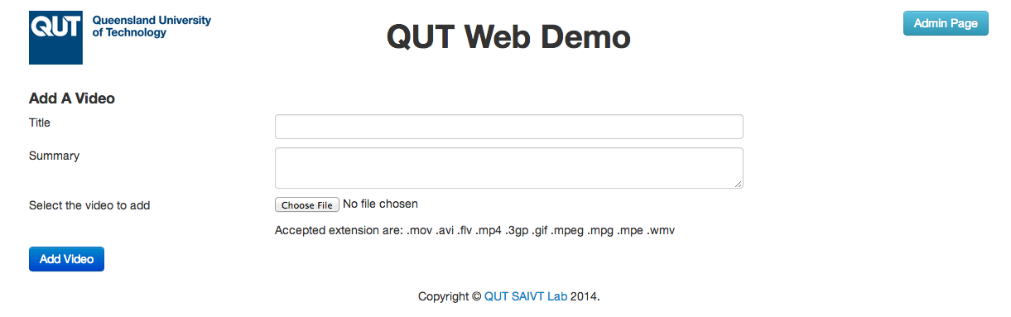
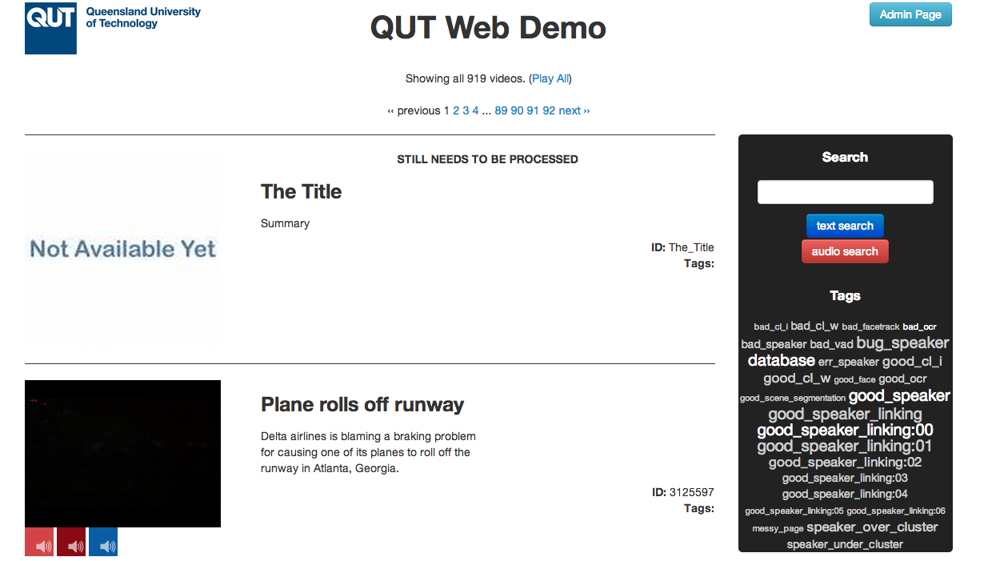
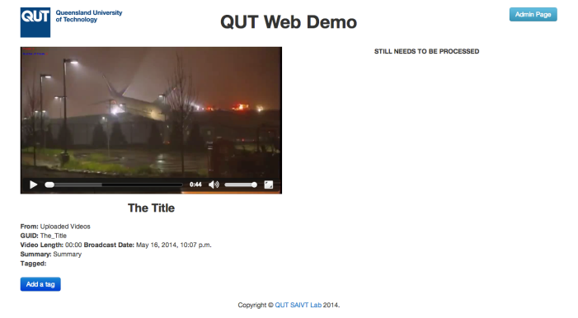
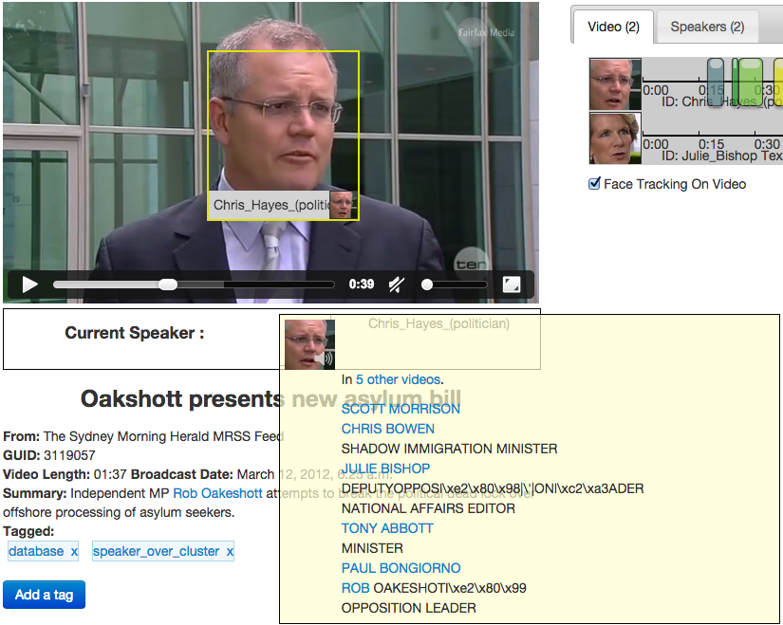

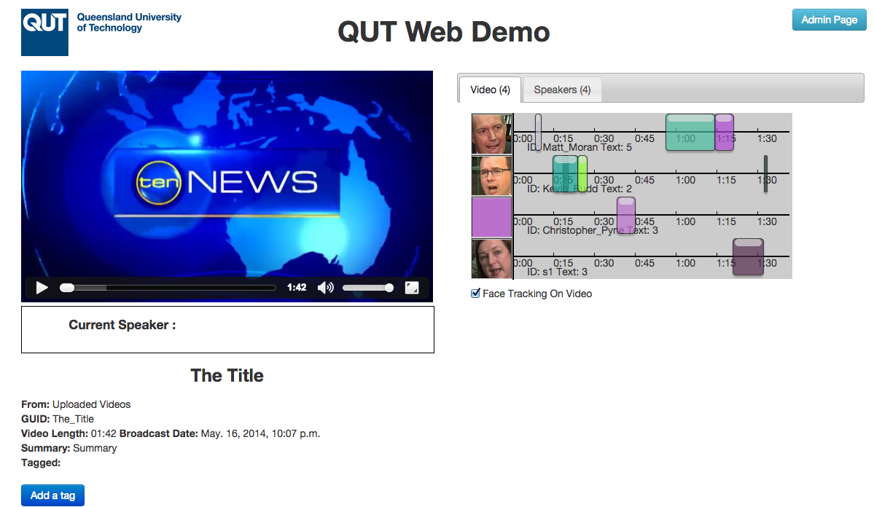
Entity Extraction Webdemo Enhancements
Francesco Ferraioli – David Dean – Clinton Fookes
Speech Audio Image Video Technologies (SAIVT)
Entity Extraction
General Enhancements
Process of extracting entities from a source. In case of a video, there are many types of entities. The main entities SAIVT focuses on are faces and speakers
OLD | NEW
Speaker detection and diarisation is defined as not only detecting when an individual is speaking but moreover the identification of the person, the individual, who is speaking.
Face recognition is the process of detecting faces and assigning a particular identity to that face in order to link the same person over different still images
Entity Display Enhancement
Add Video Functionality
Previously the faces would be highlighted in the video as a result of some video encoding of a box around the faces. Now that has been replaced by HTML elements which sit on top of the video and allow for interaction with the user.
The only way to know who was the current speaker would be to check the speakers tab on the right hand side. Now the current speaker is shown under the video as an interactive HTML element.
Cron Job
becks-1
Send
Uploaded
Get Processed
Process
lyra

