Slide 1
Job recommendation system
Project Defense
Team Member:
Suprim Golay(4543/71)
Prabesh Thapa(4521/71)
Sujan Bajracharya(4541/71)
Surya Adhikari(4546/71)

Slide 2
Introduction
“Job Recommendation System” is the online system whose sole intention is to enroll users and recommends them jobs to them as well as recommend candidates to the companies.
Our Project will help to recommend different types of job to the user based on their information provided and likewise it helps the companies to find the right person for their job by filtering the job seekers under their mentioned criteria.
In today’s busy world this system will assist a lot to the people who are seeking jobs as well as choose a right career path for them.
This is totally a web portal and need of internet is a compulsion.
This system helps to save a lot of time as well as resources.

Slide 3
Problem Identification
There are many websites and mobile applications that lists jobs to users on different categories.
These application collects a list of jobs from various employer and exhibits them to users on different categories but they do not actually recommend jobs.
Our system is being built to recommend jobs and assists the companies to find their right candidate.
Our system will recommends jobs based on the user’s skills, qualification and preferences which overcomes drawback of other projects.

Slide 4
Objectives
To aid user find appropriate jobs within less time and effort.
To recommend the relevant job to the users
To assist the companies to filter the Job Seekers from numerous applicants based on the user’s qualification, experience and skills which falls on their criteria.

Slide 5
Scope
It is very beneficial for both i.e. job offering company and user who needs job.
This system will automatically acclaims the job suitable for them and in case of organization, they can easily find the right person out of hundreds of applications in a quick time.
There are some limitations on this system such as access of internet is compulsory, system overloaded due to high number of applications which might cause the recommendation algorithm to lose productivity.

Slide 6
Tools Required

Slide 7
Analysis and Design tools
Draw.io (web tool)
Adobe XD design
Microsoft Office
Adobe Photoshop
Development tools
PyCharm IDE
ATOM
Sublime Text Editor
3. Implementation Tools
Web Browsers(Goggle Chrome,Mozilla etc)

Slide 8
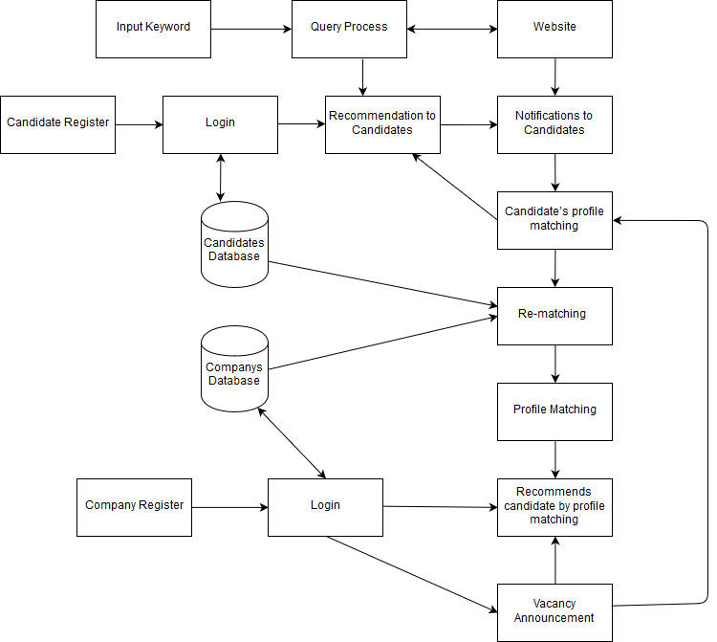
Architectural Diagram

Slide 9
Expected Outcome
Recommending suitable jobs for the users per their qualifications and skills provide by them while creating their respective accounts.
Recommending suitable candidate for the employers per their Job criteria.

Slide 10
References
[1] J.L. Herlocker, J.A, Konstan, L.G. Terveen, and J. Riedl, “Evaluating Collaborative Filtering Recommender Systems,” ACM Transactions on Information Systems, 22(1), pp. 5-53, 2004.
[2] M. Balabanovic and Y. Shoham, “Combining content -based and collaborative recommendation”, Comm. ACM, vol. 40, no.3, March 1997, pp. 66 -72.
[3] “Towards an Introduction to Collaborative Filtering”. Jia Zhou, Tiejian Luo, 2009
[4] “A Collaborative Filtering Recommendation Algorithm based on User Clustering and Item Clustering”. SongJie Gong, Zhejiang Business Technology Institute, 2010
[5] “Improved Neighborhood-based Collaborative Filtering”. Robert M. Bell and Yehuda Koren, 2007
[6] “A Framework for Collaborative, Content-Based and Demographic Filtering”. Micheal Pazzani, University of California, 2004
[7] “Online Clustering for collaborative filtering.” Lee W.S, School of Computing Technical Report, 2009
[8] “A hybrid collaborative filtering recommendation mechanism for P2P networks”. Z. Liu, W. QU, H. i, C.Xie, 2010
[9] “Recommendation based on rational inferences in collaborative filtering”. J.M. Yang, K.F. Li, D.F. Zhang, 2013
[10] “Collaborative Filtering with temporal dynamics”. Y. Koren, 2009
[11] “Amazon.com Recommendations Item-to-Item Collaborative Filtering”. Greg Linden, Brent Smith, and Jeremy York, 2006

Slide 11
Thank You!!!!

