Slide 1
Decorator
CS202
Group 03

Slide 2
Group MEMBERS
Hoang thi Minh khue
Le pham nhat quynh
Report
Slide/Source code

Slide 3
group MEMBERS
Tran nguyen dang tam
Bui le Gia cat
Report
Slide/ Source code

Slide 4
table of contents
01
02
03
Introduction
Problem
Solution
Approach to decorator
A real-world problem
A naive solution & underlying risks

Slide 5
table of contents
04
05
06
Real-world analogy
Structure
Applicability
Realistic approach
Design solution method
Compatibility

Slide 6
table of contents
07
08
09
Implementation
Pros and Cons
Relations with other patterns
How can we actually apply it?

Slide 7
table of contents
10
QUIZ

Slide 8
INTRODUCTION
Decorator is a structural design pattern that allows you to attach additional behaviors to objects by enclosing them in special wrapper objects that contain the behaviors.

Slide 9
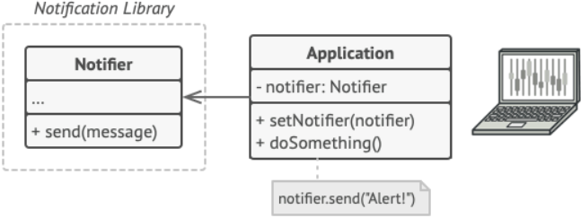
Hmm…
Imagine that you're working on a notification library that allows other applications to send out alerts to their users when crucial events occur.

Slide 10
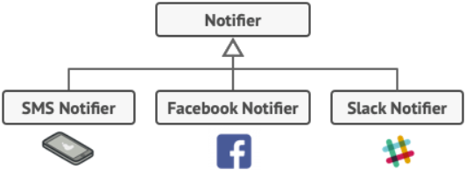
Problem
The notifier class could be used by an application to deliver important event alerts to a predetermined list of email addresses.

Slide 11
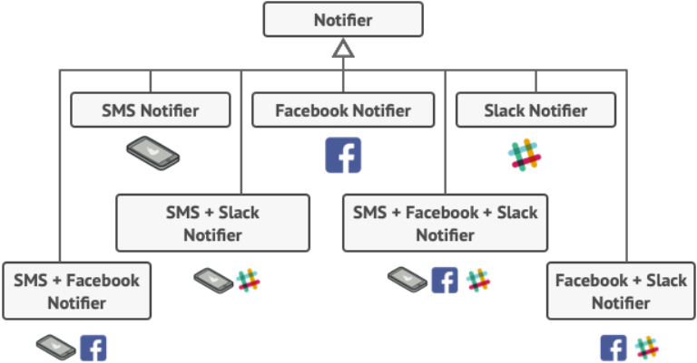
Problem
"Why can't you activate multiple notification types at the same time?" If your house is on fire, you'd undoubtedly want to know about it via every available means."
You attempted to solve the problem by designing special subclasses that included many notification methods into a single class.

Slide 12
Problem
"Why can't you activate multiple notification types at the same time?" If your house is on fire, you'd undoubtedly want to know about it via every available means."
You attempted to solve the problem by designing special subclasses that included many notification methods into a single class.

Slide 13

SOlution
There are numerous important considerations to be aware of when it comes to inheritance.
Inheritance is static.
Subclasses can have just one parent class.

Slide 14
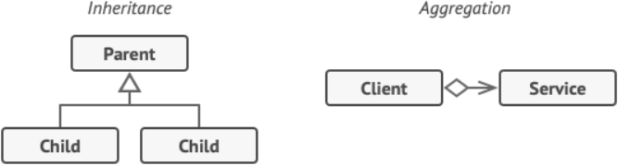
SOlution
Using Aggregation or Composition is one approach to get around these limitations.

Slide 15
SOlution
Wrapper
Is an object that can be linked with some target object.
Contains the same set of methods as the target and delegates to it all requests it receives.
May alter the result by doing something either before or after it passes the request to the target.

Slide 16
SOlution
Wrapper
The wrapper implements the same interface as the wrapped object. Make the wrapper’s reference field accept any object that follows that interface.
=> This allows you to wrap an object in several wrappers and apply the wraps' aggregate functionality to it.

Slide 17
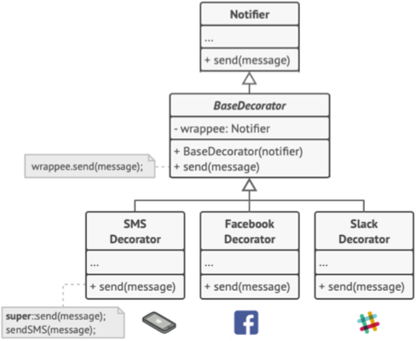
solution
Turn all other notification methods into decorators.

Slide 18
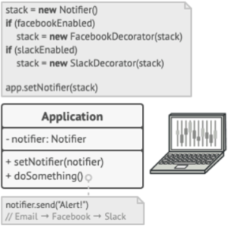
solution
Apps may create elaborate notification decorator stacks.

Slide 19

Real-World analogy
Wearing clothes is an example of using decorators.
All of them "extend" your fundamental behavior, but they aren't a part of you, and you can easily remove any piece of clothes when you don't need it.

Slide 20
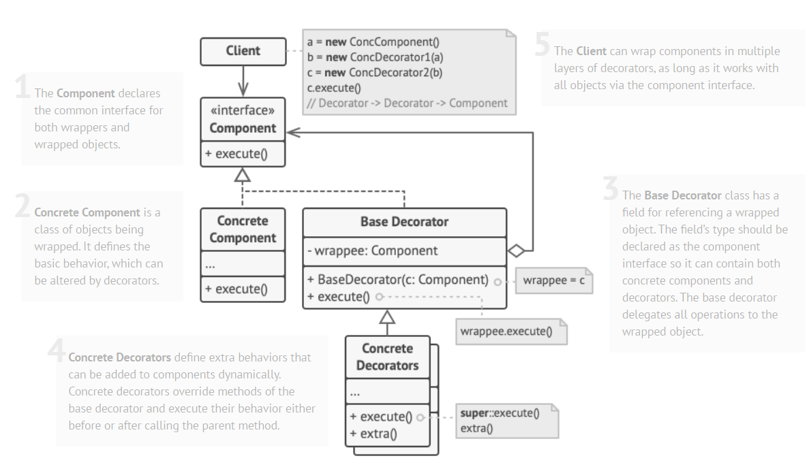
Structure

Slide 21
Applicability
MERCURY
VENUS
When you need to be able to add new behaviors to objects at runtime without disrupting the code that uses them, utilize the Decorator approach.
When it's inconvenient or impossible to extend an object's behavior through inheritance, use the pattern.

Slide 22
Implementation
first
then
Source code
Make sure your business domain can be represented as a primary component with multiple optional layers over it.
Determine which methods are shared by the principal component and optional layers. Make a component interface and add those methods to it.
class Component{
public:
virtual ~Component()=0;
virtual void execute() const = 0;
};

Slide 23
Implementation
also
Source code
Create a concrete component class and define the base behavior in it.
class ConcreteComponent : public Component{
// "is a" relationship
public:
void execute() const;
};

Slide 24
Implementation
afterthat
Source code
Create a base decorator class.
class BaseDecorator : public Component{
// "is a" relationship
private:
Component *wrappee; //"has a" relationship
public:
BaseDecorator(Component *Wrappee);
void execute() const;
};

Slide 25
Implementation
beside
Source code
Create concrete decorators by extending them from the base decorator
class ConcreteDecorator : public BaseDecorator{
public:
ConcreteDecorator(Component *wrappee);
void execute() const;
void extra();
};

Slide 26
Implementation
Last but not least
Make sure all classes implement the component interface.
The client code must be responsible for creating decorators and composing them in the way the client needs.

Slide 27
Pros & Cons : Pros
________
________
________
________
1 / one
2 / two
3 / three
4 / four
You can extend the behavior of an object without creating a new subclass.
At runtime, you can add or remove responsibilities from an object.
Wrapping an object with numerous decorators allows you to combine multiple behaviors.
Single Responsibility Principle.

Slide 28
Pros & Cons : cons
________
________
________
1/ one
2 / two
3 / three
It’s hard to remove a specific wrapper from the wrappers stack.
It's difficult to create a decorator whose behavior is independent of the order in which the decorators are applied.
Layer configuration code may appear to be rather nasty at first.

Slide 29
Relations with other patterns
one
two
three
Adapter modifies an existing object's interface, whereas Decorator improves an object's appearance without affecting its interface.
Adapter provides a different interface to the wrapped object, Proxy provides it with the same interface, and Decorator provides it with an enhanced interface.
Decorator and Proxy are based on the composition principle, which states that one object should transfer some of its responsibilities to another.

Slide 30
Relations with other patterns
four
five
Chain of Responsibility and Decorator rely on recursive composition to pass the execution through a series of objects.
Both Composite and Decorator use recursive composition to organize an open-ended number of objects, hence their structure diagrams are similar.

Slide 31
Relations with other patterns
six
seven
Designs that make heavy use of Composite and Decorator can often benefit from using Prototype. Applying the pattern lets you clone complex structures instead of reconstructing them from scratch.
Decorator lets you change the skin of an object, while Strategy lets you change the guts.

