Slide 1
String
字串處理

Slide 2
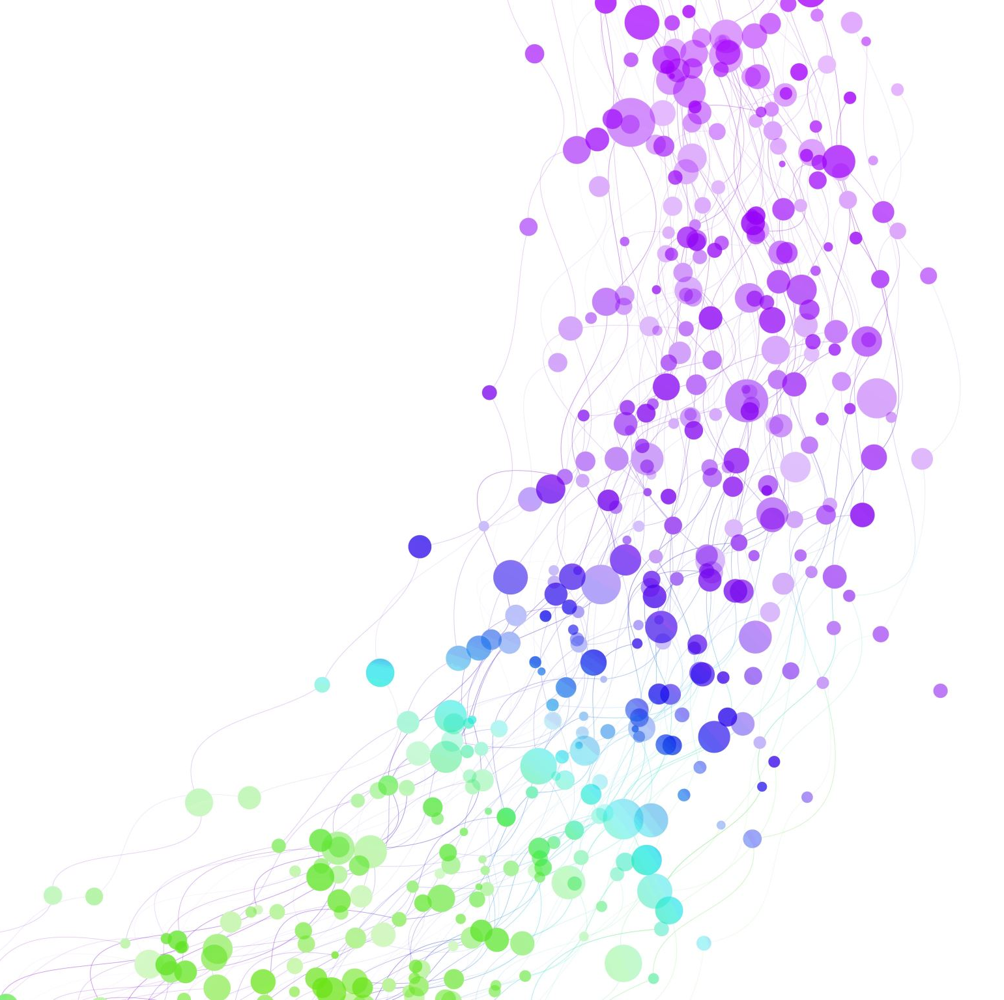
Radix Sort
基數排序

Slide 3
Counting Sort
輸入 $n$ 個範圍 $0\sim k−1$ 的數字，將其排序後輸出
0 | 1 | 2 | 3 | 4 | 5
7 | 1 | 2 | 2 | 7 | 1

Slide 4
Counting Sort
輸入 $n$ 個範圍 $0\sim k−1$ 的數字，將其排序後輸出
0 | 1 | 2 | 3 | 4 | 5
7 | 1 | 2 | 2 | 7 | 1
0 | 1 | 2 | 3 | 4 | 5 | 6 | 7
0 | 2 | 2 | 0 | 0 | 0 | 0 | 2
Bucket

Slide 5
Counting Sort
輸入 $n$ 個範圍 $0\sim k−1$ 的數字，將其排序後輸出
0 | 1 | 2 | 3 | 4 | 5
7 | 1 | 2 | 2 | 7 | 1
0 | 1 | 2 | 3 | 4 | 5 | 6 | 7
0 | 2 | 2 | 0 | 0 | 0 | 0 | 2
Bucket
0 | 1 | 2 | 3 | 4 | 5
1 | 1 | 2 | 2 | 7 | 7

Slide 6
Counting Sort
vector<unsigned> counting_sort(const vector<unsigned> &Arr, unsigned k) {
vector<unsigned> Bucket(k, 0);
for (auto x : Arr)
++Bucket[x];
vector<unsigned> Ans;
for (unsigned x = 0; x < k; ++x)
while (Bucket[x]--)
Ans.emplace_back(x);
return Ans;
}
不喜歡這樣的寫法，基本上只能用在數字上

Slide 7
標準的 Counting Sort
vector<unsigned> counting_sort(const vector<unsigned> &Arr, unsigned k) {
vector<unsigned> Bucket(k, 0);
for (auto x : Arr)
++Bucket[x];
partial_sum(Bucket.begin(), Bucket.end(), Bucket.begin());
vector<unsigned> Ans(Arr.size());
for (auto Iter = Arr.rbegin(); Iter != Arr.rend(); ++Iter)
Ans[--Bucket[*Iter]] = *Iter;
return Ans;
}

Slide 8
標準的 Counting Sort
0 | 1 | 2 | 3 | 4 | 5
7 | 1 | 2 | 2 | 7 | 1
0 | 1 | 2 | 3 | 4 | 5 | 6 | 7
0 | 2 | 2 | 0 | 0 | 0 | 0 | 2
Bucket

Slide 9
標準的 Counting Sort
std::partial_sum
0 | 1 | 2 | 3 | 4 | 5
7 | 1 | 2 | 2 | 7 | 1
0 | 1 | 2 | 3 | 4 | 5 | 6 | 7
0 | 2 | 4 | 4 | 4 | 4 | 4 | 6
Bucket
0 | 1 | 2 | 3 | 4 | 5
Ans

Slide 10
標準的 Counting Sort
std::partial_sum
0 | 1 | 2 | 3 | 4 | 5
7 | 1 | 2 | 2 | 7 | 1
0 | 1 | 2 | 3 | 4 | 5 | 6 | 7
0 | 1 | 4 | 4 | 4 | 4 | 4 | 6
Bucket
0 | 1 | 2 | 3 | 4 | 5
 | 1
Ans

Slide 11
標準的 Counting Sort
std::partial_sum
0 | 1 | 2 | 3 | 4 | 5
7 | 1 | 2 | 2 | 7 | 1
0 | 1 | 2 | 3 | 4 | 5 | 6 | 7
0 | 1 | 4 | 4 | 4 | 4 | 4 | 5
Bucket
0 | 1 | 2 | 3 | 4 | 5
 | 1 |  |  |  | 7
Ans

Slide 12
標準的 Counting Sort
std::partial_sum
0 | 1 | 2 | 3 | 4 | 5
7 | 1 | 2 | 2 | 7 | 1
0 | 1 | 2 | 3 | 4 | 5 | 6 | 7
0 | 1 | 3 | 4 | 4 | 4 | 4 | 5
Bucket
0 | 1 | 2 | 3 | 4 | 5
 | 1 |  | 2 |  | 7
Ans

Slide 13
標準的 Counting Sort
std::partial_sum
0 | 1 | 2 | 3 | 4 | 5
7 | 1 | 2 | 2 | 7 | 1
0 | 1 | 2 | 3 | 4 | 5 | 6 | 7
0 | 1 | 2 | 4 | 4 | 4 | 4 | 5
Bucket
0 | 1 | 2 | 3 | 4 | 5
 | 1 | 2 | 2 |  | 7
Ans

Slide 14
標準的 Counting Sort
std::partial_sum
0 | 1 | 2 | 3 | 4 | 5
7 | 1 | 2 | 2 | 7 | 1
0 | 1 | 2 | 3 | 4 | 5 | 6 | 7
0 | 0 | 2 | 4 | 4 | 4 | 4 | 5
Bucket
0 | 1 | 2 | 3 | 4 | 5
1 | 1 | 2 | 2 |  | 7
Ans

Slide 15
標準的 Counting Sort
std::partial_sum
0 | 1 | 2 | 3 | 4 | 5
7 | 1 | 2 | 2 | 7 | 1
0 | 1 | 2 | 3 | 4 | 5 | 6 | 7
0 | 0 | 2 | 4 | 4 | 4 | 4 | 4
Bucket
0 | 1 | 2 | 3 | 4 | 5
1 | 1 | 2 | 2 | 7 | 7
Ans

Slide 16
標準的 Counting Sort – 性質
可以排序非整數物件 (例如某個 struct 只需要對某個 member 排序)
它是個穩定排序 (stable sort)

Slide 17
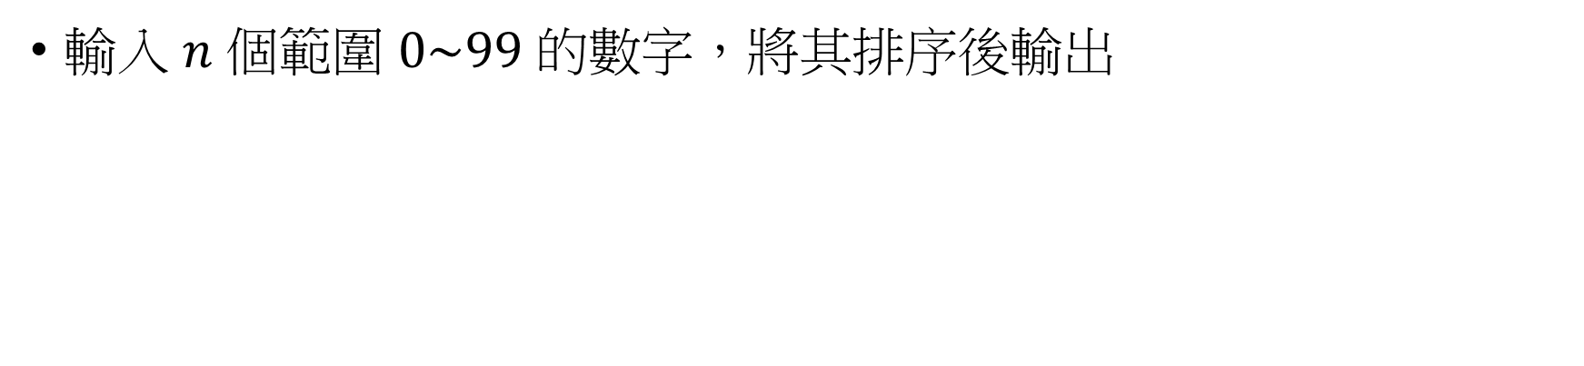
Radix Sort
輸入 $n$ 個範圍 $0\sim 99$ 的數字，將其排序後輸出
0 | 1 | 2 | 3 | 4 | 5
76 | 15 | 23 | 27 | 71 | 14

Slide 18
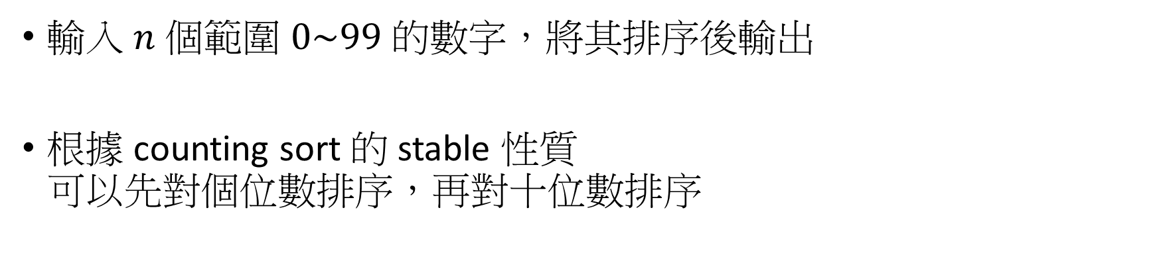
Radix Sort
輸入 $n$ 個範圍 $0\sim 99$ 的數字，將其排序後輸出
根據 counting sort 的 stable 性質 可以先對個位數排序，再對十位數排序
0 | 1 | 2 | 3 | 4 | 5
76 | 15 | 23 | 27 | 71 | 14
0 | 1 | 2 | 3 | 4 | 5
71 | 23 | 14 | 15 | 76 | 27

Slide 19
Radix Sort
輸入 $n$ 個範圍 $0\sim 99$ 的數字，將其排序後輸出
根據 counting sort 的 stable 性質 可以先對個位數排序，再對十位數排序
0 | 1 | 2 | 3 | 4 | 5
76 | 15 | 23 | 27 | 71 | 14
0 | 1 | 2 | 3 | 4 | 5
71 | 23 | 14 | 15 | 76 | 27
只需要大小是 10 的額外空間！
0 | 1 | 2 | 3 | 4 | 5
14 | 15 | 23 | 27 | 71 | 76

Slide 20
2 位數 - Radix Sort
void bucket_sort(vector<unsigned> &Arr) {
auto counting_sort = [&](auto getKey) {
vector<unsigned> Bucket(10, 0);
for (auto x : Arr)
++Bucket[getKey(x)];
partial_sum(Bucket.begin(), Bucket.end(), Bucket.begin());
vector<unsigned> Ans(Arr.size());
for (auto Iter = Arr.rbegin(); Iter != Arr.rend(); ++Iter)
Ans[--Bucket[getKey(*Iter)]] = move(*Iter);
return Ans;
};
Arr = counting_sort([&](unsigned x) { return x % 10; });
Arr = counting_sort([&](unsigned x) { return x / 10; });
}

Slide 21
將 counting-sort 的部分拆開來
template <class Ty, class BucketTy, class FuncTy>
void counting_sort(const Ty &Input, Ty &Output, BucketTy &Bucket,
FuncTy getKey) {
fill(Bucket.begin(), Bucket.end(), 0);
for (auto x : Input)
++Bucket[getKey(x)];
partial_sum(Bucket.begin(), Bucket.end(), Bucket.begin());
for (auto Iter = Input.rbegin(); Iter != Input.rend(); ++Iter)
Output[--Bucket[getKey(*Iter)]] = move(*Iter);
}

Slide 22
unsigned - Radix Sort
void bucket_sort(vector<unsigned> &Arr) {
vector<unsigned> Bucket(10, 0), Tmp(Arr.size());
unsigned base = 1;
for (unsigned T = 1; T <= 10; ++T) {
counting_sort(Arr, Tmp, Bucket,
[base](unsigned x) { return (x / base) % 10; });
Arr.swap(Tmp);
base *= 10;
}
}

Slide 23
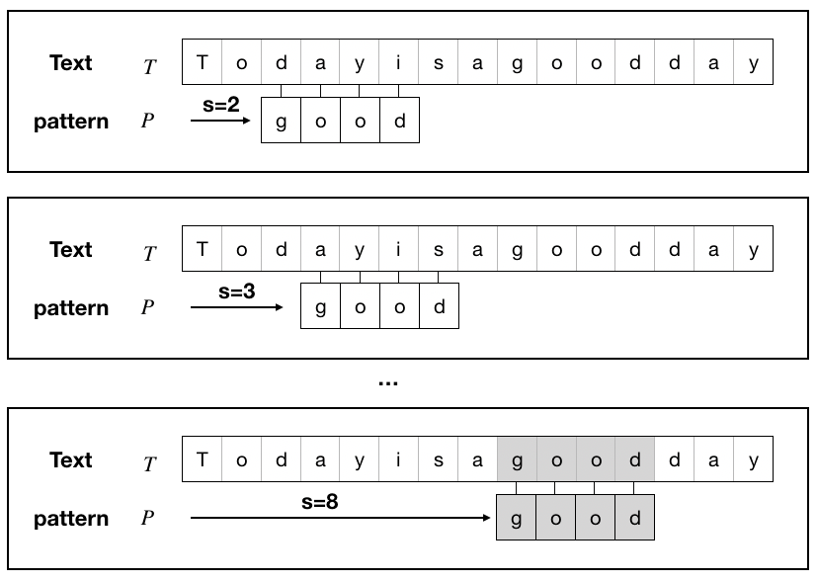
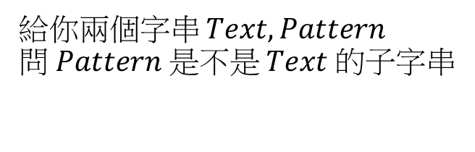
字串匹配問題
給你兩個字串 $Text,Pattern$ 問 $Pattern$ 是不是 $Text$ 的子字串

Slide 24
最簡單的暴力法
size_t matching(const string &text, const string &pattern) {
for (size_t i = 0; i < text.size(); ++i) {
bool match = true;
for (size_t j = 0; j < pattern.size(); ++j)
if (i + j >= text.size() || text[i + j] != pattern[j]) {
match = false;
break;
}
if (match) return i;
}
return std::string::npos;
}

Slide 25
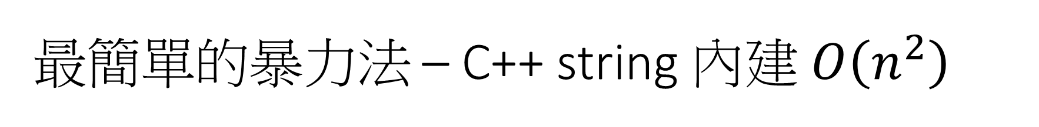
最簡單的暴力法 – C++ string 內建 $O\left(n^{2}\right)$
size_t matching(const string &text, const string &pattern) {
return text.find(pattern);
}

Slide 26


暴力法會變成 $O\left(n^{2}\right)$ 的例子
$Text=aaaa…aaaaaa$
$Pattern=aaa…aaab$
$len\left(Pattern\right)=\left\lfloor \frac{len\left(Text\right)}{2}\right\rfloor$

Slide 27
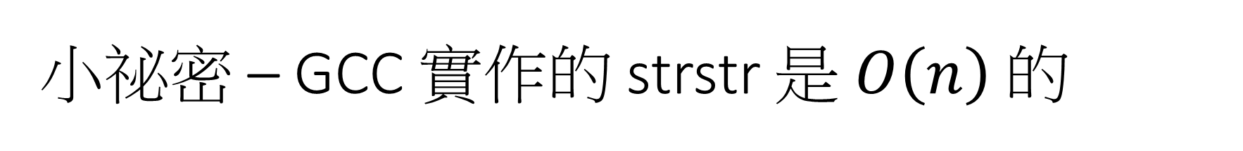
小祕密 – GCC 實作的 strstr 是 $O\left(n\right)$ 的
#include <cstring>
#include <iostream>
using namespace std;
int main() {
char Tc[] = "This is C-style string with an Egg.";
char Sc[] = "Egg";
if (auto res = strstr(Tc, Sc); res != nullptr) {
cout << "found " << Sc << " at " << res - Tc << '\n';
}
return 0;
}

Slide 28
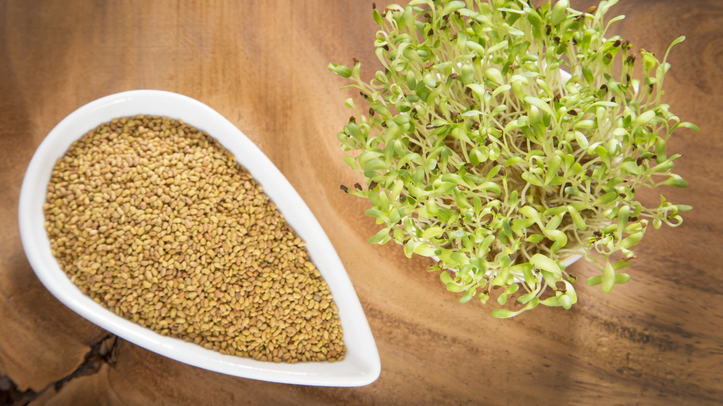
Suffix Array
後綴數組
苜蓿芽 (alfalfa)

Slide 29
後綴 (Suffix)
0 | 1 | 2 | 3 | 4 | 5 | 6 | 7
a | a | b | a | a | a | a | b
0 | a | a | b | a | a | a | a | b
Suffix
1 | a | b | a | a | a | a | b
2 | b | a | a | a | a | b
3 | a | a | a | a | b
4 | a | a | a | b
5 | a | a | b
6 | a | b
7 | b

Slide 30
後綴數組 (Suffix Array, SA)
0 | 1 | 2 | 3 | 4 | 5 | 6 | 7
a | a | b | a | a | a | a | b
3 | a | a | a | a | b
Suffix Sorted In Lexicographic Order
4 | a | a | a | b
5 | a | a | b
0 | a | a | b | a | a | a | a | b
0 | 1 | 2 | 3 | 4 | 5 | 6 | 7
3 | 4 | 5 | 0 | 6 | 1 | 7 | 2
SA
6 | a | b
1 | a | b | a | a | a | a | b
0 | 1 | 2 | 3 | 4 | 5 | 6 | 7
3 | 5 | 7 | 0 | 1 | 2 | 4 | 6
Rank
7 | b
2 | b | a | a | a | a | b

Slide 31

後綴數組上二分搜
0 | 1 | 2 | 3 | 4 | 5 | 6 | 7
a | a | b | a | a | a | a | b
3 | a | a | a | a | b
Suffix Sorted In Lexicographic Order
4 | a | a | a | b
5 | a | a | b
0 | a | a | b | a | a | a | a | b
6 | a | b
$$Pattern$$
a | b | a
1 | a | b | a | a | a | a | b
7 | b
2 | b | a | a | a | a | b

Slide 32
複習：模板化的二分搜
template <class Ty, class FuncTy>
pair<Ty, Ty> binarySearch(Ty L, Ty R, FuncTy check) {
if (check(R) == true) return {R, R + 1};
if (check(L) == false) return {L - 1, L};
while (L + 1 < R) {
Ty Mid = L + (R - L) / 2;
if (check(Mid)) L = Mid;
else R = Mid;
}
return {L, R};
}
L
K
K+1
R
check(x) = True
check(x) = False

Slide 33
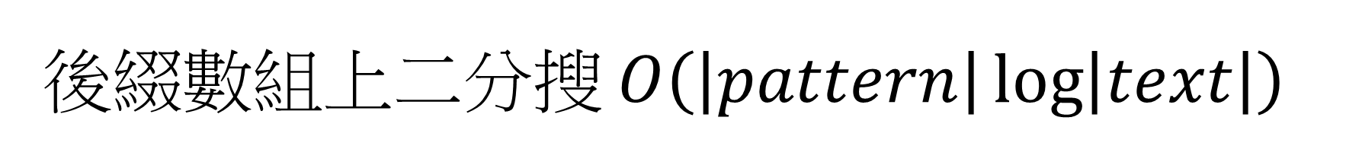
後綴數組上二分搜 $O\left(\left|pattern\right|\log\left|text\right|\right)$
pair<vector<int>, vector<int>> buildSuffixArray(const string &text) {
// TODO
}
size_t matching(const string &text, const string &pattern) {
auto [SA, Rank] = buildSuffixArray(text);
auto [L, R] = binarySearch(0, int(SA.size()) - 1, [&](int Idx) {
return text.substr(SA[Idx]) < pattern;
});
if (R < SA.size() && pattern == text.substr(SA[R], pattern.size()))
return SA[R];
return std::string::npos;
}

Slide 34

構造後綴數組常見方法
倍增法：$O\left(n\log{n}\right)$
DC3： $O\left(n\right)$
SA_IS： $O\left(n\right)$
自己學放模板

Slide 35
倍增法基本概念
a | a | b | a | a | a | a | b
第 1 次排序
rank
0 | 0 | 1 | 0 | 0 | 0 | 0 | 1
長度 1
0,0 | 0,1 | 1,0 | 0,0 | 0,0 | 0,0 | 0,1 | 1,x
第 2 次排序
rank
0 | 1 | 3 | 0 | 0 | 0 | 1 | 2
長度 2
0,3 | 1,0 | 3,0 | 0,0 | 0,1 | 0,2 | 1,x | 2,x
第 3 次排序
rank
3 | 5 | 7 | 0 | 1 | 2 | 4 | 6
長度 4
3,1 | 5,2 | 7,4 | 0,6 | 1,x | 2,x | 4,x | 6,x
第 4 次排序 (不會執行到)
rank
3 | 5 | 7 | 0 | 1 | 2 | 4 | 6
長度 8

Slide 36

倍增法實作
$$k=0$$
0 | 1 | 2 | 3 | 4 | 5 | 6 | 7
0 | a | a | b | a | a | a | a | b
SA
1 | a | b | a | a | a | a | b
0 | 1 | 2 | 3 | 4 | 5 | 6 | 7
0 | 1 | 2 | 3 | 4 | 5 | 6 | 7
2 | b | a | a | a | a | b
Index
3 | a | a | a | a | b
0 | 1 | 2 | 3 | 4 | 5 | 6 | 7
‘a’ | ‘a’ | ‘b’ | ‘a’ | ‘a’ | ‘a’ | ‘a’ | ‘b’
4 | a | a | a | b
Rank
5 | a | a | b
6 | a | b
7 | b

Slide 37
倍增法實作
$$k=0$$
0 | 1 | 2 | 3 | 4 | 5 | 6 | 7
0 | 1 | 3 | 4 | 5 | 6 | 2 | 7
0 | a | a | b | a | a | a | a | b
SA
1 | a | b | a | a | a | a | b
Sort by rank
0 | 1 | 2 | 3 | 4 | 5 | 6 | 7
0 | 1 | 2 | 3 | 4 | 5 | 6 | 7
3 | a | a | a | a | b
Index
4 | a | a | a | b
0 | 1 | 2 | 3 | 4 | 5 | 6 | 7
‘a’ | ‘a’ | ‘b’ | ‘a’ | ‘a’ | ‘a’ | ‘a’ | ‘b’
5 | a | a | b
Rank
6 | a | b
2 | b | a | a | a | a | b
7 | b

Slide 38

倍增法實作
$$k=1$$
0 | 1 | 2 | 3 | 4 | 5 | 6 | 7
0 | 1 | 3 | 4 | 5 | 6 | 2 | 7
0 | a | a | b | a | a | a | a | b
SA
1 | a | b | a | a | a | a | b
update Index
0 | 1 | 2 | 3 | 4 | 5 | 6 | 7
7 | 0 | 2 | 3 | 4 | 5 | 1 | 6
3 | a | a | a | a | b
Index
4 | a | a | a | b
0 | 1 | 2 | 3 | 4 | 5 | 6 | 7
‘a’ | ‘a’ | ‘b’ | ‘a’ | ‘a’ | ‘a’ | ‘a’ | ‘b’
5 | a | a | b
Rank
6 | a | b
0 | 1 | 2 | 3 | 4 | 5 | 6 | 7
a | a | b | a | a | a | a | b
2 | b | a | a | a | a | b
rank
0 | 0 | 1 | 0 | 0 | 0 | 0 | 1
7 | b
0,0 | 0,1 | 1,0 | 0,0 | 0,0 | 0,0 | 0,1 | 1,x

Slide 39
倍增法實作
$$k=1$$
0 | 1 | 2 | 3 | 4 | 5 | 6 | 7
0 | 1 | 3 | 4 | 5 | 6 | 2 | 7
7 | b
SA
0 | a | a | b | a | a | a | a | b
update Index
0 | 1 | 2 | 3 | 4 | 5 | 6 | 7
7 | 0 | 2 | 3 | 4 | 5 | 1 | 6
2 | b | a | a | a | a | b
Index
3 | a | a | a | a | b
0 | 1 | 2 | 3 | 4 | 5 | 6 | 7
‘a’ | ‘a’ | ‘b’ | ‘a’ | ‘a’ | ‘a’ | ‘a’ | ‘b’
4 | a | a | a | b
Rank
5 | a | a | b
0 | 1 | 2 | 3 | 4 | 5 | 6 | 7
a | a | b | a | a | a | a | b
1 | a | b | a | a | a | a | b
rank
0 | 0 | 1 | 0 | 0 | 0 | 0 | 1
6 | a | b
0,0 | 0,1 | 1,0 | 0,0 | 0,0 | 0,0 | 0,1 | 1,x

Slide 40
Update Index
template <class Ty>
void updateIndex(Ty &Index, const Ty &SA, int k) {
int n = SA.size();
Index.clear();
for (int i = n - k; i < n; ++i)
Index.emplace_back(i);
for(auto x: SA)
if (x >= k)
Index.emplace_back(x - k);
}

Slide 41
倍增法實作
$$k=1$$
0 | 1 | 2 | 3 | 4 | 5 | 6 | 7
0 | 3 | 4 | 5 | 1 | 6 | 7 | 2
0 | a | a | b | a | a | a | a | b
SA
3 | a | a | a | a | b
Sort by rank
0 | 1 | 2 | 3 | 4 | 5 | 6 | 7
7 | 0 | 2 | 3 | 4 | 5 | 1 | 6
4 | a | a | a | b
Index
5 | a | a | b
0 | 1 | 2 | 3 | 4 | 5 | 6 | 7
‘a’ | ‘a’ | ‘b’ | ‘a’ | ‘a’ | ‘a’ | ‘a’ | ‘b’
6 | a | b
Rank
1 | a | b | a | a | a | a | b
7 | b
2 | b | a | a | a | a | b

Slide 42
倍增法實作
$$k=1$$
0 | 1 | 2 | 3 | 4 | 5 | 6 | 7
0 | 3 | 4 | 5 | 1 | 6 | 7 | 2
0 | a | a | b | a | a | a | a | b
SA
3 | a | a | a | a | b
0 | 1 | 2 | 3 | 4 | 5 | 6 | 7
7 | 0 | 2 | 3 | 4 | 5 | 1 | 6
4 | a | a | a | b
Index
5 | a | a | b
0 | 1 | 2 | 3 | 4 | 5 | 6 | 7
0 | 1 | 3 | 0 | 0 | 0 | 1 | 2
6 | a | b
Rank
update Rank
1 | a | b | a | a | a | a | b
7 | b
2 | b | a | a | a | a | b

Slide 43
Update Rank
template <class Ty>
int updateRank(Ty &NewRank, Ty &Rank, const Ty &SA, int k) {
int n = SA.size();
int Idx = 0;
NewRank[SA[0]] = 0;
Rank.resize(n * 2, -1);
auto Compare = [&](int a, int b) {
return Rank[a] != Rank[b] || Rank[a + k] != Rank[b + k];
};
for (int i = 1; i < n; ++i)
NewRank[SA[i]] = (Idx += Compare(SA[i - 1], SA[i]));
return Idx + 1; // size of Bucket
}

Slide 44
Update Rank
template <class Ty>
int updateRank(Ty &NewRank, const Ty &Rank, const Ty &SA, int k) {
int n = SA.size();
int Idx = 0;
NewRank[SA[0]] = 0;
auto Compare = [&](int a, int b) {
return Rank[a] != Rank[b] || a + k >= n || Rank[a + k] != Rank[b + k];
};
for (int i = 1; i < n; ++i)
NewRank[SA[i]] = (Idx += Compare(SA[i - 1], SA[i]));
return Idx + 1; // size of Bucket
}

Slide 45

倍增法實作
$$k=2$$
0 | 1 | 2 | 3 | 4 | 5 | 6 | 7
0 | 3 | 4 | 5 | 1 | 6 | 7 | 2
0 | a | a | b | a | a | a | a | b
SA
3 | a | a | a | a | b
update Index
0 | 1 | 2 | 3 | 4 | 5 | 6 | 7
6 | 7 | 1 | 2 | 3 | 4 | 5 | 0
4 | a | a | a | b
Index
5 | a | a | b
0 | 1 | 2 | 3 | 4 | 5 | 6 | 7
0 | 1 | 3 | 0 | 0 | 0 | 1 | 2
6 | a | b
Rank
1 | a | b | a | a | a | a | b
0 | 1 | 2 | 3 | 4 | 5 | 6 | 7
a | a | b | a | a | a | a | b
7 | b
rank
0 | 1 | 3 | 0 | 0 | 0 | 1 | 2
2 | b | a | a | a | a | b
0,3 | 1,0 | 3,0 | 0,0 | 0,1 | 0,2 | 1,x | 2,x

Slide 46
倍增法實作
$$k=2$$
0 | 1 | 2 | 3 | 4 | 5 | 6 | 7
0 | 3 | 4 | 5 | 1 | 6 | 7 | 2
6 | a | b
SA
7 | b
update Index
0 | 1 | 2 | 3 | 4 | 5 | 6 | 7
6 | 7 | 1 | 2 | 3 | 4 | 5 | 0
1 | a | b | a | a | a | a | b
Index
2 | b | a | a | a | a | b
0 | 1 | 2 | 3 | 4 | 5 | 6 | 7
0 | 1 | 3 | 0 | 0 | 0 | 1 | 2
3 | a | a | a | a | b
Rank
4 | a | a | a | b
0 | 1 | 2 | 3 | 4 | 5 | 6 | 7
a | a | b | a | a | a | a | b
5 | a | a | b
rank
0 | 1 | 3 | 0 | 0 | 0 | 1 | 2
0 | a | a | b | a | a | a | a | b
0,3 | 1,0 | 3,0 | 0,0 | 0,1 | 0,2 | 1,x | 2,x

Slide 47
倍增法實作
$$k=2$$
0 | 1 | 2 | 3 | 4 | 5 | 6 | 7
3 | 4 | 5 | 0 | 6 | 1 | 7 | 2
3 | a | a | a | a | b
SA
4 | a | a | a | b
Sort by rank
0 | 1 | 2 | 3 | 4 | 5 | 6 | 7
6 | 7 | 1 | 2 | 3 | 4 | 5 | 0
5 | a | a | b
Index
0 | a | a | b | a | a | a | a | b
0 | 1 | 2 | 3 | 4 | 5 | 6 | 7
0 | 1 | 3 | 0 | 0 | 0 | 1 | 2
6 | a | b
Rank
1 | a | b | a | a | a | a | b
7 | b
2 | b | a | a | a | a | b

Slide 48
倍增法實作
$$k=2$$
0 | 1 | 2 | 3 | 4 | 5 | 6 | 7
3 | 4 | 5 | 0 | 6 | 1 | 7 | 2
3 | a | a | a | a | b
SA
4 | a | a | a | b
0 | 1 | 2 | 3 | 4 | 5 | 6 | 7
6 | 7 | 1 | 2 | 3 | 4 | 5 | 0
5 | a | a | b
Index
0 | a | a | b | a | a | a | a | b
0 | 1 | 2 | 3 | 4 | 5 | 6 | 7
3 | 5 | 7 | 0 | 1 | 2 | 4 | 6
6 | a | b
Rank
update Rank
1 | a | b | a | a | a | a | b
每個後綴的 rank 都不一樣就可以結束了
7 | b
2 | b | a | a | a | a | b

Slide 49
倍增法程式碼
pair<vector<int>, vector<int>> buildSuffixArray(const string &text) {
int n = text.size(), BucketSize = 1 << (sizeof(char) * 8);
vector<int> SA(n), Rank(n), Index(n), Bucket(max(n + 1, BucketSize));
for (int i = 0; i < n; ++i)
Rank[Index[i] = i] = text[i];
counting_sort(Index, SA, Bucket, [&](int x) { return Rank[x]; });
for (int k = 1;; k *= 2) {
updateIndex(Index, SA, k);
counting_sort(Index, SA, Bucket, [&](int x) { return Rank[x]; });
Rank.swap(Index);
BucketSize = updateRank(Rank, Index, SA, k);
if (BucketSize >= n) break;
Bucket.resize(BucketSize);
}
return {SA, Rank};
}

Slide 50

最常共同前綴 (Longest Common Prefix, LCP)
$S = "abcdefgh"$
$T = "abcefgh"$
$lcp\left(S,T\right)="abc"$

Slide 51
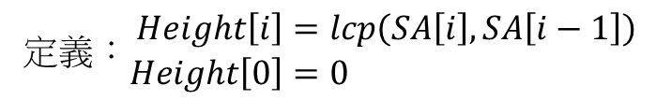
高度數組 (Height)
0 | 1 | 2 | 3 | 4 | 5 | 6 | 7
3 | 4 | 5 | 0 | 6 | 1 | 7 | 2
3 | a | a | a | a | b
SA
4 | a | a | a | b
0 | 1 | 2 | 3 | 4 | 5 | 6 | 7
0
5 | a | a | b
Height
0 | a | a | b | a | a | a | a | b
定義：$\begin{aligned}Height\left[i\right]&=lcp\left(SA\left[i\right],SA\left[i−1\right]\right) \\ Height\left[0\right]&=0\end{aligned}$
6 | a | b
1 | a | b | a | a | a | a | b
7 | b
2 | b | a | a | a | a | b

Slide 52
高度數組 (Height)
0 | 1 | 2 | 3 | 4 | 5 | 6 | 7
3 | 4 | 5 | 0 | 6 | 1 | 7 | 2
3 | a | a | a | a | b
SA
4 | a | a | a | b
0 | 1 | 2 | 3 | 4 | 5 | 6 | 7
0 | 3
5 | a | a | b
Height
0 | a | a | b | a | a | a | a | b
定義：$\begin{aligned}Height\left[i\right]&=lcp\left(SA\left[i\right],SA\left[i−1\right]\right) \\ Height\left[0\right]&=0\end{aligned}$
6 | a | b
1 | a | b | a | a | a | a | b
7 | b
2 | b | a | a | a | a | b

Slide 53
高度數組 (Height)
0 | 1 | 2 | 3 | 4 | 5 | 6 | 7
3 | 4 | 5 | 0 | 6 | 1 | 7 | 2
3 | a | a | a | a | b
SA
4 | a | a | a | b
0 | 1 | 2 | 3 | 4 | 5 | 6 | 7
0 | 3 | 2
5 | a | a | b
Height
0 | a | a | b | a | a | a | a | b
定義：$\begin{aligned}Height\left[i\right]&=lcp\left(SA\left[i\right],SA\left[i−1\right]\right) \\ Height\left[0\right]&=0\end{aligned}$
6 | a | b
1 | a | b | a | a | a | a | b
7 | b
2 | b | a | a | a | a | b

Slide 54
高度數組 (Height)
0 | 1 | 2 | 3 | 4 | 5 | 6 | 7
3 | 4 | 5 | 0 | 6 | 1 | 7 | 2
3 | a | a | a | a | b
SA
4 | a | a | a | b
0 | 1 | 2 | 3 | 4 | 5 | 6 | 7
0 | 3 | 2 | 3
5 | a | a | b
Height
0 | a | a | b | a | a | a | a | b
定義：$\begin{aligned}Height\left[i\right]&=lcp\left(SA\left[i\right],SA\left[i−1\right]\right) \\ Height\left[0\right]&=0\end{aligned}$
6 | a | b
1 | a | b | a | a | a | a | b
7 | b
2 | b | a | a | a | a | b

Slide 55
高度數組 (Height)
0 | 1 | 2 | 3 | 4 | 5 | 6 | 7
3 | 4 | 5 | 0 | 6 | 1 | 7 | 2
3 | a | a | a | a | b
SA
4 | a | a | a | b
0 | 1 | 2 | 3 | 4 | 5 | 6 | 7
0 | 3 | 2 | 3 | 1
5 | a | a | b
Height
0 | a | a | b | a | a | a | a | b
定義：$\begin{aligned}Height\left[i\right]&=lcp\left(SA\left[i\right],SA\left[i−1\right]\right) \\ Height\left[0\right]&=0\end{aligned}$
6 | a | b
1 | a | b | a | a | a | a | b
7 | b
2 | b | a | a | a | a | b

Slide 56
高度數組 (Height)
0 | 1 | 2 | 3 | 4 | 5 | 6 | 7
3 | 4 | 5 | 0 | 6 | 1 | 7 | 2
3 | a | a | a | a | b
SA
4 | a | a | a | b
0 | 1 | 2 | 3 | 4 | 5 | 6 | 7
0 | 3 | 2 | 3 | 1 | 2
5 | a | a | b
Height
0 | a | a | b | a | a | a | a | b
定義：$\begin{aligned}Height\left[i\right]&=lcp\left(SA\left[i\right],SA\left[i−1\right]\right) \\ Height\left[0\right]&=0\end{aligned}$
6 | a | b
1 | a | b | a | a | a | a | b
7 | b
2 | b | a | a | a | a | b

Slide 57
高度數組 (Height)
0 | 1 | 2 | 3 | 4 | 5 | 6 | 7
3 | 4 | 5 | 0 | 6 | 1 | 7 | 2
3 | a | a | a | a | b
SA
4 | a | a | a | b
0 | 1 | 2 | 3 | 4 | 5 | 6 | 7
0 | 3 | 2 | 3 | 1 | 2 | 0
5 | a | a | b
Height
0 | a | a | b | a | a | a | a | b
定義：$\begin{aligned}Height\left[i\right]&=lcp\left(SA\left[i\right],SA\left[i−1\right]\right) \\ Height\left[0\right]&=0\end{aligned}$
6 | a | b
1 | a | b | a | a | a | a | b
7 | b
2 | b | a | a | a | a | b

Slide 58
高度數組 (Height)
0 | 1 | 2 | 3 | 4 | 5 | 6 | 7
3 | 4 | 5 | 0 | 6 | 1 | 7 | 2
3 | a | a | a | a | b
SA
4 | a | a | a | b
0 | 1 | 2 | 3 | 4 | 5 | 6 | 7
0 | 3 | 2 | 3 | 1 | 2 | 0 | 1
5 | a | a | b
Height
0 | a | a | b | a | a | a | a | b
定義：$\begin{aligned}Height\left[i\right]&=lcp\left(SA\left[i\right],SA\left[i−1\right]\right) \\ Height\left[0\right]&=0\end{aligned}$
6 | a | b
1 | a | b | a | a | a | a | b
7 | b
2 | b | a | a | a | a | b

Slide 59
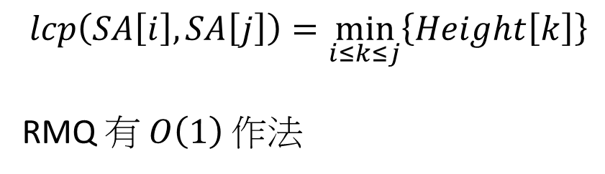
高度數組 (Height) – 性質
0 | 1 | 2 | 3 | 4 | 5 | 6 | 7
3 | 4 | 5 | 0 | 6 | 1 | 7 | 2
3 | a | a | a | a | b
SA
4 | a | a | a | b
2
0 | 1 | 2 | 3 | 4 | 5 | 6 | 7
0 | 3 | 2 | 3 | 1 | 2 | 0 | 1
5 | a | a | b
Height
3
0 | a | a | b | a | a | a | a | b
1
6 | a | b
2
$$lcp\left(SA\left[i\right],SA\left[j\right]\right)=\min_{i≤k≤j}\left\{Height\left[k\right]\right\}$$
RMQ 有 $O\left(1\right)$ 作法
1 | a | b | a | a | a | a | b
7 | b
2 | b | a | a | a | a | b

Slide 60
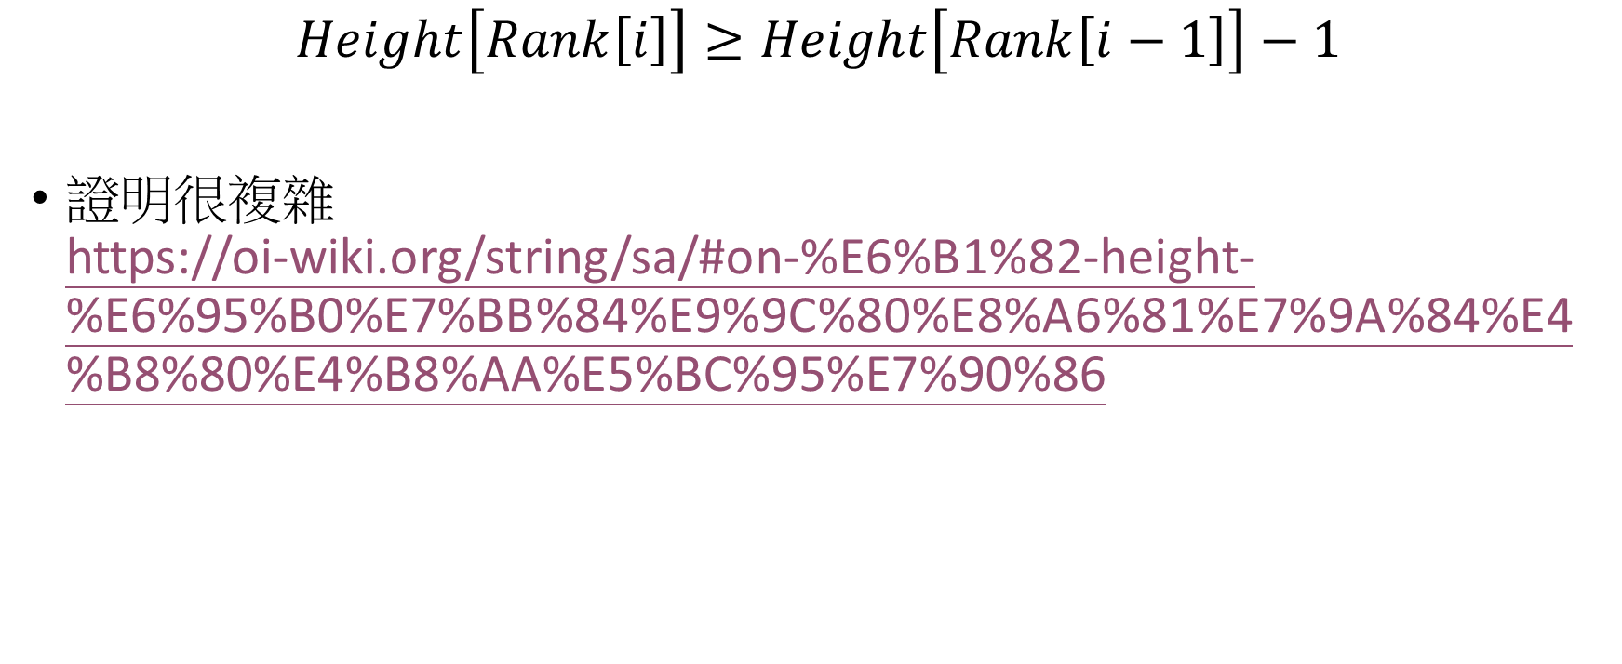
定理
$$Height\left[Rank\left[i\right]\right]≥Height\left[Rank\left[i−1\right]\right]−1$$
證明很複雜 https://oi-wiki.org/string/sa/#on-%E6%B1%82-height-%E6%95%B0%E7%BB%84%E9%9C%80%E8%A6%81%E7%9A%84%E4%B8%80%E4%B8%AA%E5%BC%95%E7%90%86

Slide 61

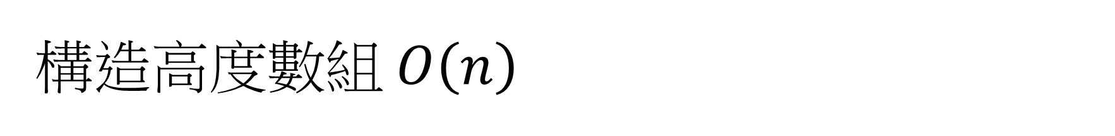
構造高度數組 $O\left(n\right)$
$k$ 不會超過 $n$，最多被減 $n$ 次
template <class Ty>
vector<int> buildHeight(const string &text, const Ty &SA, const Ty &Rank) {
int n = SA.size(), k = 0;
vector<int> Height(n, 0);
for (int i = 0; i < n; ++i) {
if (Rank[i] == 0) continue;
if (k) --k;
while (text[i + k] == text[SA[Rank[i] - 1] + k]) ++k;
Height[Rank[i]] = k;
}
return Height;
}

Slide 62
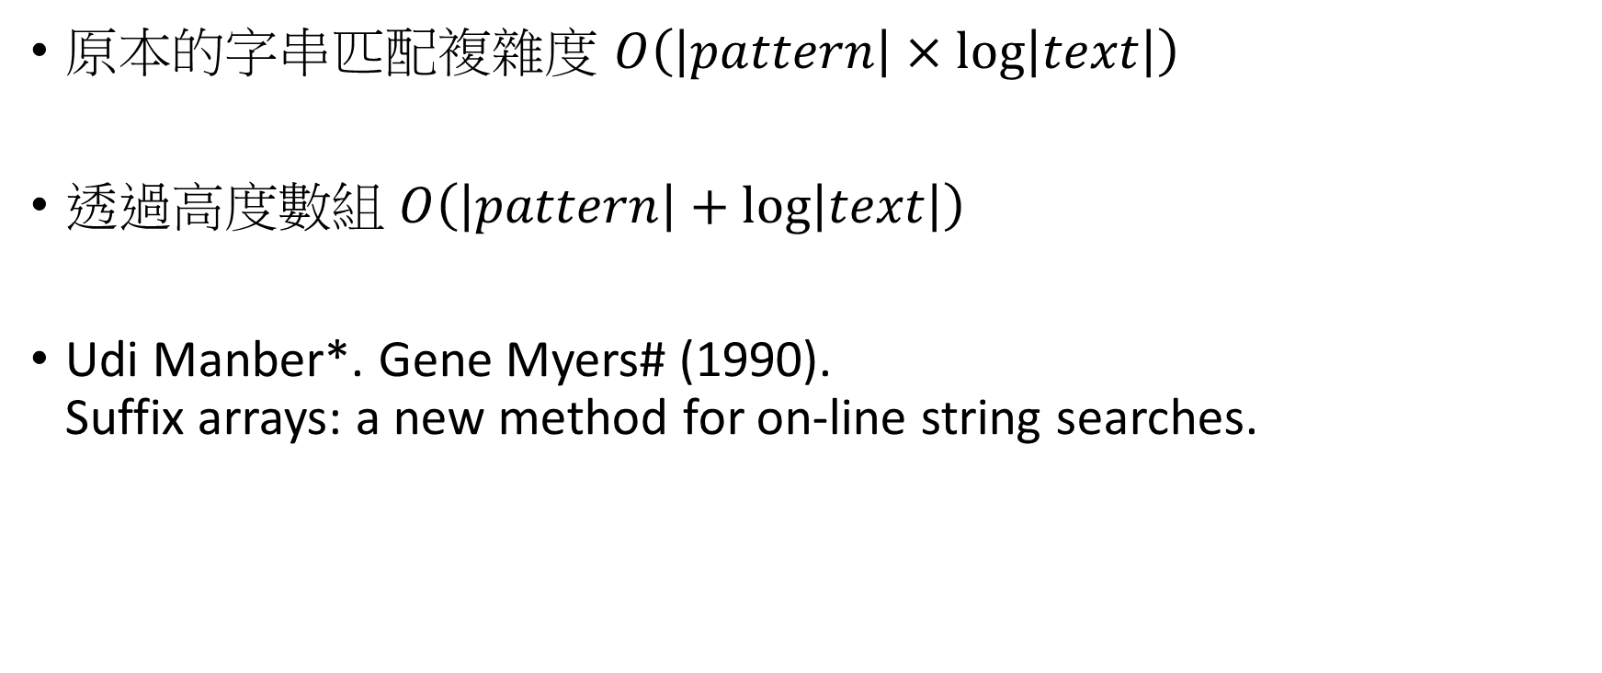
高度數組好處
原本的字串匹配複雜度 $O\left(\left|pattern\right|×\log\left|text\right|\right)$
透過高度數組 $O\left(\left|pattern\right|+\log\left|text\right|\right)$
Udi Manber*. Gene Myers# (1990). Suffix arrays: a new method for on-line string searches.
乘法變加法
自己試試看實作

Slide 63

最長共同子字串(Longest Common Substring)
$A=\text{aaaba}, B=\text{abaa}$
$A,B$ 的最長共同子字串是 $\text{aba}$

Slide 64
利用後綴數組
a | a | a | b | a
a | a | a | b | a
5 | $ | a | b | a | a
9 | a
0 | 1 | 2 | 3 | 4 | 5 | 6 | 7 | 8 | 9
a | a | a | b | a | $ | a | b | a | a
1
4 | a | $ | a | b | a | a
1
8 | a | a
2
某個沒出現過的符號
0 | a | a | a | b | a | $ | a | b | a | a
1 | a | a | b | a | $ | a | b | a | a
2 | a | b | a | $ | a | b | a | a
3
LCS 會相鄰，直接在 Height 上面找就行
6 | a | b | a | a
0
3 | b | a | $ | a | b | a | a
2
7 | b | a | a

Slide 65
Longest Common Substring
string getLongestCommonSubstring(const string &A, const string &B) {
string S = A + "$" + B;
auto [SA, Rank] = buildSuffixArray(S);
auto Height = buildHeight(S, SA, Rank);
int nA = A.size(), Ans = 0, Idx = -1;
for (size_t i = 1; i < Height.size(); ++i)
if (Height[i] > Ans)
if ((nA < SA[i - 1] && SA[i] < nA) || (nA > SA[i - 1] && SA[i] > nA))
Ans = Height[Idx = i];
if (Idx != -1)
return S.substr(SA[Idx], Ans);
return "";
}

Slide 66

最小表示法 (Minimal String Rotation)
$S=\text{bacd}$
Rotation of $S$:
$\text{bacd}$
$\text{acdb}$
$\text{c}\text{dba}$
$\text{dbac}$
Minimal String Rotation

Slide 67
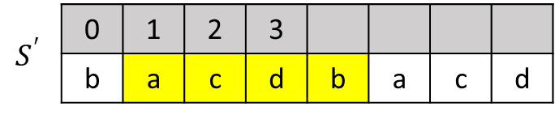


利用後綴數組
$$S^{′}$$ | 0 | 1 | 2 | 3
$$S^{′}$$ | b | a | c | d | b | a | c | d
設 $S^{′}=SS$
求出 $S^{′}$ 的後綴數組 $SA$
找出最小的 $SA[k]$ 使得 $0≤SA\left[k\right]<\left|S\right|$
$S^{′}\left[SA\left[k\right],SA\left[k\right]+\left|S\right|−1\right]$ 就是答案
$$SA$$ | 5 | 1 | 4 | 0 | 6 | 2 | 7 | 3

Slide 68

最長迴文子字串 (Longest Palindromic Substring)
$S=\text{aabaaaab}$
$S$ 的最長迴文子字串是 $\text{baaaab}$
string getLongestPalindromicSubstring(const string &S) {
auto S2 = S;
std::reverse(S2.begin(), S2.end());
return getLongestCommonSubstring(S, S2);
}

Slide 69
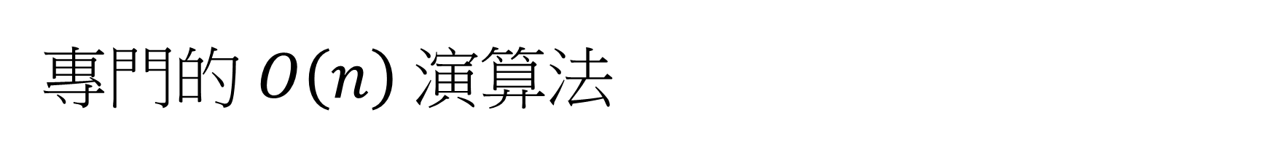
專門的 $O\left(n\right)$ 演算法
最小表示法：
String Booth's Algorithm
最長迴文子字串
Manacher Algorithm

Slide 70

KMP 演算法
Knuth-Morris-Pratt
Mississippi

Slide 71
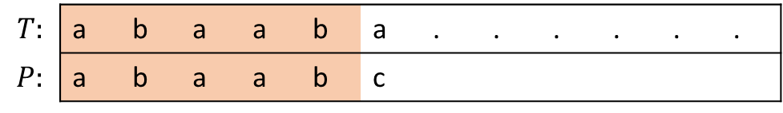
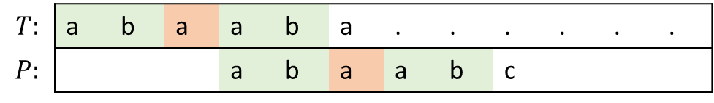
基本概念：共同前後綴
在 $T$ 中尋找 $P$ ，兩字串已知共同前綴部分為 $R$ (橘色部分)
$$T:$$ | a | b | a | a | b | a | . | . | . | . | . | .
$$P:$$ | a | b | a | a | b | c
若 $R$ 中存在一個不等於 $R$ 的前綴等於後綴 $Q$ (綠色部分)
a | b | a | a | b
$$T:$$ | a | b | a | a | b | a | . | . | . | . | . | .
$$P:$$ |  |  |  | a | b | a | a | b | c
把 $P$ 往後移動 $\left|R\right|−\left|Q\right|$ 的距離也有機會產生匹配

Slide 72
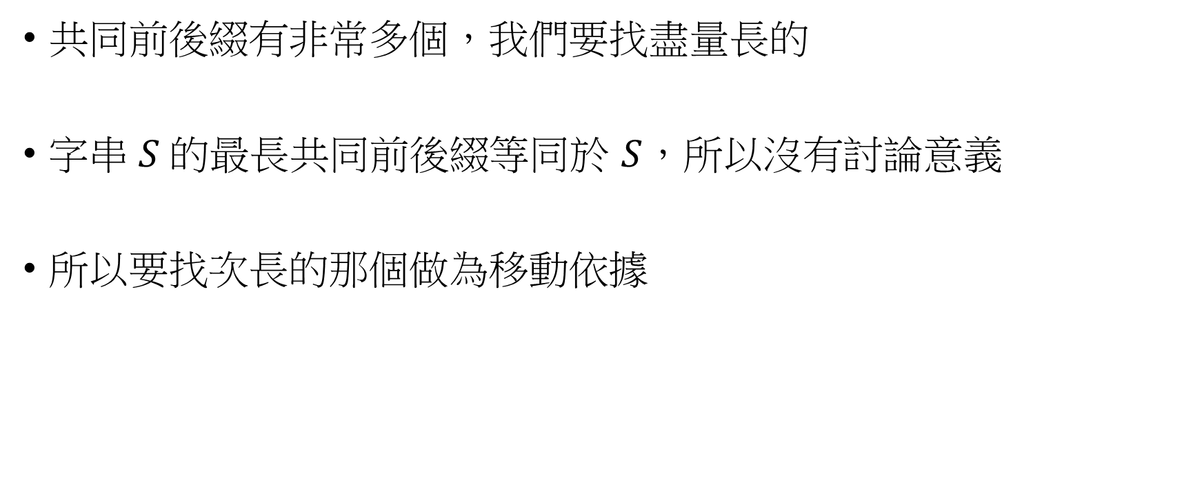
次長共同前後綴
共同前後綴有非常多個，我們要找盡量長的
字串 $S$ 的最長共同前後綴等同於 $S$，所以沒有討論意義
所以要找次長的那個做為移動依據
a | b | a | a | b | a
a | b | a | a | b | a
a | b | a | a | b | a

Slide 73


前缀函数
給定字串 $S$，定義前缀函数 $π\left(i\right)$
$$\left\{\begin{aligned}π\left(i\right)&=S\left[0:i\right] \text{的次長共同前後綴}終點位置 \\ π\left(0\right)&=−1\end{aligned}\right.$$
0 | 1 | 2 | 3 | 4 | 5 | 6 | 7
a | b | c | a | a | b | c | d
-1 | -1 | -1 | 0 | 0 | 1 | 2 | -1
$$π$$

Slide 74
前缀函数
給定字串 $S$，定義前缀函数 $π\left(i\right)$
$$\left\{\begin{aligned}π\left(i\right)&=S\left[0:i\right] \text{的次長共同前後綴}終點位置 \\ π\left(0\right)&=−1\end{aligned}\right.$$
0 | 1 | 2 | 3 | 4 | 5 | 6 | 7
a | b | c | a | a | b | c | d
-1 | -1 | -1 | 0 | 0 | 1 | 2 | -1
$$π$$

Slide 75
前缀函数
給定字串 $S$，定義前缀函数 $π\left(i\right)$
$$\left\{\begin{aligned}π\left(i\right)&=S\left[0:i\right] \text{的次長共同前後綴}終點位置 \\ π\left(0\right)&=−1\end{aligned}\right.$$
0 | 1 | 2 | 3 | 4 | 5 | 6 | 7
a | b | c | a | a | b | c | d
-1 | -1 | -1 | 0 | 0 | 1 | 2 | -1
$$π$$

Slide 76

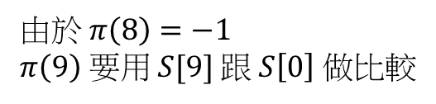
前缀函数 – 動態規劃
Case 1:
$$π\left(i−1\right)=−1$$
直接比較 $S\left[0\right],S\left[i\right]$
由於 $π\left(8\right)=−1$
$π\left(9\right)$ 要用 $S[9]$ 跟 $S\left[0\right]$ 做比較
0 | 1 | 2 | 3 | 4 | 5 | 6 | 7 | 8 | 9
A | B | C | X | X | X | A | B | Z | A
-1 | -1 | -1 | -1 | -1 | -1 | 0 | 1 | -1
$$π$$

Slide 77
前缀函数 – 動態規劃
Case 1:
$$π\left(i−1\right)=−1$$
直接比較 $S\left[0\right],S\left[i\right]$
由於 $π\left(8\right)=−1$
$π\left(9\right)$ 要用 $S[9]$ 跟 $S\left[0\right]$ 做比較
0 | 1 | 2 | 3 | 4 | 5 | 6 | 7 | 8 | 9
A | B | C | X | X | X | A | B | Z | A
-1 | -1 | -1 | -1 | -1 | -1 | 0 | 1 | -1 | 0
$$π$$

Slide 78

前缀函数 – 動態規劃
Case 2:
$$S\left[i\right]=S\left[π\left(i−1\right)+1\right]$$
$π\left(i\right)=π\left(i−1\right)+1$
0 | 1 | 2 | 3 | 4 | 5 | 6 | 7 | 8 | 9
A | B | C | D | X | X | A | B | C | D
-1 | -1 | -1 | -1 | -1 | -1 | 0 | 1 | 2
$$π$$

Slide 79
前缀函数 – 動態規劃
Case 2:
$$S\left[i\right]=S\left[π\left(i−1\right)+1\right]$$
$π\left(i\right)=π\left(i−1\right)+1$
0 | 1 | 2 | 3 | 4 | 5 | 6 | 7 | 8 | 9
A | B | C | D | X | X | A | B | C | D
-1 | -1 | -1 | -1 | -1 | -1 | 0 | 1 | 2 | 3
$$π$$

Slide 80

前缀函数 – 動態規劃
Case 3:
$$S\left[i\right]≠S\left[π\left(i−1\right)+1\right]$$
透過 $S\left[0\sim π\left(i−1\right)\right]$ 的次長共同前後綴繼續檢查 直到產生 case 1 或 case 2 為止
j
0 | 1 | 2 | 3 | 4 | 5 | 6 | 7 | 8 | 9 | 10 | 11
A | B | C | A | B | D | A | B | C | A | B | A
-1 | -1 | -1 | 0 | 1 | -1 | 0 | 1 | 2 | 3 | 4
$$π$$

Slide 81
前缀函数 – 動態規劃
Case 3:
$$S\left[i\right]≠S\left[π\left(i−1\right)+1\right]$$
透過 $S\left[0\sim π\left(i−1\right)\right]$ 的次長共同前後綴繼續檢查 直到產生 case 1 或 case 2 為止
j
0 | 1 | 2 | 3 | 4 | 5 | 6 | 7 | 8 | 9 | 10 | 11
A | B | C | A | B | D | A | B | C | A | B | A
-1 | -1 | -1 | 0 | 1 | -1 | 0 | 1 | 2 | 3 | 4
$$π$$

Slide 82
前缀函数 – 動態規劃
Case 3:
$$S\left[i\right]≠S\left[π\left(i−1\right)+1\right]$$
透過 $S\left[0\sim π\left(i−1\right)\right]$ 的次長共同前後綴繼續檢查 直到產生 case 1 或 case 2 為止
j
0 | 1 | 2 | 3 | 4 | 5 | 6 | 7 | 8 | 9 | 10 | 11
A | B | C | A | B | D | A | B | C | A | B | A
-1 | -1 | -1 | 0 | 1 | -1 | 0 | 1 | 2 | 3 | 4
$$π$$

Slide 83
前缀函数 – 動態規劃
Case 3:
$$S\left[i\right]≠S\left[π\left(i−1\right)+1\right]$$
透過 $S\left[0\sim π\left(i−1\right)\right]$ 的次長共同前後綴繼續檢查 直到產生 case 1 或 case 2 為止
j
0 | 1 | 2 | 3 | 4 | 5 | 6 | 7 | 8 | 9 | 10 | 11
A | B | C | A | B | D | A | B | C | A | B | A
-1 | -1 | -1 | 0 | 1 | -1 | 0 | 1 | 2 | 3 | 4
$$π$$

Slide 84
前缀函数 – 動態規劃
Case 3:
$$S\left[i\right]≠S\left[π\left(i−1\right)+1\right]$$
透過 $S\left[0\sim π\left(i−1\right)\right]$ 的次長共同前後綴繼續檢查 直到產生 case 1 或 case 2 為止
j
0 | 1 | 2 | 3 | 4 | 5 | 6 | 7 | 8 | 9 | 10 | 11
A | B | C | A | B | D | A | B | C | A | B | A
-1 | -1 | -1 | 0 | 1 | -1 | 0 | 1 | 2 | 3 | 4 | 0
$$π$$

Slide 85
前綴函數 – 程式碼
vector<int> buildPi(const string &S) {
vector<int> Pi(S.size());
Pi[0] = -1;
for (size_t i = 1; i < S.size(); ++i) {
int j = Pi[i - 1];
while (j != -1 && S[i] != S[j + 1]) // case 3
j = Pi[j];
if (S[i] == S[j + 1]) Pi[i] = j + 1; // case 2
else Pi[i] = -1; // case 1
}
return Pi;
}

Slide 86
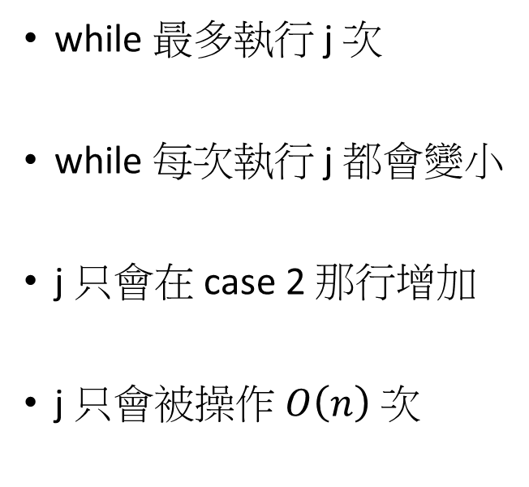
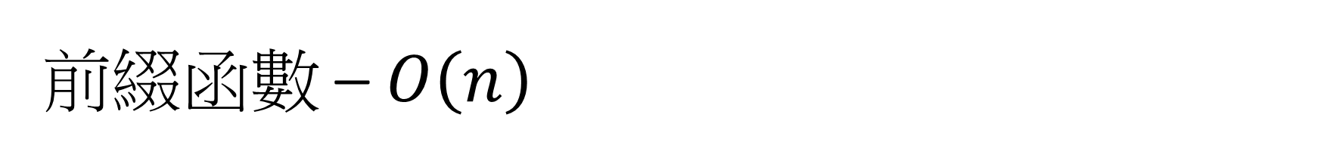
前綴函數 – $O\left(n\right)$
另一種把 j 放外面的寫法
vector<int> buildPi(const string &S) {
vector<int> Pi(S.size());
int j = -1;
Pi[0] = j;
for (size_t i = 1; i < S.size(); ++i) {
while (j != -1 && S[i] != S[j + 1]) // case 3
j = Pi[j];
if (S[i] == S[j + 1]) Pi[i] = j += 1; // case 2
else Pi[i] = j = -1; // case 1
}
return Pi;
}
while 最多執行 j 次
while 每次執行 j 都會變小
j 只會在 case 2 那行增加
j 只會被操作 $O\left(n\right)$ 次

Slide 87

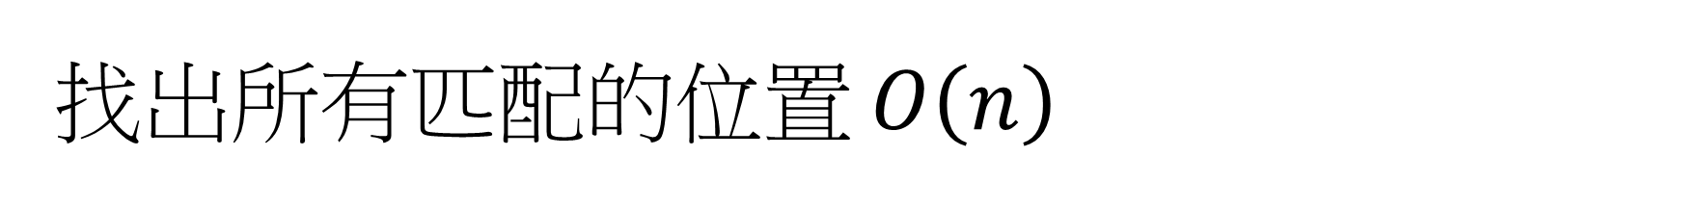
找出所有匹配的位置 $O\left(n\right)$
pattern
text
p | p | a | p
p | p | p | a | p | a
某個沒出現過的符號
0 | 1 | 2 | 3 | 4 | 5 | 6 | 7 | 8 | 9 | 10
p | p | a | p | $ | p | p | p | a | p | a
-1 | 0 | -1 | 0 | -1 | 0 | 1 | 1 | 2 | 3 | -1
$$π$$

Slide 88
找出所有匹配的位置 $O\left(n\right)$
pattern
text
p | p | a | p
p | p | p | a | p | a
某個沒出現過的符號
0 | 1 | 2 | 3 | 4 | 5 | 6 | 7 | 8 | 9 | 10
p | p | a | p | $ | p | p | p | a | p | a
-1 | 0 | -1 | 0 | -1 | 0 | 1 | 1 | 2 | 3 | -1
$$π$$

Slide 89
找出所有匹配的位置 $O\left(n\right)$
vector<size_t> matching_all(const string &text, const string &pattern) {
string S = pattern + '$' + text;
size_t nP = pattern.size();
auto Pi = buildPi(S);
vector<size_t> ans;
for (size_t i = nP + 1; i < S.size(); i++) {
if (Pi[i] + 1 == nP)
ans.push_back(i - 2 * nP);
}
return ans;
}

Slide 90
空間更少的做法
vector<size_t> matching_all(const string &text, const string &pattern) {
auto Pi = buildPi(pattern);
vector<size_t> ans;
int j = -1;
for (size_t i = 0; i < text.size(); ++i) {
while (j != -1 && pattern[j + 1] != text[i])
j = Pi[j];
if (pattern[j + 1] == text[i]) ++j;
if (j + 1 == pattern.size()) {
ans.emplace_back(i + 1 - pattern.size());
j = Pi[j];
}
}
return ans;
}

Slide 91

UVa 11475
給你一個字串 $S$
問這要在 $S$ “結尾”最少增加幾個字，才能使 $S$ 變成迴文
Ex: $S=\text{cabaa}$ 加入 $\text{bac}$ ➔ $\text{cabaa}\text{bac}$ 變成迴文

Slide 92
想法
c | a | b | a | a
reverse
normal
0 | 1 | 2 | 3 | 4 | 5 | 6 | 7 | 8 | 9 | 10
a | a | b | a | c | $ | c | a | b | a | a
-1 | 0 | -1 | 0 | -1 | -1 | -1 | 0 | -1 | 0 | 1
$$π$$

Slide 93

字串最小週期
若存在某個字串 $R$ 使得字串 $S=RRR…RR$ 則稱 $R$ 為 $S$ 的週期
輸入 $S$ ，請找出 $S$ 長度最小的週期

Slide 94

想法
0 | 1 | 2 | 3 | 4 | 5 | 6 | 7 | 8 | 9 | 10 | 11
a | b | a | a | b | a | a | b | a | a | b | a
-1 | -1 | 0 | 0 | 1 | 2 | 3 | 4 | 5 | 6 | 7 | 8
$$π$$
string getMinPeriod(const string &S) {
auto Pi = buildPi(S);
size_t PeriodLen = S.size() - Pi.back() - 1;
if (S.size() % PeriodLen != 0)
return S;
return S.substr(0, PeriodLen);
}

Slide 95
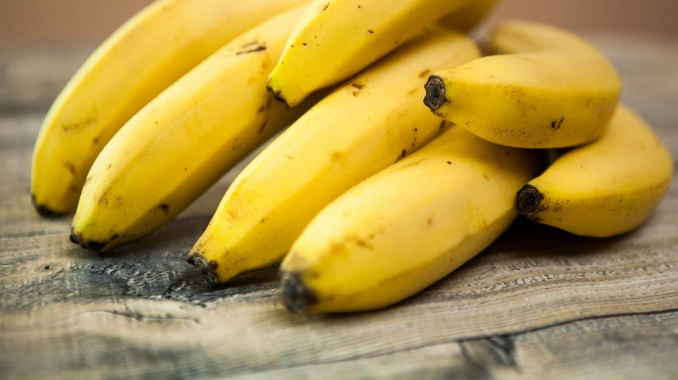
Z Algorithm
Gusfield’s Algorithm
banana

Slide 96


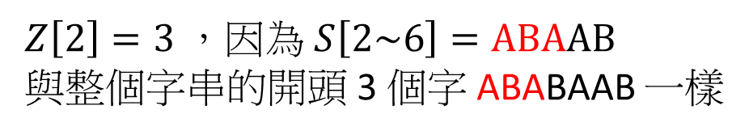
拓展 KMP
0 | 1 | 2 | 3 | 4 | 5 | 6
A | B | A | B | A | A | B
0 | 0 | 3 | 0 | 1 | 2 | 0
$$Z$$
與 KMP 的 $π$ 定義很像，但不一樣
給定字串 $S$
定義 $\left\{\begin{aligned}&Z\left[i\right]&=&lcp\left(S\left[i:\left|S\right|−1\right],S\right) \\ &Z\left[0\right]&=&0\end{aligned}\right.$
$Z\left[2\right]=3$，因為 $S\left[2\sim 6\right]=\text{ABA}\text{AB}$
與整個字串的開頭 3 個字 ABABAAB 一樣

Slide 97


Z Algorithm
為了快速計算 Z ，我們維護一個範圍 $\left[L,R\right]$
該範圍滿足 $S\left[L\sim R\right]=S[0:R−L]$
L
R
0 | 1 | 2 | 3 | 4 | 5 | 6
A | B | A | B | A | A | B
0 | 0 | 3 | 0 | 1 | 2 | 0
$$Z$$

Slide 98
Z Algorithm
為了快速計算 Z ，我們維護一個範圍 $\left[L,R\right]$
該範圍滿足 $S\left[L\sim R\right]=S[0:R−L]$
L
R
0 | 1 | 2 | 3 | 4 | 5 | 6
A | B | A | B | A | A | B
0 | 0 | 3 | 0 | 1 | 2 | 0
$$Z$$

Slide 99


Case 1: $i$ 不再 $\left[L,R\right]$ 範圍內
當前的 $L,R$ 完全沒有用，直接暴力求答案
並把 $L,R$ 更新成找到的範圍
vector<int> buildZ(const string &S) {
int L = 0, R = 0, n = S.size();
vector<int> Z(n);
for (int i = 1; i < n; ++i) {
if (R < i) { // Case 1
while (S[Z[i]] == S[i + Z[i]])
++Z[i];
L = i, R = i + Z[i] - 1;
} else {
// TODO
}
}
return Z;
}

Slide 100

Case 2: $L≤i≤R$ 且 $i+Z\left[i−L\right]−1<R$
$$Z\left[i\right]=Z\left[i−L\right]$$
根據定義，橘色區域會一樣
L
i
R

Slide 101


Case 2: $L≤i≤R$ 且 $i+Z\left[i−L\right]−1<R$
$$Z\left[i\right]=Z\left[i−L\right]$$
根據定義，橘色區域會一樣
根據 $Z\left[i−L\right]$ 可知綠色部分也相等
i-L
L
i
R
$$Z\left[i−L\right]=2$$

Slide 102
Case 2: $L≤i≤R$ 且 $i+Z\left[i−L\right]−1<R$
vector<int> buildZ(const string &S) {
int L = 0, R = 0, n = S.size();
vector<int> Z(n);
for (int i = 1; i < n; ++i) {
if (R < i) { // Case 1
while (S[Z[i]] == S[i + Z[i]])
++Z[i];
L = i, R = i + Z[i] - 1;
} else if (i + Z[i - L] - 1 < R) { // Case 2
Z[i] = Z[i - L];
} else {
// TODO
}
}
return Z;
}

Slide 103
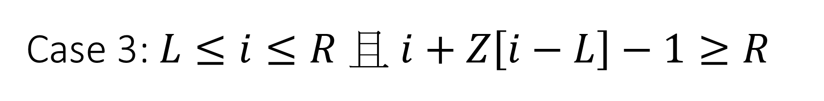

Case 3: $L≤i≤R$ 且 $i+Z\left[i−L\right]−1≥R$
根據定義，橘色區域會一樣
i-L
L
i
R
$$Z\left[i−L\right]=3$$

Slide 104
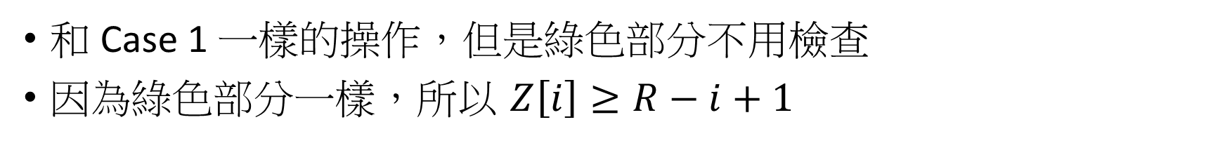
Case 3: $L≤i≤R$ 且 $i+Z\left[i−L\right]−1≥R$
和 Case 1 一樣的操作，但是綠色部分不用檢查
因為綠色部分一樣，所以 $Z\left[i\right]≥R−i+1$
根據定義，橘色區域會一樣
根據 $Z\left[i−L\right]$ 可知綠色部分也相等
i-L
L
i
R
$$Z\left[i−L\right]=3$$

Slide 105
Z Algorithm
vector<int> buildZ(const string &S) {
int L = 0, R = 0, n = S.size();
vector<int> Z(n);
for (int i = 1; i < n; ++i) {
if (R < i) { // Case 1
Z[i] = 0;
while (S[Z[i]] == S[i + Z[i]])
++Z[i];
L = i, R = i + Z[i] - 1;
} else if (i + Z[i - L] - 1 < R) { // Case 2
Z[i] = Z[i - L];
} else { // Case 3
Z[i] = R - i + 1;
while (S[Z[i]] == S[i + Z[i]])
++Z[i];
L = i, R = i + Z[i] - 1;
}
}
return Z;
}
重複了

Slide 106
Z Algorithm
vector<int> buildZ(const string &S) {
int L = 0, R = 0, n = S.size();
vector<int> Z(n);
for (int i = 1; i < n; ++i) {
if (i <= R && i + Z[i - L] - 1 < R) { // Case 2
Z[i] = Z[i - L];
} else { // Case 1 & 3
Z[i] = max(0, R - i + 1);
while (S[Z[i]] == S[i + Z[i]])
++Z[i];
L = i, R = i + Z[i] - 1;
}
}
return Z;
}
要小心會有負數 不能用 unsigned

Slide 107
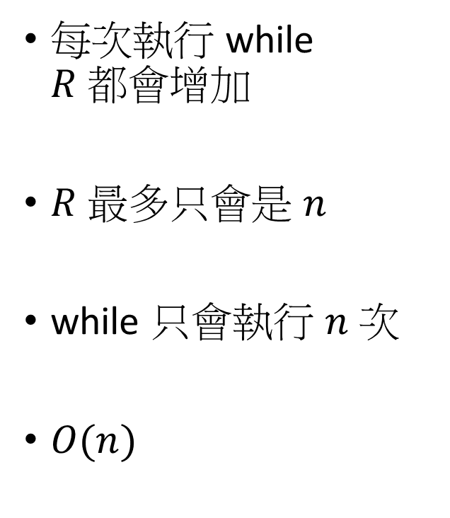
Z Algorithm – 時間複雜度
vector<int> buildZ(const string &S) {
int L = 0, R = 0, n = S.size();
vector<int> Z(n);
for (int i = 1; i < n; ++i) {
if (i <= R && i + Z[i - L] - 1 < R) { // Case 2
Z[i] = Z[i - L];
} else { // Case 1 & 3
Z[i] = max(0, R - i + 1);
while (S[Z[i]] == S[i + Z[i]])
++Z[i];
L = i, R = i + Z[i] - 1;
}
}
return Z;
}
每次執行 while $R$ 都會增加
$R$ 最多只會是 $n$
while 只會執行 $n$ 次
$O(n)$

Slide 108

找出所有匹配的位置 $O\left(n\right)$
pattern
text
p | p | a | p
p | p | p | a | p | a
某個沒出現過的符號
0 | 1 | 2 | 3 | 4 | 5 | 6 | 7 | 8 | 9 | 10
p | p | a | p | $ | p | p | p | a | p | a
0 | 1 | 0 | 1 | 0 | 2 | 4 | 1 | 0 | 1 | 0
$$Z$$

Slide 109
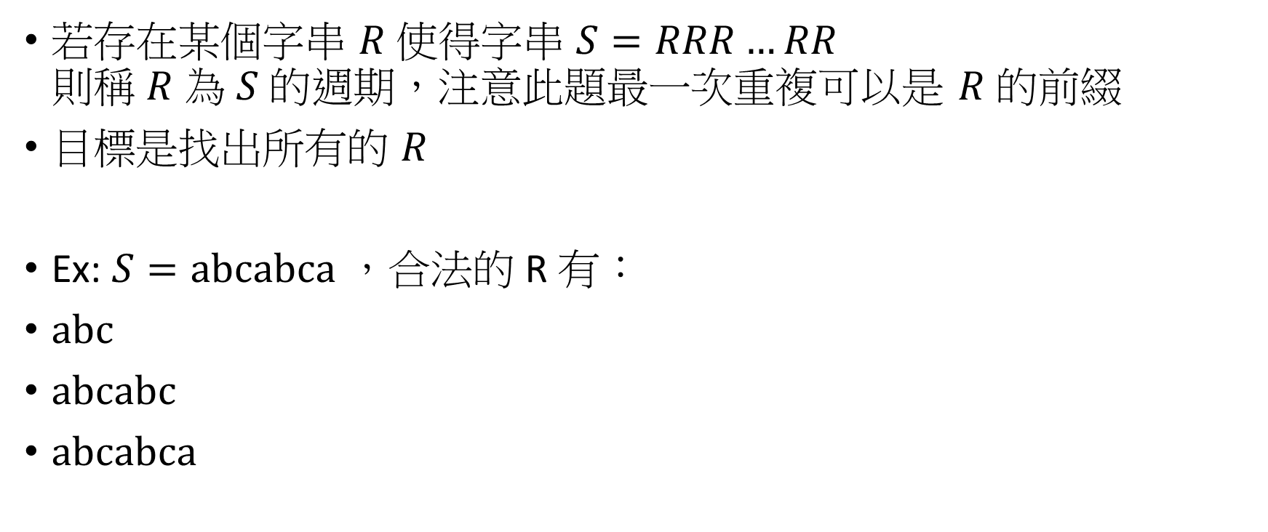
CSES - Finding Periods
若存在某個字串 $R$ 使得字串 $S=RRR…RR$ 則稱 $R$ 為 $S$ 的週期，注意此題最一次重複可以是 $R$ 的前綴
目標是找出所有的 $R$
Ex: $S=\text{abcabca}$ ，合法的 R 有：
$\text{a}\text{bc}$
$\text{abcabc}$
$\text{abcabca}$

Slide 110

觀察
0 | 1 | 2 | 3 | 4 | 5 | 6
a | b | c | a | b | c | a
0 | 0 | 0 | 4 | 0 | 0 | 1
0 | 1 | 2 | 3 | 4 | 5 | 6
a | b | c | a | b | c | a
0 | 0 | 0 | 4 | 0 | 0 | 1
$$Z$$
$$Z$$

Slide 111
CSES - Finding Periods
vector<int> findingPeriods(const string &S) {
auto Z = buildZ(S);
vector<int> Ans;
for (size_t i = 0; i < Z.size(); ++i) {
if (Z[i] == Z.size() - i)
Ans.emplace_back(i);
}
Ans.emplace_back(Z.size());
return Ans;
}

Slide 112

Rabin-Karp Rolling Hash
滾動雜湊
Roll a Hash Joint

Slide 113

滾動雜湊
設 $S=s_{0}s_{1}…s_{n−1}$ ，給定兩個質數 $P,M$
定義 $H\left(S,P,M\right)=\left(s_{0}P^{n−1}+s_{1}P^{n−2}+…+s_{n−1}\right)\%M$

Slide 114
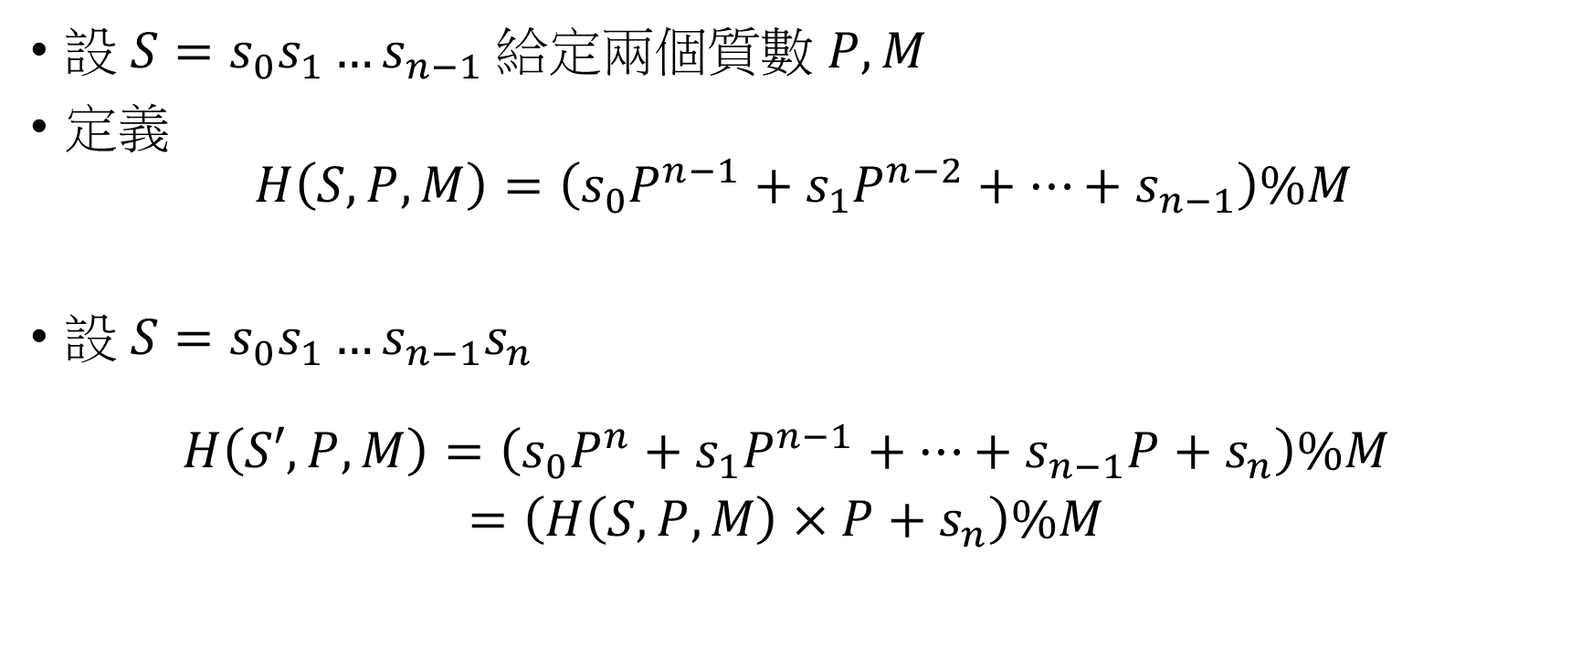
滾動雜湊
設 $S=s_{0}s_{1}…s_{n−1}$ 給定兩個質數 $P,M$
定義 $H\left(S,P,M\right)=\left(s_{0}P^{n−1}+s_{1}P^{n−2}+…+s_{n−1}\right)\%M$
設 $S=s_{0}s_{1}…s_{n−1}s_{n}$ $\begin{aligned}H\left(S′,P,M\right)=\left(s_{0}P^{n}+s_{1}P^{n−1}+…+s_{n−1}P+s_{n}\right)\%M \\ &=\left(H\left(S,P,M\right)×P+s_{n}\right)\%M\end{aligned}$

Slide 115
程式碼
建議在 code book 裡面紀錄一些 int, long long 範圍質數的表
很多演算法需要質數的幫忙
vector<long long> rollingHash(const string &S, long long prime,
long long prime_mod) {
vector<long long> H(S.size() + 1);
for (size_t i = 1; i <= S.size(); ++i) {
H[i] = (H[i - 1] * prime + S[i - 1]) % prime_mod;
}
return H;
}

Slide 116
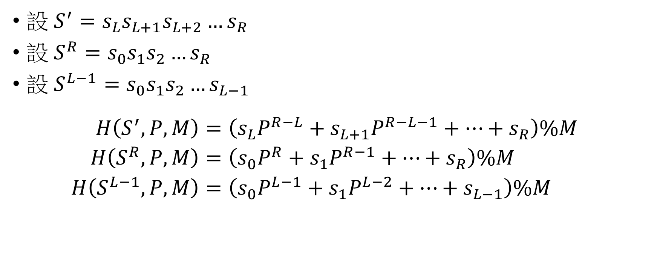
子字串的 hash
設 $S^{′}=s_{L}s_{L+1}s_{L+2}…s_{R}$
設 $S^{R}=s_{0}s_{1}s_{2}…s_{R}$
設 $S^{L−1}=s_{0}s_{1}s_{2}…s_{L−1}$ $\begin{aligned}H\left(S^{′},P,M\right)&=\left(s_{L}P^{R−L}+s_{L+1}P^{R−L−1}+…+s_{R}\right)\%M \\ H\left(S^{R},P,M\right)&=\left(s_{0}P^{R}+s_{1}P^{R−1}+…+s_{R}\right)\%M \\ H\left(S^{L−1},P,M\right)&=\left(s_{0}P^{L−1}+s_{1}P^{L−2}+…+s_{L−1}\right)\%M\end{aligned}$

Slide 117
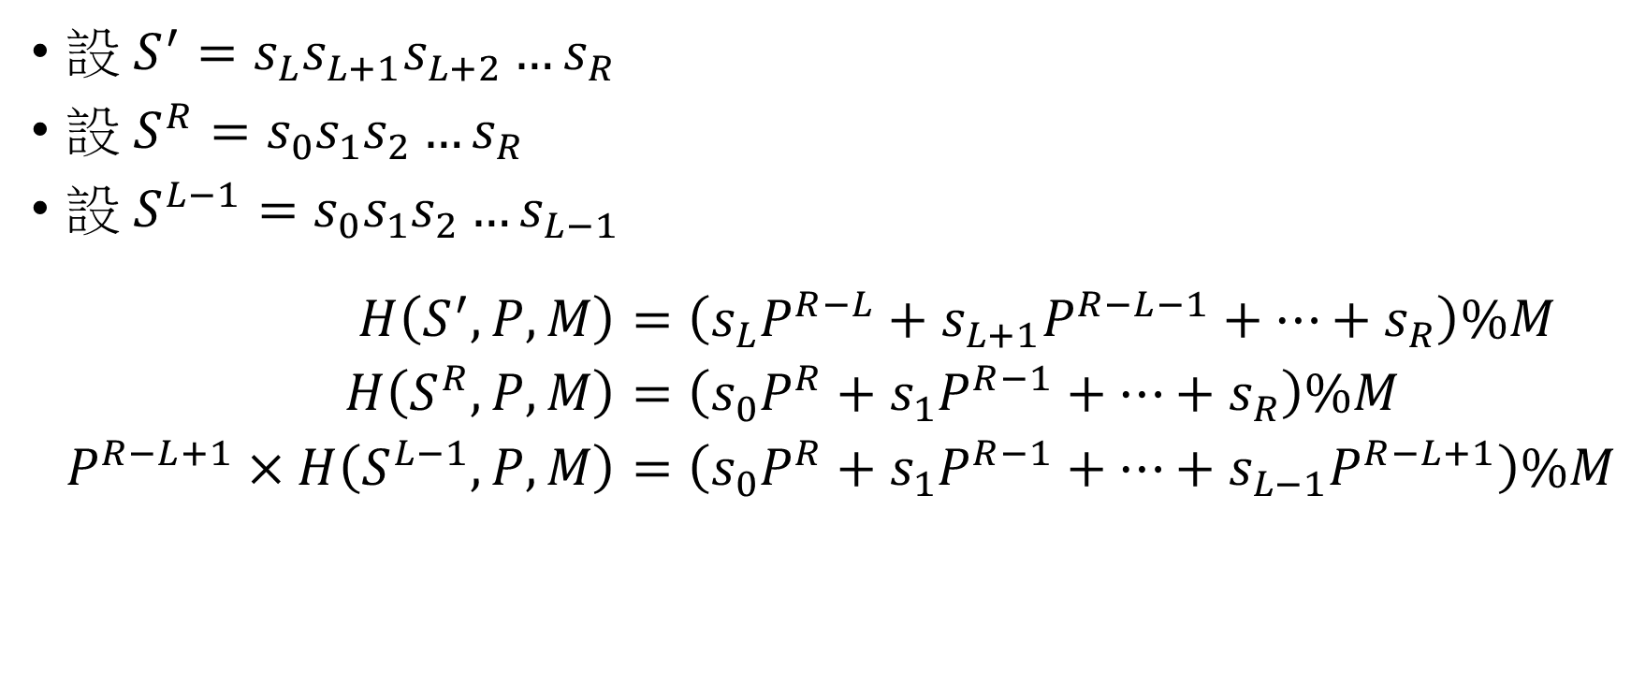
子字串的 hash
設 $S^{′}=s_{L}s_{L+1}s_{L+2}…s_{R}$
設 $S^{R}=s_{0}s_{1}s_{2}…s_{R}$
設 $S^{L−1}=s_{0}s_{1}s_{2}…s_{L−1}$ $\begin{aligned}H\left(S^{′},P,M\right)&=\left(s_{L}P^{R−L}+s_{L+1}P^{R−L−1}+…+s_{R}\right)\%M \\ H\left(S^{R},P,M\right)&=\left(s_{0}P^{R}+s_{1}P^{R−1}+…+s_{R}\right)\%M \\ P^{R−L+1}×H\left(S^{L−1},P,M\right)&=\left(s_{0}P^{R}+s_{1}P^{R−1}+…+s_{L−1}P^{R−L+1}\right)\%M\end{aligned}$
$$H\left(S^{′},P,M\right)=\left(H\left(S^{R},P,M\right)−P^{R−L+1}×H\left(S^{L−1},P,M\right)\right)\%M$$

Slide 118
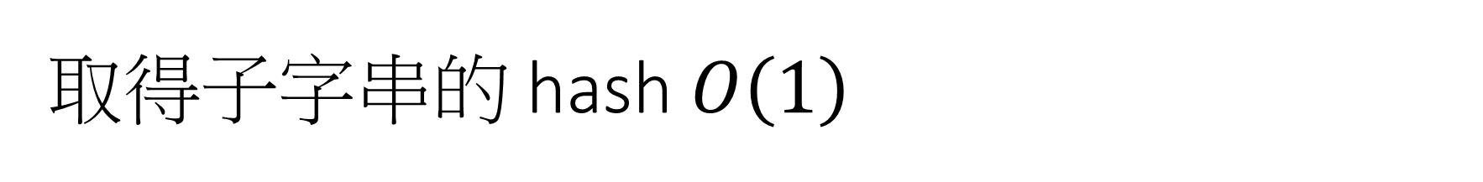
取得子字串的 hash $O\left(1\right)$
vector<long long> buildBase(int n, long long prime, long long prime_mod) {
vector<long long> Base(n + 1);
Base[0] = 1;
for (size_t i = 1; i < Base.size(); ++i)
Base[i] = Base[i - 1] * prime % prime_mod;
return Base;
}
long long getSubStrHash(const vector<long long> &H,
const vector<long long> &Base, int L, int R,
long long prime, long long prime_mod) {
return (H[R + 1] - (H[L] * Base[R - L + 1]) % prime_mod + prime_mod) %
prime_mod;
}

Slide 119

唬爛法
若兩字串 $A,B$
$H\left(A,P,M\right)=H\left(B,P,M\right)$
則我們認定 $A=B$

Slide 120

碰撞問題
碰撞定義： $H\left(A,P,M\right)=H\left(B,P,M\right),A≠B$
若不考慮 modulo，$H$ 函數相當於是將字串編碼成 $P$ 進位的整數
因此碰撞只跟取餘數 $M$ 有關，單次比較碰撞機率為： $\frac{1}{M}$

Slide 121

碰撞問題
如果進行 $k$ 次比較，希望有 90 % 的正確率， $M$ 要多大? $\begin{aligned}{\left(1−\frac{1}{M}\right)}^{k}&≥0.9 \\ PM≥\frac{1}{1−{0.9}^{\frac{1}{k}}}\end{aligned}$
有人推了近似公式： $M≥5k^{2}$
如果還是不夠用，就用多個 $M_{1},M_{2},…$ 做 Hash 比較用 tuple 包起來一起比較

Slide 122

特殊質數
不要用特殊質數，例如 $2^{k}−1$ 的質數
很容易可以設計出碰撞的測資

Slide 123

Trie
字典樹

Slide 124

儲存、查找字串
設 $n$ 表示 ST.size()
若插入/刪除/查詢一個字串 $S$
花費的時間為 $O\left(\left|S\right|\log{n}\right)$
int main() {
set<string> ST;
ST.emplace("ant");
ST.emplace("can");
ST.emplace("cat");
cout << ST.count("can") << endl;
return 0;
}
有沒有辦法去除這個 log ?

Slide 125

Trie (讀做 Try)
$$\{ant, c, can,cat\}$$
字典樹的邊表示一個字母
如果到該節點已經有單字組成了 則在節點做標記
a
c
1
n
a
struct node {
int hit = 0;
node *next[26] = {}; // a-z
};
t
n
t
1
1
1

Slide 126

加入資料很簡單 $O\left(\left|S\right|\right)$
void insert(const char *S, node *&root) {
if (!root)
root = new node;
if (*S == '\0') {
++root->hit;
} else {
insert(S + 1, root->next[*S - 'a']);
}
}

Slide 127

Trie 的好處
假設有一些字串 $S_{1},S_{2},…,S_{k}$ ，將其加入 Trie 只要 $O\left(\sum_{i}{\left|S_{i}\right|}\right)$
對一個字串 $T$ 查詢：
有幾個 $S_{i}=T$
有幾個 $S_{i}$ 是 $T$ 的前綴
複雜度都是 $O\left(\left|T\right|\right)$
大多數字串處理自動機都基於 Trie 的結構

Slide 128


注意 Trie 的空間
實際上

Slide 129
特殊題型 0-1 Trie
把數字當作是 由 0 或 1 組成的 二進位字串，用 Tire 維護
HDU4825: 給一個數字集合 詢問數字 s 與集合內的哪一個數字 xor 起來最大
洛谷P4551: 問一個有權重的樹，所有路徑中，權重 xor 最大值為何

