Slide 1
Endgame

Slide 2
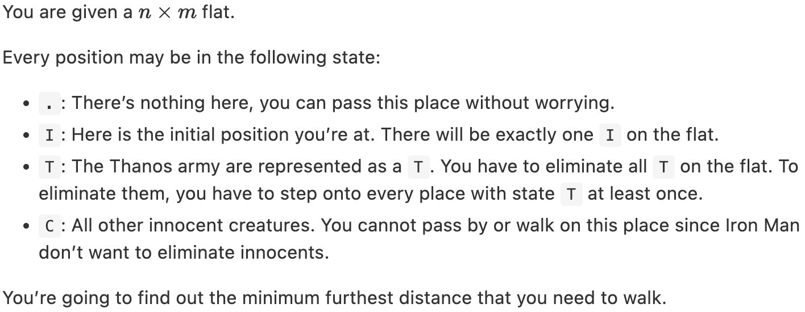
Requirments

Slide 3
Requirments
Sample Input: Sample Output:
5 5
TT.C.
C.C.T
CICC.
TTTC.
CC..T
8

Slide 4
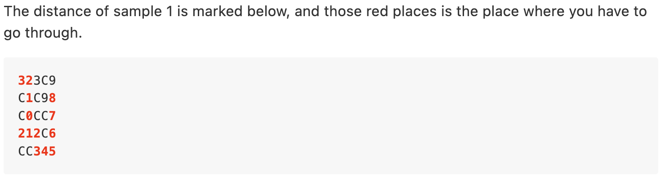
Requirments

Slide 5
Breadth-first Search (BFS)
BFS
DFS

Slide 6
solution
Prepare a queue, each element of the queue will contain (cur_x, cur_y, step)
Find the position (x, y) of I, which is the starting point.
Push (x, y, 0) into the queue.
While the queue is not empty, pop the front element E of the queue in each round. For every unvisited neighbor of E, if type == ‘T’ or type == ‘.’, push the neighbor into the queue. Remember to increase the value of step.
Remember to update current max step and the number of T that has been visited along the way.

Slide 7
Solution
Queue: (cur_x, cur_y, step)
(3, 2, 0)
(3, 2, 0)
(2, 2, 1)
(2, 2, 1)
(4, 2, 1)
(4, 2, 1)
(1, 2, 2)
(4, 1, 2)
…
(4, 3, 2)

