Slide 1
Rock

Slide 2
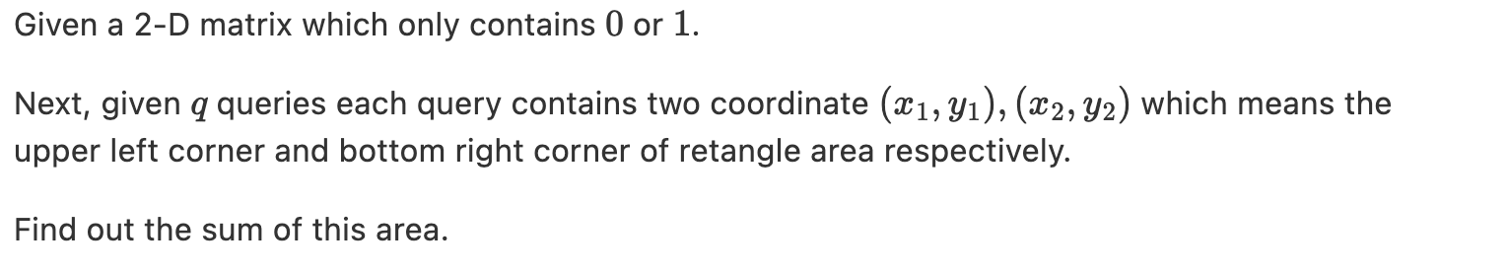
Requirments

Slide 3
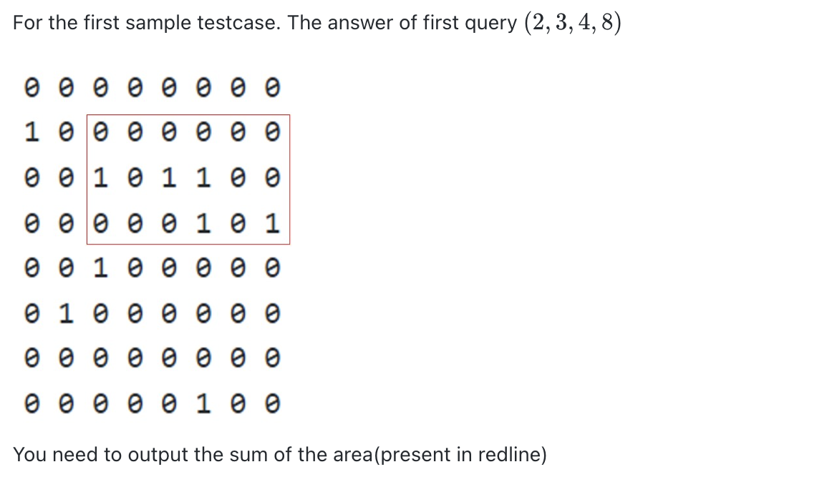
Requirments

Slide 4
Dynamic Programming (DP)
Divide a big problem into multiple small problems.
Each element in arr represents the sum from top left to the element.
arr
4x4 matrix
0 0 0 0
0 0 1 0
0 1 1 0
1 0 0 0
0
0
0
0
0
0
1
1
0
1
3
3
1
2
4
4

Slide 5
Dynamic Programming (DP)
With this arr, we can calculate the sum of some range easily.
arr
4x4 matrix
0 0 0 0
0 0 1 0
0 1 1 0
1 0 0 0
0 0 0 0
0 0 1 0
0 1 1 0
1 0 0 0
0
0
0
0
0
0
1
1
0
1
3
3
1
2
4
4

Slide 6
Compute arr
arr
4x4 matrix
0 0 0 0
0 0 1 0
0 1 1 0
1 0 0 0
0
0
0
0
0
0
1
1
0
1
3
3
1
2
4
4

Slide 7
Solution
Compute arr from top left to bottom right.
use arr to calculate each test case.

