Slide 1
Capstone Presentation
NBA Salary Prediction and Assessment

Slide 2
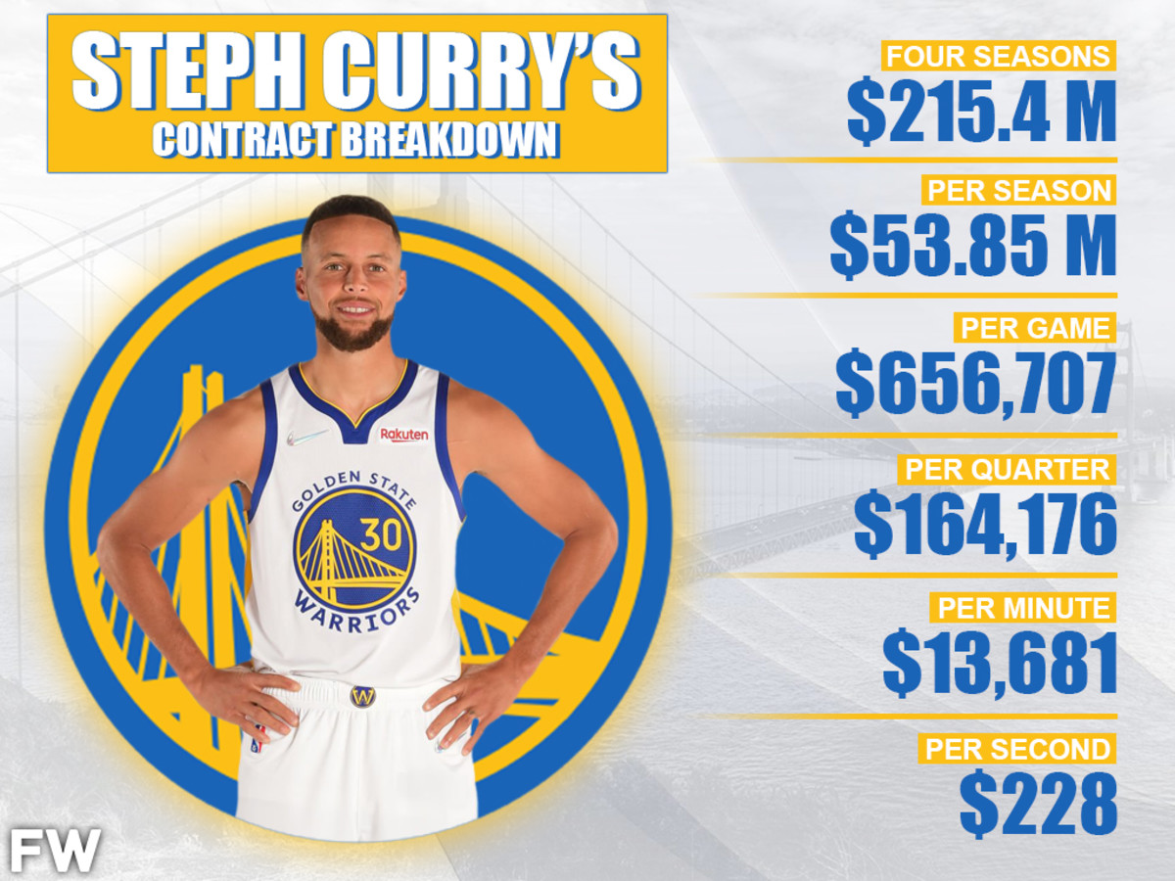
Problem Statement
Notes:
As the world’s most elite basketball athletes, NBA players in general receive high income as a result of their talent and hard work. Most of the time, NBA players who are under the final year of their contracts have to have good performances along with good looking statistics (points, rebounds, etc.) for them to receive big contracts the next year. Certain players could have received a long term big contract (4 years is deemed to be a long term contract), but they might not perform well after they got paid. The purpose of this project is to create a model that will help us predict a player’s salary in the 2021-2022 season with their respective stats from 2020-2021 season. Moreover, as some of the players have received their contracts from years back, this model could also serve as a yardstick to evaluate a player’s performance to see whether he is being overpaid or underpaid.

Slide 3
Data Collection
2020-2021 NBA Player Stats: Per Game
2020-2021 NBA Player Stats: Advanced
NBA Contracts Summary

Slide 4
Data Wrangling
Merged data via player’s name
Notes:
ince the datasets are collected from the same website, I simply merged the three datasets with the player’s unique ID. One of the problems I encountered in merging these datasets is that certain players were traded during the season, as a result, they have different stats for different teams. I decided to keep players’ stats for each team, since maybe a player might start performing well after getting traded, resulting in receiving a bigger contract.

Slide 5
Data Wrangling
Merged data via player’s name
Dropped players with missing FG% variables.
Notes:
Moreover, I dropped the players that have missing values for FG% (field goal percentage), since those players might have never shot a ball once on their respective team. After dropping those players, I kept the players with a missing 3 point FG%, since those players might have received that result from not shooting a 3 the whole season, but they still played a good amount of time that season.

Slide 6
Data Wrangling
Merged data via player’s name
Dropped players with missing FG% variables.
1221 rows x 58 columns to 454 rows * 51 columns
Notes:
I wanted to keep as many observations as possible, since there are generally not a lot of players in the league. Consequently, the shape of our dataset has been reduced from 1221 rows x 58 columns to 454 rows * 51 columns (After deleting duplicate rows and players that did not play much).

Slide 7
Exploratory Data Analysis
Certain insights:
The average point scored by NBA players is around 10.65.
The NBA is a young players driven league, with players under 25 occupying more than 50% of the league roster spots.
While shooting percentages and 3 point percentages tend to follow a normal distribution, field goals made and attempts tend to be a shape that is skewed to the right.
Salary is also skewed to the right, with certain bins popping at the very end

Slide 8
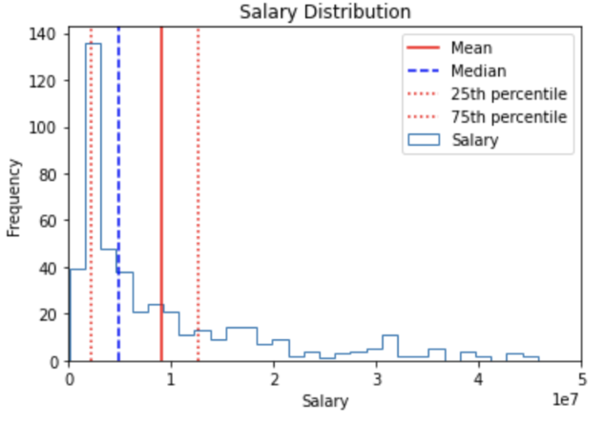
Exploratory Data Analysis
Salary Distribution

Slide 9
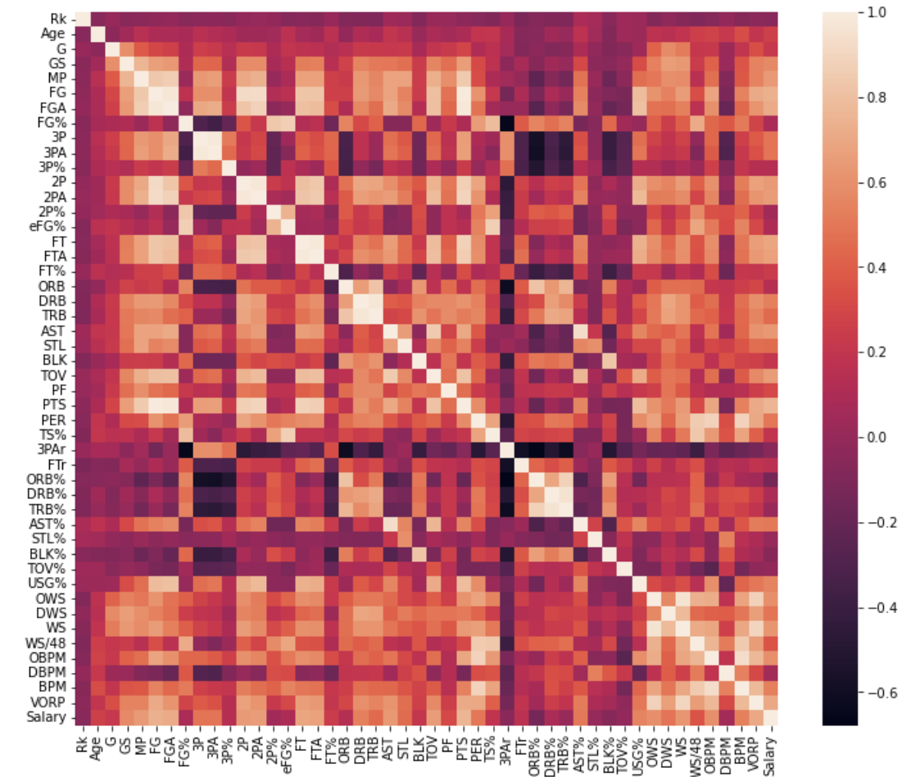
Exploratory Data Analysis
Heatmap for Salaries and other variables
Points
FG makes
FG attempts
VORP (Value Over Replacement Players)
Notes:
Points, FG makes, FG attempts, and VORP (Value over replacement players) have the highest correlations with salary

Slide 10
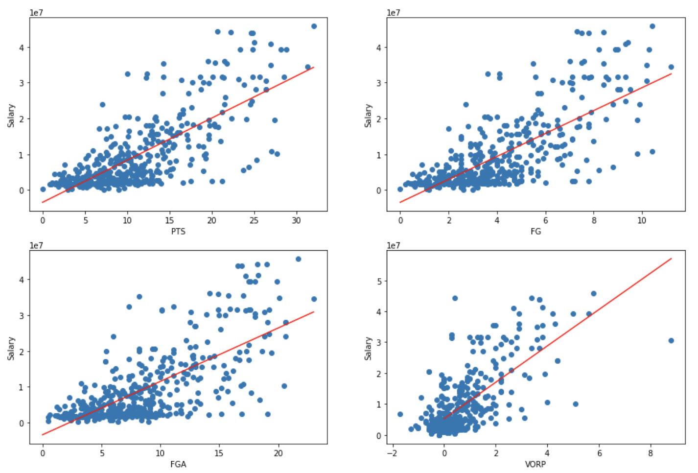
Exploratory Data Analysis

Slide 11
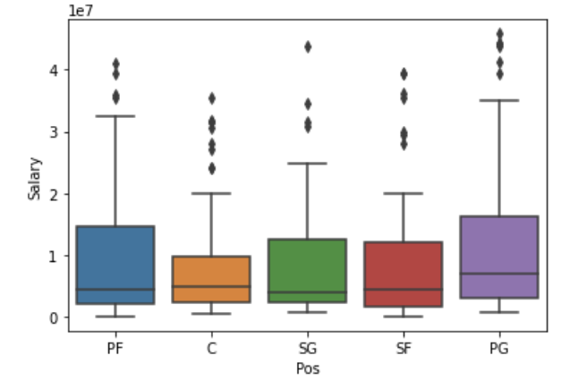
Categorical Data Treatment
Keeping Positions as a Variable

Slide 12
Categorical Data Treatment
Keeping Positions as a Variable
Null hypothesis: Being point guards do not have any impact on a player's salary. We reject the hypothesis with p<0.05.
Notes:
As we can see here that PG has a higher mean for salary than the rest of the positions (Positions except PG have similar means for salary).
Null hypothesis: Being point guards do not have any impact on a player's salary. We reject the hypothesis with p<0.05.
After our test, we received a P-value lower than 0.05, rejecting the null hypothesis and kept the positions for each player.

Slide 13
Modeling
Linear Regression
Random Forest Regression
Gradient Boosting Regression

Slide 14
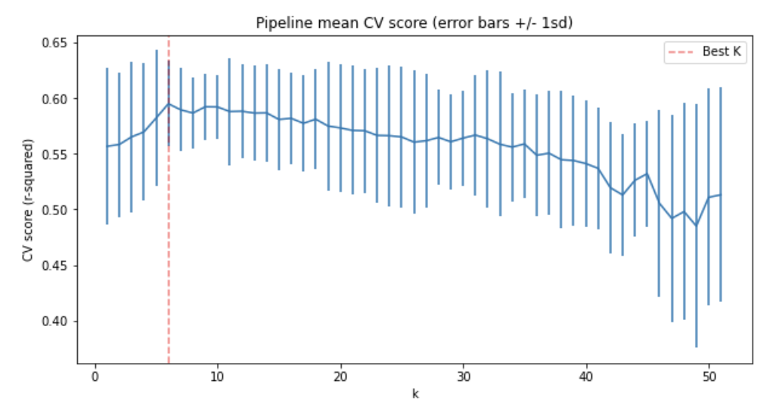
Linear Regression
Select K-Best
Notes:
For our first model, we did a linear regression model, with parameters Standard Scaler and Select K best. Below is the CV score after grid searching.
The four most important features: PTS, VORP, FGA, FT.

Slide 15
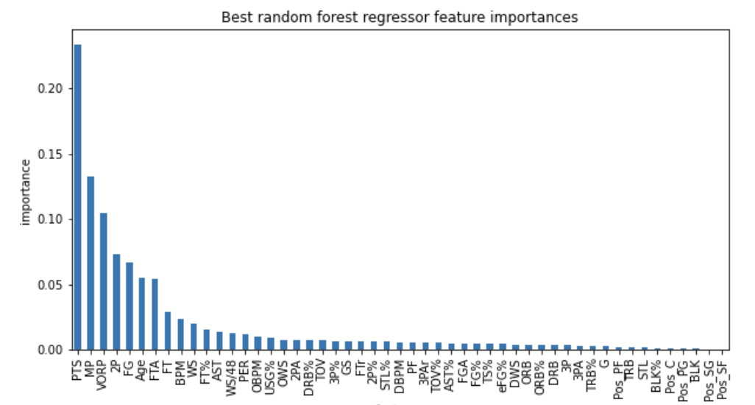
Random Forest
‘bootstrap': True
‘max_depth': 80,
‘min_samples_leaf': 3,
‘n_estimators': 33,
StandardScaler()

Slide 16
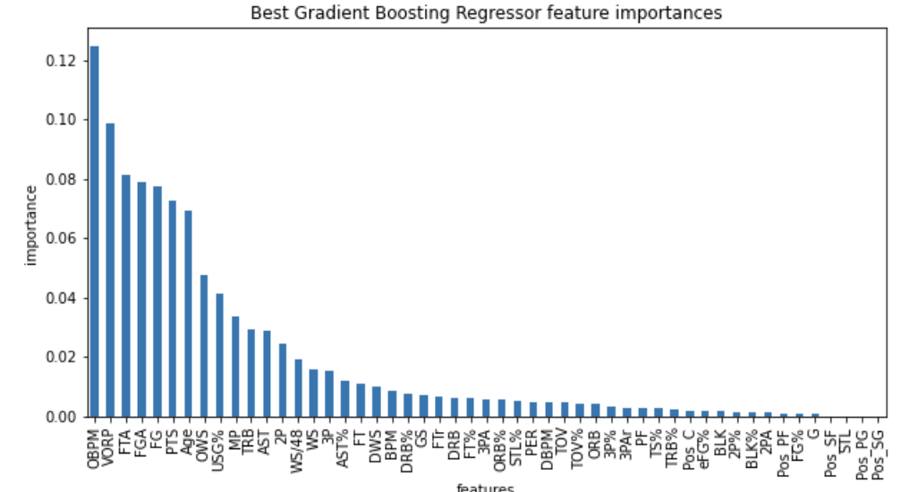
Gradient Boosting Regression
-

Slide 17
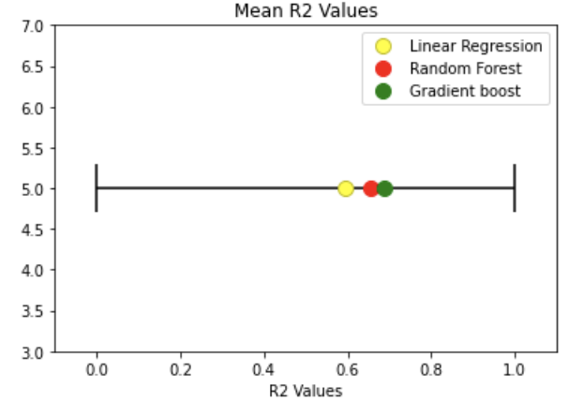
Final Assessment with 5 fold cross validation
R Squared

Slide 18
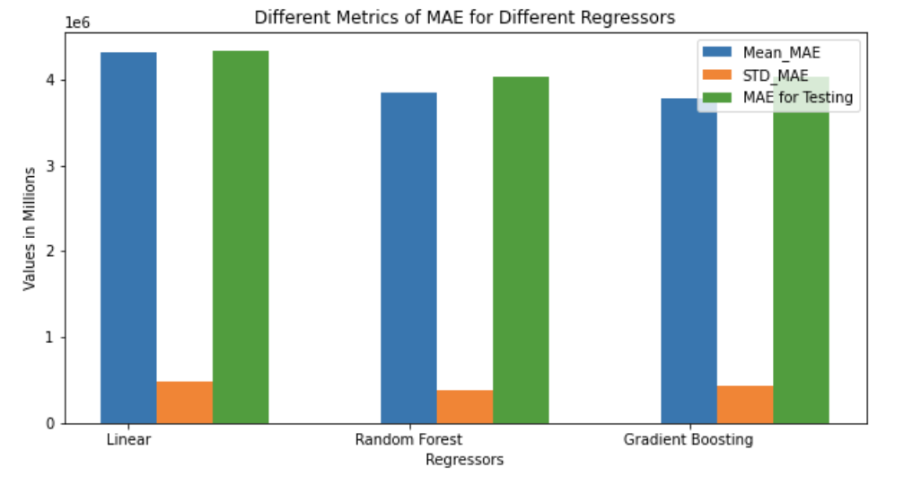
Final Assessment with 5 fold cross validation
Mean Absolute Error

Slide 19
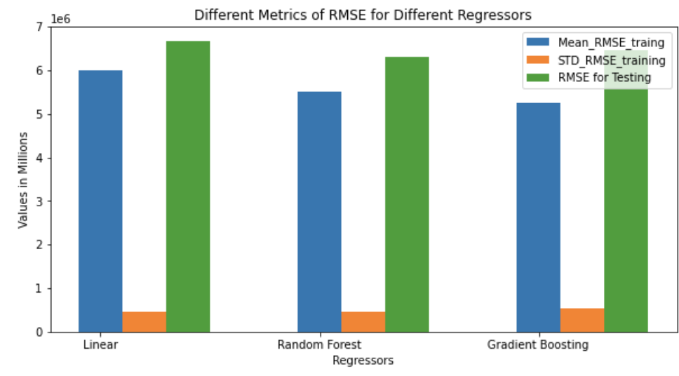
Final Assessment with 5 fold cross validation
Root Mean Squared Error

Slide 20
Final Model Selection and Reasoning
Random Forest Regression
Performance on testing data
Not overfitting
Notes:
From the metrics we have chosen, it seems like Random Forest Regressor with its respective best parameters would outperform the other two models. It has the lowest mean and std for mean absolute error of the training set, and the mean absolute of the prediction from the testing data is the lowest among the three models as well. Moreover, random forest regressor happens to perform well on the test set compared to gradient boosting regressor, which has a lower value for the RMSE when it comes to training data, indicating that gradient boosting regressor could be overfitting.

Slide 21
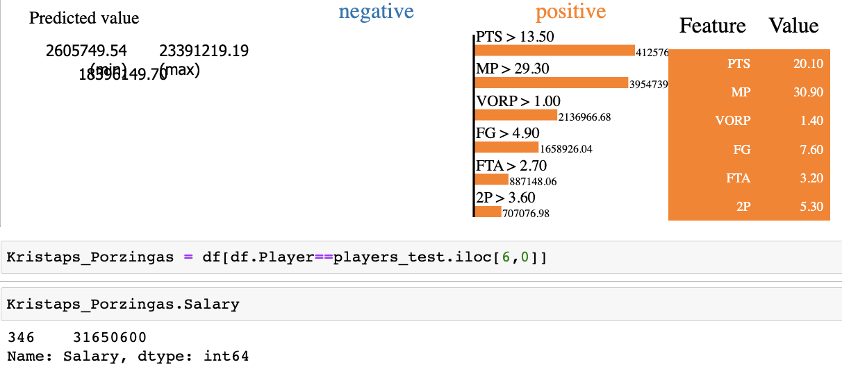
Lime Interpretation
Kristaps Porzingas

