Slide 1
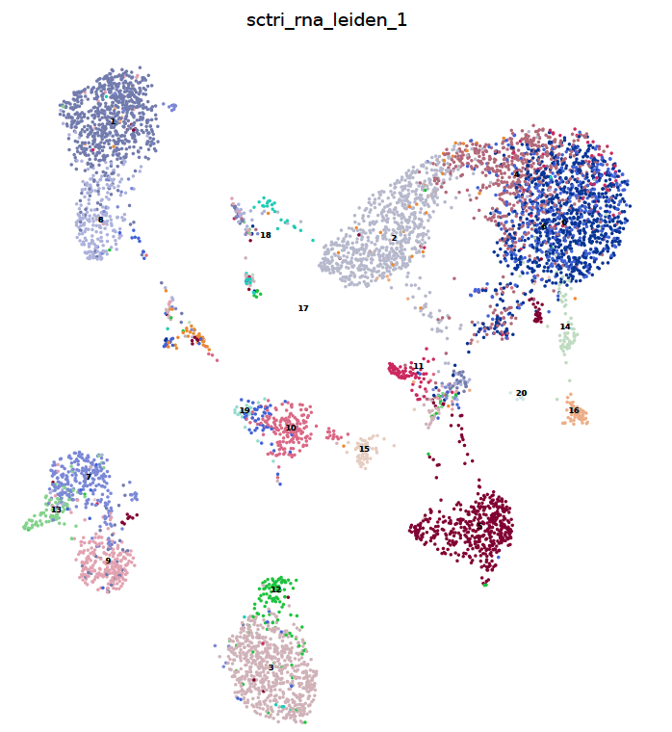
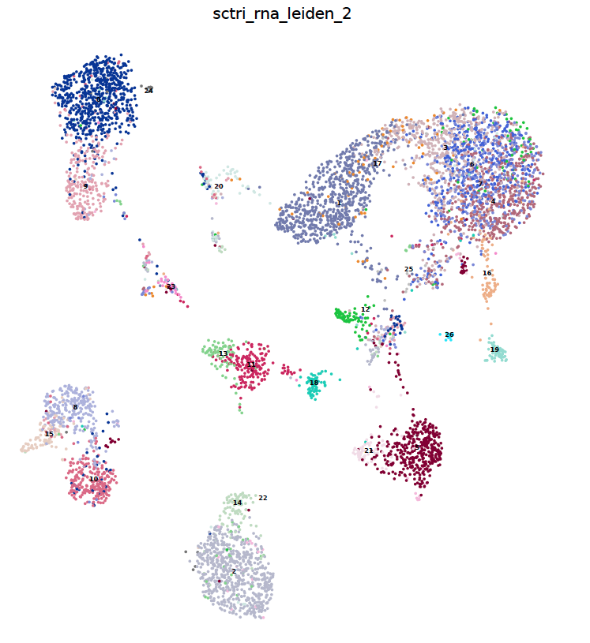
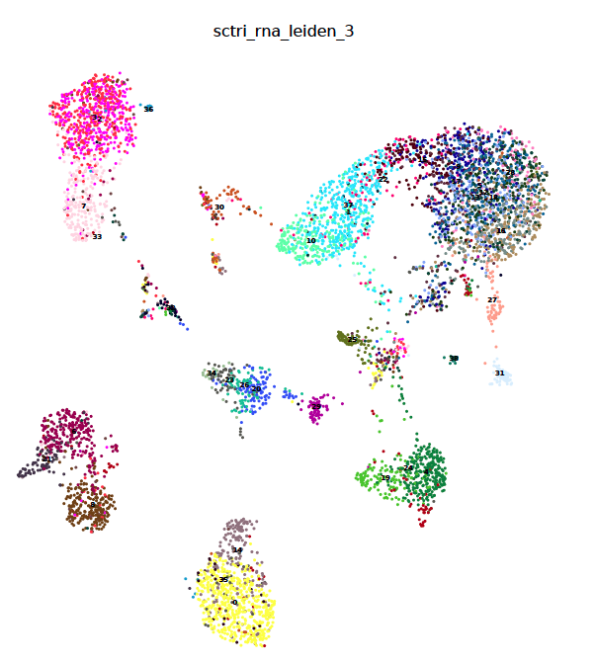
RNA r=1: 20 clusters
RNA r=2: 26 clusters
RNA r=3: 38 clusters

Slide 2
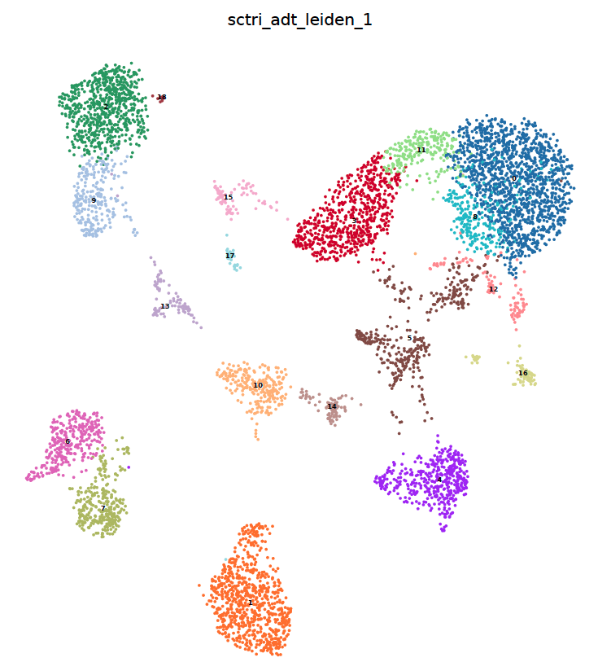
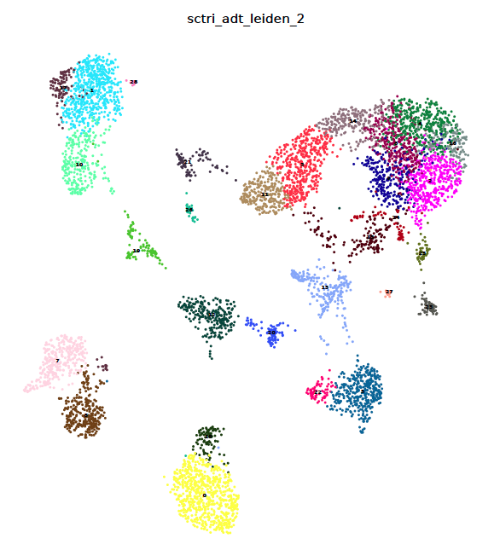
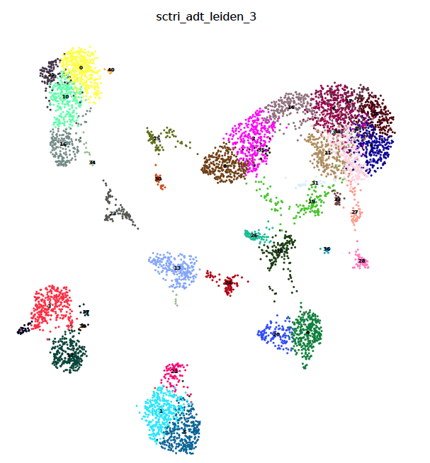
ADT r=1, 16 clusters
ADT r=2, 28 clusters
ADT r=3, 40 clusters

Slide 3
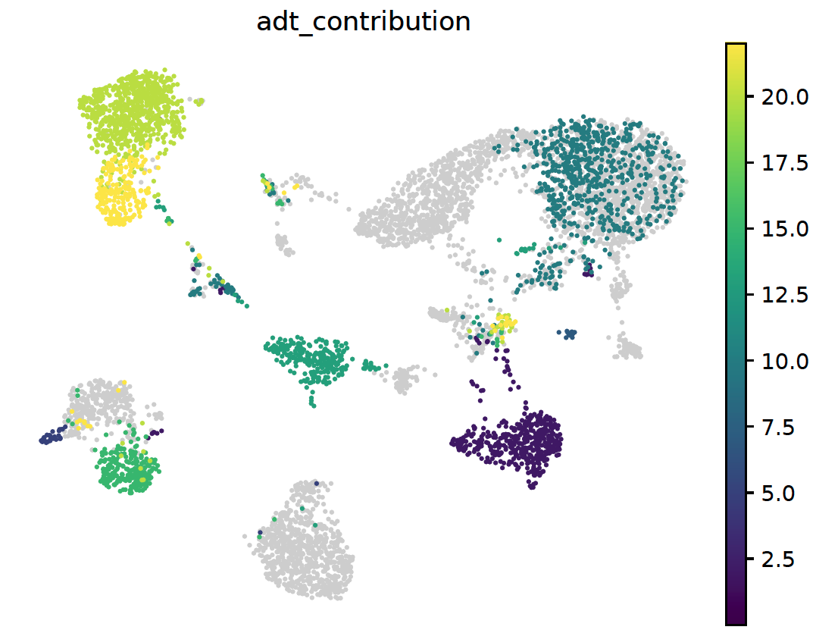
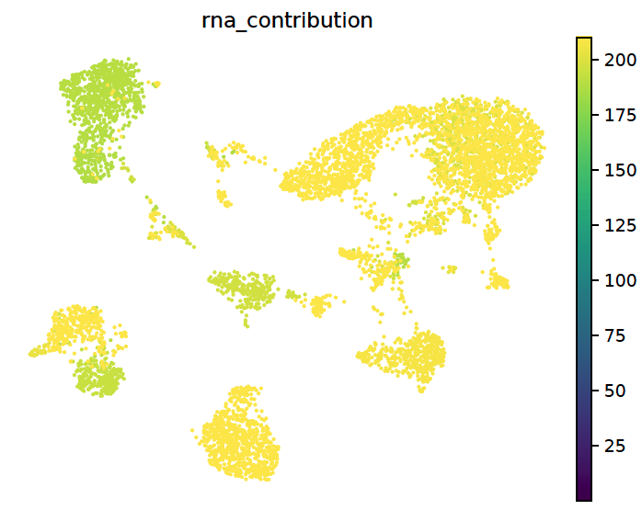

Slide 4
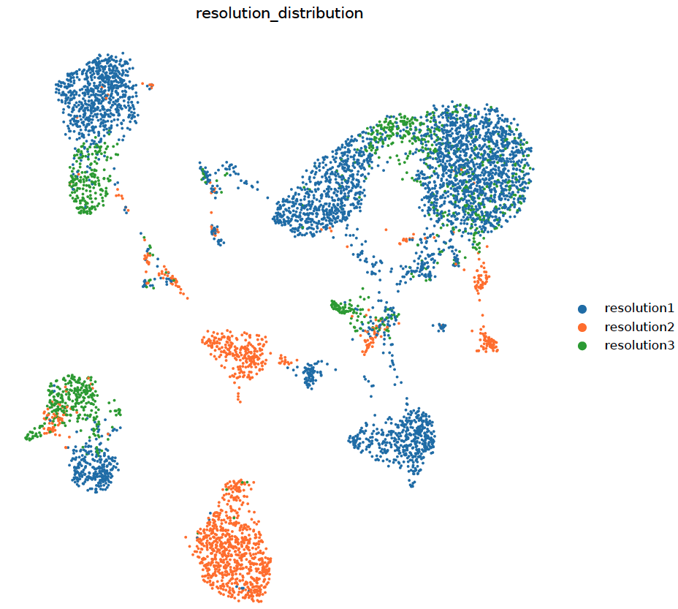

Slide 5
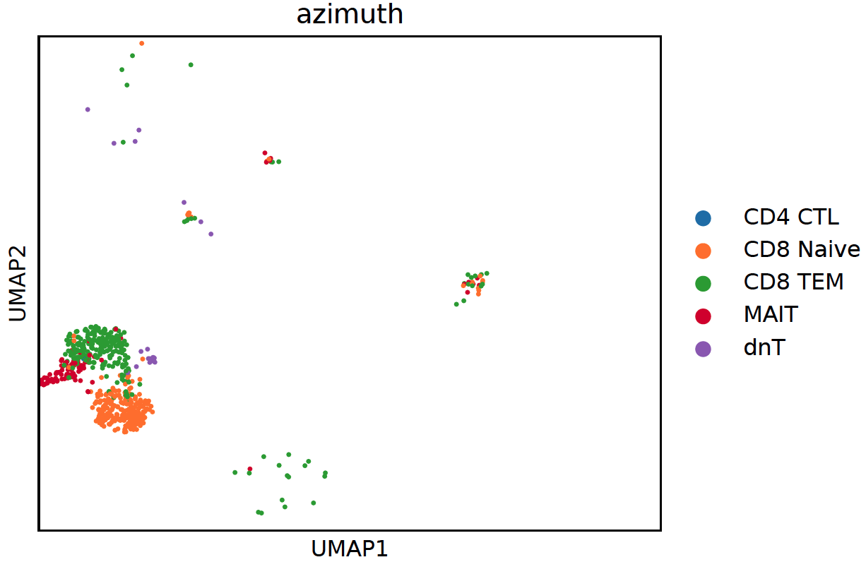
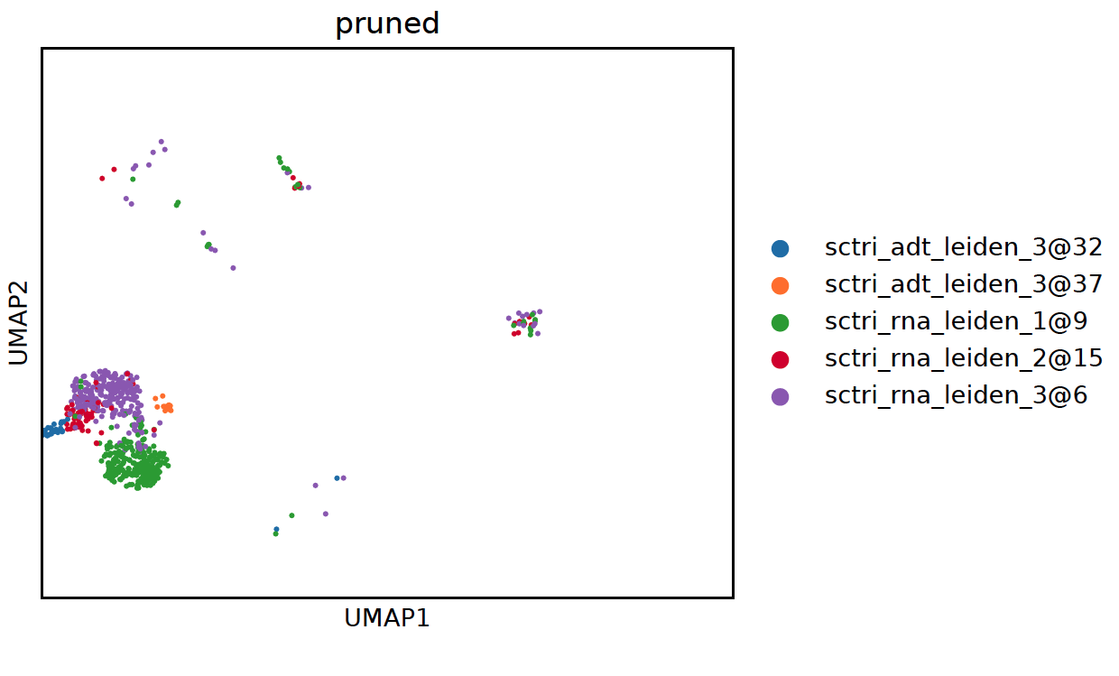
Novel CD56 high MAIT cell

Slide 6
Try to construct a Anndata like below
RNA cluster annotation 1,2
RNA expr
ADT expr
ATAC expr
ADT
ATAC
If expr has been scaled/corrected somehow, put raw count in anndata.layers[key], and specify layer parameter when executing sctri.lazy_run()
If you don’t have existing annotation, using preprocessing.scanpy_recipe() to derive Leiden clusters
If you have existing annotation to add, using preprocessing.add_annotation()

