Slide 1

Synthetic Gauge Field and Spin-Orbit Coupling in Cold Atoms
An informal tutorial
Han Pu
RLUP presentation, Sept. 21st, 2012

Slide 2
Atom-photon interaction
Eigenstates (dressed states):
General state expansion:

Slide 3
Atom-photon interaction
General state expansion:
Emergence of the Gauge field:
Assuming , the effective Schroedinger equation for :

Slide 4
Atom-photon interaction: Raman Coupling
effective Hamiltonian for :

Slide 5
Atom-photon interaction: Raman Coupling
effective Hamiltonian for :
Synthetic magnetic field:
Synthetic electric field:

Slide 6
Exp. on synthetic Gauge field

Slide 7
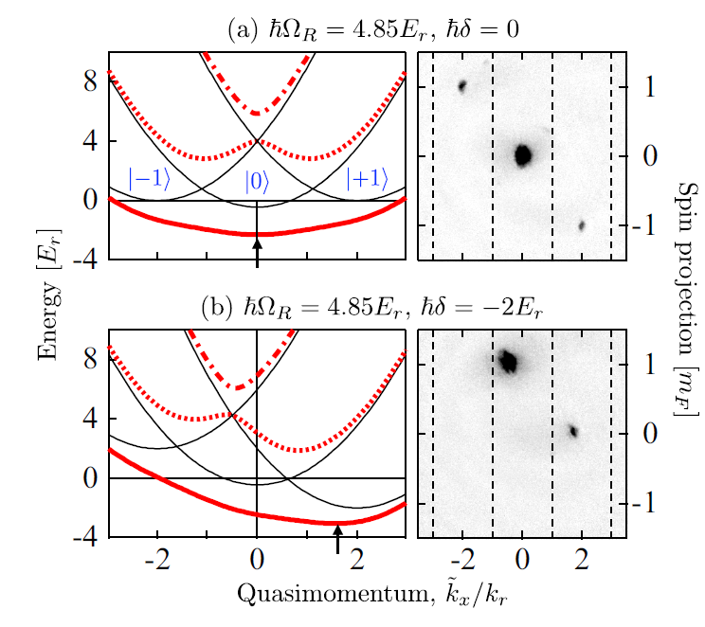
Exp. on synthetic Gauge field
Dispersion near ground state

Slide 8
Exp. on synthetic Gauge field
Nature 426, 628 (2009)
Dispersion near ground state

Slide 9
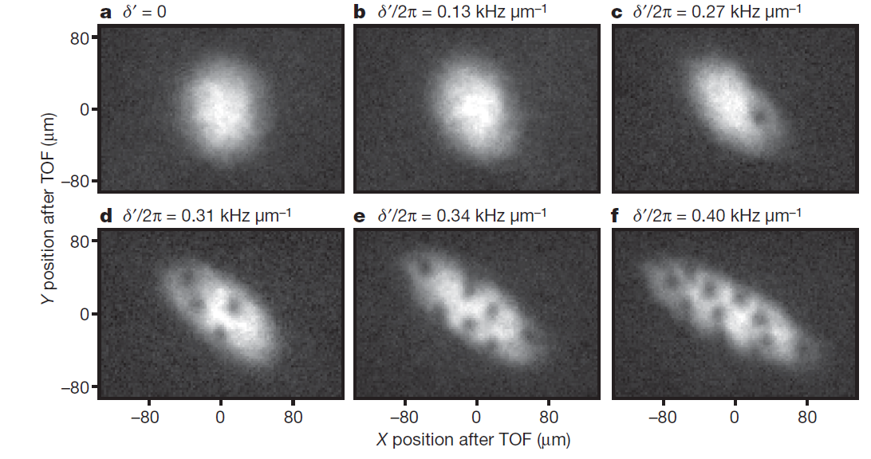
Exp. on synthetic Gauge field
Nature 426, 628 (2009)

Slide 10
Exp. on synthetic Gauge field
Nature Phys. 7, 531 (2011)

Slide 11
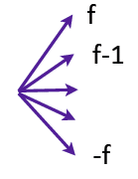


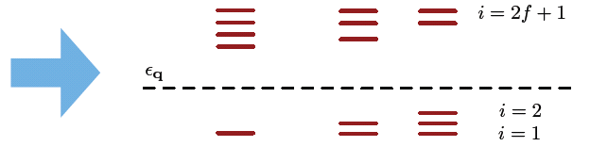
Artificial Gauge Potential from laser manipulation
A general model for n-level atom
L=1
L=2
L=3

Slide 12
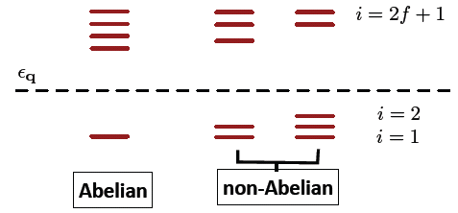
Artificial Gauge Potential from laser manipulation
A general model for n-level atom
Non-Abelian gauge field:
can lead to spin-orbit coupling

Slide 13
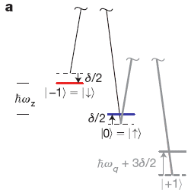
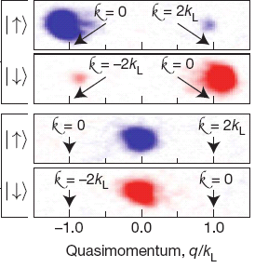
Spin-orbit coupled BEC
Nature 471, 83 (2011)

Slide 14

Spin-orbit coupled BEC

Slide 15
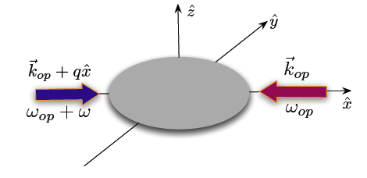

Experimental progress
Spielman (NIST): ⁸⁷Rb, ⁴⁰K
Zhang (Shanxi): ⁸⁷Rb, ⁴⁰K
Chen and Pan (USTC): ⁸⁷Rb
Engels (Washington State): ⁸⁷Rb
Zwierlein (MIT): ⁶Li
Chen (Purdue): ⁸⁷Rb

Slide 16
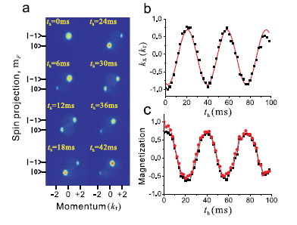
Experimental progress: collective excitation of SO coupled BEC

Slide 17
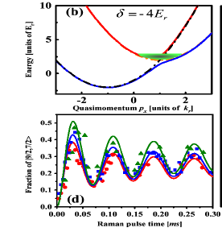
Experimental progress: SO coupled Fermi gas
⁴⁰K

Slide 18
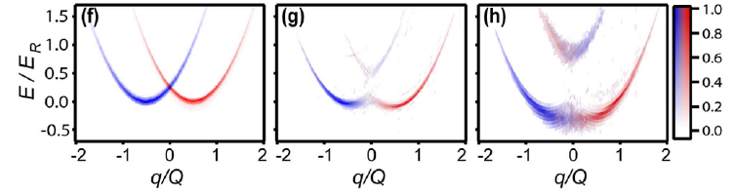
Experimental progress: SO coupled Fermi gas
⁶Li

Slide 19
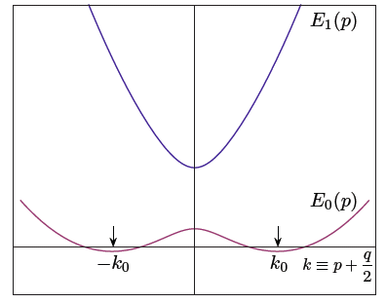
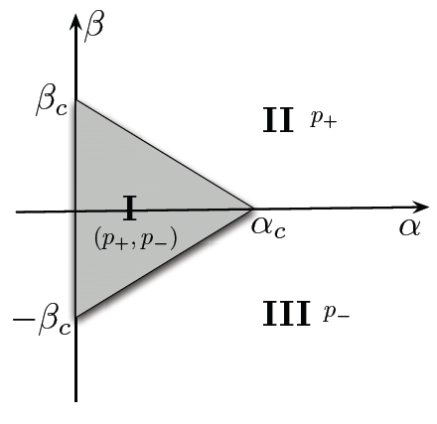
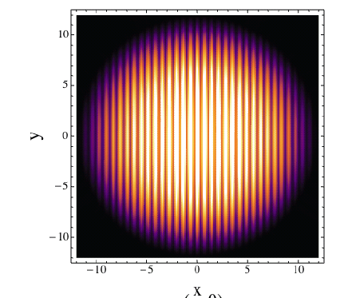

Many bosons: nontrivial topological BEC
Ho and Zhang, PRL 107, 150403 (2011)

Slide 20

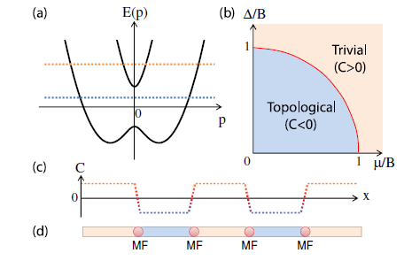
Many fermions: Majorana mode in 1D
Jiang et al., PRL 106, 220402 (2011)

Slide 21
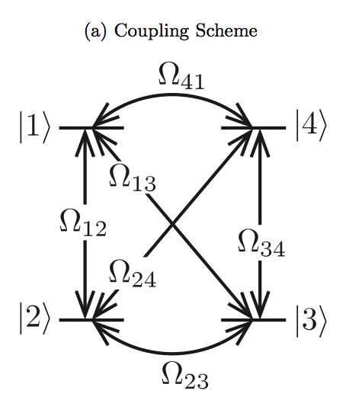

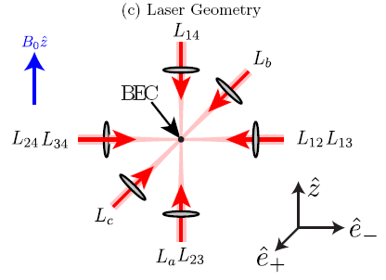
Synthetic 3D spin-orbit coupling
Anderson et al., PRL 108, 235301 (2012)

Slide 22
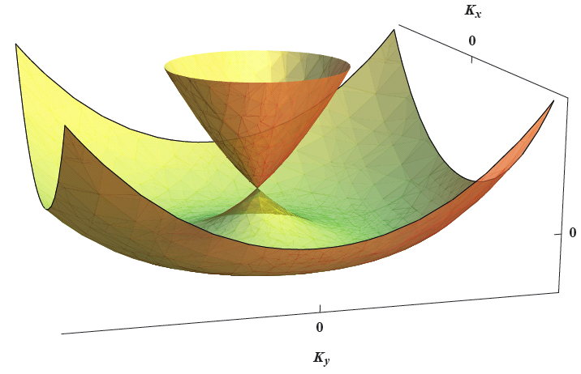
Rashba spin-orbit coupling
Spin-orbit coupling Hamiltonian
Single-particle dispersion:
Dirac point at p=0

Slide 23

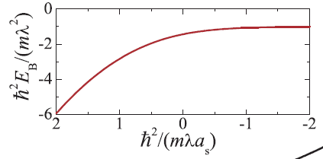
Rashba SOC: Two fermions
Bound-state solution:
There always exists a two-body bound state!
In the absence of SO coupling, two-body bound state only exist when as>0.
Vyasanakere and Shenoy, PRB 83, 094515 (2011)

Slide 24
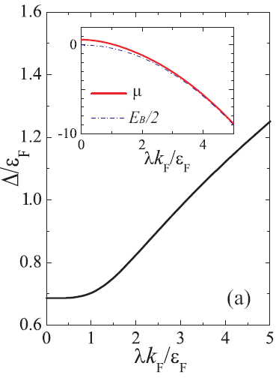
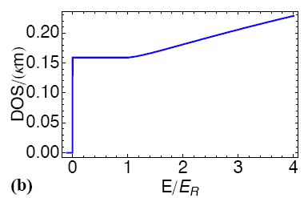
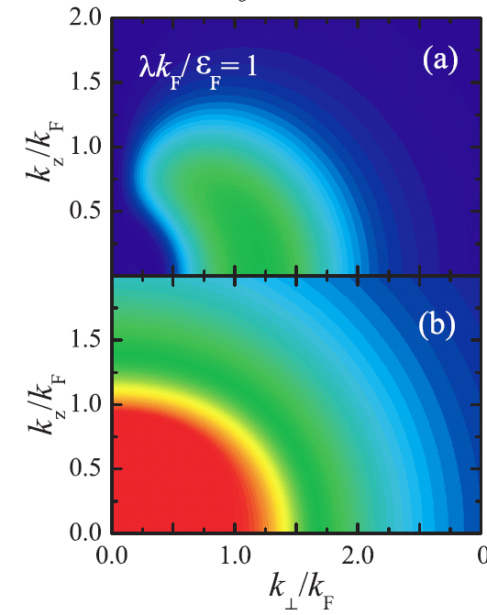

Rashba SOC: Many fermions --- enhanced pairing
Enhanced pairing
Mixed-spin pairing
Hu et al., PRL 107, 195305 (2011)
Yu et al., PRL 107, 195304 (2011)

Slide 25
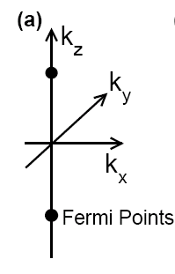
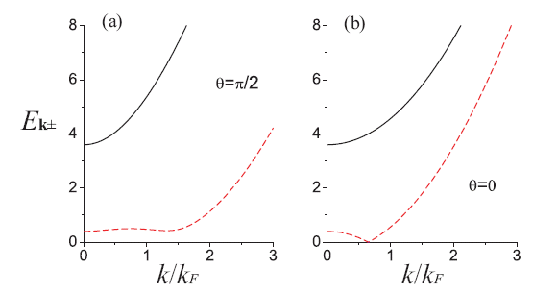
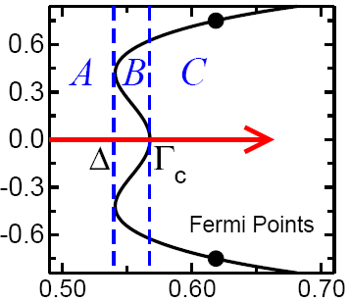
Rashba SOC + Zeeman term: Many fermions --- topological superfluid
Quasi-particle dispersion
h=2E_{F}
k_{z}
Gapless excitation
h(E_{F})
Gong et al., PRL 107, 195303 (2011)

Slide 26
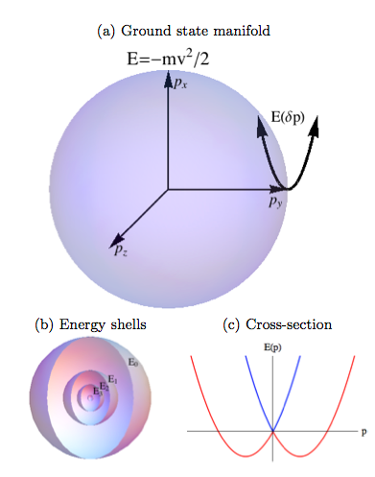
3D isotropic spin-orbit coupling
Spin-orbit coupling Hamiltonian
Single-particle dispersion:
Ground state form a sphere in p-space：
Dirac point at: p = 0
Anderson et al., PRL 108, 235301 (2012)

Slide 27
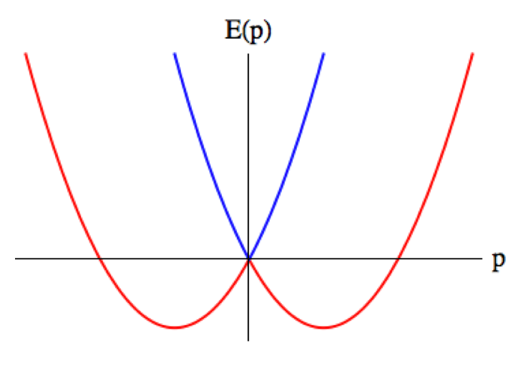
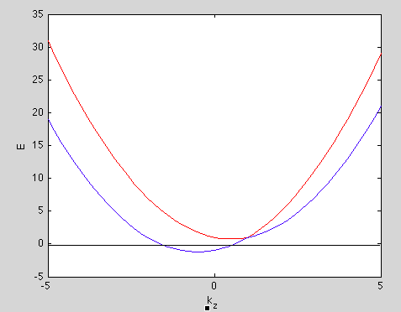
3D isotropic SOC + Zeeman term
Spin-orbit coupling Hamiltonian
Single-particle dispersion:
Ground state at：
Dirac point at:

Slide 28
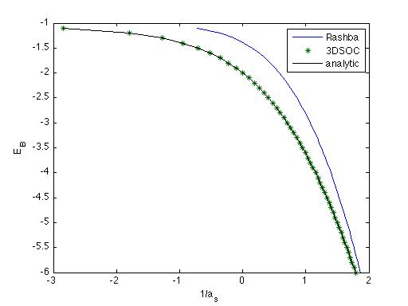
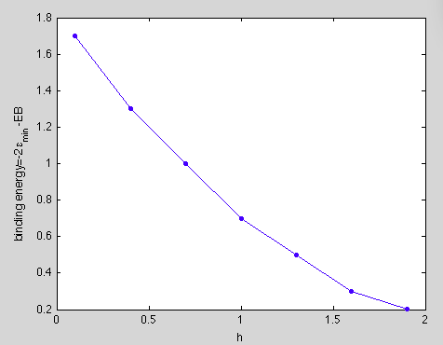
3D isotropic SOC: Two fermions
Rashba SOC
1/a_{s}=0
2body bound state energy
Binding energy
3D isotropic SOC
1/a_{s}
Zeeman field
Analytic result for h=0: He and Huang arXiv:1202.1492

