Slide 1
RISKLAB CREDIT RISK ANALYSIS
Predicting the probability of default of credit card customers

Slide 2
Defining The Analytical Questions
What factors determine the repayment status of customers?
Is there a trend in repayment status?
Can a combination of factors be used to predict the probability of repayment
What is the best model for predicting probability of repayment?

Slide 3

DATA ANALYSIS AND INFERENCE

Slide 4
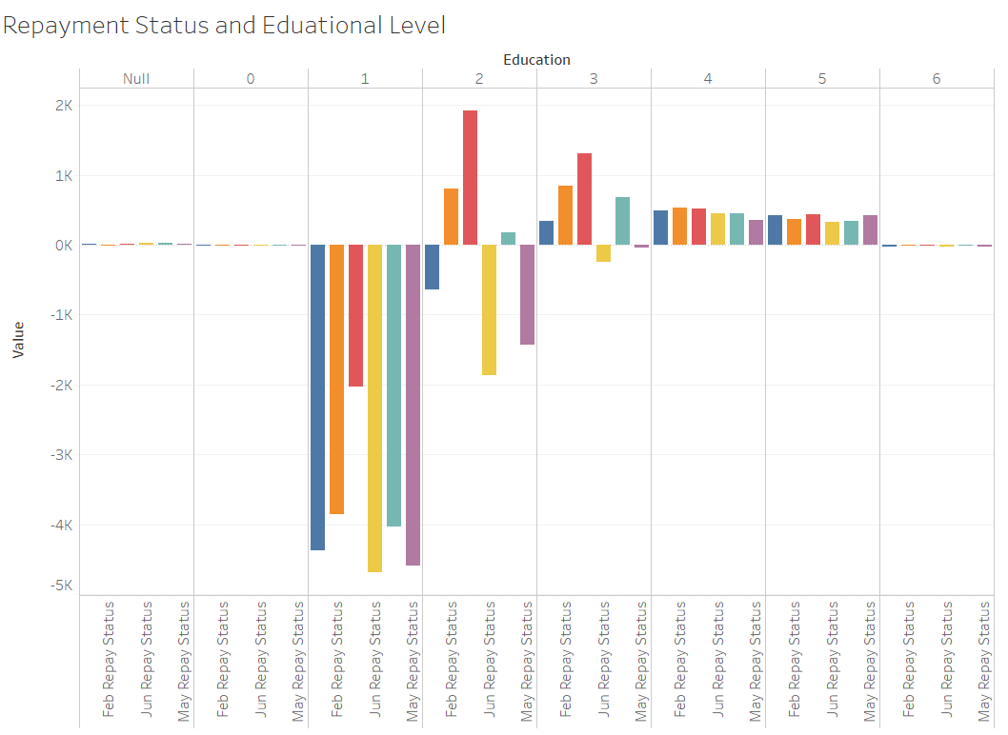
What Impact does Education level have on loan repayment status?
The bar chart shows that individuals with a higher level of education(1) had a higher tendency on running late in their repayment. On the other hand, Individuals with a lower level of education do well in their repayment. This may be because highly educated individuals have a high paying jobs, get higher credit limits, but at the same time have a high standard of living which is expensive to maintain.

Slide 5
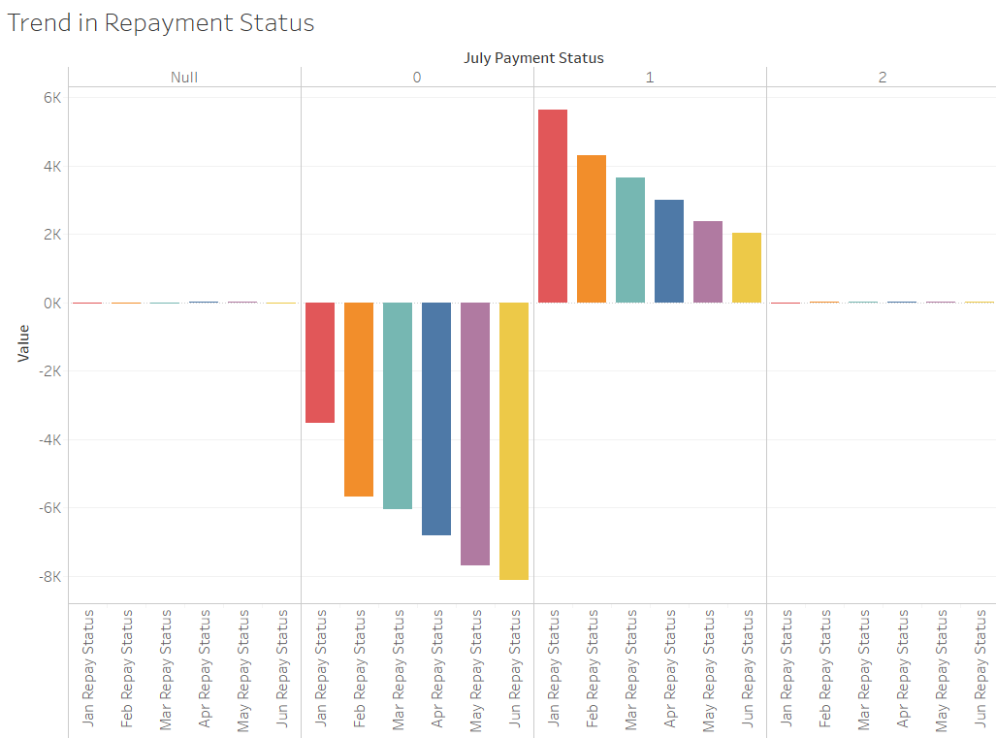
Credit History and Repayment status
There is a noticeable trend in the repayment status for customers with a good July payment status. The repayment amount over the months increased for customers with that defaulted in July payment while the repayment was reduced on average for customers that paid their July credit repayment.

Slide 6
Age relation to Payment Status
As shown in the chart below;
Customers within the high-risk age group of 22 – 40 have a higher probability of defaulting on credit repayment as shown in the orange and red dot lines which are higher within range of the age group.

Slide 7
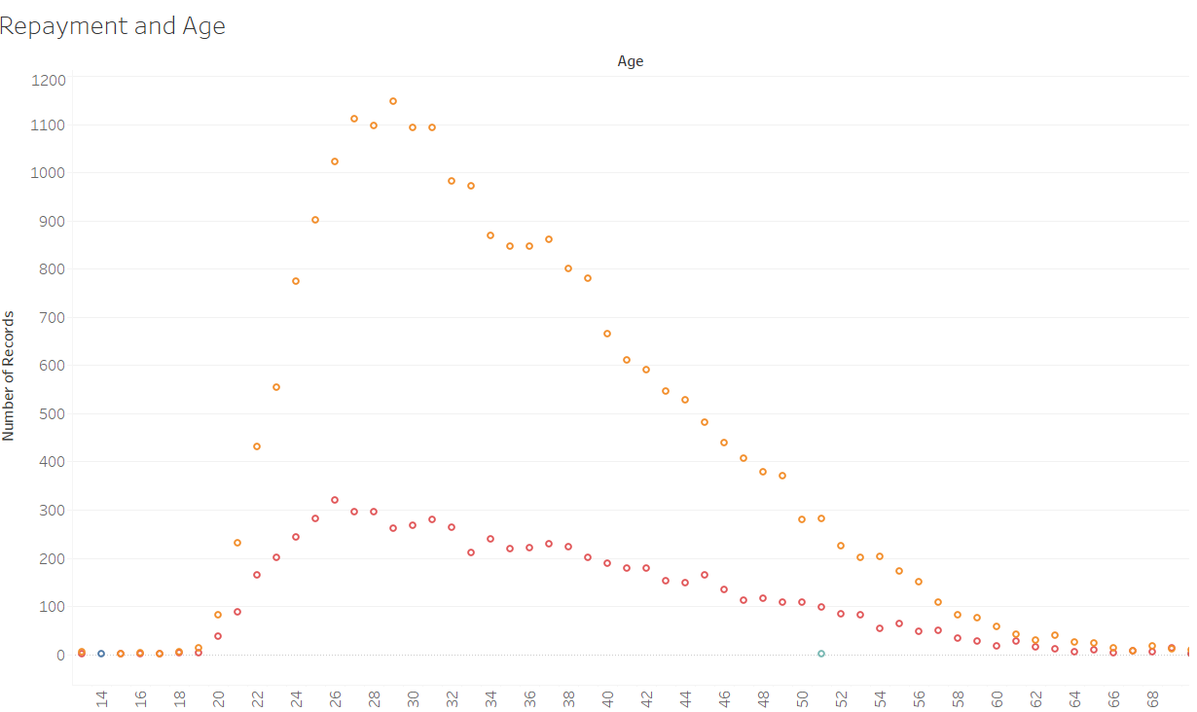

Slide 8
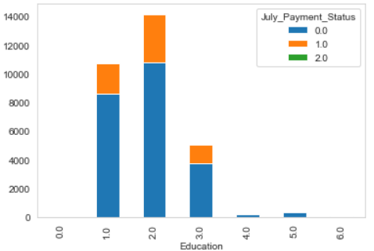
Does Education level have effect on credit repayment?

Slide 9
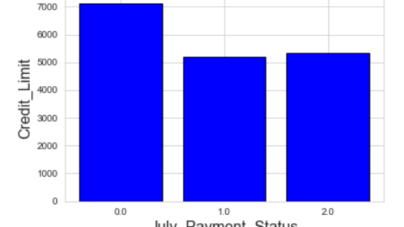
Does the credit limit affect the repayment status of the credit?
The graph shows that there is equal proportion in credit limit for customers who defaulted on their July payment. The amount of credit granted its not a deciding factor in the loan repayment

Slide 10
Analytical Report
Different Variables show a relation to the repayment status of the customer’s credit.
The trend in repayment status seem to correlate with the July payment status
The same can be said of the educational status as having a relationship with the July payment status.
However, no one variable can accurately predict the outcome of the July Payment status. But a combination of variables can be used to predict outcome of the July payment status
We use such combination of variables in Predictive modelling of the Payment status

Slide 11
Predictive Modelling of Credit Payment Status Outcome

Slide 12
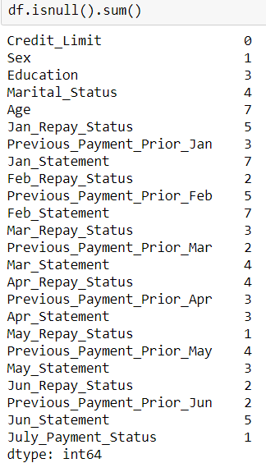
The Dataset
The dataset is a csv file with 24 variables(1 categorical).
There were no much missing values in the dataset and the few missing values were handled using the mode and median of the variables, since this will not have much effect on the data analysis.
All data already converted to numbers for most of the variables.

Slide 13
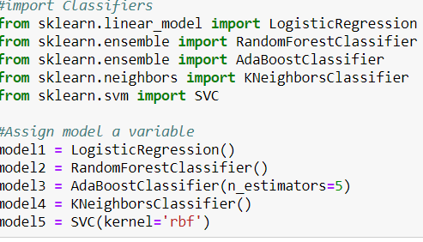
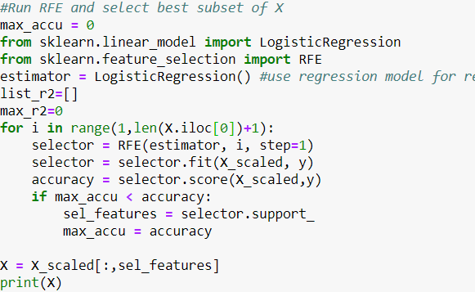
Model Selection and Evaluation
The prediction algorithm used is a classification algorithm. This is because our target variable(July_Payment_Status) is a categorical variable.
To get the best result for the prediction, different classification algorithms were employed
An RFE was also used to select the best independent variables for the prediction.

Slide 14
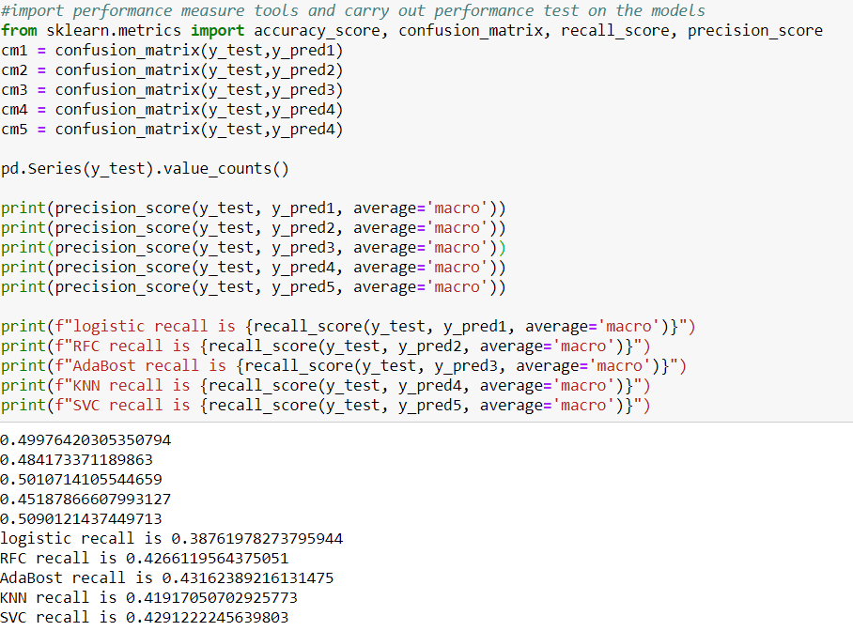
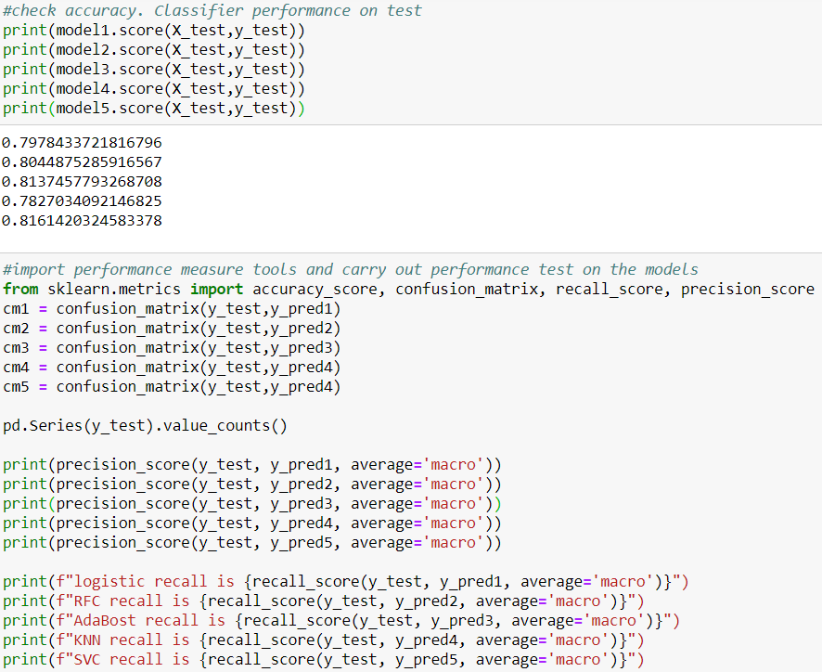
Prediction Accuracy and Result
Among the algorithms used, the support vector classifier gave a higher model score but almost the same amount of precision score as other models
Model score 81.61%
Precision score 42.91%
Before we can conclude that SVC is the best algorithm for model building, I suggest that other modifications of the data be prepared or deep learning models be employed

