Slide 1

NUS CCA Finder
--Find suitable CCAs for you

Slide 2





Log in with:
Home
Want to find out more about CCAs around you? Want to see what CCA’s your friends are taking?
With CCA Finder, CCA finding is easier than ever!
Find out more about CCAs around in NUS.
Help Developers

Slide 3
Log in with:
Home
Developers
Junchao: …….
Manmeet: …..
Help Developers

Slide 4
Log in with:
Home
Help
Full description of features in the help section.
To make the user experience better.
Help Developers

Slide 5
Log in with:
Log in as users via NUS open id
Home
Want to find out more about CCAs around you? Want to let others know about what CCA's are in store for them?
With CCA Finder, CCA finding is easier than ever!
Find out more about CCAs around in NUS. Check out what CCAs your friends have taken up.
Help Developers
Notes:
Users can do all the stuff on the website except for editing CCAs;
Visitors can search and view but do not have profile
More functionalities will follow

Slide 6
Log in with:
Log in as visitors using Facebook account
Home
Want to find out more about CCAs around you? Want to let others know about what CCA's are in store for them?
With CCA Finder, CCA finding is easier than ever!
Find out more about CCAs around in NUS. Check out what CCAs your friends have taken up.
Help Developers

Slide 7
Log in with:
Log in as visitors using Google account
Home
Want to find out more about CCAs around you? Want to let others know about what CCA's are in store for them?
With CCA Finder, CCA finding is easier than ever!
Find out more about CCAs around in NUS. Check out what CCAs your friends have taken up.
Help Developers

Slide 8
Welcome,
A****750
Logout
Home
Profile
Search
View
Haven’t edited your profile?
GO edit NOW!
Help Developers
Notes:
Log in as users. For Junchao and Manmeet’s NUS open id, the system will directly redirect them to admin
Or we can design an admin later
Case 1: profile incomplete

Slide 9
Welcome,
A****750
Logout
Home
Profile
Search
View
Want to find some more interesting
CCAs?
Help Developers
Notes:
Case 2: profile complete

Slide 10

Welcome,
A****750
Logout
Home
Profile
Search
View
Hello, Name !
A sentence of greeting depending on the local time on the computer
Your Profile:
Name: ***** Gender: *****
Faculty: *** Year: *
Residence: Temasek Hall
Interest: Track, Football, Chinese Chess, …
CCAs you are in: Tech Crew VIEW
ECE Club VIEW
CCAs you are interested:*(similar format as the previous one)
Click to upload profile photo
Share this:
Notes:
Case one: users
Share the CCAs they are in currently using facebook or google+
Manmeet edited – Add a profile photo

Slide 11
Welcome,
A****750
Logout
Home
Profile
Search
View
Sorry, you cannot view this page since you are visiting this website as a visitor.
You must log in via NUS Open Id to see this page.
Want to view CCA’s instead?
Help Developers
Notes:
Case two: visitor;

Slide 12
Welcome,
A****750
Logout
Home
Profile
Search
View
Enter the NUS NET account of your friend:
Submit
Help Developers

Slide 13
Welcome,
A****750
Logout
Home
Profile
Search
View
Information about A****750:
CCAs s/he is in:
CCAs s/he is interested in:
Help Developers
Notes:
Case two: visitor;

Slide 14
Welcome,
A****750
Logout
Home
Profile
Search
View
Location
Category
Search
Want to find some more interesting
CCAs?
Scroll over to “View” to view CCA’s by location, category or just Search up the CCA you are interested to find more about.
Help Developers
Notes:
Case two: visitor;

Slide 15
Welcome,
A****750
Logout
Home
Profile
Search
View
Temasek
Eusoff
Sheares
NUS campus
Kent Ridge
Raffles
King Edward
Help Developers

Slide 16
Welcome,
A****750
Logout
Home
Profile
Search
View
Sports
Singing & Chorus
Dance
Drawing & Design
…
Help Developers
Notes:
Case two: visitor;

Slide 17
Welcome,
A****750
Logout
Home
Profile
Search
View
Enter the name of a CCA:
Submit
Help Developers

Slide 18
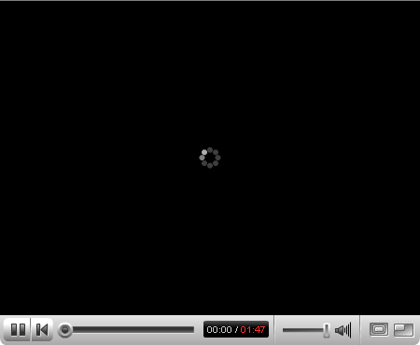
Welcome,
A****750
Logout
Home
Profile
Search
View
Name: Tech Crew Location: Temasek Hall
Description:…..
Pictures:…
Videos:… - Possible YouTube link or the video is embedded in the web page.
Share this:
Notes:
Manmeet edited – youtube link

