Slide 1
CIN-MNH
Data Entry Trends

Slide 2
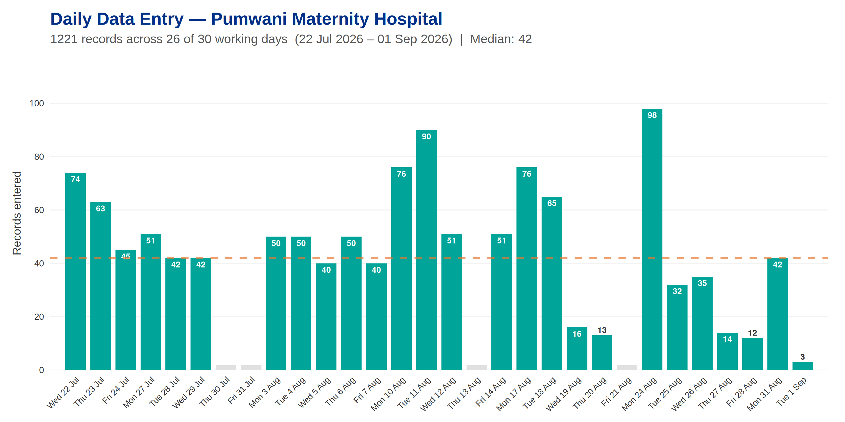
Pumwani Maternity Hospital

Slide 3
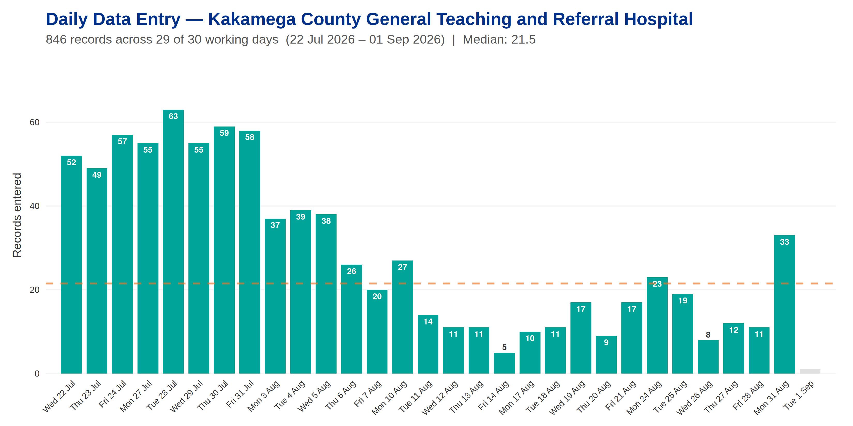
Kakamega County General Teaching and Referral Hospital

Slide 4
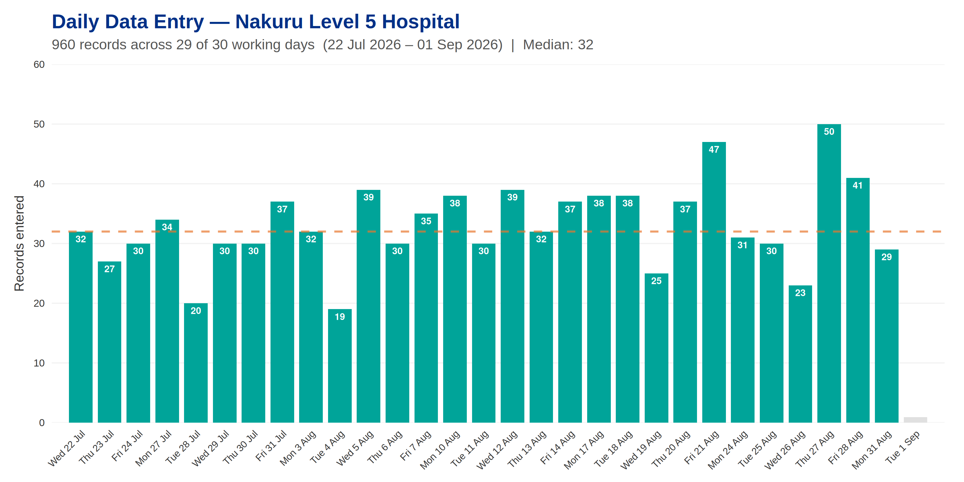
Nakuru Level 5 Hospital

Slide 5
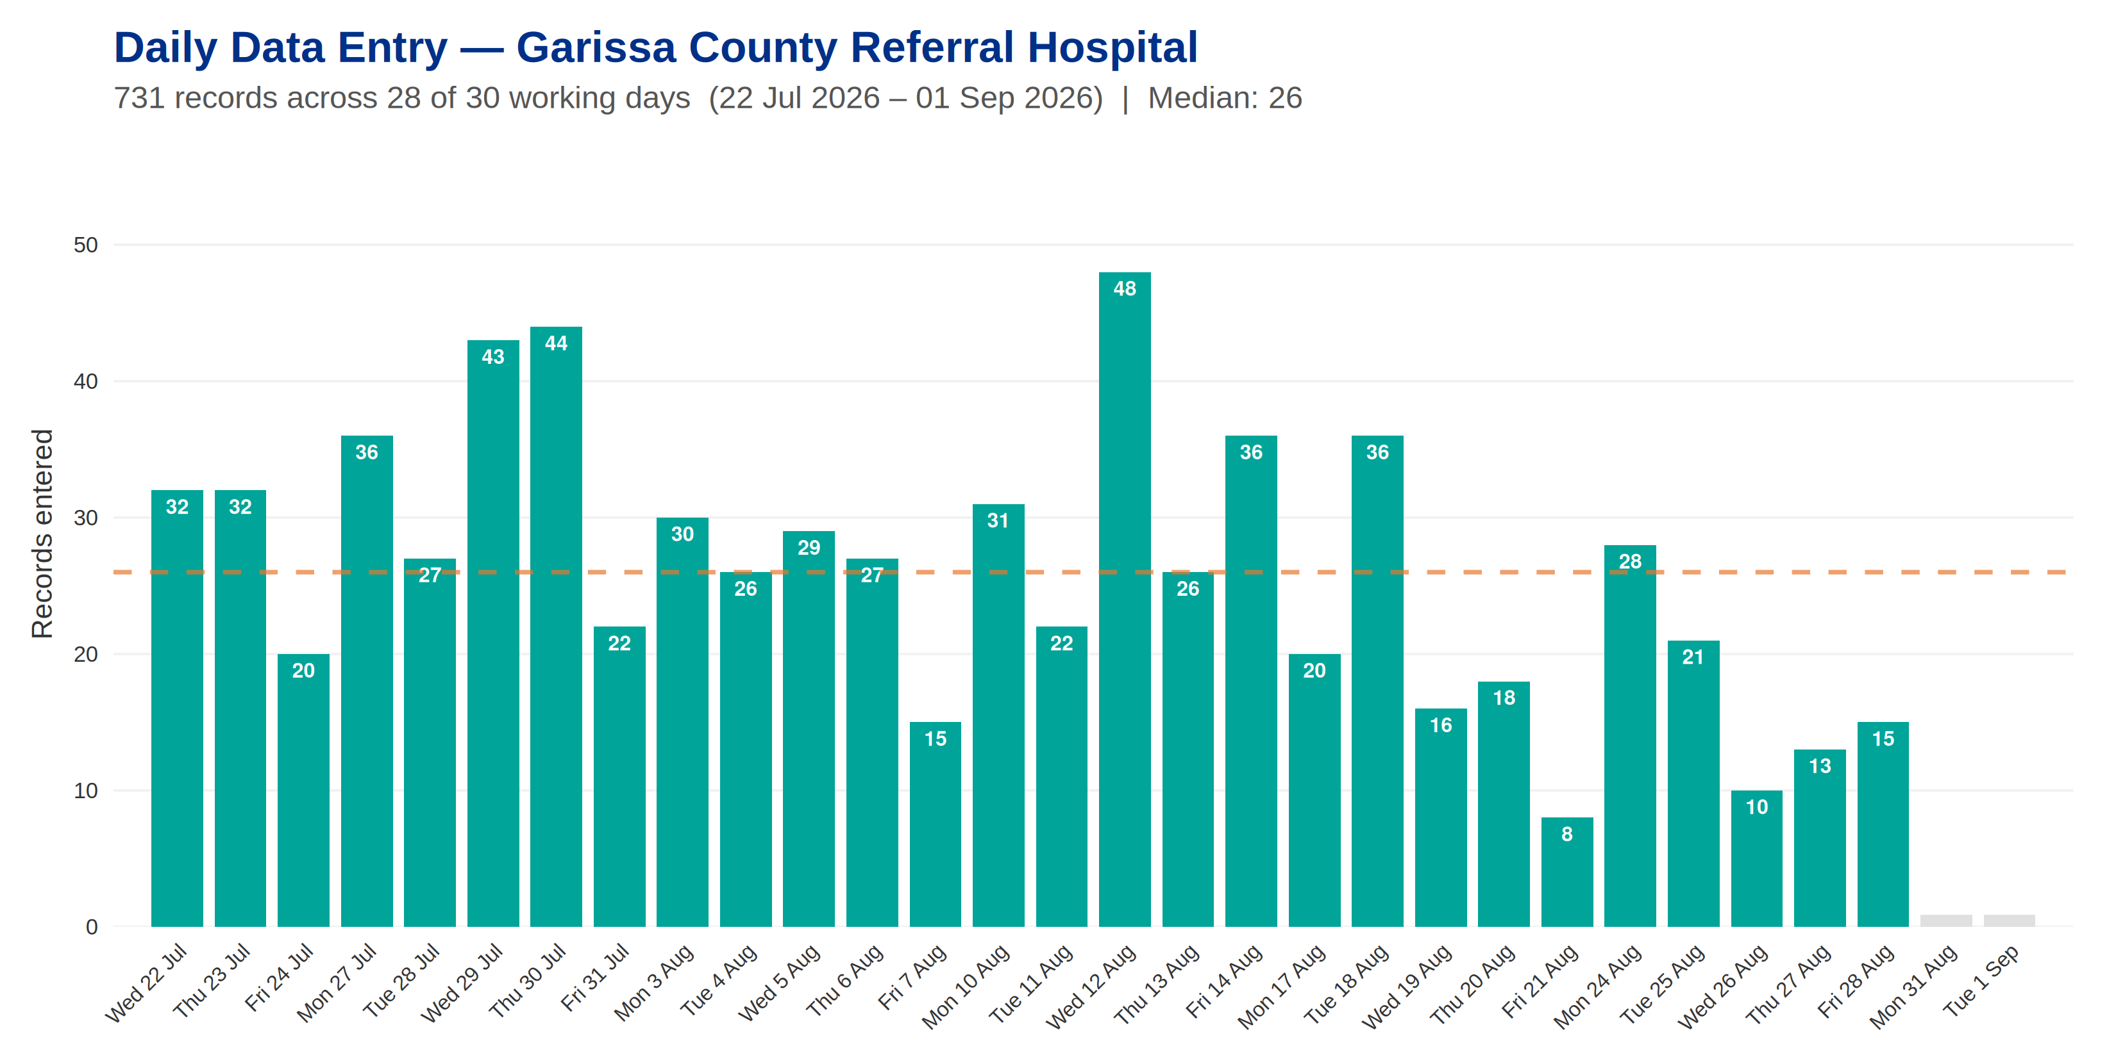
Garissa County Referral Hospital

Slide 6
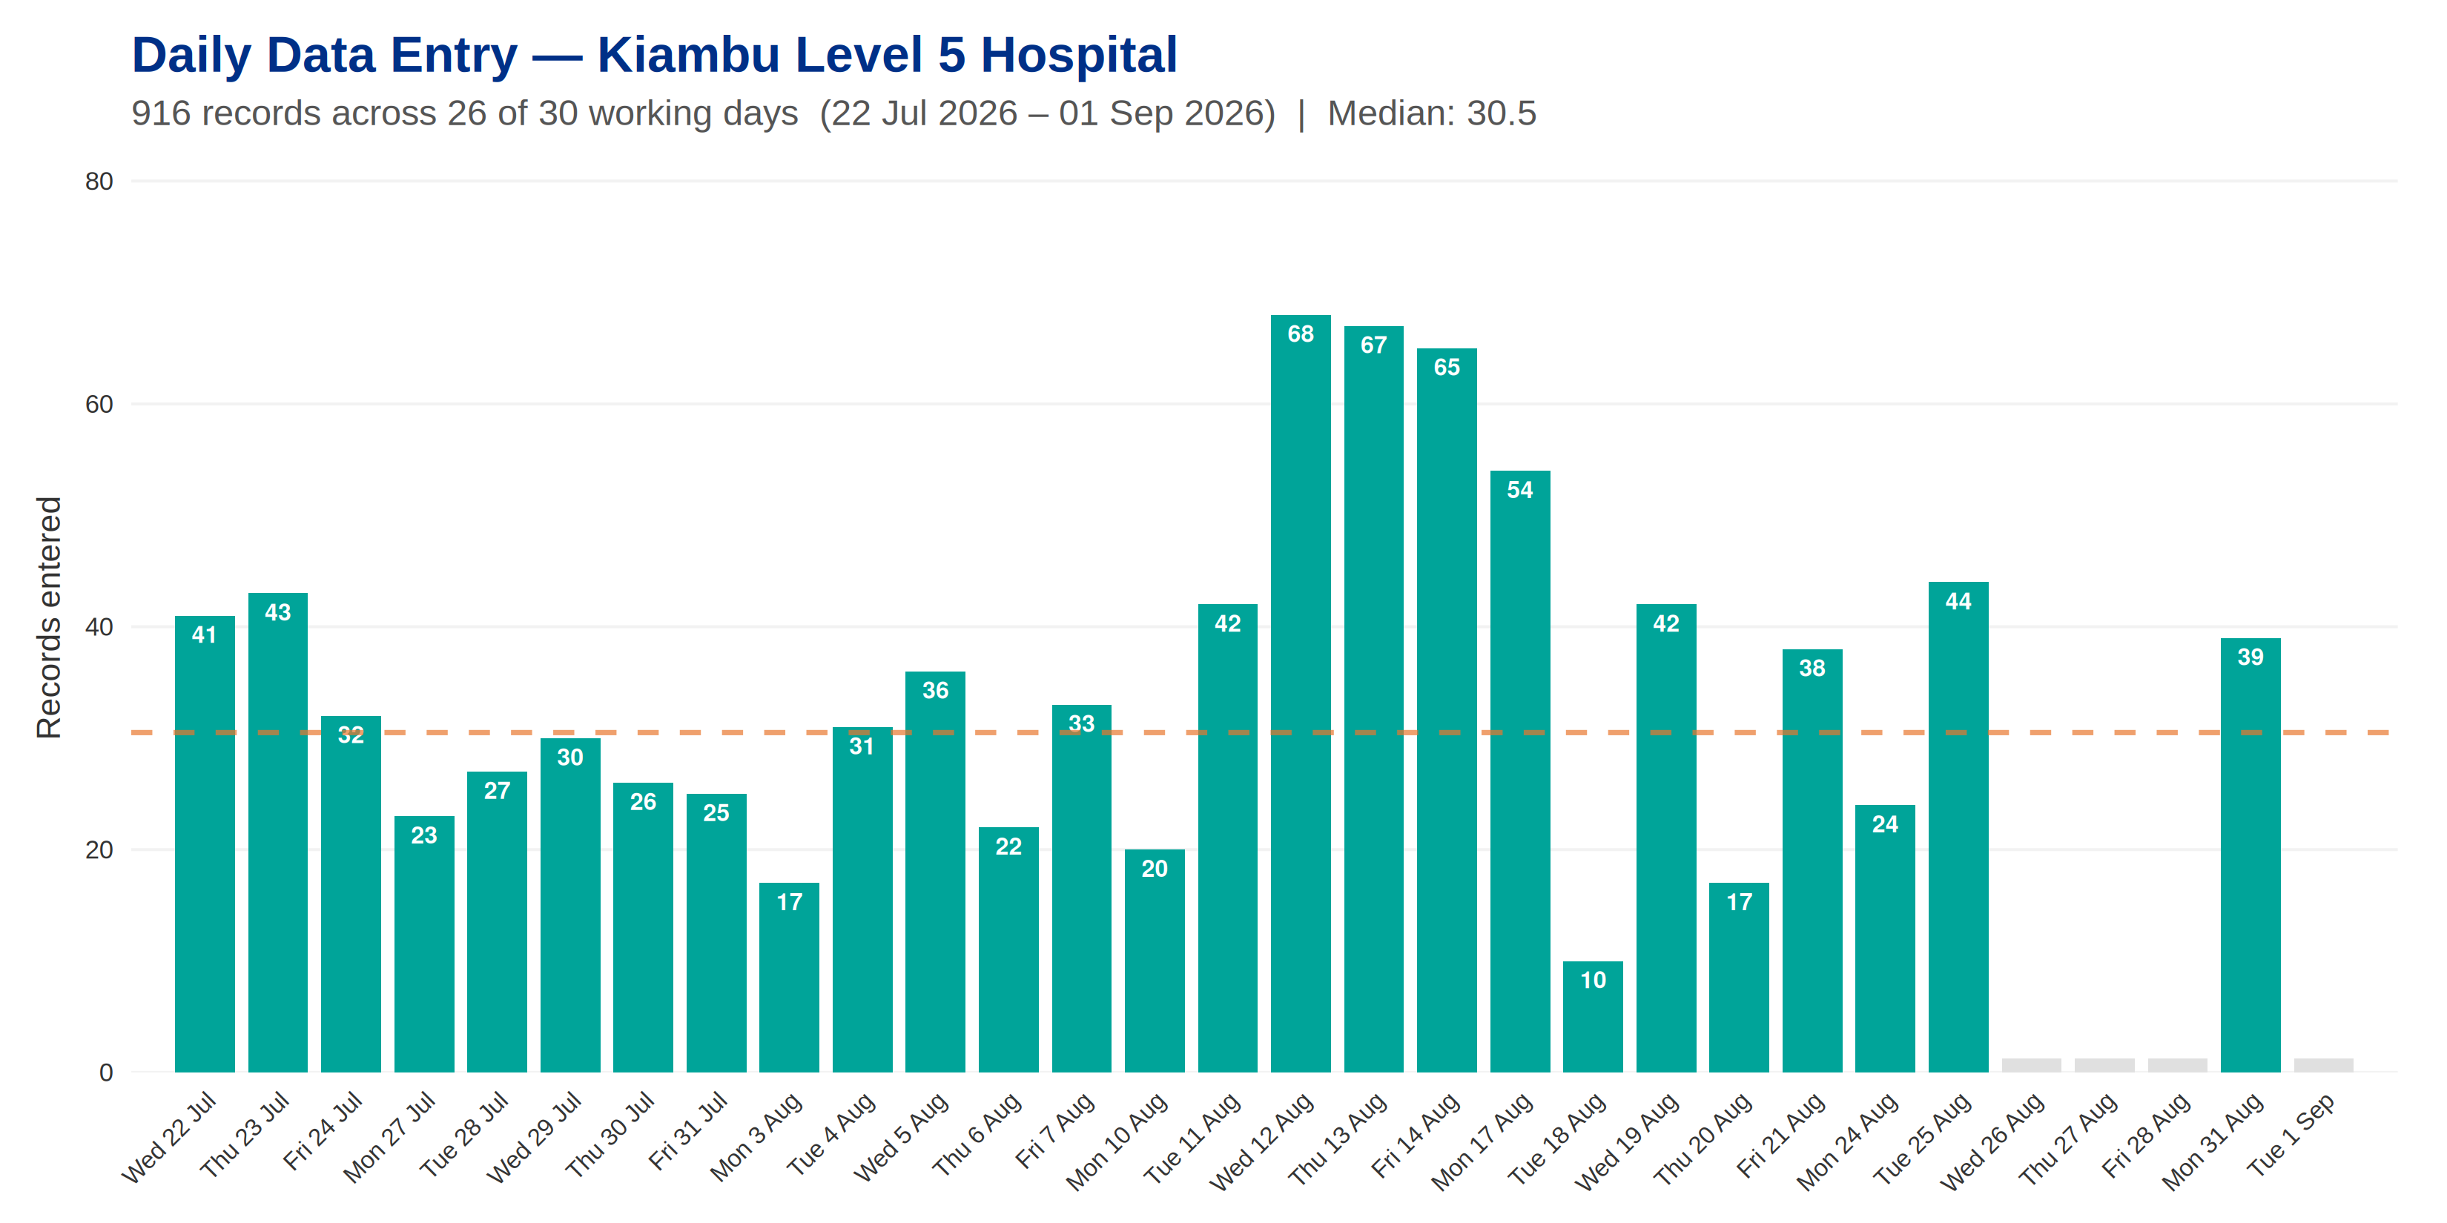
Kiambu Level 5 Hospital

Slide 7
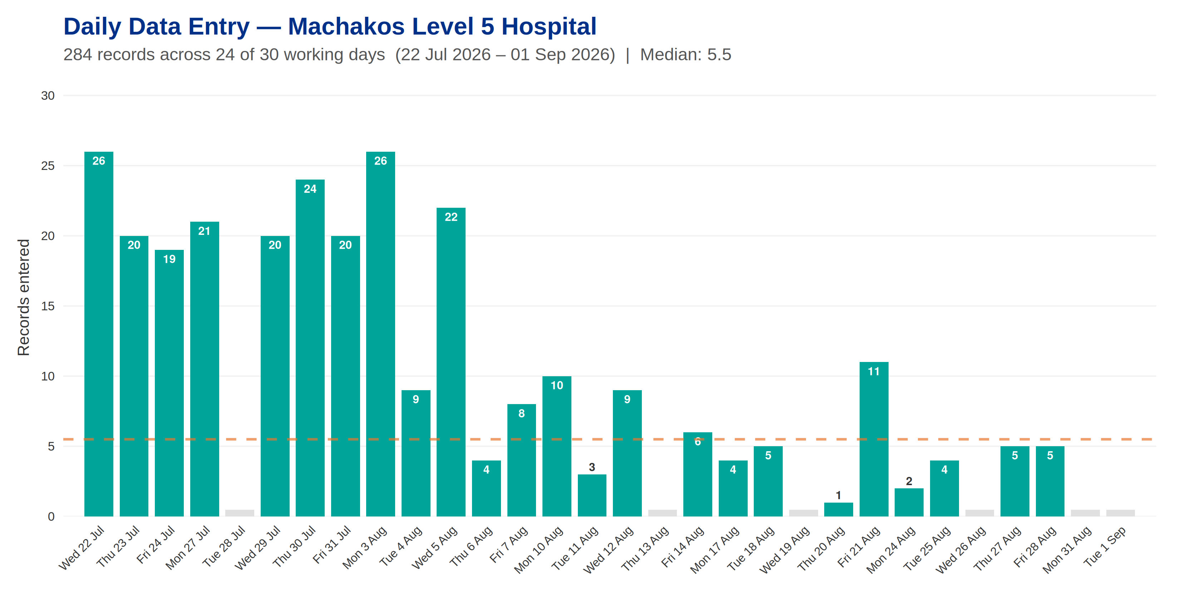
Machakos Level 5 Hospital

Slide 8
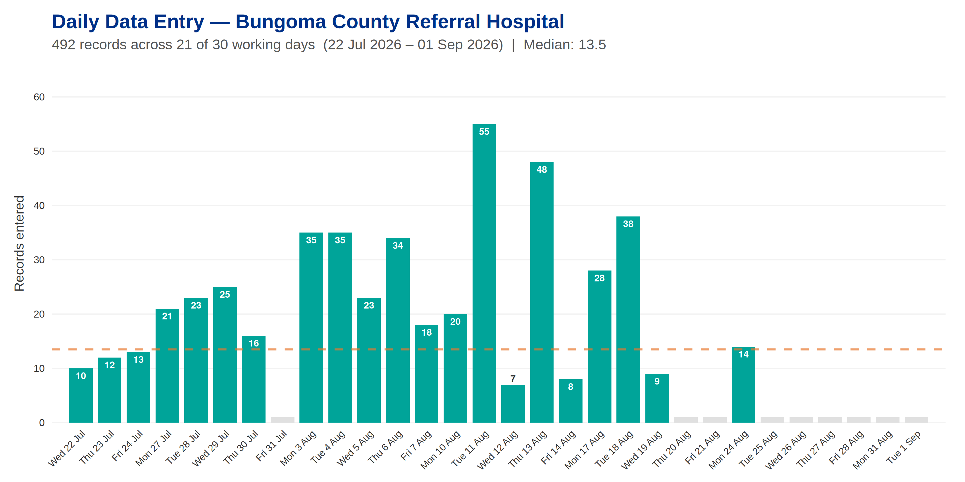
Bungoma County Referral Hospital

Slide 9
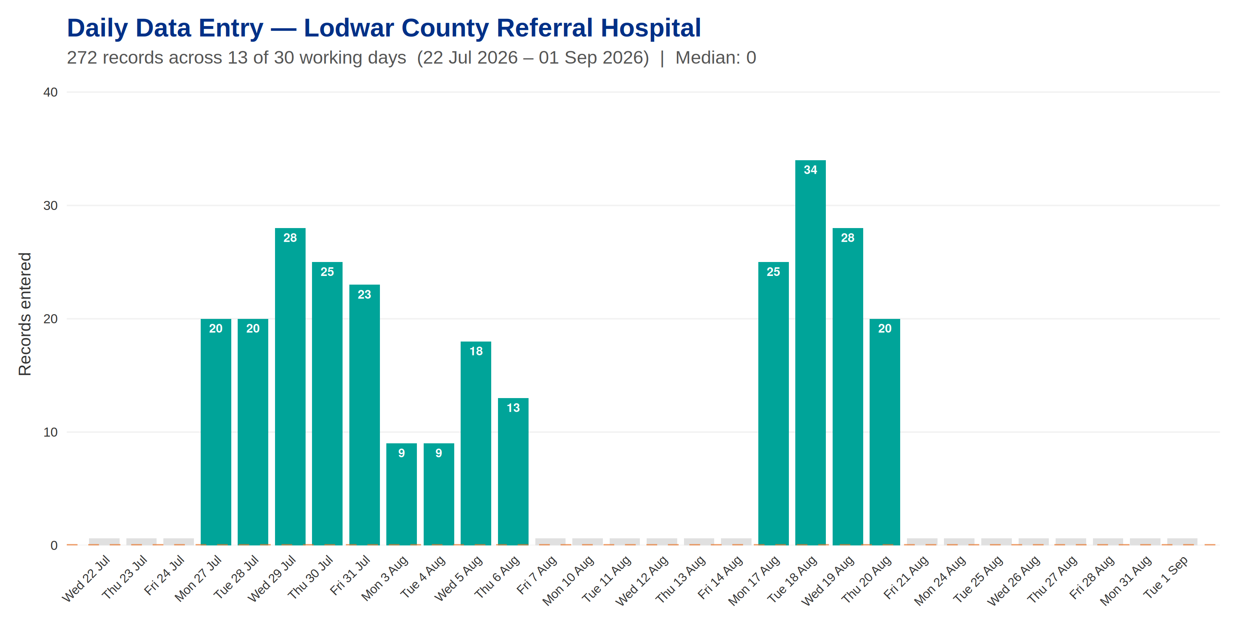
Lodwar County Referral Hospital

Slide 10
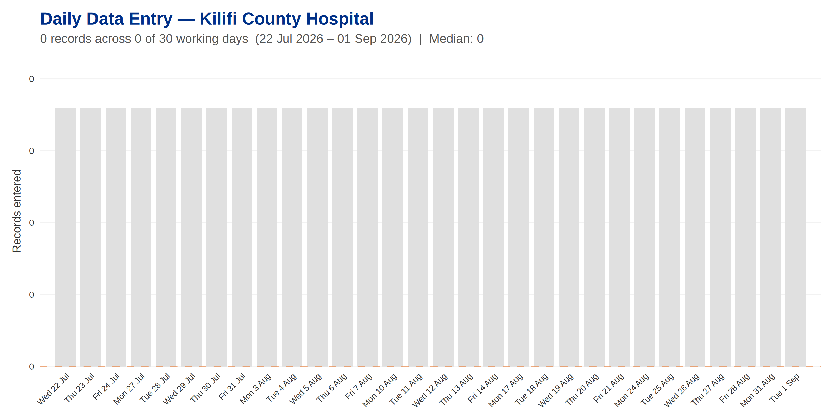
Kilifi County Hospital

