Slide 1
UX Design – Realisticity
Some improvements on bcre website can be relied upon UX Design on the search boxes.
UX can be increased by offer of more realisticity senses to users in the options’ choices.
Two things can be done on the search boxes:
1. combinations of search choices
2. real search choices themselves
Let see the bcec website search box first: P.T.O.

Slide 2
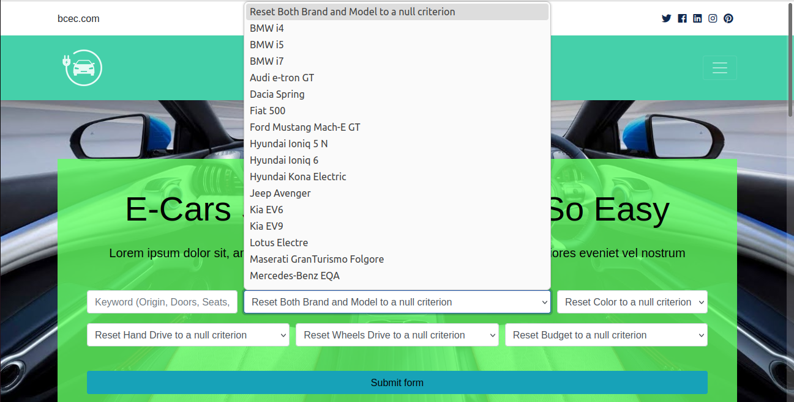
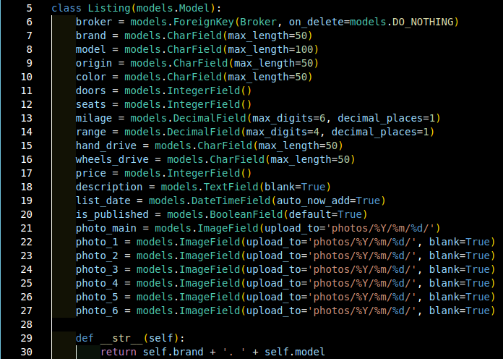
search boxes and search fields

Slide 3
Combinations of Search Choices / Fields
Some relatively major search fields / choices in this case such as brand and model need to be combined to restrict from unrealistic combinations to drive out users’ possible confusions in selecting options.

Slide 4
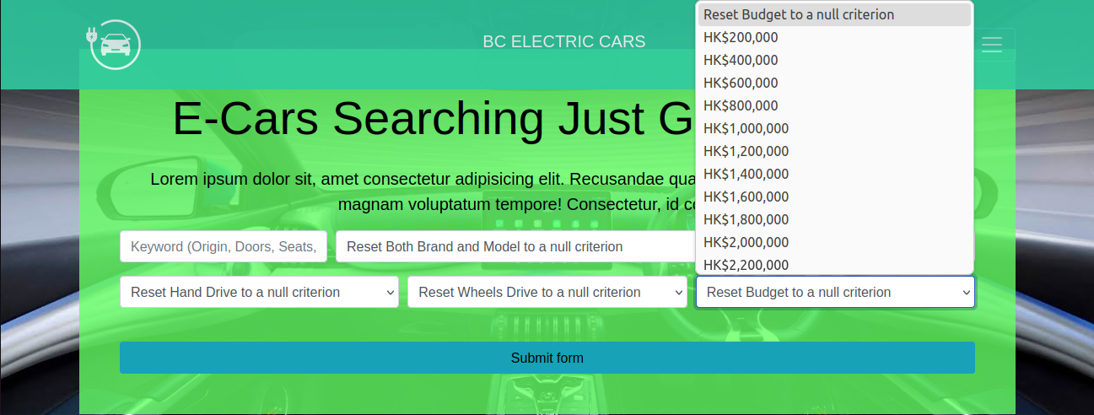
Combinations of Search Choices / Fields
Other relatively minor search fields / choices in this case such as color and budget can be individualized as freedom of preferences allowing for unrealistic combinations for example below a budget not a color available or accessible retaining user exploration joy.

Slide 5
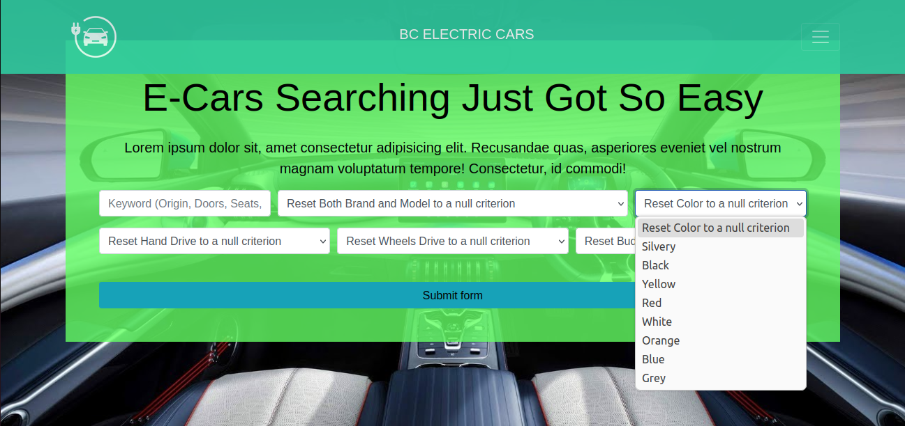
Real Search Choices of Fields
Real Search fields choices can be derived from db data reflecting true options for potential customers, increasing informative values of the website.

Slide 6
How can we achieve those ideals?
See my share of python / django coding tips, p.t.o.

