Slide 1
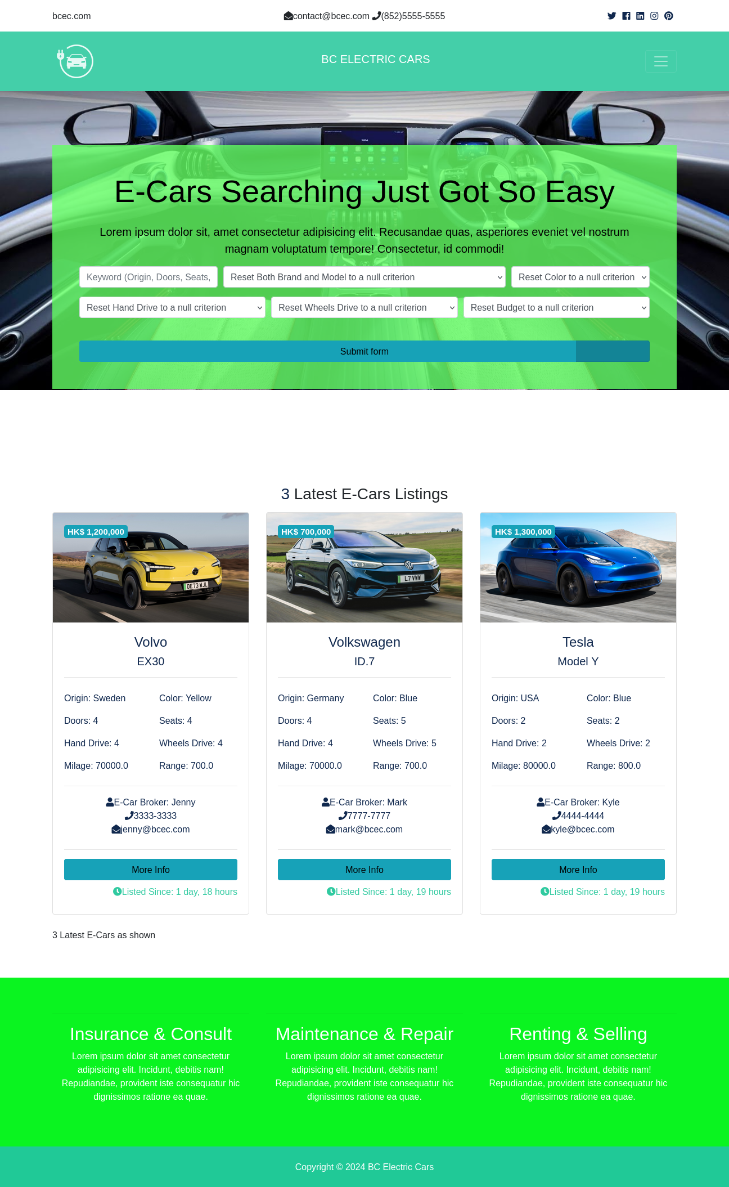
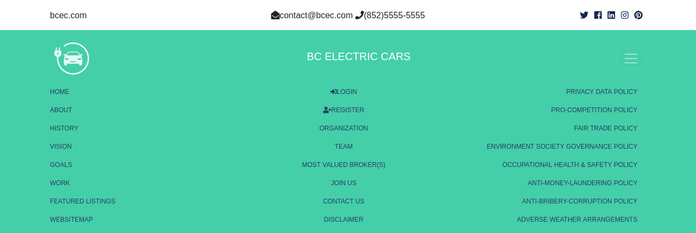
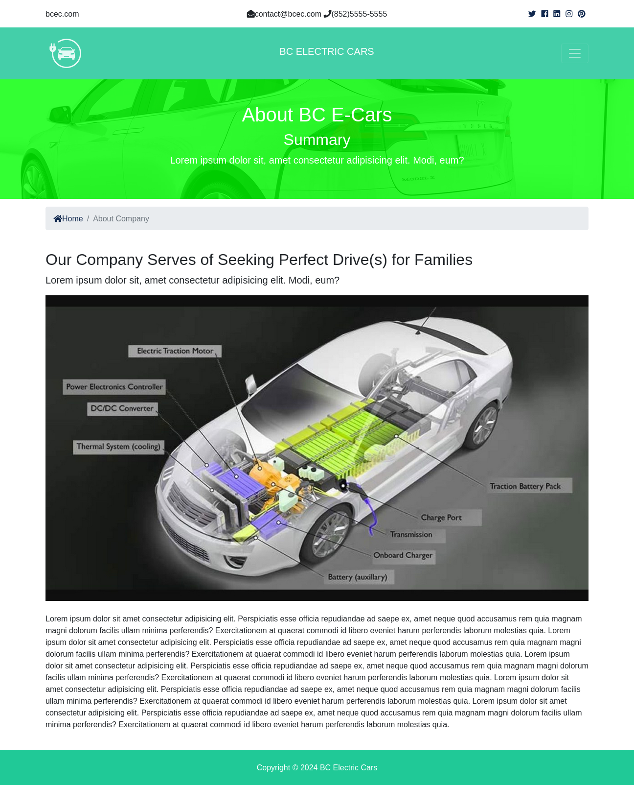
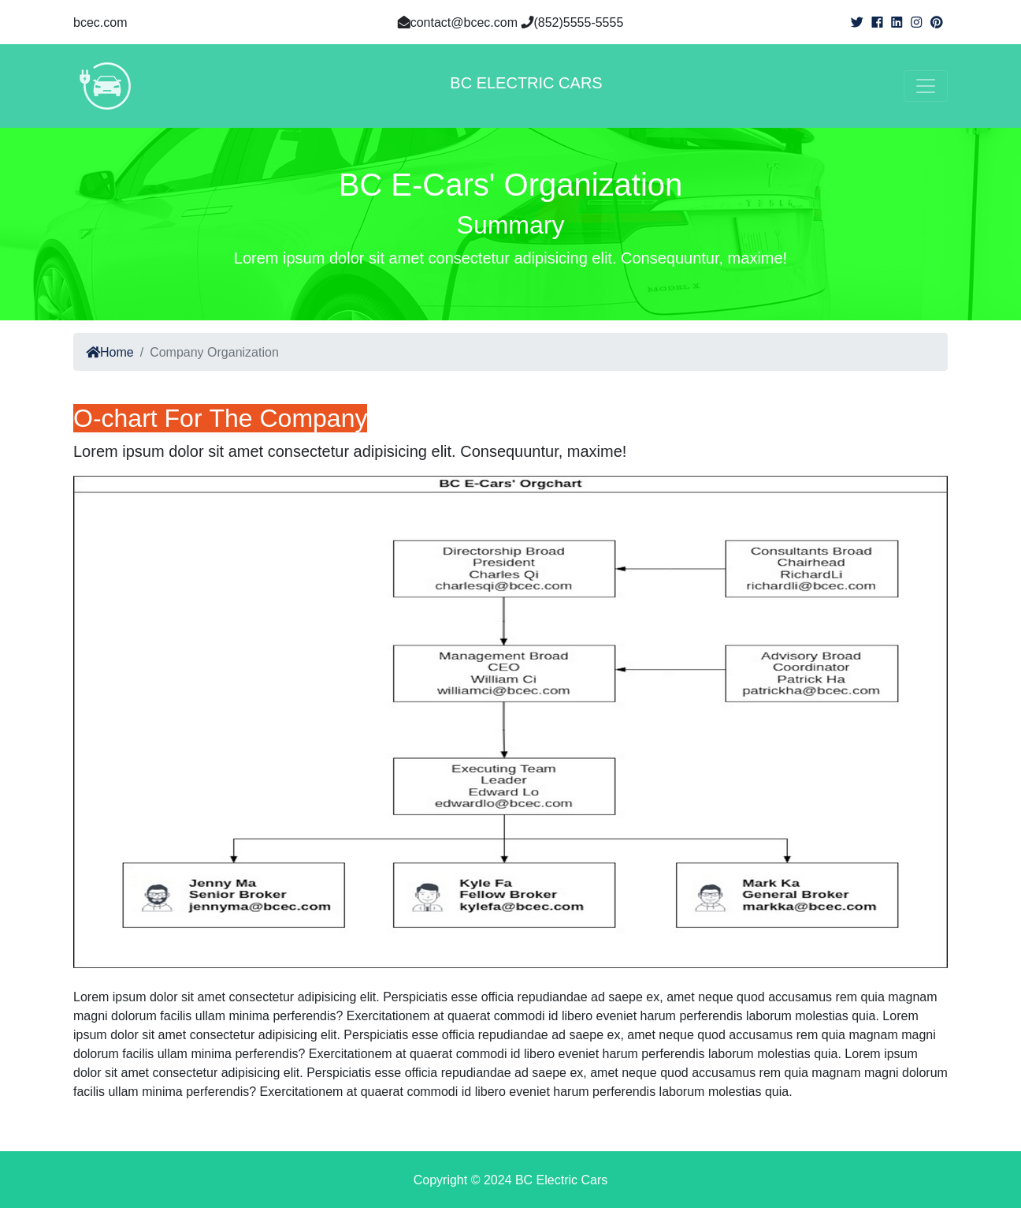
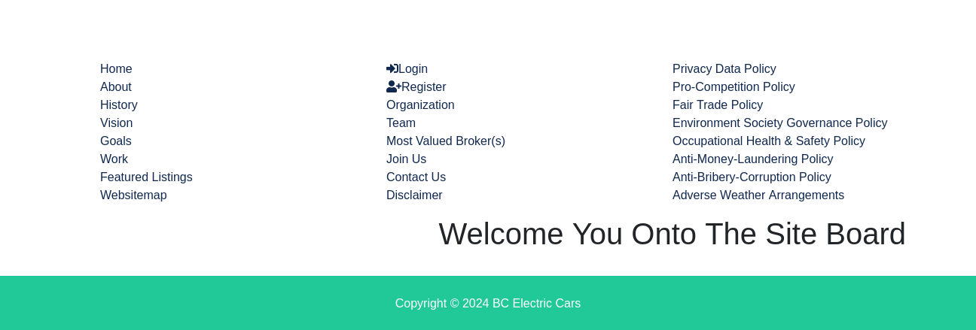
BC Electric Cars
Summary: Building upon design of given bcre.com, bcec.com for web of e-cars improved searching, enchanced listing, enlightened navbar menu, incorporated a websitemap, and included some more inform pages.
Project Creator: Frank, Mok Wai Tak Student 21 of HKCT Django Course the Fifth Class 17-Oct-2024

Slide 2
Limitations on Django
Web Application Framework itself not completely full-stacked with frontends of nondirect roundabout CRUDs, drillings thru’ html forms’ submit buttons back to an app’s views functions in where they being carried out.
Does imply itself not strong on all kinds of applications.

Slide 3
Analysis on bcre.com
Generic on products of very high price, very low volume mostly of uniqueness / singularity
Instances for products like jewelry, artefacts, artworks, paintings, timepieces, real estates, vehicles (vessels, aircrafts), plant and instrumentation
Transactions via top banks, good law firms offline c/w financial, insurantial and legal arrangements
A promotionally informative system online

Slide 4
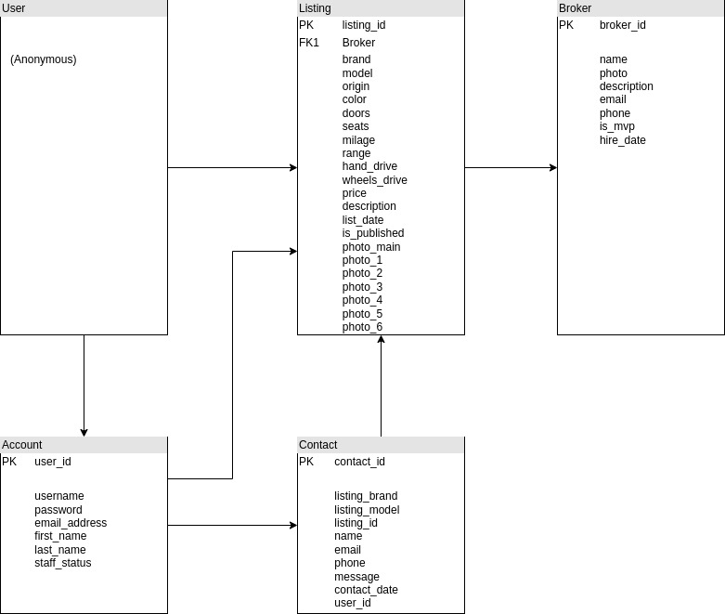
Different products, Different attributes

Slide 5
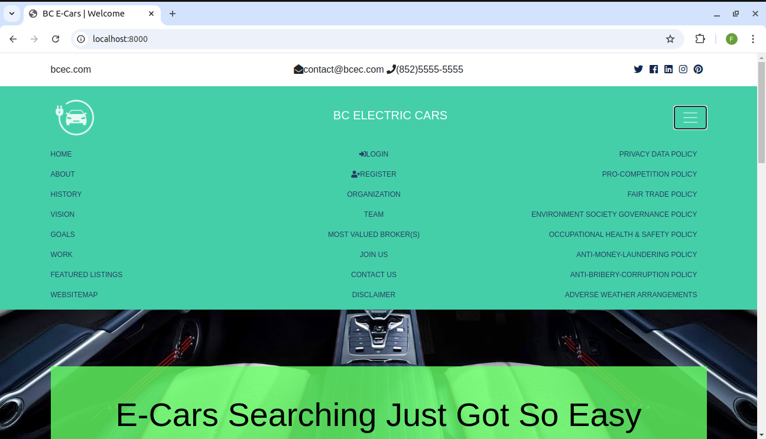
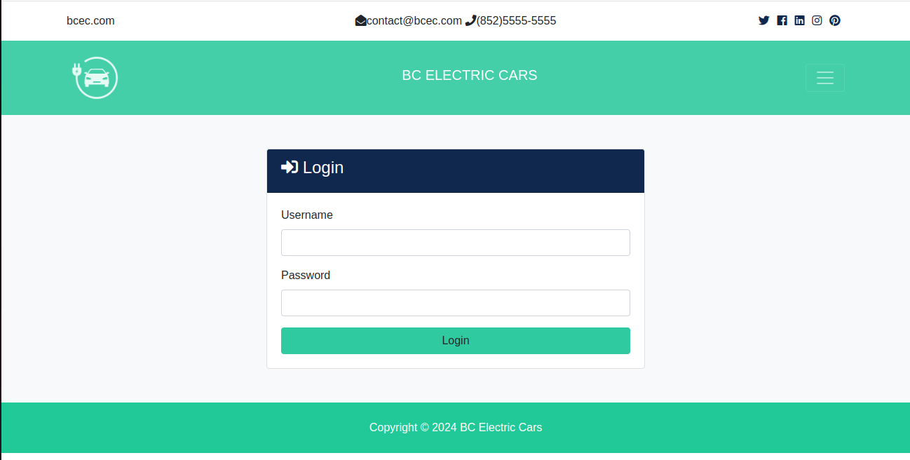
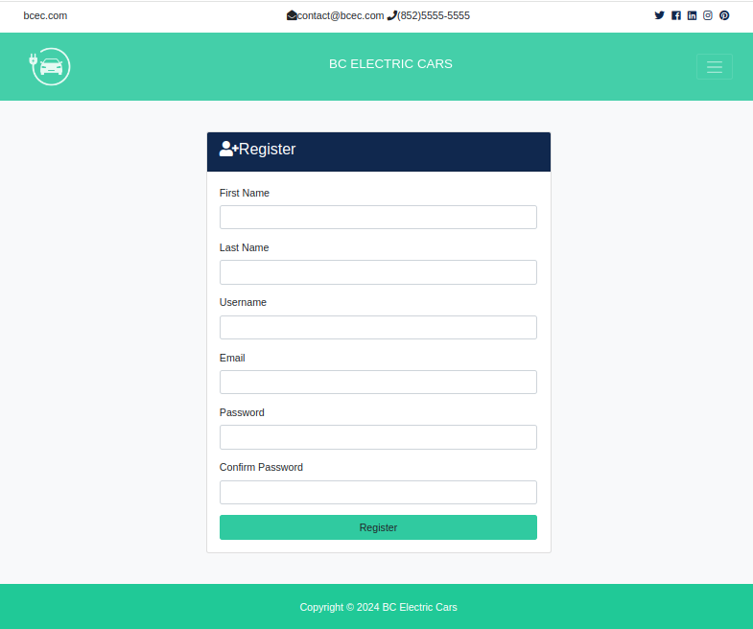
Enriched NavBar-Left/Center/Right Cols

Slide 6
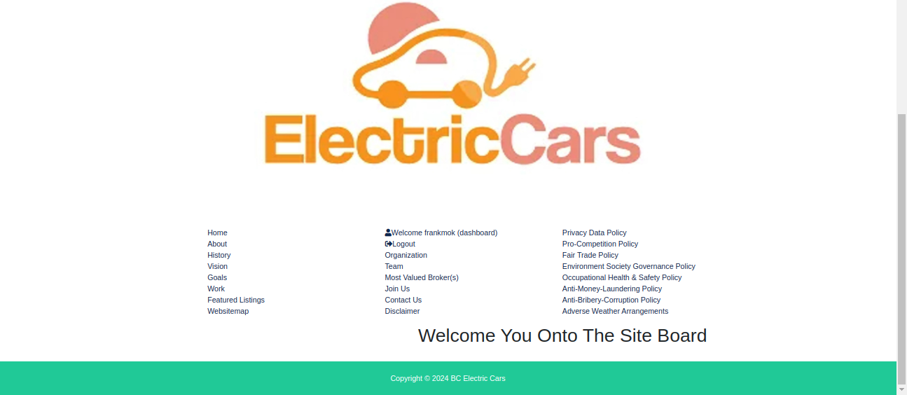

Newly WebSiteMap: logged-in/out differ

Slide 7
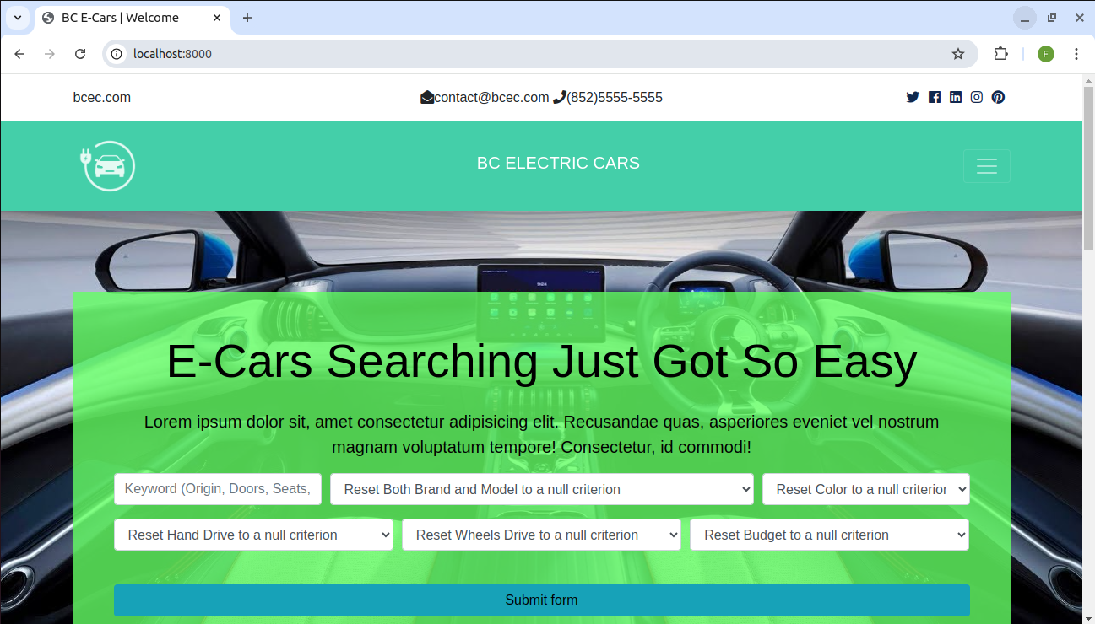
Enabled Reset Some Search Fields

Slide 8
UX Design – Realisticity in Search
Some improvements on bcre website can be relied upon UX Design on the search boxes.
UX can be increased by offer of more realisticity senses to users in the options’ choices.
Two things can be done on the search boxes:
1. combinations of search choices
2. real search choices softcoded
Let see the bcec website search box first: P.T.O.

Slide 9
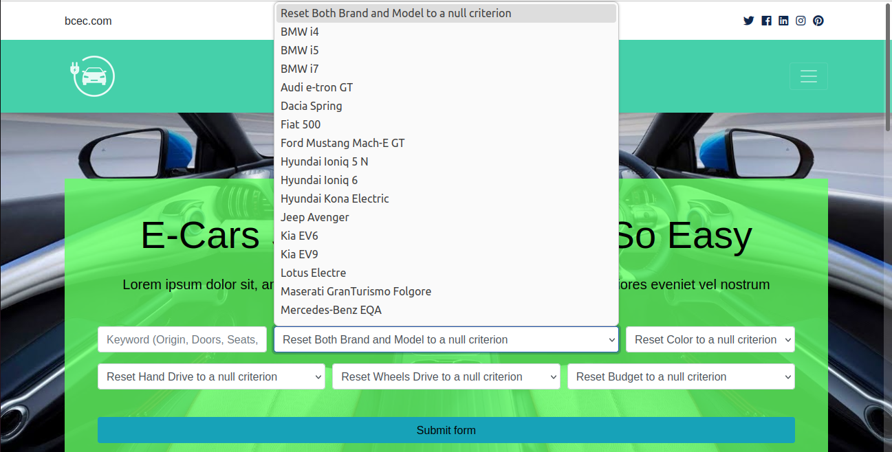
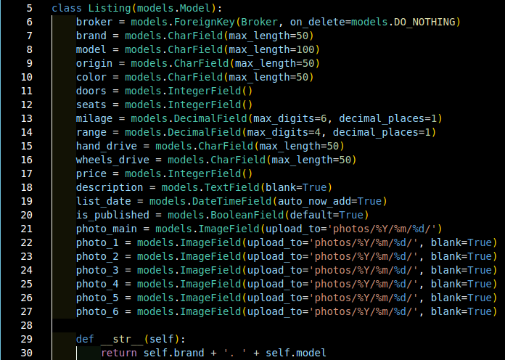
search boxes and search fields

Slide 10
Combinations of Search Choices / Combined Fields Searches
Some relatively major search choices in this case such as brand field and model field be combined to restrict from users’ unrealistic nonexistent combinations e.g. M.Benz i5 to exclude possible confusions in selecting options to keep up their own rigorous sense of majorness.

Slide 11
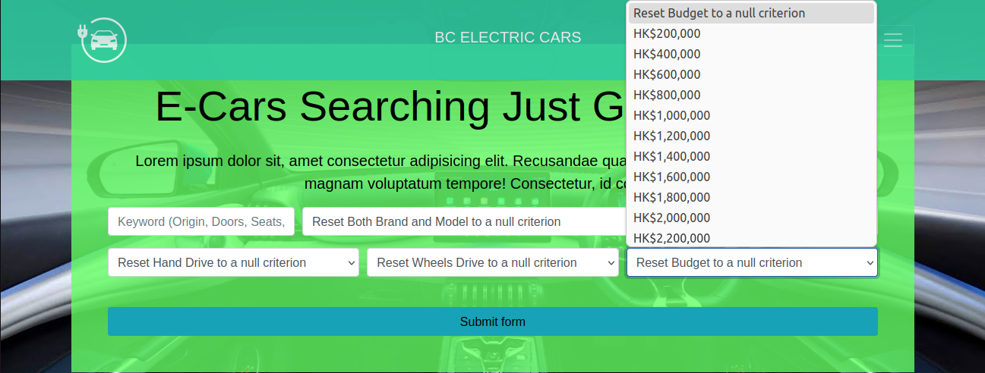
No Combinations of Search Choices / Individualized Field Searches
Other relatively minor search choices in this case such as color field and budget field be individualized as of users’ preferential freedom allowing for negative unsuccessful combinations e.g. below a budget not a color offered retaining users’ joy in course of explorations on searching for products, the e-cars.

Slide 12
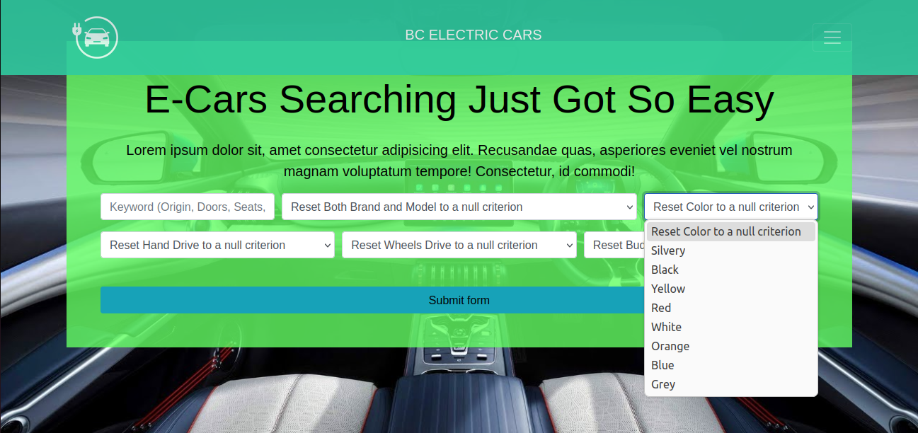
Field Searches’ Real Choices
Field searches’ real choices can be derived from database’s data existent reflecting true options for potential customers, increasing informative values for users in selections of products the e-cars.

Slide 13
How can we achieve?
See my share of python / django coding tips, p.t.o.

Slide 14
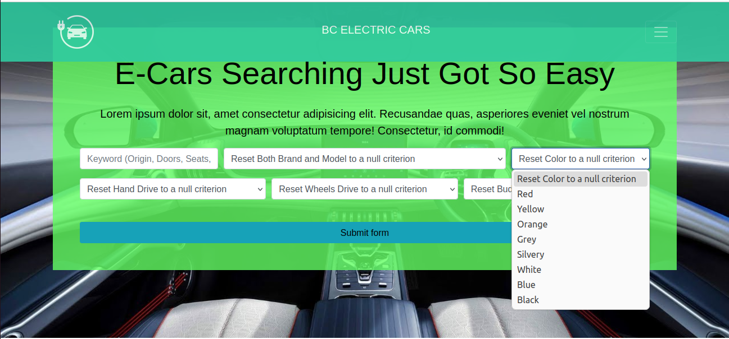
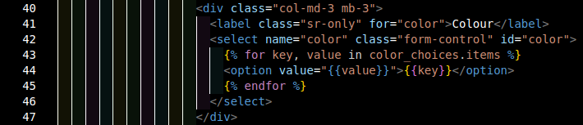
to share django / python coding tips: search field color
1: set of colors from db 2:dictionary 3:add reset null to dict head 4:options, dynamic from db

Slide 15
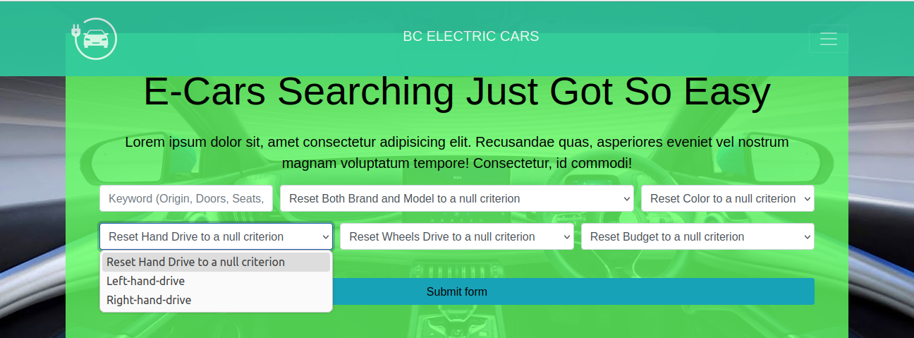
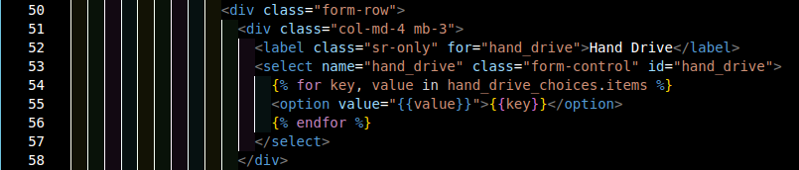
to share django / python coding tips: search field hand_drive
1: set of hand_drives from db 2:dictionary 3:add reset null to dict head 4:options, dynamic from db

Slide 16
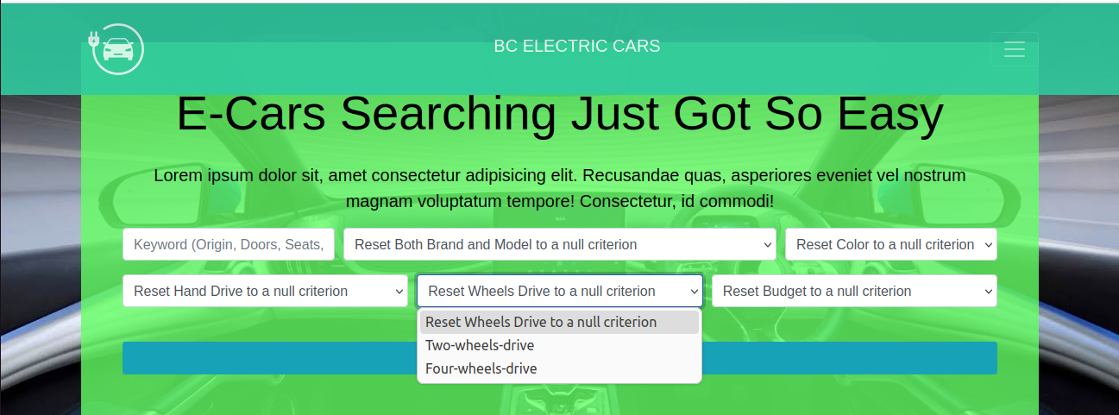
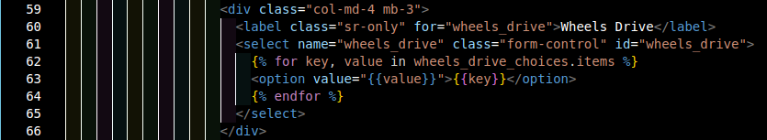
to share django / python coding tips: search field wheels_drive
1: set of wheels_drives from db 2:dictionary 3:add reset null to dict head 4:options, dynamic from db

Slide 17
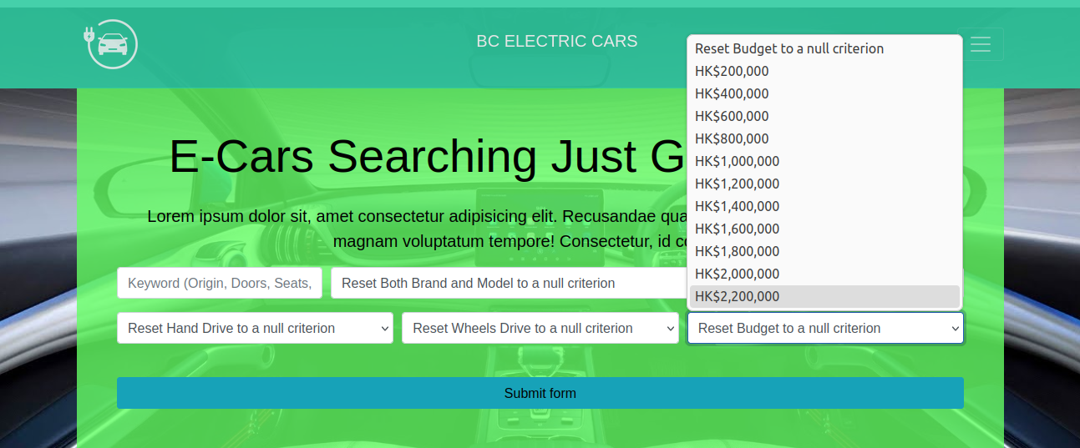

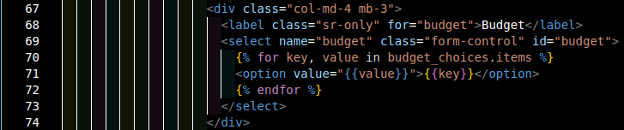
to share django / python coding tips: search field budget
1: max of set of prices from db 2:grade 3: grades of range() 4: dictionary 3:add reset null to dict head 4:options, dynamic from db

Slide 18
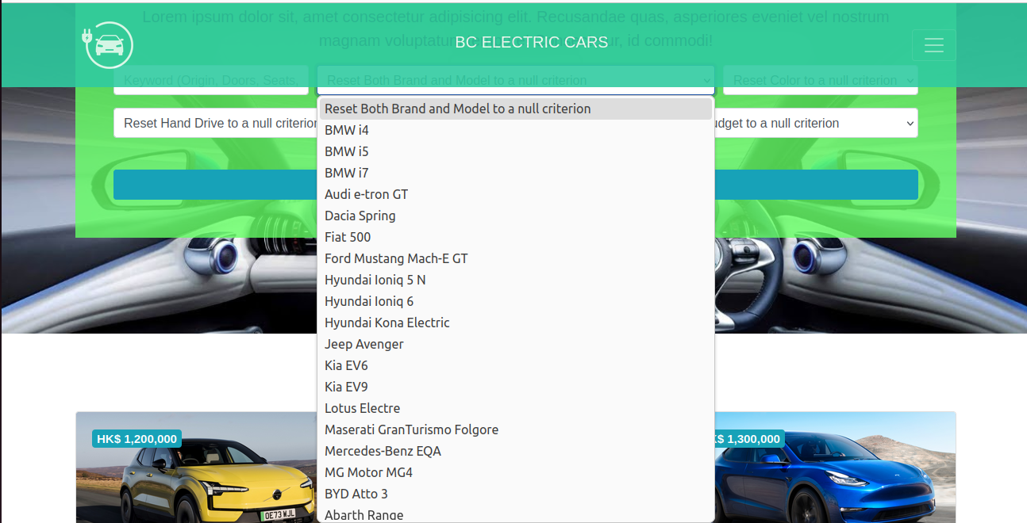
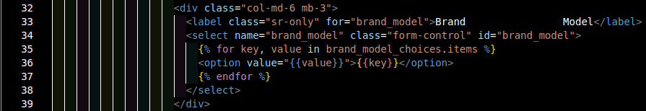
django / python coding tips: combination field brand & model
b
1:dictionary of brand+’ ‘+model : brand+’~’+model 2:add reset null to dict head 3:options, dynamic from db

Slide 19
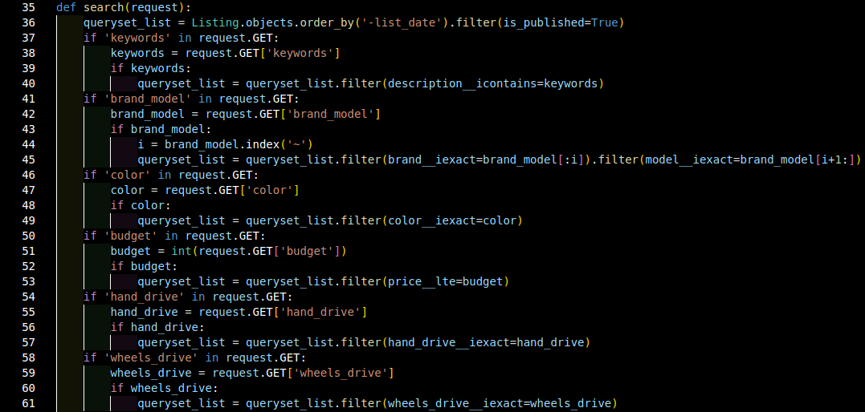
django / python coding tips: the search code
1.quest for search field key in json 2.read in search field value in json 3.screen out null criterion search passing wholly 4.search non-null criterion 5.pass to repeat till all search fields 6.for brand & model: double searches / filters in succession

Slide 20
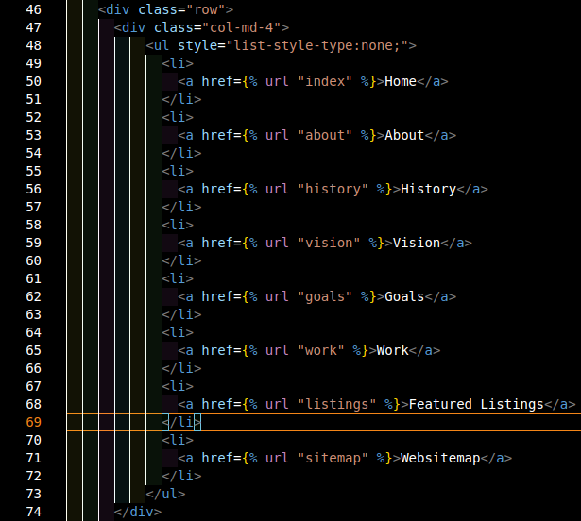
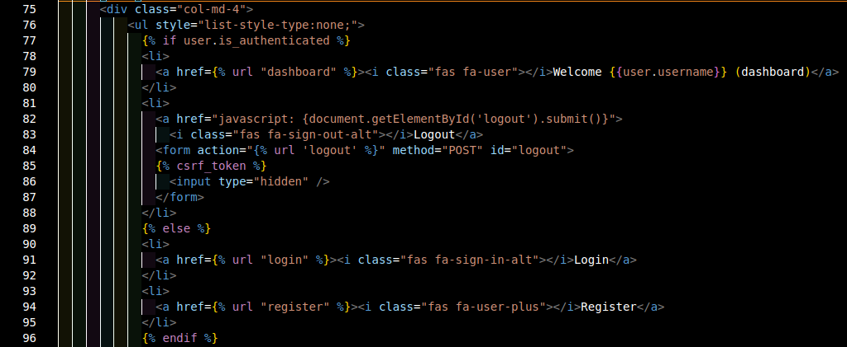
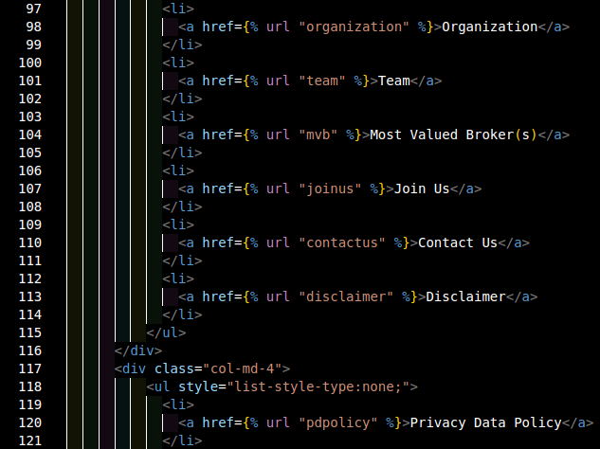
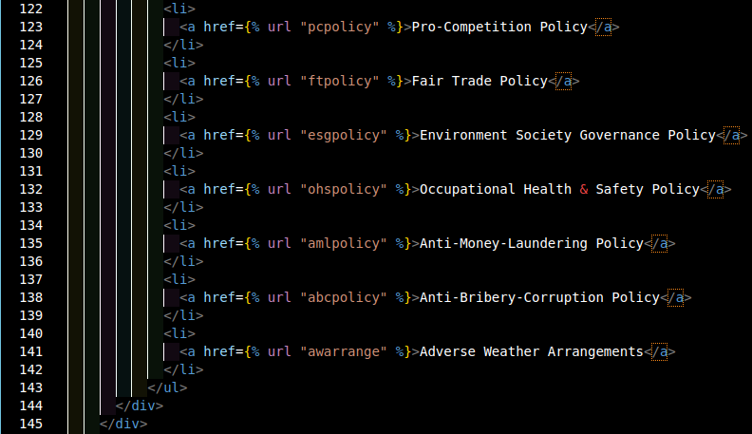
django / python coding tips: the websitemap code

Slide 21
Conclusion
Before conclusion, demo time of bece.com .
Finally, UX is an important niche of software design as ultimate users are human. It much increases the value of use, i.e. usability, of the software.
Thank you for your participation.
Thanksgiving to Wai Lung Sir.
Chance comes, meeting again.

