Slide 1
Design Patterns
Strategy Pattern
How to design for flexibility?
Strategy Pattern

Slide 2
References
Design Patterns: Elements of Reusable Object-Oriented Software By Gamma, Erich; Richard Helm, Ralph Johnson, and John Vlissides (1995). Addison-Wesley. ISBN 0-201-63361-2.
Head First Design Patterns By Eric Freeman, Elisabeth Freeman, Kathy Sierra, Bert Bates
First Edition October 2004
ISBN 10: 0-596-00712-4
Strategy Pattern

Slide 3
Existing Duck application
All ducks quack and swim. The superclass takes care of the implementation code
Duck
quack()
swim()
display()
//other duck-like methods…
The display() method is abstract, since all duck subtypes look different
Each duck subtype is responsible for implementing its own display() method
Other duck types inherit from the Duck class
. . .
MallardDuck
display() {
// looks like a mallard}
RedHeadDuck
display() {
// looks like a redhead }
Strategy Pattern

Slide 4
Inheritance
All subclasses inherit the superclass’ properties
  Variables and methods
See Strategy0 project
Strategy Pattern

Slide 5
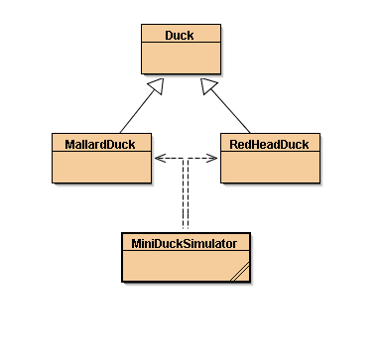
Inheritance UML
Strategy Pattern

Slide 6
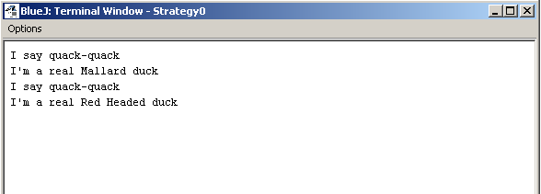
Testing Mallard, RedHeadDuck classes
Strategy Pattern

Slide 7
But Executives want to introduce fly capability quickly
How to do it in a short time, like 2 days?
Strategy Pattern

Slide 8
Solution #1
No sweat!
  Add a method fly() in Duck
  Continue to use inheritance
Strategy Pattern

Slide 9
Add a method fly() in Duck
Duck
quack()
swim()
display()
fly()
//other duck-like methods…
All subclasses inherit fly()
MallardDuck
display() {
// looks like a mallard}
RedHeadDuck
display() {
// looks like a redhead }
Strategy Pattern

Slide 10
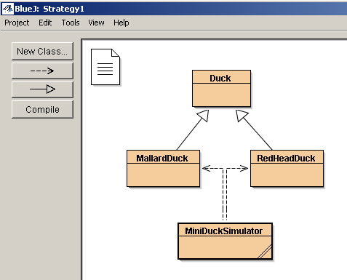
See Strategy1 class
Strategy Pattern

Slide 11
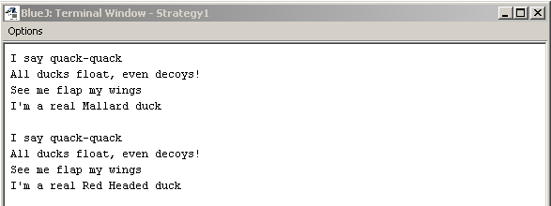
Executing Strategy1
Strategy Pattern

Slide 12
Everything OK?
Think harder.
Strategy Pattern

Slide 13
Something seriously wrong!
Duck
quack()
swim()
display()
fly()
//other duck-like methods…
All duck types now can fly including RubberDuck
RubberDuck
quack() {
// overridden to Squeak }
display() {
// looks like a rubberduck }
MallardDuck
display() {
// looks like a mallard}
ReadHeadDuck
display() {
// looks like a redhead }
Strategy Pattern

Slide 14
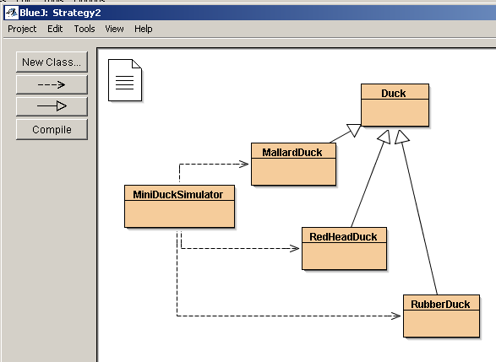
Add an instance of RubberDuck
Strategy Pattern

Slide 15
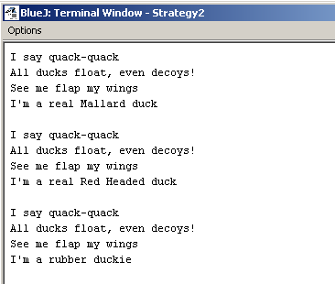
Executing Strategy2 … What?
Strategy Pattern

Slide 16
Root cause?
Applying inheritance to achieve re-use
Poor solution for maintenance
Strategy Pattern

Slide 17
How do we fix this?
Using inheritance as before
  Override the fly() method in rubber duck as in quack()
Will it fix the problem?
  See Strategy3
Strategy Pattern

Slide 18
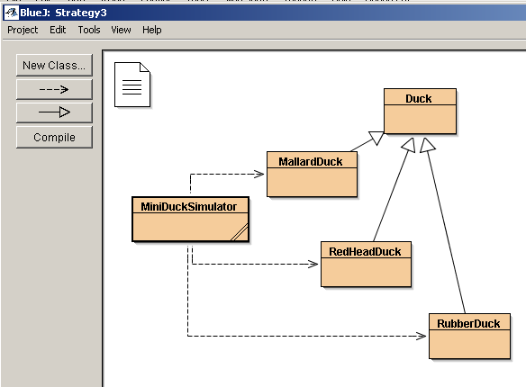
Strategy3
Strategy Pattern

Slide 19
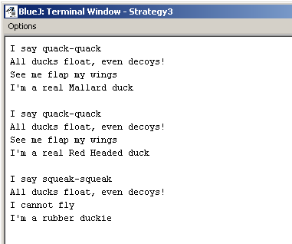
Executing Strategy3
Strategy Pattern

Slide 20
Is the problem solved?
Any new problems?
Strategy Pattern

Slide 21
Wait a minute
How about new duck types?
  Decoy duck?
    Can’t quack
    Can’t fly
How do we solve it?
Strategy Pattern

Slide 22
Summary
What have we done so far?
What problems have we solved?
What problems have we introduced in solving the problems?
Is there a better way of doing things?
Strategy Pattern

Slide 23
How about Interface?
Take the fly() method out of Duck superclass
And make a Flyable() interface
  Only those ducks that fly are required to implement the interface
Make a Quackable interface too
Strategy Pattern

Slide 24
interface Flyable
fly()
Interface Quackable
quack()
class Duck
swim()
display()
//other duck-like methods…
MallardDuck
display()
fly()
quack()
RedHeadDuck
display()
fly()
quack()
RubberDuck
display() {
quack()
Strategy Pattern

Slide 25
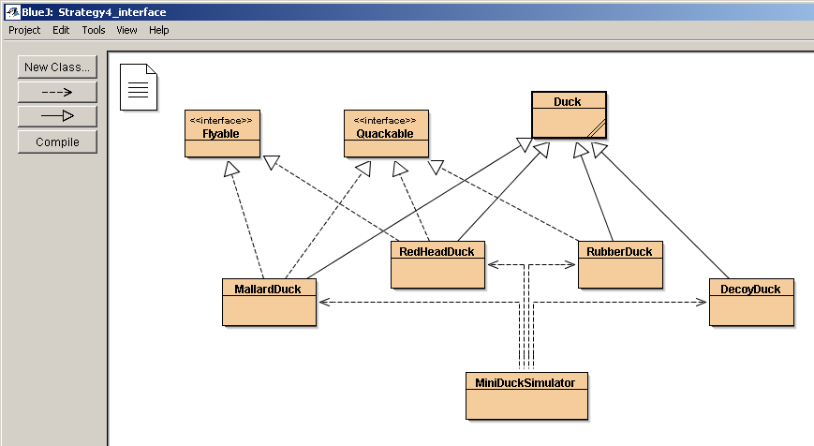
How about this Strategy4_interface solution?
Strategy Pattern

Slide 26
But
You shoot yourself in the foot by duplicating code for every duck type that can fly and quack!
And we have a lot of duck types
We have to be careful about the properties – we cannot just call the methods blindly
We have created a maintenance nightmare!
Strategy Pattern

Slide 27
Re-thinking:
Inheritance has not worked well because
  Duck behavior keeps changing
  Not suitable for all subclasses to have those properties
Interface was at first promising, but
  No code re-use
  Tedious
    Every time a behavior is changed, you must track down and change it in all the subclasses where it is defined
  Error prone
Strategy Pattern

Slide 28
#1 Design Principle
Identify the aspects of your application that vary and separate them from what stays the same
So what are variable in the Duck class?
  Flying behavior
  Quacking behavior
Pull these duck behaviors out of the Duck class
  Create new classes for these behaviors
Strategy Pattern

Slide 29
How do we design the classes to implement the fly and quack behaviors?
Goal: to keep things flexible
Want to assign behaviors to instances of Duck
  Instantiate a new MallardDuck instance
  Initialize it with a specific type of flying
  Be able to change the behavior dynamically
Strategy Pattern

Slide 30
#2 Design Principle
Program to a supertype, not an implementation
Use a supertype to represent each behavior
  FlyBehavior and QuackBehavior
  Each implementation of a behavior will implement one of these supertypes
In the past, we rely on an implementation
  In superclass Duck, or
  A specialized implementation in the subclass
Now: Duck subclass will use a behavior represented in a supertype.
Strategy Pattern

Slide 31
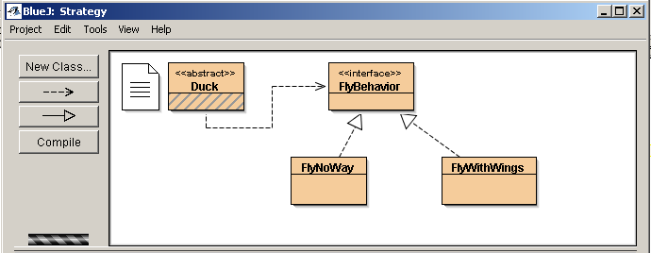
Strategy Pattern

Slide 32
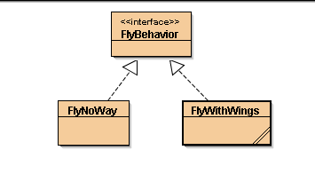
Strategy Pattern

Slide 33
3 classes in code
public interface FlyBehavior {
public void fly();
}
---------------------------------------------------------------------------------------------------------
public class FlyWithWings implements FlyBehavior {
public void fly() {
System.out.println("I'm flying!!");
}
}
---------------------------------------------------------------------------------------------------------
public class FlyNoWay implements FlyBehavior {
public void fly() {
System.out.println("I can't fly");
}
}
Strategy Pattern

Slide 34
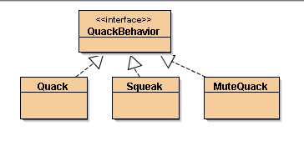
public interface QuackBehavior {
public void quack();
}
Strategy Pattern

Slide 35
Specific behaviors by implementing interface QuackBehavior
public class Quack implements QuackBehavior {
public void quack() {
System.out.println("Quack");
}
}
----------------------------------------------------------------------------
public class Squeak implements QuackBehavior {
public void quack() {
System.out.println("Squeak");
}
}
-----------------------------------------------------------------------------
public class MuteQuack implements QuackBehavior {
public void quack() {
System.out.println("<< Silence >>");
}
}
Strategy Pattern

Slide 36
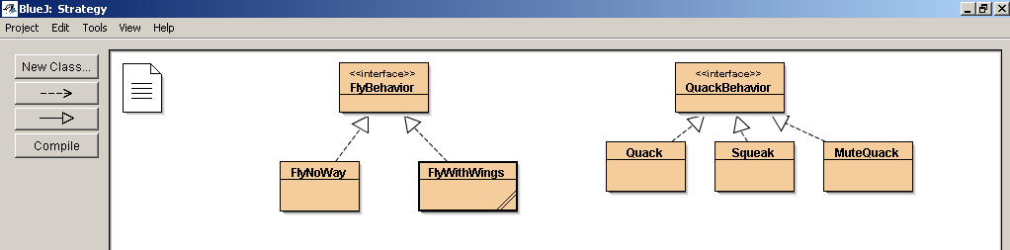
Strategy Pattern

Slide 37
Program to a Supertype
“Program to a Supertype” means:
  Exploit polymorphism by programming to a supertype
  The actual runtime object isn’t locked into the code
  The declared type of the variable should be a supertype, usually an abstract class or interface
  Objects assigned to those variables can be of any concrete implementations of the supertype
  The class declaring them need not know about the actual object type
Strategy Pattern

Slide 38
Integrating the Duck Behavior
Add 2 instance variables:
Behavior variables are declared as the behavior SUPERTYPE
Duck
FlyBehavior flyBehavior
QuackBehavior quackBehavior
performQuack()
Swim()
Display()
performFly()
//OTHER duck-like methods
Instance variables hold a reference to a specific behavior at runtime
These general methods replace fly() and quack()
Strategy Pattern

Slide 39
2. Implement performQuack()
public abstract class Duck {
// Declare two reference variables for the behavior interface types
FlyBehavior flyBehavior;
QuackBehavior quackBehavior; // All duck subclasses inherit these
// etc
public Duck() {
}
public void performQuack() {
quackBehavior.quack(); // Delegate to the behavior class
}
Strategy Pattern

Slide 40
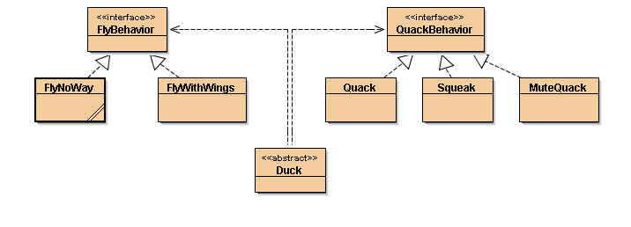
Strategy Pattern

Slide 41
3. How to set the quackBehavior variable & flyBehavior variable
public class MallardDuck extends Duck {
public MallardDuck() {
quackBehavior = new Quack();
// A MallardDuck uses the Quack class to handle its quack,
// so when performQuack is called, the responsibility for the quack
// is delegated to the Quack object and we get a real quack
flyBehavior = new FlyWithWings();
// And it uses flyWithWings as its flyBehavior type
}
public void display() {
System.out.println("I'm a real Mallard duck");
}
Strategy Pattern

Slide 42
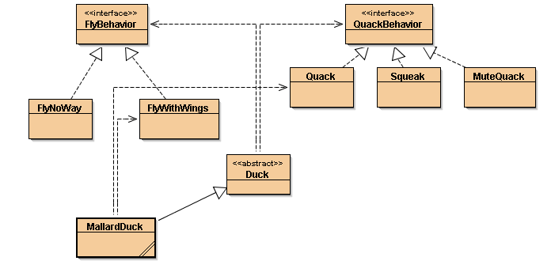
Strategy Pattern

Slide 43
Testing the Duck code
Type and compile:
Duck class and the MallardDuck class
FlyBehavior interface and the two behavior implementation classes (FlyWithwings.java and flyNoWay.java)
QuackBehavior interface and 3 behavior implementation classes
Test class (MiniDuckSimulator.java)
Strategy Pattern

Slide 44
// 1. Duck class
public abstract class Duck {
// Reference variables for the behavior interface types
FlyBehavior flyBehavior;
QuackBehavior quackBehavior; // All duck subclasses inherit these
public Duck() {
}
abstract void display();
public void performFly() {
flyBehavior.fly(); // Delegate to the behavior class
}
public void performQuack() {
quackBehavior.quack(); // Delegate to the behavior class
}
public void swim() {
System.out.println("All ducks float, even decoys!");
}
Strategy Pattern

Slide 45
2. FlyBehavior and two behavior implementation classes
public interface FlyBehavior {
public void fly();
}
---------------------------------------------------------------------------------------------------------
public class FlyWithWings implements FlyBehavior {
public void fly() {
System.out.println("I'm flying!!");
}
}
---------------------------------------------------------------------------------------------------------
public class FlyNoWay implements FlyBehavior {
public void fly() {
System.out.println("I can't fly");
}
}
Strategy Pattern

Slide 46
// 3. QuackBehavior interface and 3 behavior implementation classes
public interface QuackBehavior {
public void quack();
}
----------------------------------------------------------------------------------------------------
public class Quack implements QuackBehavior {
public void quack() {
System.out.println("Quack");
}
}
---------------------------------------------------------------------------------------------------
public class Squeak implements QuackBehavior {
public void quack() {
System.out.println("Squeak");
}
}
---------------------------------------------------------------------------------------------------
public class MuteQuack implements QuackBehavior {
public void quack() {
System.out.println("<< Silence >>");
}
}
Strategy Pattern

Slide 47
4. Type and compile the test class (MiniDuckSimulator.java)
public class MiniDuckSimulator {
public static void main(String[] args) {
Duck mallard = new MallardDuck();
mallard.performQuack();
// This calls the MallardDuck's inherited performQuack() method,
// which then delegates to the object's QuackBehavior
// (i.e. calls quack() on the duck's inherited quackBehavior
// reference)
mallard.performFly();
// Then we do the same thing with MallardDuck's inherited
// performFly() method.
}
}
Strategy Pattern

Slide 48
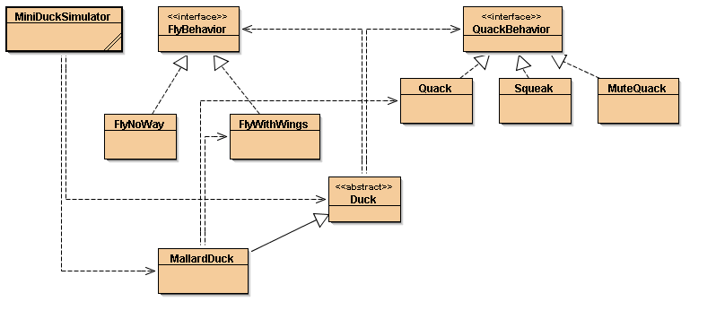
Strategy project
Strategy Pattern

Slide 49
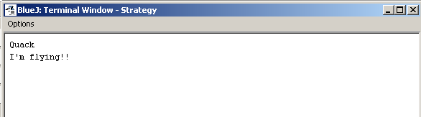
Run MiniDuckSimulator
Strategy Pattern

Slide 50
Check-in
We have built dynamic behavior in ducks e.g. a MallardDuck
  The dynamic behavior is instantiated in the duck’s constructor
How can we change the duck’s behavior after instantiation?
Strategy Pattern

Slide 51
Changing a duck’s behavior after instantiation
Set the duck’s behavior type through a mutator method on the duck’s subclass
Strategy Pattern

Slide 52
How to set behavior dynamically?
Add new methods to the Duck class
public void setFlyBehavior (FlyBehavior fb) {
flyBehavior = fb;
}
public void setQuackBehavior(QuackBehavior qb) {
quackBehavior = qb;
}
Strategy Pattern

Slide 53
2. Make a new Duck type (ModelDuck.java)
public class ModelDuck extends Duck {
public ModelDuck() {
flyBehavior = new FlyNoWay();
// Model duck has no way to fly
quackBehavior = new Quack();
}
public void display() {
System.out.println("I'm a model duck");
}
}
Strategy Pattern

Slide 54
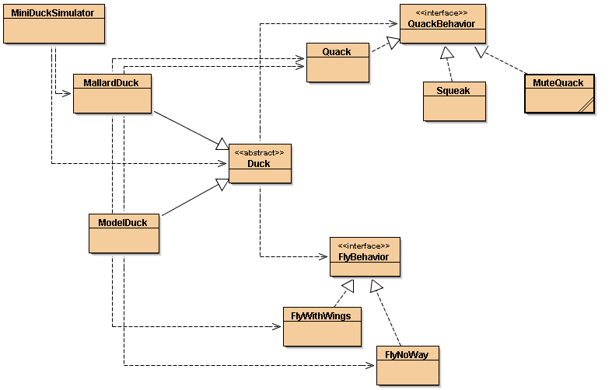
Strategy Pattern

Slide 55
Enabling ModelDuck to fly
Use a mutator (setter) method to enable ModelDuck to fly
Strategy Pattern

Slide 56
3. Make a new FlyBehavior type (FlyRocketPowered.java)
public class FlyRocketPowered implements FlyBehavior {
public void fly() {
System.out.println("I'm flying with a rocket");
}
}
Strategy Pattern

Slide 57
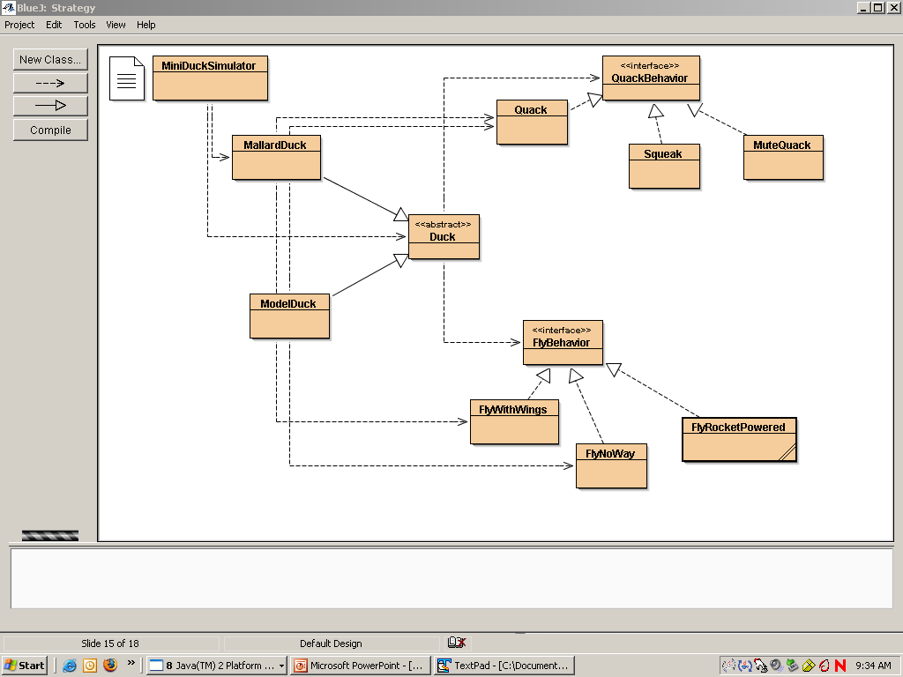
Strategy Pattern

Slide 58
4. Change the test class (MiniDuckSimulator.java), add the ModelDuck, and make the ModelDuck rocket-enabled
Duck model = new ModelDuck();
model.performFly();
// call to performFly() delegates to the flyBehavior
// object set in ModelDuck's constructor
model.setFlyBehavior(new FlyRocketPowered());
// change the duck's behavior at runtime by
// invoking the model's inherited behavior setter
// method
model.performFly();
Strategy Pattern

Slide 59
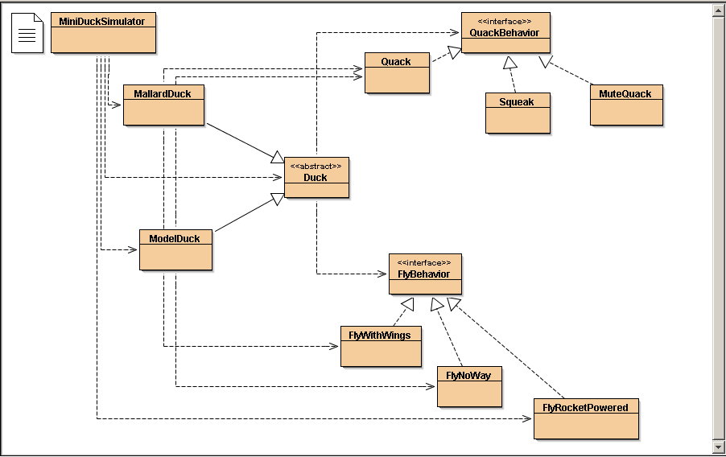
Strategy Pattern

Slide 60
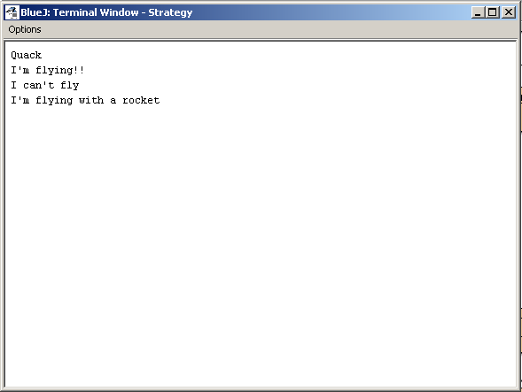
Test again
From mallard
Due to
flyBehavior = new FlyNoWay();
In constructor of ModelDuck
Due to setter method inherited from Duck but set in model
Strategy Pattern

Slide 61
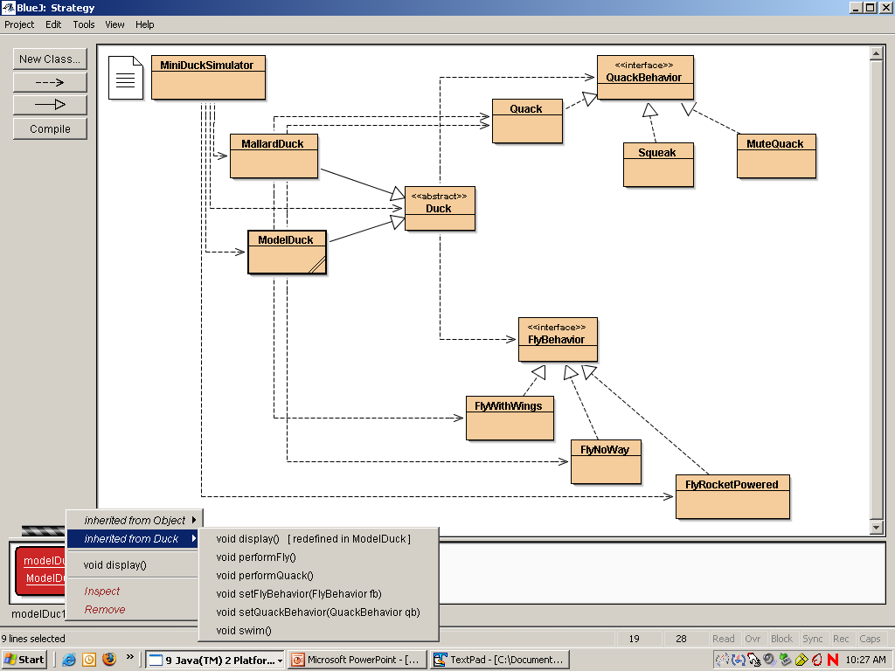
Strategy Pattern

Slide 62
Big Picture on encapsulated behaviors
Reworked class structure
Strategy Pattern

Slide 63
Summary
Reworked class structure
  ducks extending Duck
  fly behaviors implementing FlyBehavior
  quack behaviors implementing QuackBehavior
Think of each set of behaviors as a family of algorithms
Relationships: IS-A, HAS-A, IMPELMENTS
Exercise: mark up the following diagram with the relationships above
Strategy Pattern

Slide 64
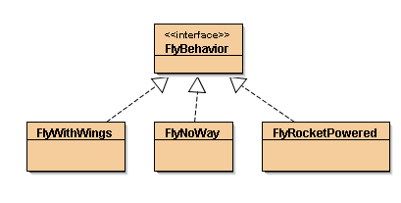
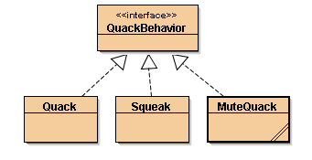
Encapsulated fly behavior
Duck
FlyBehavior flyBehavior
QuackBehavior quackBehavior
Swim()
Display()
performQuack()
performFly()
setFlyBehavior()
setQuackbehavior()
//OTHER duck-like methods
Encapsulated quack behavior
MallardDuck
display()
RedHeadDuck
display()
RubberDuck
display()
Strategy Pattern

Slide 65
HAS-A can be better than IS-A
Each duck has a FlyBehavior and a QuackBehavior to which it delegates flying and quacking
Composition at work
  Instead of inheriting behavior, ducks get their behavior by being composed with the right behavior object
Strategy Pattern

Slide 66
Third Design Principle
Favor composition over inheritance
  More flexibility
  Encapsulate a family of algorithms into their own set of classes
  Able to change behavior at runtime
Strategy Pattern

Slide 67

Strategy Pattern
The strategy Pattern
  Defines a family of algorithms,
  Encapsulates each one,
  Makes them interchangeable.
Strategy lets the algorithm vary independently from clients that use it
Strategy Pattern

