Slide 1
Wearable Computer Contest
Ideation

Slide 2
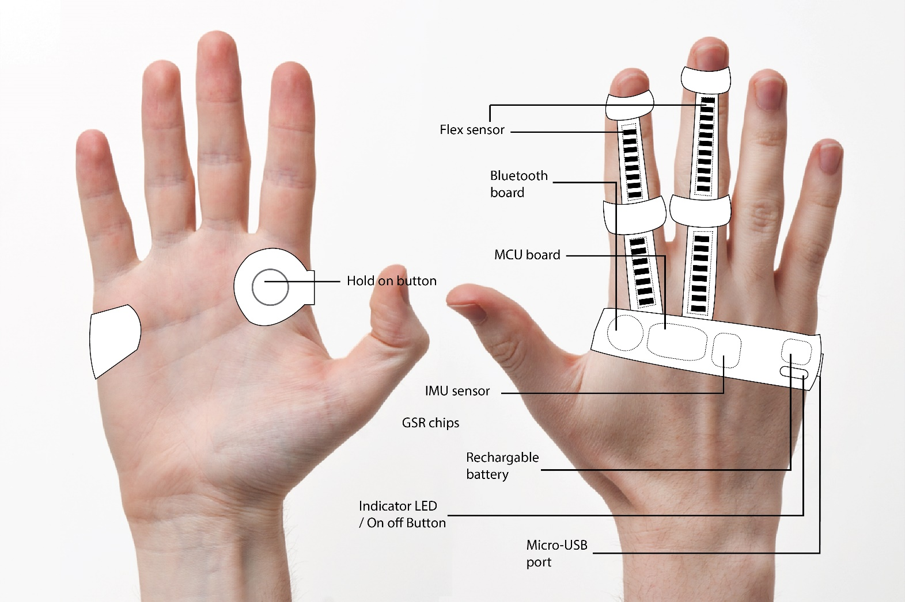
Ideation I: Virtual Mouse

Slide 3
Specifications
A new way to use mouse
Hand-free wireless wearable device
User friendly: ease to use
Convenience and affordable

Slide 4

Hardware
Micro-controller
Flex sensor x 2
Inertial Measurement Unit
Bluetooth transmitter
LED
Battery
Button

Slide 5
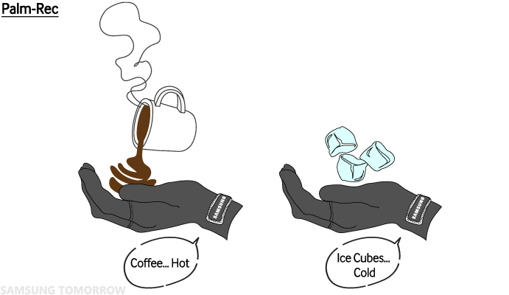
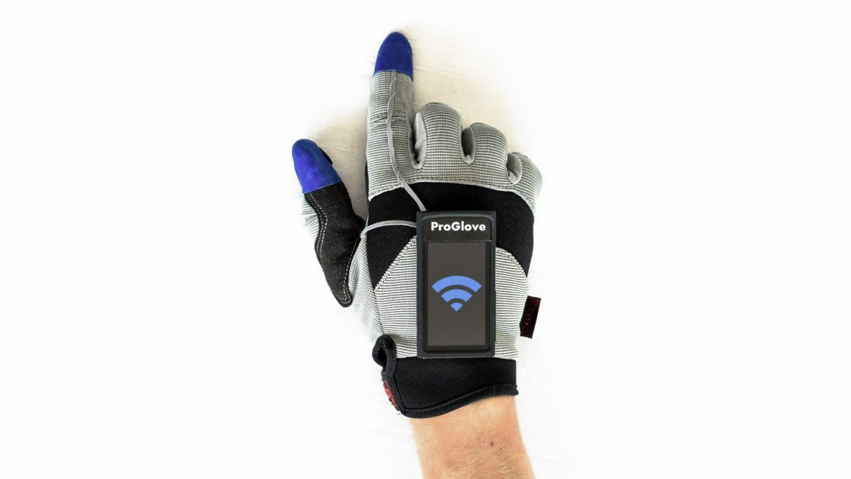
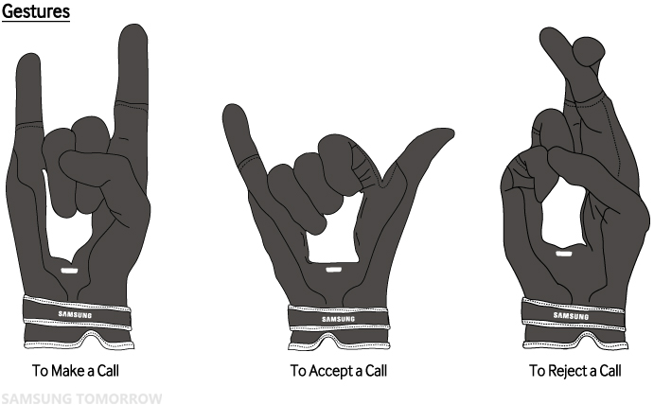
Ideation II

