Slide 1
C Development Environment Guide
(Fall 2026 CSED103 Introduction to Programming)

Slide 2
Contents
Windows Users
  Visual studio 2022
  VSCode
We grade assignments in Visual Studio 2022 on Windows. Even if your program works in another environment, you must check that it runs correctly in the specified grading environment.
We recommend using Visual Studio 2022 on Windows from the start. This guide covers that environment in the most detail.

Slide 3
Visual Studio 2022 Setup
(Windows)

Slide 4
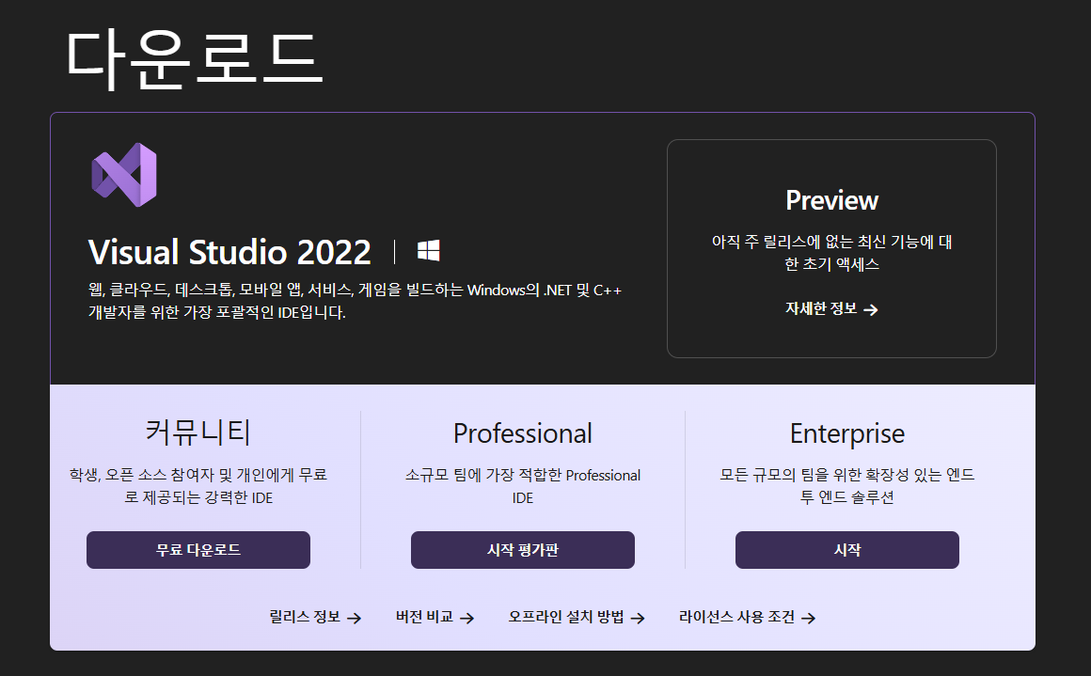
Visual Studio 2022 Installation
Search for Visual Studio 2022 download or
Download link: https://aka.ms/vs/17/release/vs_community.exe
Click the download button for the Community edition shown below.

Slide 5
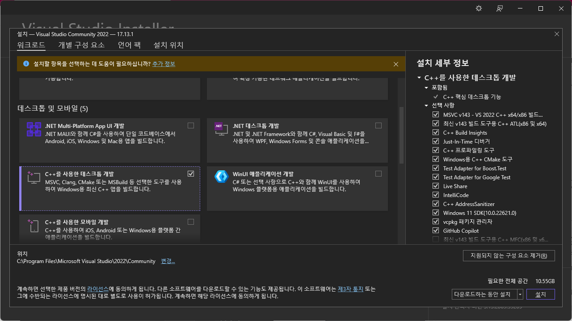
Visual Studio 2022 Installation
Run the downloaded VisualStudioSetup.exe and continue to install Visual Studio Installer.
Select Desktop development with C++ as shown below, then click Install.

Slide 6
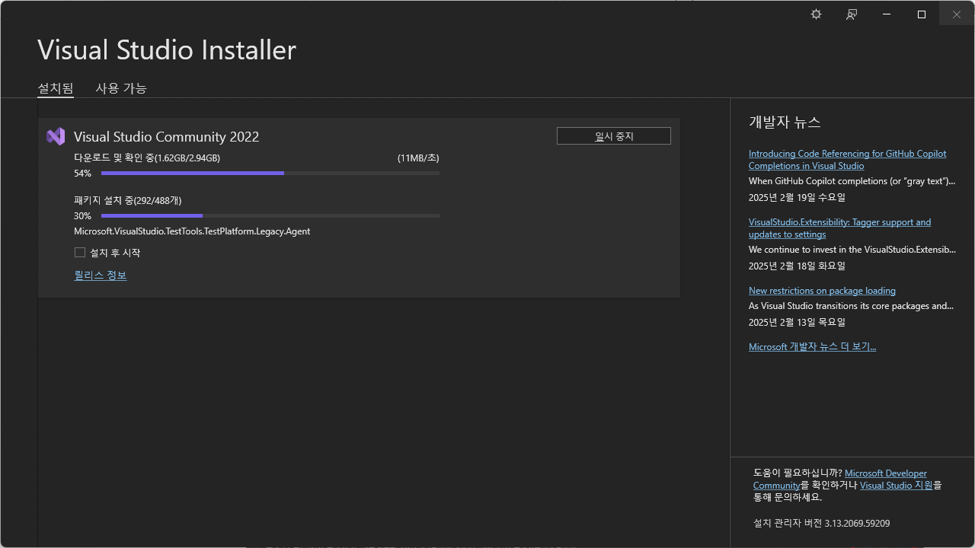
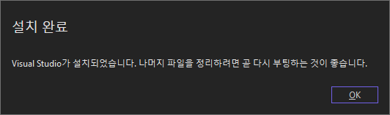
Visual Studio 2022 Installation
Run the downloaded VisualStudioSetup.exe and continue to install Visual Studio Installer.
Select Desktop development with C++, then click Install.
After the download,
we recommend restarting your computer.
Download in progress

Slide 7
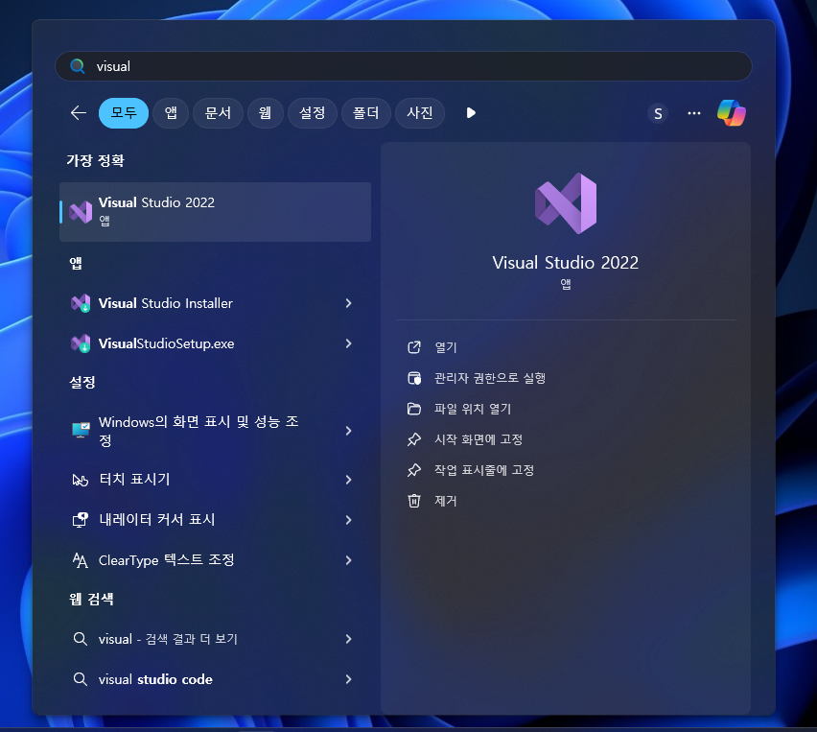
Visual Studio 2022 Installation
Search for Visual Studio 2022 and open it.

Slide 8
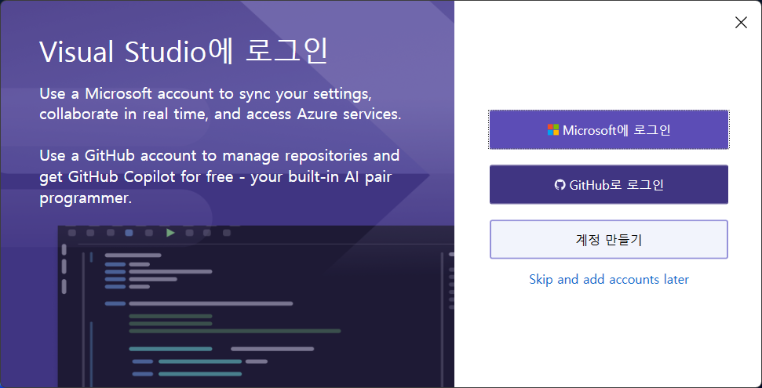
Visual Studio 2022 Installation
Click Skip and add accounts later to continue without signing in.

Slide 9
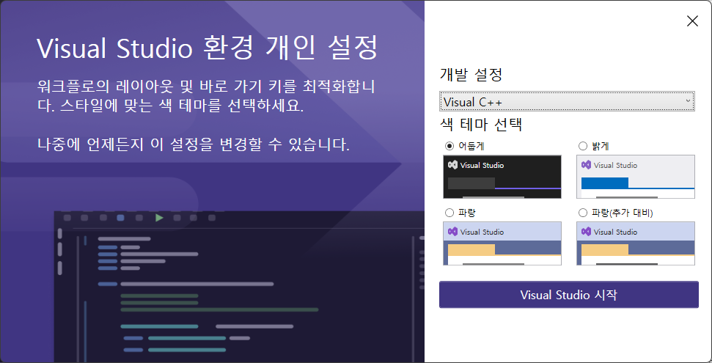
Visual Studio 2022 Installation
Select Visual C++ as your development setting, then choose a theme.
Click Start Visual Studio.

Slide 10
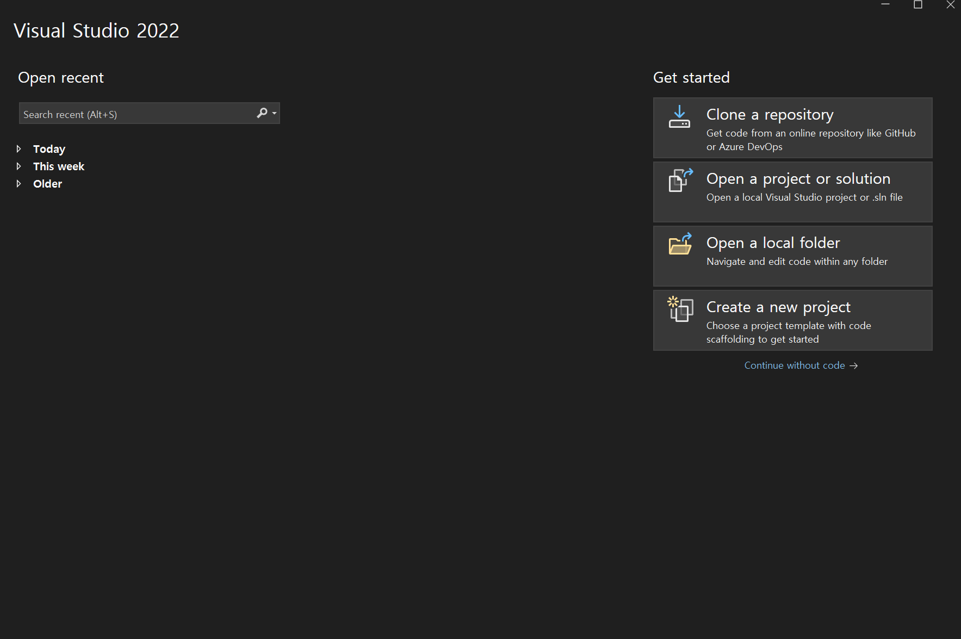
Visual Studio 2022 Project Creation
Click Create a new project.

Slide 11
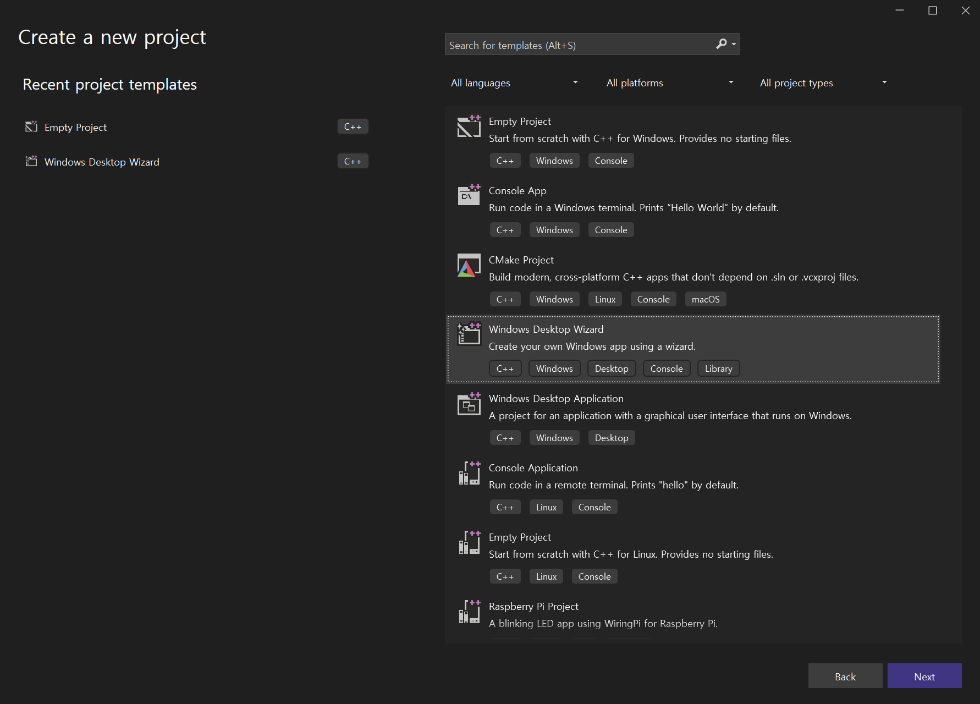
Visual Studio 2022 Project Creation
Select Windows Desktop Wizard, then click Next.

Slide 12
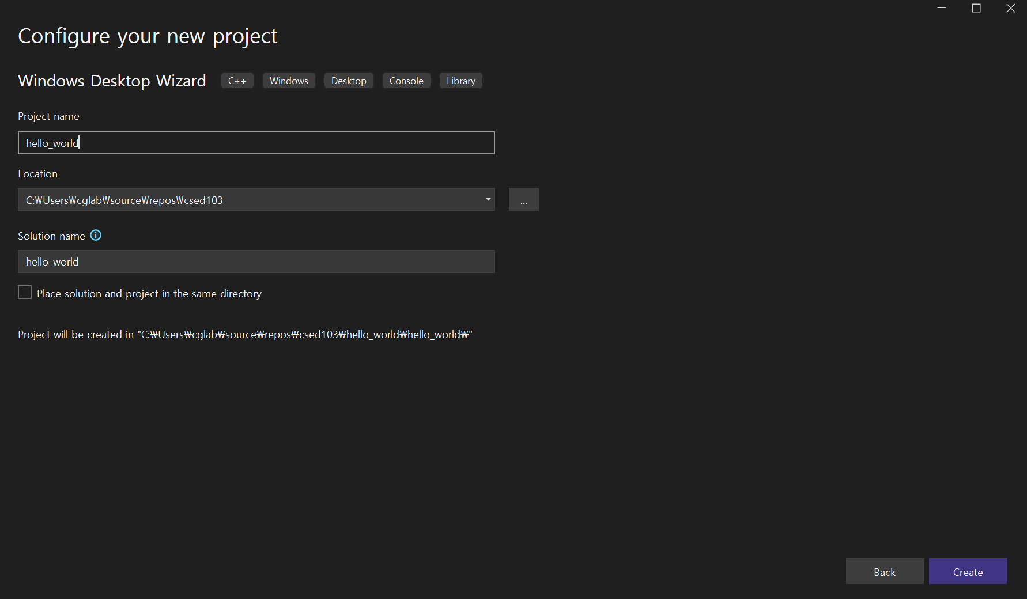
Visual Studio 2022 Project Creation
Enter a project name, choose a location for the project folder, then click Create.
(Avoid Korean characters and spaces in project names and folder paths, as they may cause errors.)

Slide 13
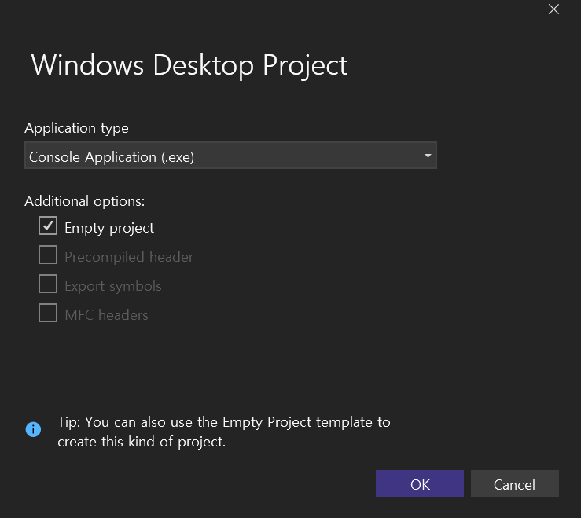
Visual Studio 2022 Project Creation
Under Additional options, select Empty project, then click OK.

Slide 14
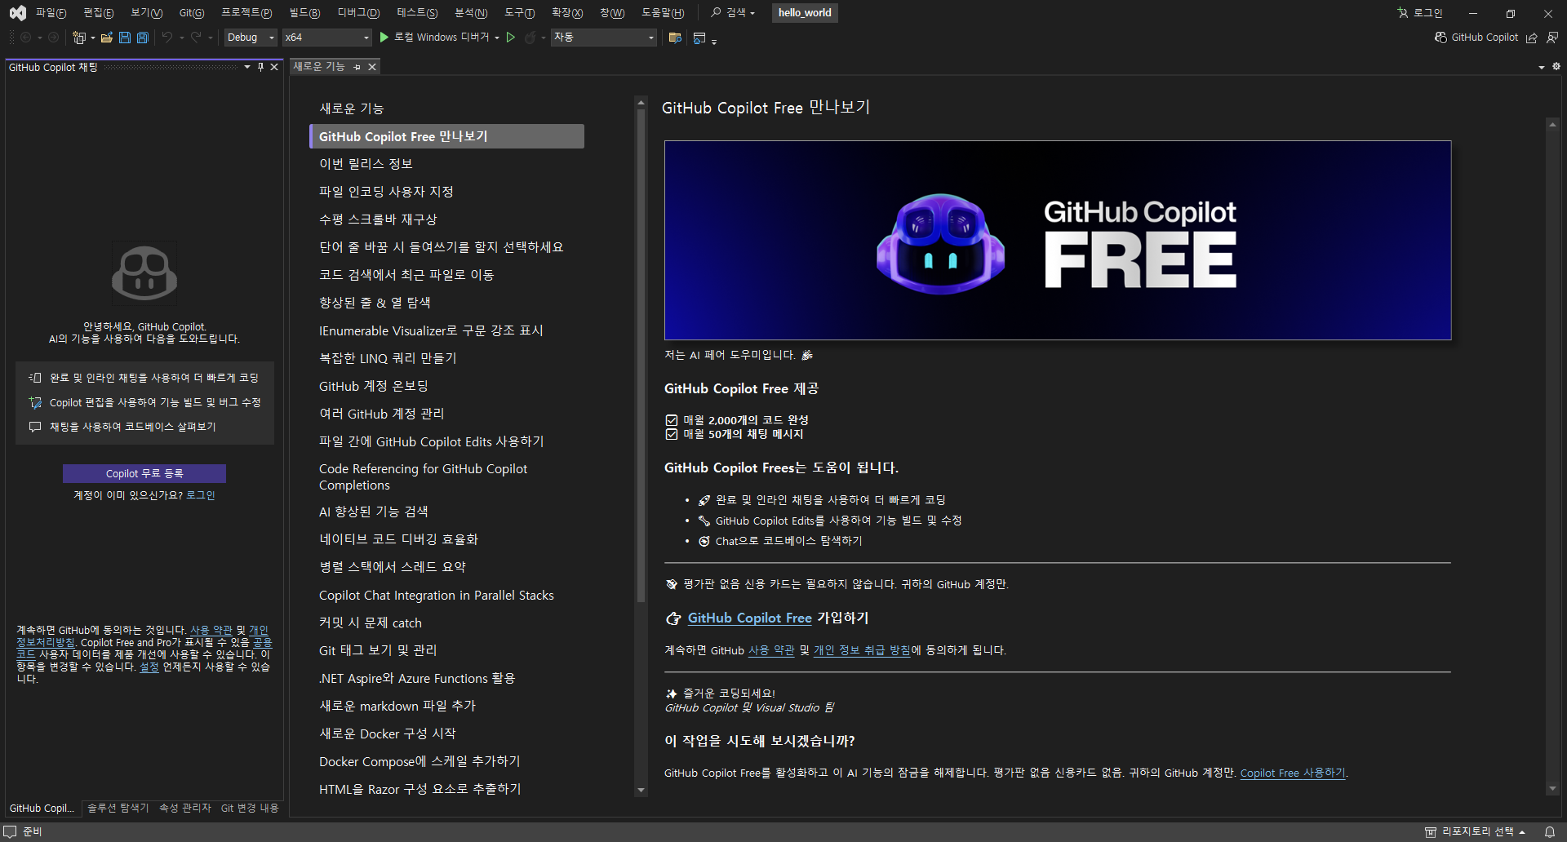
Visual Studio 2022 Project Creation
Close the initial tabs, such as release notes.

Slide 15
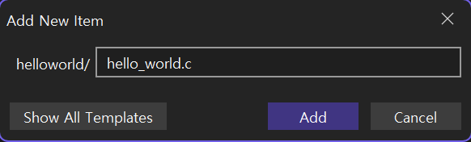
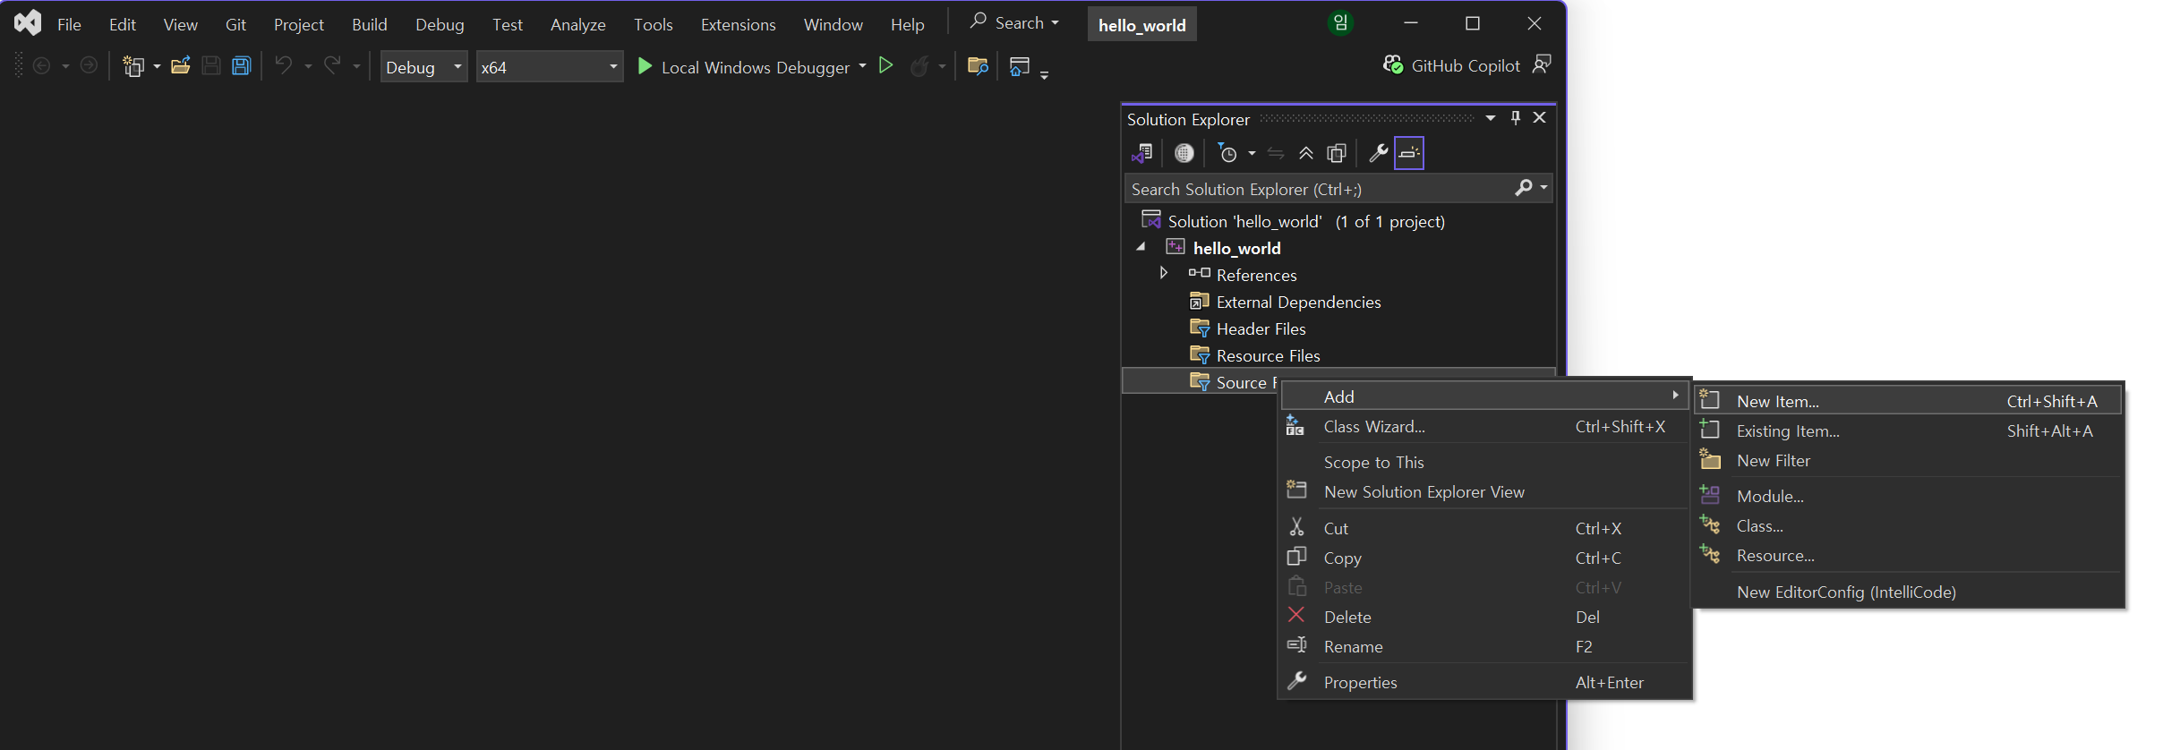
Visual Studio 2022: Code and Run
In Solution Explorer on the left (Ctrl+Alt+L), right-click Source Files, then select Add, New Item.
Enter a file name with the .c extension, then click Add.

Slide 16
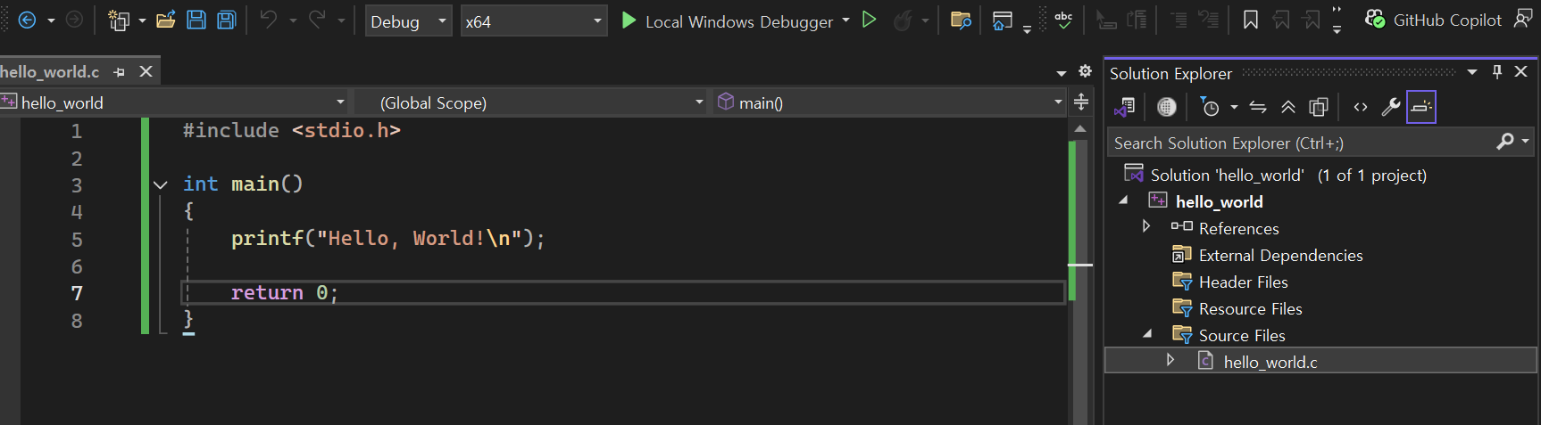
Visual Studio 2022: Code and Run
Check that hello_world.c appears in Solution Explorer on the left.
Click the file to open the editor on the right. Enter the code shown in the image.

Slide 17
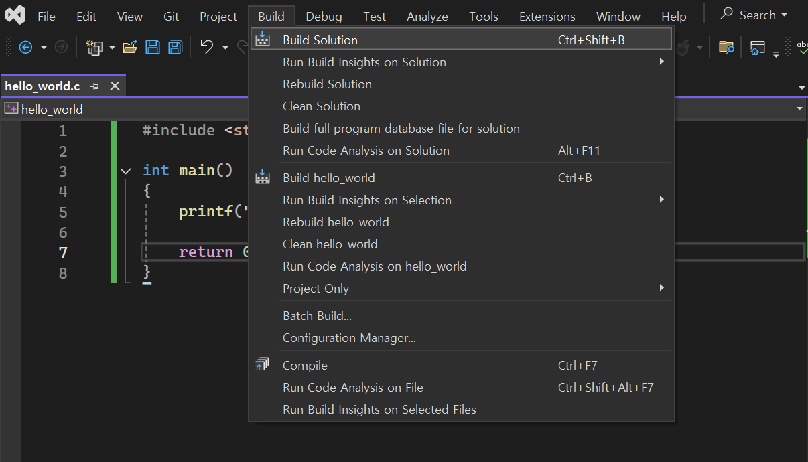
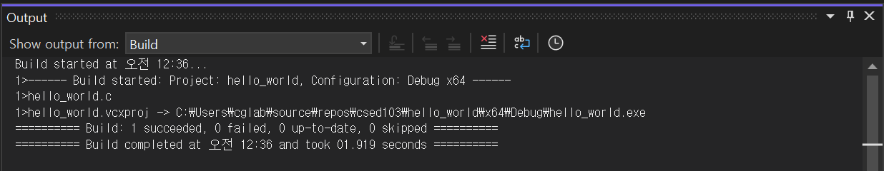
Visual Studio 2022: Code and Run
Build the code (compile and link) to create an executable file.
  Select Build, then Build Solution.

Slide 18
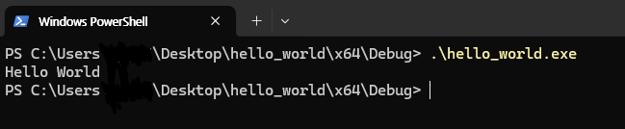
Visual Studio 2022: Code and Run
Run the .exe file in "project folder\x64\Debug" from a terminal such as cmd to see the output.
  If you open this file with the mouse, its window closes immediately. This is normal.

Slide 19
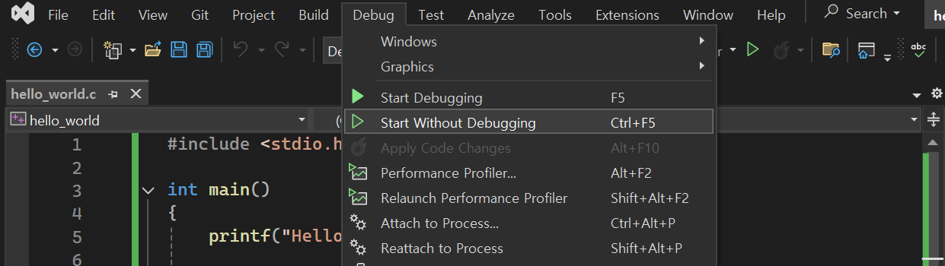
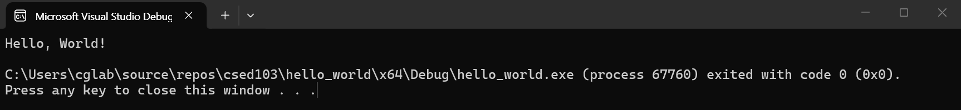
Visual Studio 2022: Code and Run
Select Debug, Start Without Debugging (Ctrl+F5) to build and run the program in one step.

Slide 20
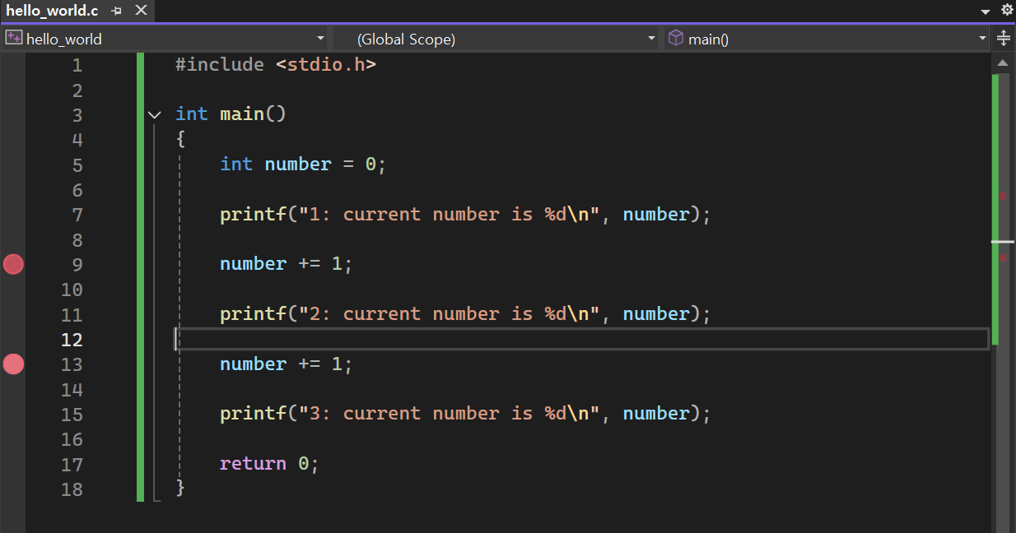
Visual Studio 2022 Debugging
Debugging lets you pause before a breakpoint and inspect the program state, including variable values.
Enter the code below. Click to the left of a line number to set a breakpoint, shown as a red circle. You can set more than one.

Slide 21
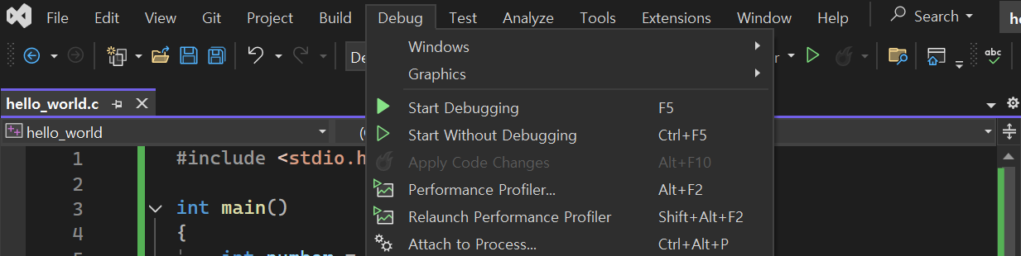
Visual Studio 2022 Debugging
With a breakpoint set, select Debug, Start Debugging (F5) to build and debug the program.
You can also set breakpoints after starting the debugger.

Slide 22
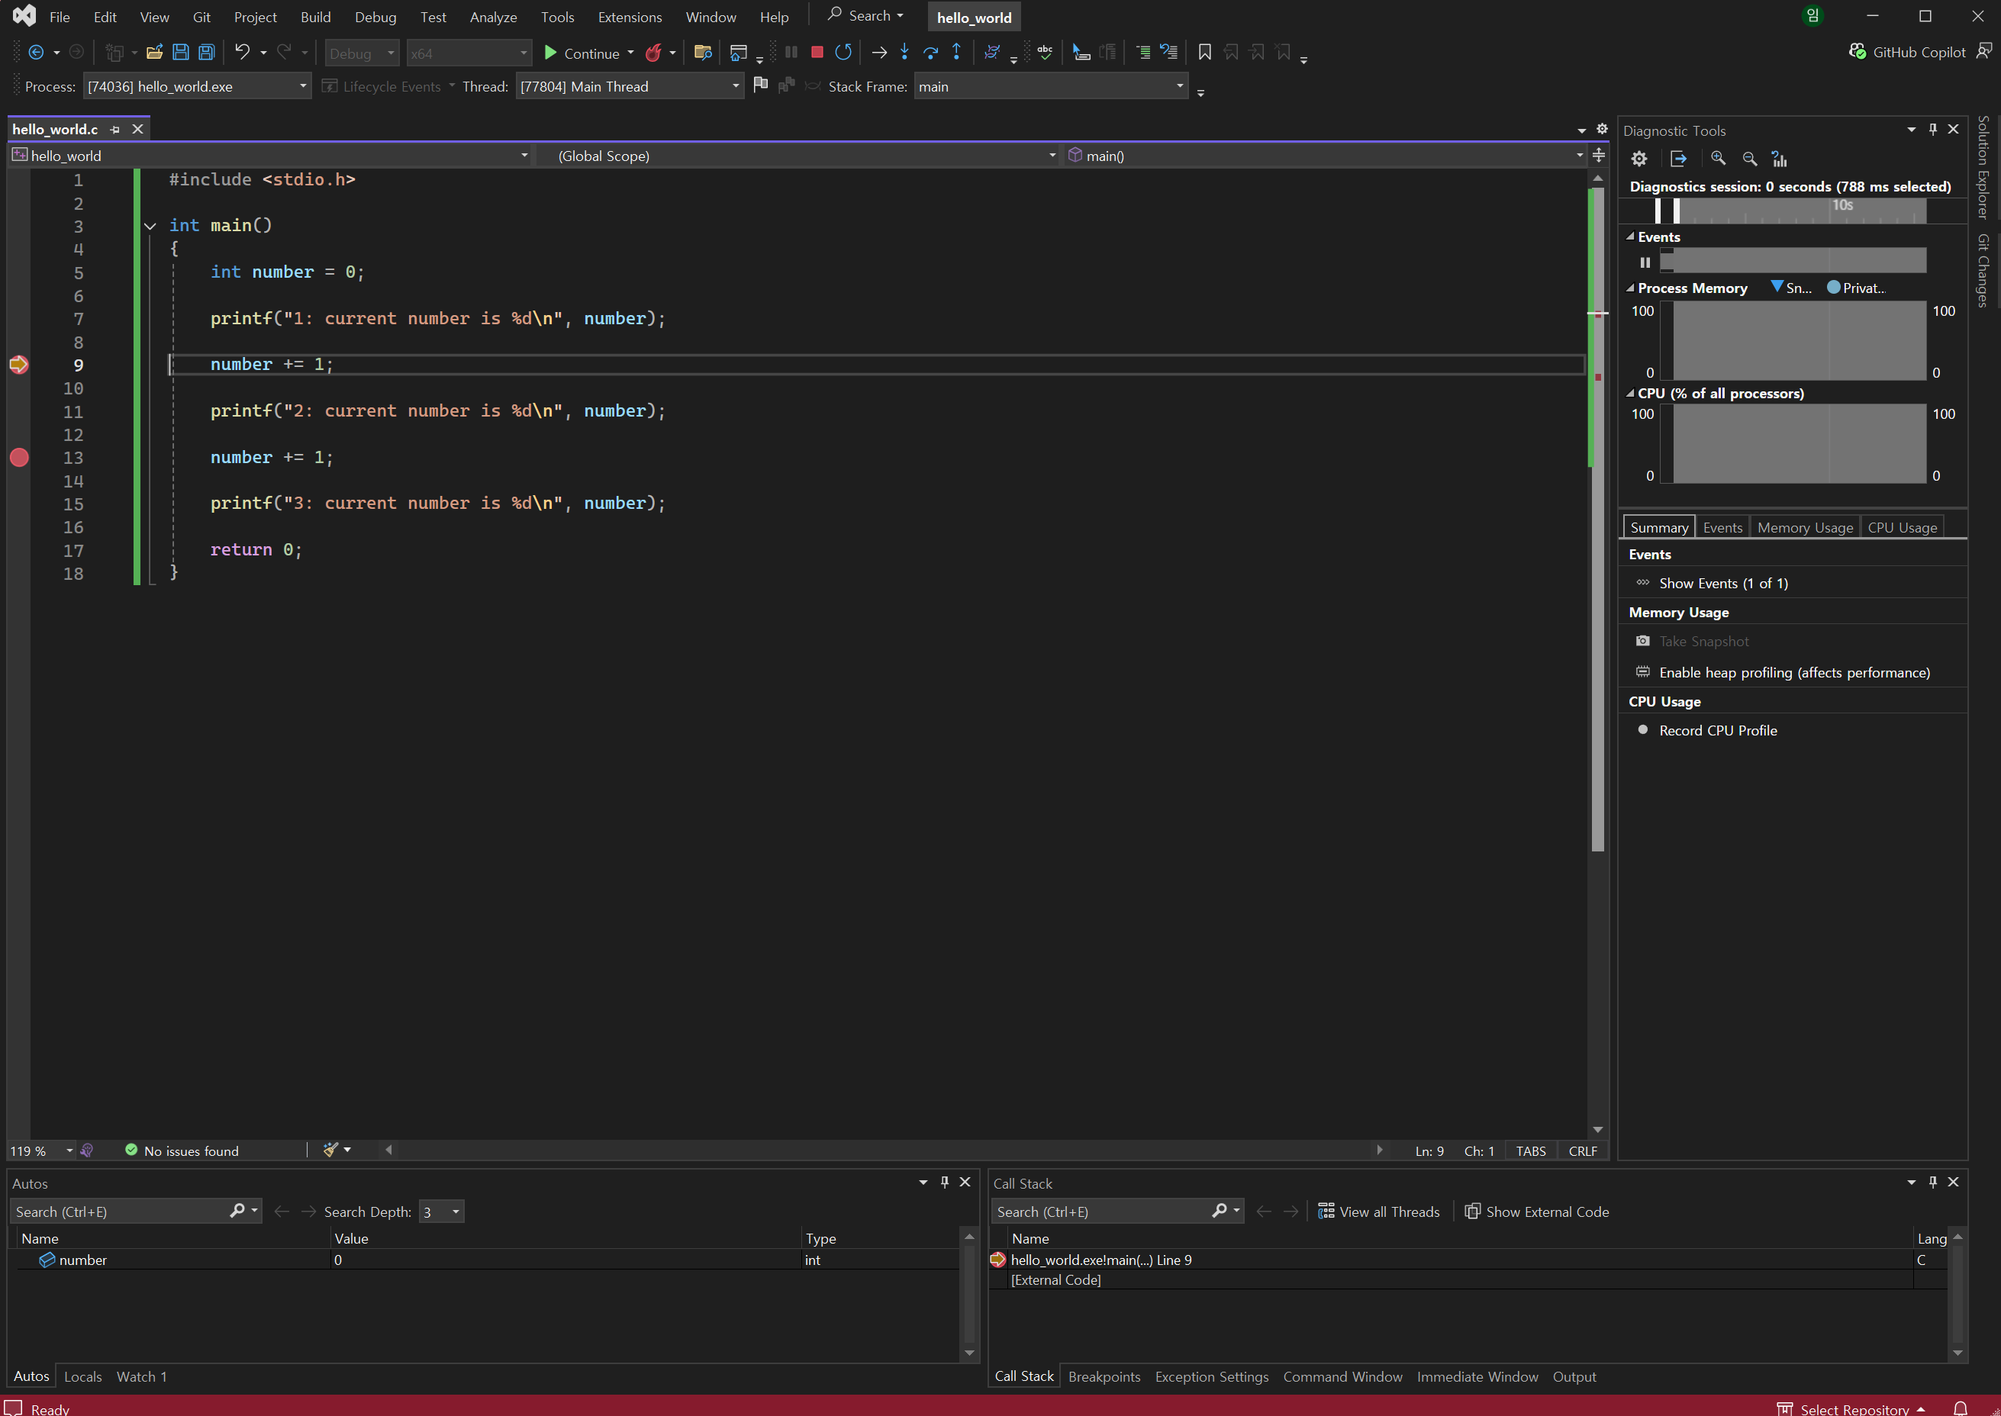
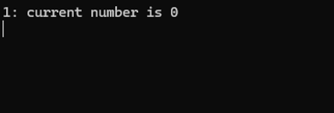
Visual Studio 2022 Debugging
Starting the debugger opens both VS2022 and a terminal. Inspect variable values in VS2022 and view the output so far in the terminal.
Debug controls
Current execution position
Current variable values
Call stack

Slide 23
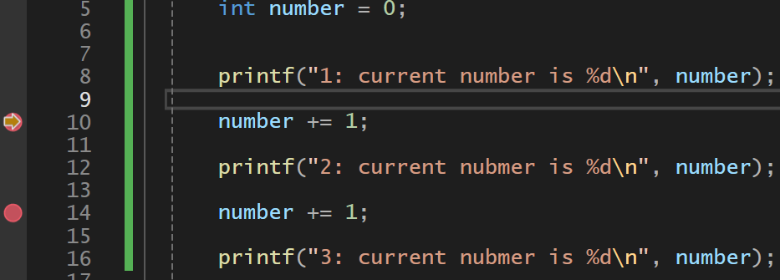
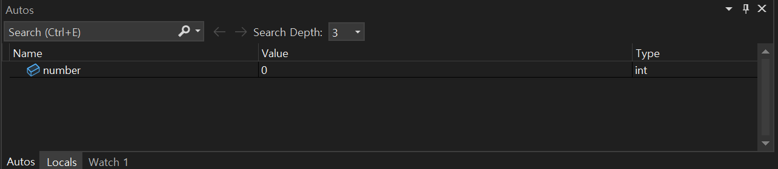
Visual Studio 2022 Debugging
Starting the debugger opens both VS2022 and a terminal. Inspect variable values in VS2022 and view the output so far in the terminal.
The line at the breakpoint has not run yet. The preceding printf() has run, and number still contains 0.

Slide 24
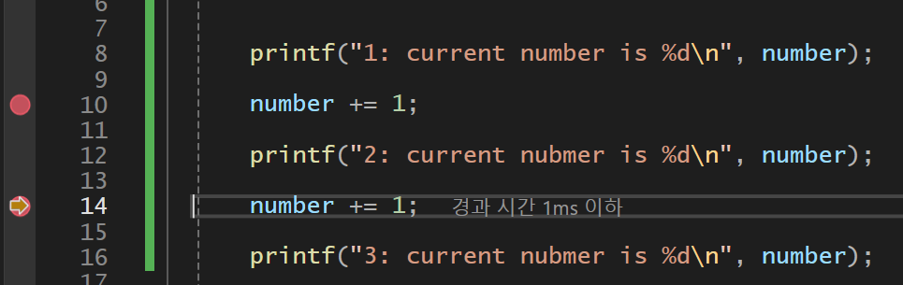
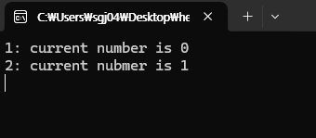
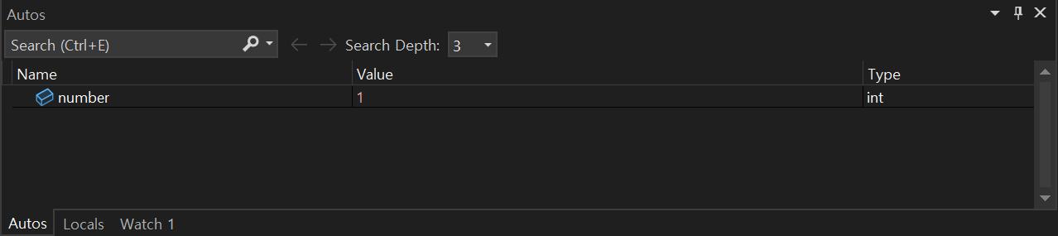
Visual Studio 2022 Debugging
Click Continue to run to the next breakpoint, or to the end if no more breakpoints remain.
The current-position arrow, the value of number, and the terminal output all update.

Slide 25
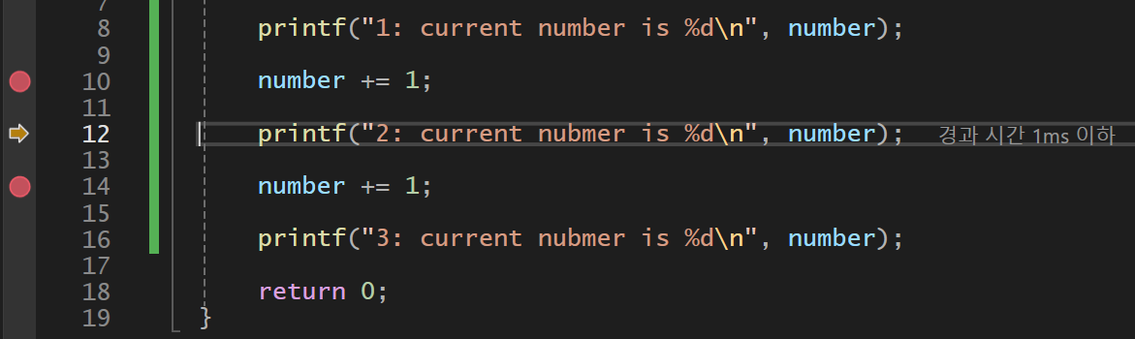
Visual Studio 2022 Debugging
Click Step Into to stop at the next statement, rather than the next breakpoint.

Slide 26
Visual Studio 2022 Debugging
Click Stop Debugging to end the debugging session immediately.

Slide 27
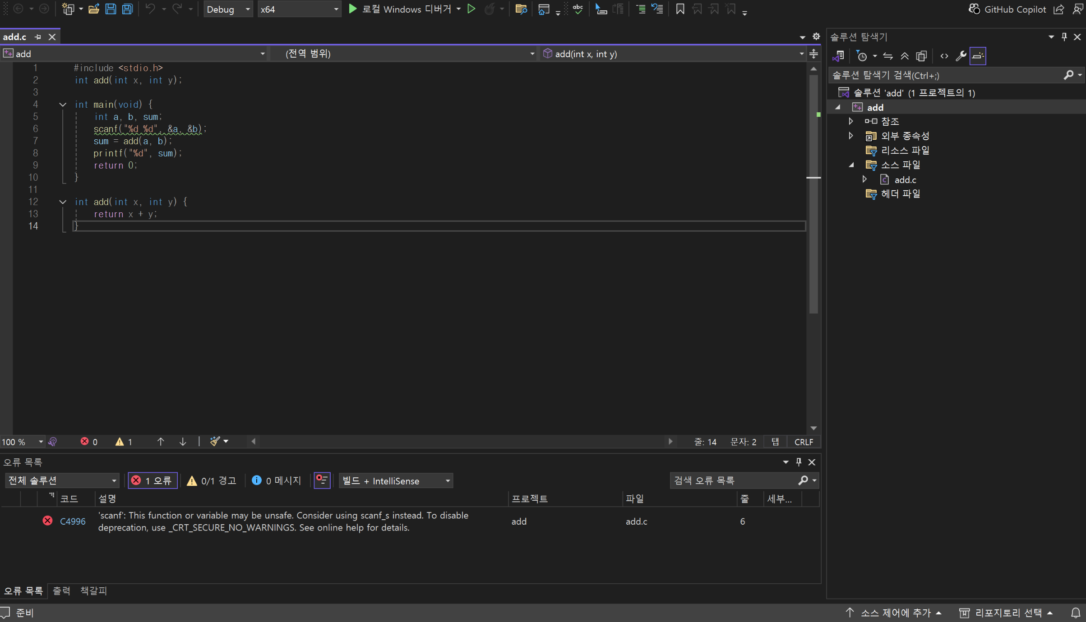
Visual Studio 2022 Tips
If a build or run fails, the Error List appears as shown below.
Read the error description, or copy it into Google to find solutions to common errors.

Slide 28
VSCode Setup
(Windows)

Slide 29
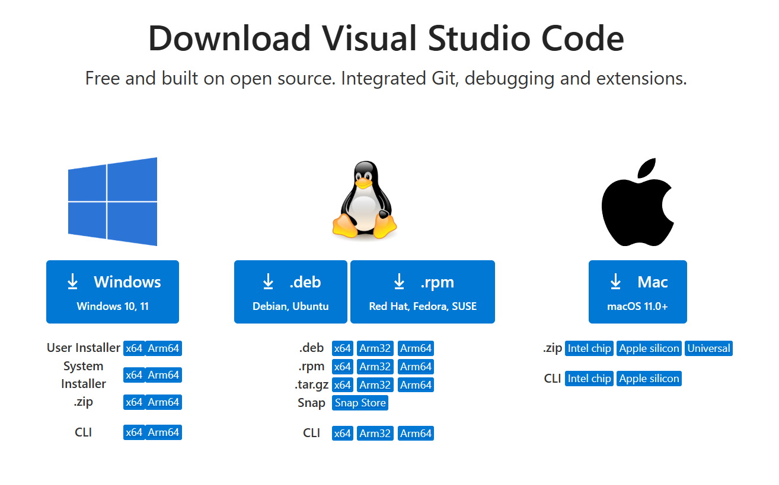
Visual Studio Code Installation
Search for Visual Studio Code download or
visit: https://code.visualstudio.com/download
Click the Windows installer shown below.

Slide 30
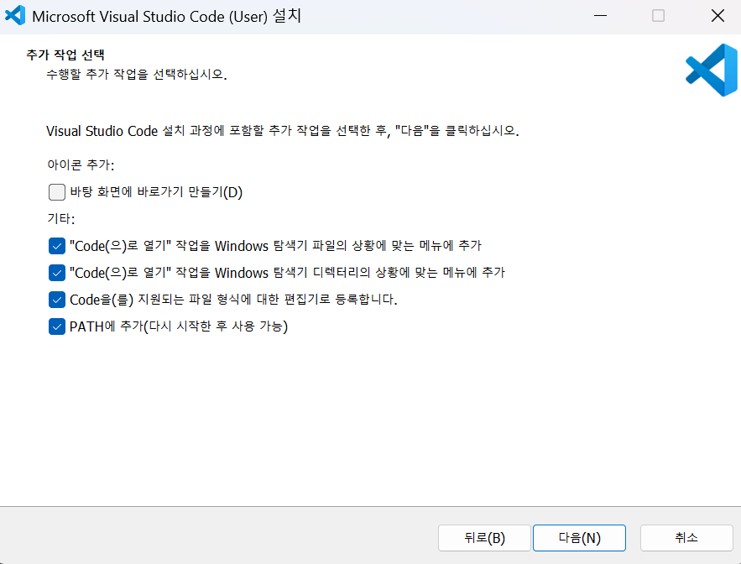
Visual Studio Code Installation
Run the downloaded file, select your preferred options, and install.

Slide 31
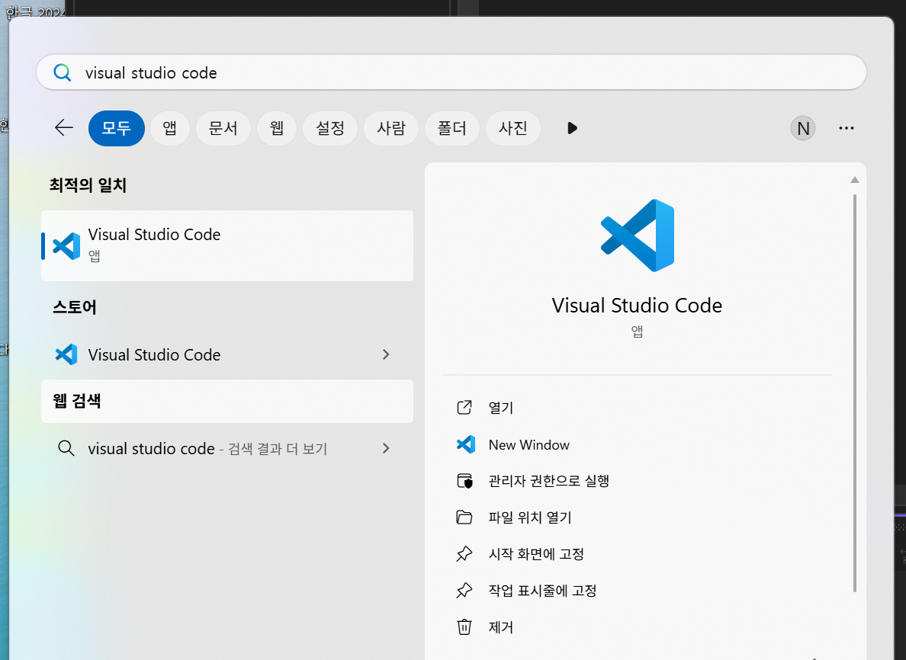
Visual Studio Code Installation
Search for Visual Studio 2022 and open it.

Slide 32
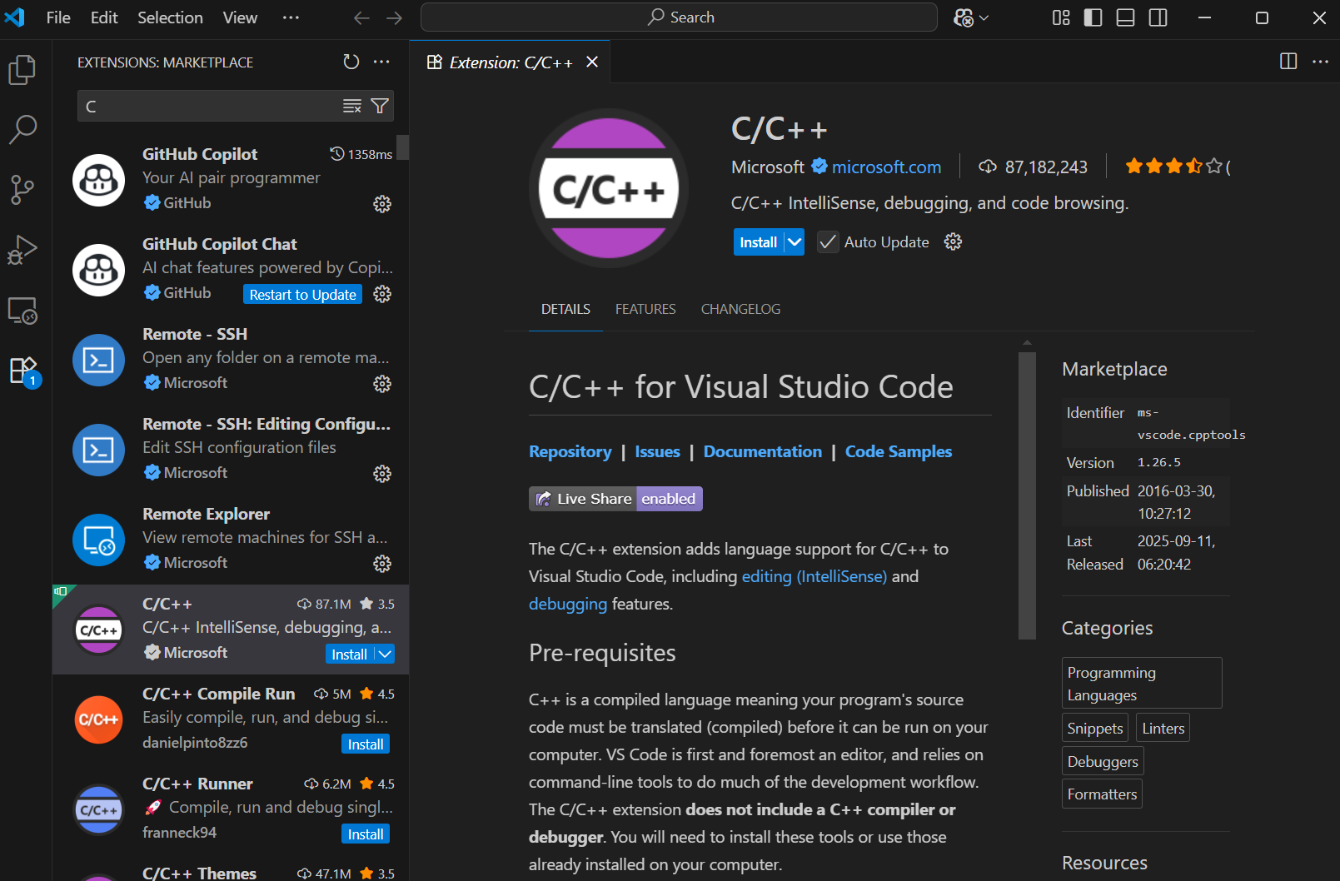

Visual Studio Code Installation
Open Extensions, search for C/C++, and install the extension.

Slide 33
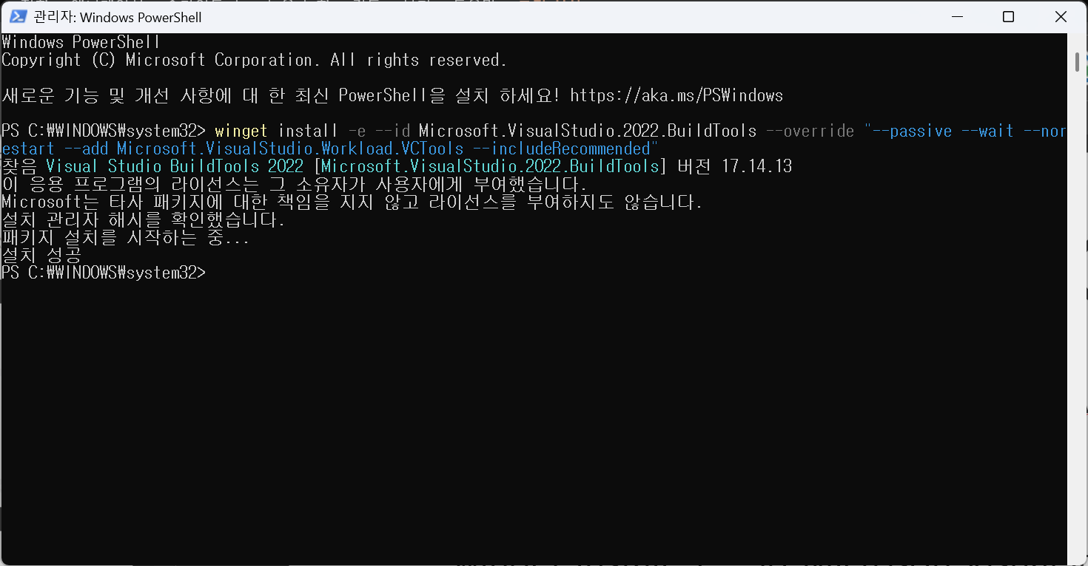
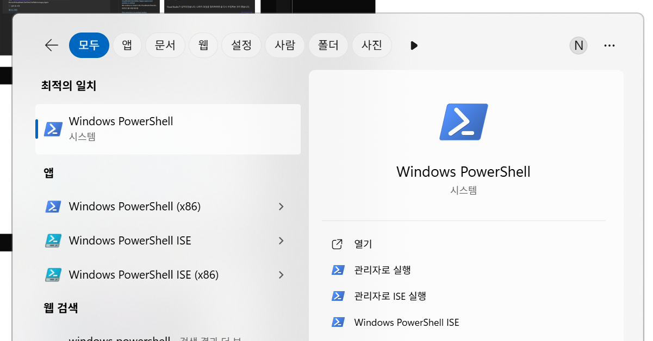
Visual Studio Code Installation
Match the Visual Studio 2022 environment by opening Windows PowerShell as administrator. Run the command below to install Build Tools 2022 (MSVC v143 + Windows SDK).
winget install -e --id Microsoft.VisualStudio.2022.BuildTools --override "--passive --wait --norestart --add Microsoft.VisualStudio.Workload.VCTools --includeRecommended"

Slide 34
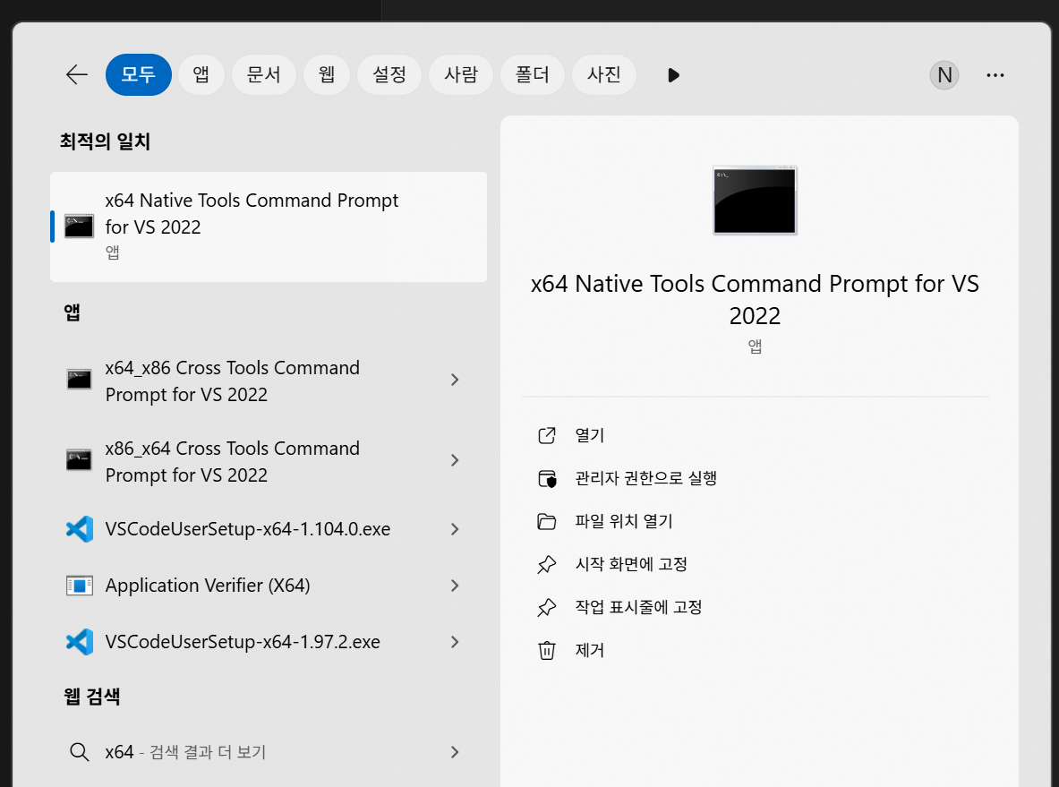
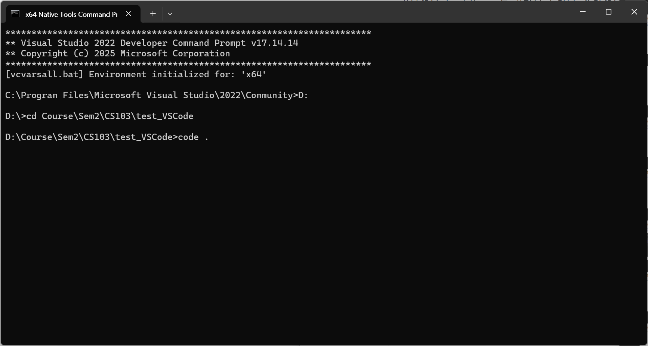
Visual Studio Code Installation
Open "X64 Native Tools Command Prompt for VS 2022". In your working folder, enter "code ." to launch VSCode.

Slide 35
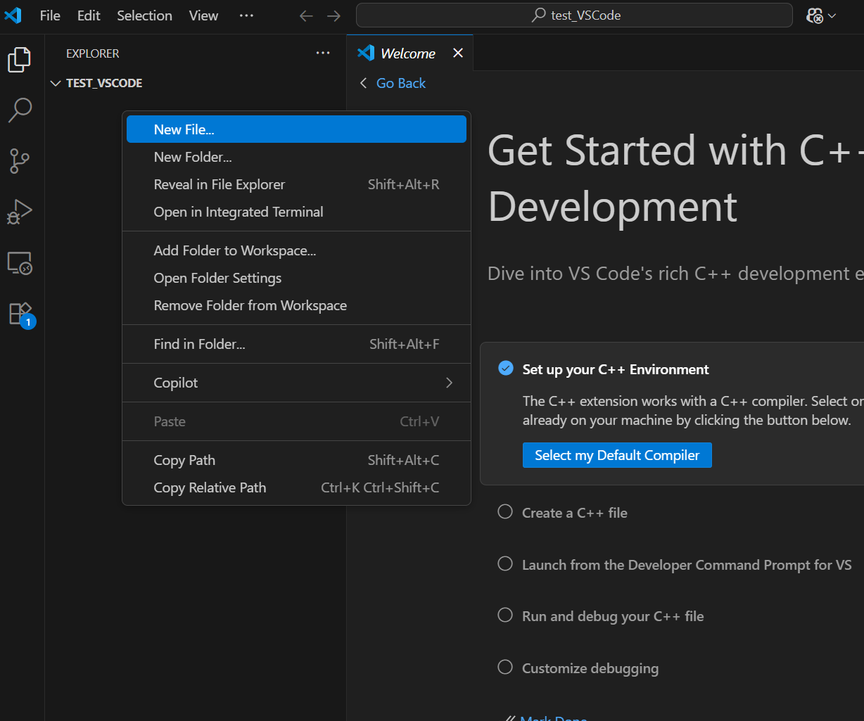
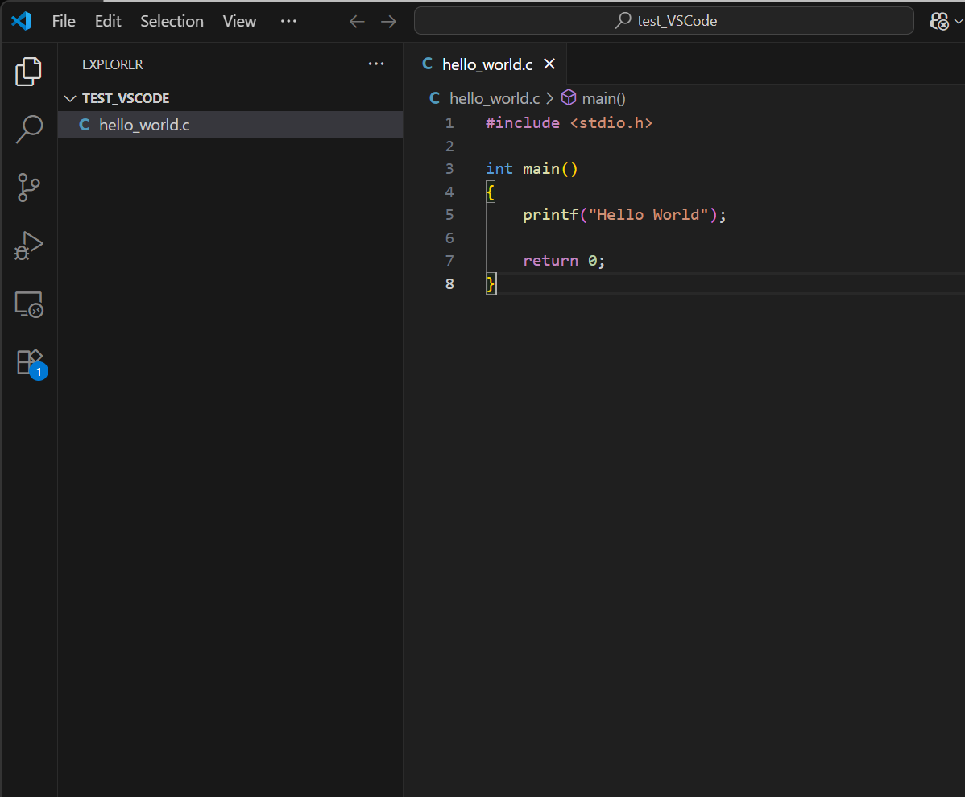
Visual Studio Code Installation
Create hello_world.c and enter your code.

Slide 36
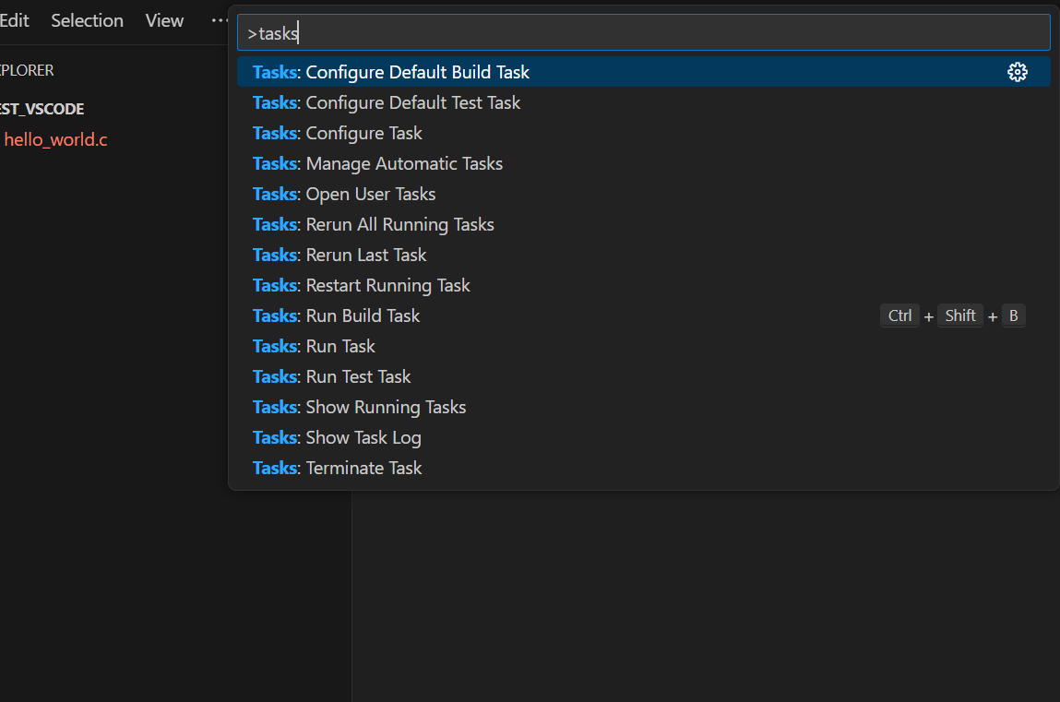
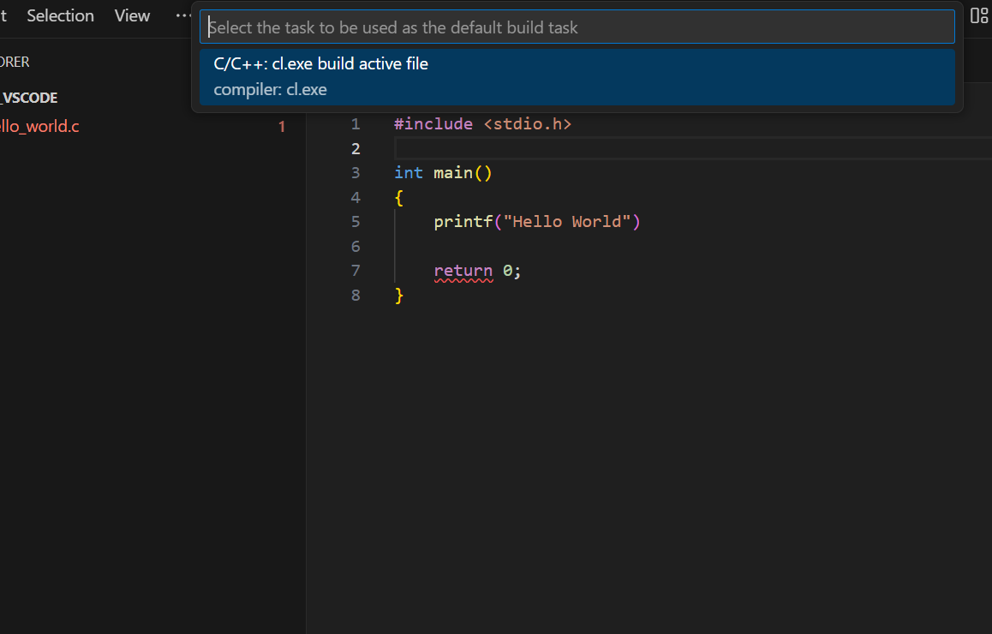
Visual Studio Code Installation
In the Command Palette (Ctrl+Shift+P), search for and run Tasks: Configure Default Build Tasks.
Select C/C++: cl.exe build active file.
This creates tasks.json inside the .vscode folder.

Slide 37
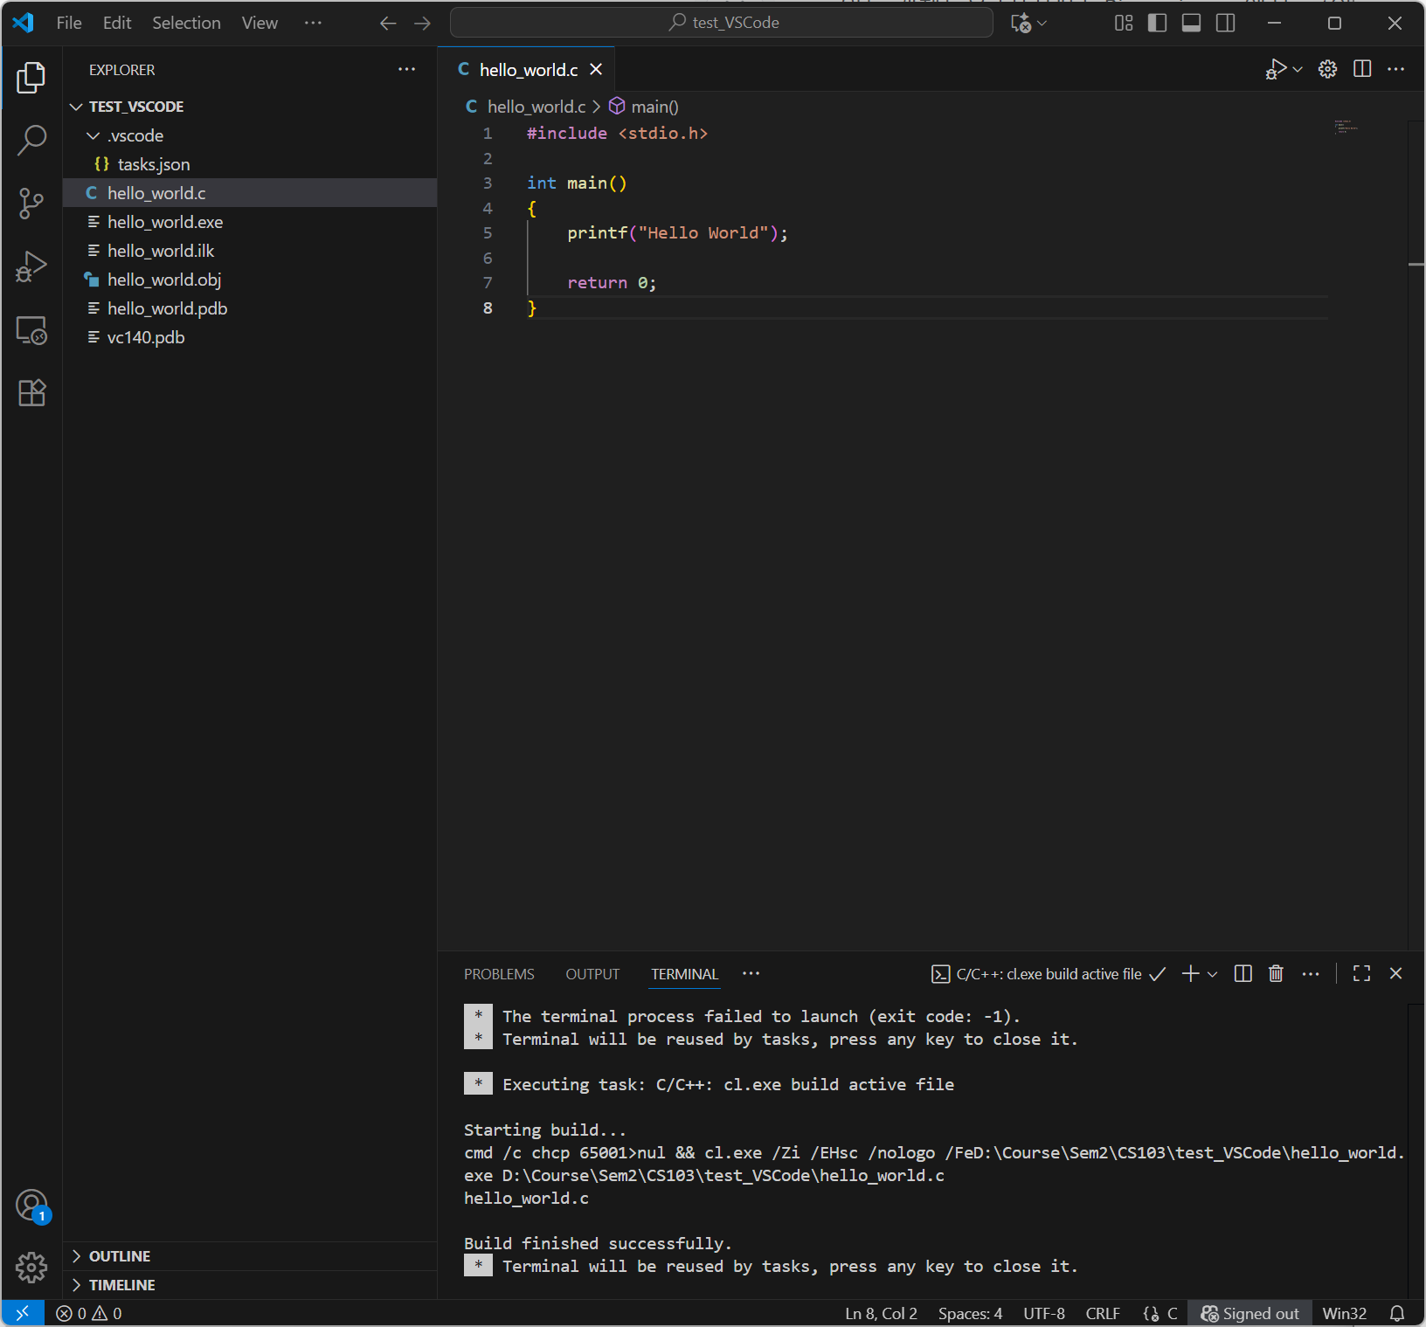
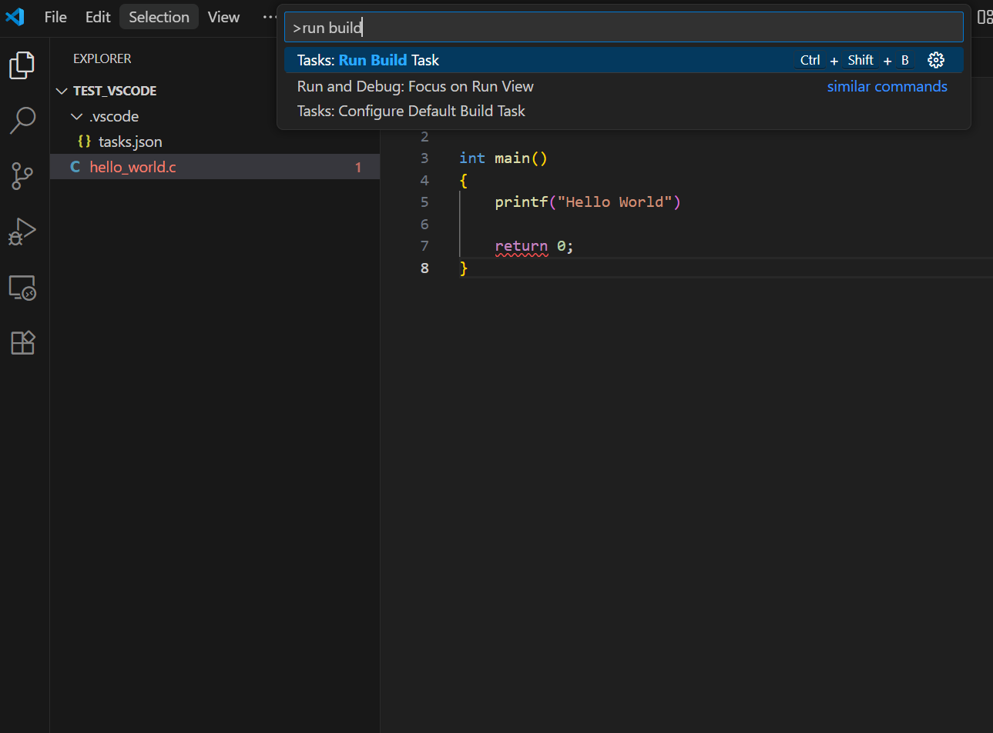
Visual Studio Code Installation
Open hello_world.c and run Tasks: Run build tasks (Ctrl+Shift+B) from the Command Palette. The build generates the output files.

Slide 38
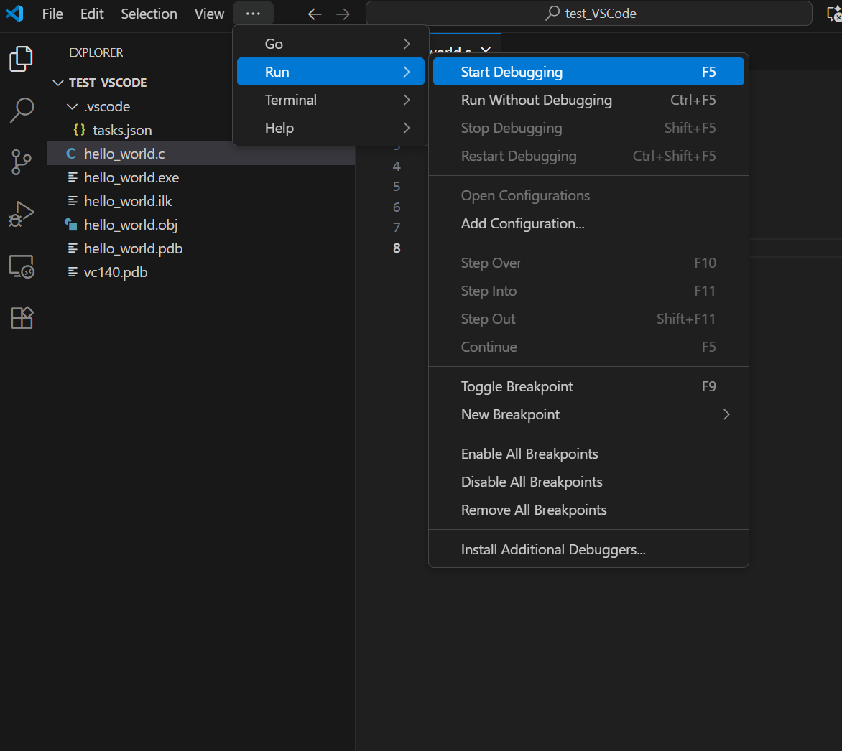
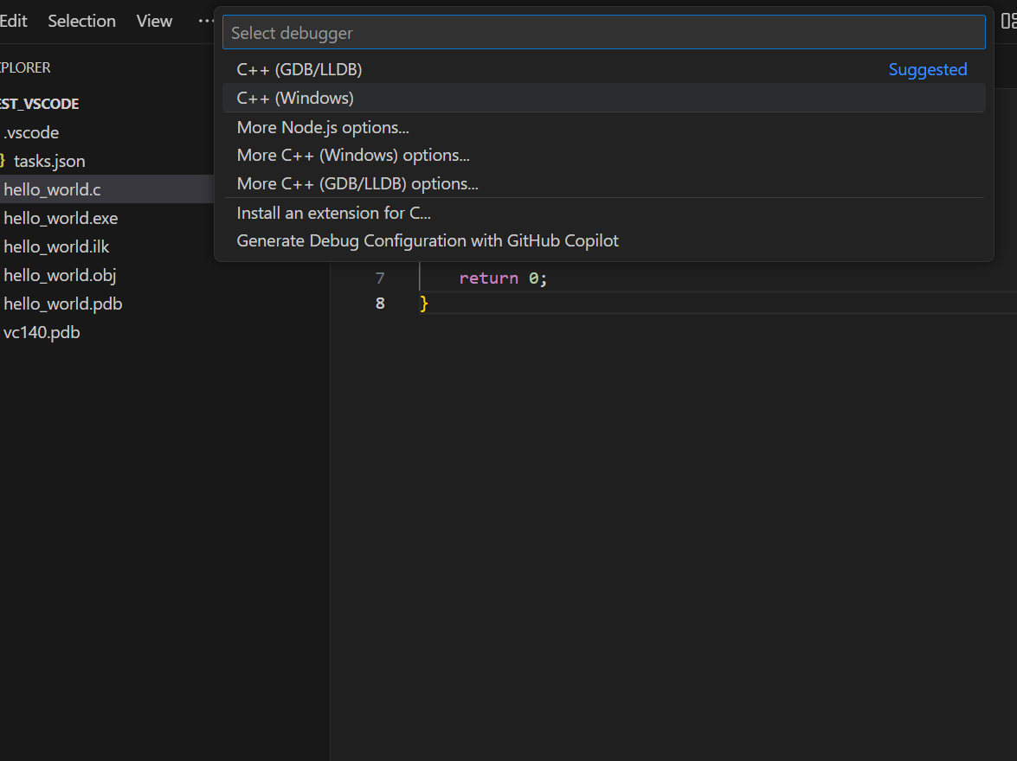
Visual Studio Code Installation
Select Run, Start Debugging (F5) to debug.
Select C++(Windows) as the debugger.

Slide 39
Troubleshooting winget is unavailable
Open PowerShell and enter the following commands.
Reference
  Use WinGet to install and manage applications | Microsoft Learn
$progressPreference = 'silentlyContinue'
Write-Host "Installing WinGet PowerShell module from PSGallery..."
Install-PackageProvider -Name NuGet -Force | Out-Null
Install-Module -Name Microsoft.WinGet.Client -Force -Repository PSGallery | Out-Null
Write-Host "Using Repair-WinGetPackageManager cmdlet to bootstrap WinGet..."
Repair-WinGetPackageManager -AllUsers
Write-Host "Done."

Slide 40
Troubleshooting cl.exe is not listed
Edit tasks.json as shown below.
Search Google for "vscode default build tasks configure c/c++ cl.exe".
{
"version”: “2.0.0”,
“tasks”: [
{
“label”: “cl.exe build active file",
"type": "shell",
"command": "cl.exe",
"args": [
"/Zi", // Enable debugging information
"/EHsc", // Enable C++ exception handling
"/Fe:", // Specify output executable name
"${fileDirname}\\${fileBasenameNoExtension}.exe",
"${file}" // The active file
],
"group": {
"kind": "build",
"isDefault": true // Set this task as the default build task
},
"presentation": {
"reveal": "always"
},
"problemMatcher": "$msvc" // Use the MSVC problem matcher for error highlighting
}
]
}

Slide 41
MacOS

Slide 42
MacOS
Xcode
  Install Xcode for a graphical environment similar to Visual Studio.
  Download it from the Mac App Store.
g++
  You can compile in a terminal using g++.
  When you first use g++ after installing Xcode, you may need to install Command Line Tools. Reference: http://thdev.net/132 Choose any text editor you prefer.
  To use a GNU compiler instead of Apple's LLVM compiler, download and install it. Reference: http://jijinlee.blogspot.kr/2017/08/mac-gnu.html
Search online for any additional installation steps.
We grade assignments in Visual Studio 2022 on Windows.
On macOS, also test in the Windows grading environment before submitting.

