Slide 1
Beyond the Bamboo Forest: Pandas for the Brave and the Curious
Franko Buneta, IBM

Slide 2
About my work
Data Scientist - work mostly for sales leaders
Pandas pandas pandas - mostly use pandas
Jupyter Notebook
PyCharm
19 years in IBM
4 years Python programming

Slide 3
Setting the expectations
Pandas pandas pandas
Very simple business examples
Ways to improve the way you are working with pandas
Ways to improve the way you are showing what you are doing with pandas
Corporate way of working
Community of pandas users

Slide 4
EDA
Today's presentation will be mostly about...
Exploratory Data Analysis (EDA) is an approach to analyzing datasets by summarizing their main characteristics, often with visual methods, to understand patterns, spot anomalies, and generate new hypotheses.
...while Data Science can cover many things, today we talk about EDA.

Slide 5
Agenda
Helpful custom methods in Pandas
Filtering and updating data with complex criteria
Data lineage using Pandas and Mermaid

Slide 6
Introducing our sample dataset

Slide 7
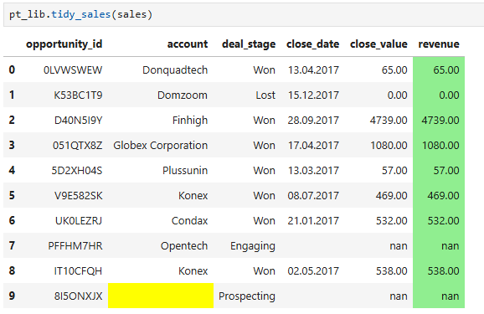
Sales dataset

Slide 8
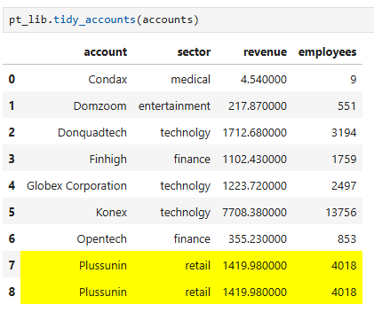
Accounts dataset

Slide 9
Helpful custom methods in Pandas

Slide 10
Attrs property

Slide 11
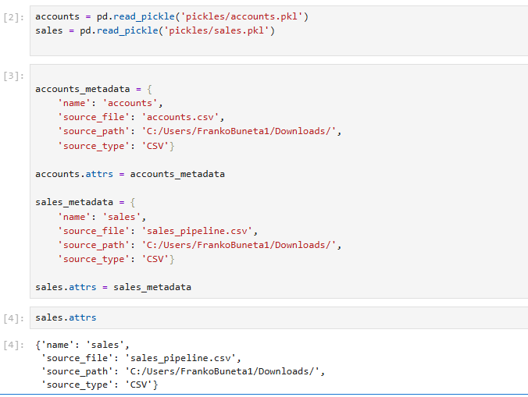
Attrs

Slide 12
Better merge()

Slide 13
Issues with merge()
default join is 'inner' instead of 'left'
will create additional rows if right data frame has duplicate values in join index
will rename columns if left and right df have the same name columns
will convert int64 to float64 if the join creates nulls in int64 series

Slide 14
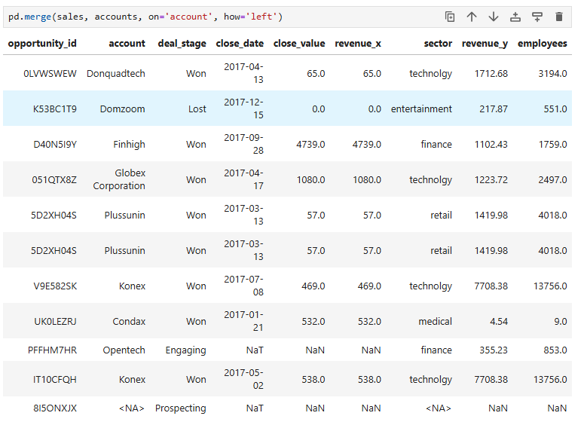
Merge

Slide 15
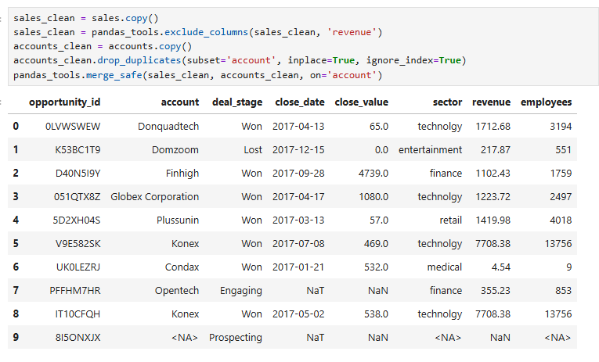
Implementing merge_safe()

Slide 16
Why can't my pandas do that?

Slide 17
What is a register_dataframe_accessor?
@pd.api.extensions.register_dataframe_accessor("name")
it's a decorator of a class
it will "attach" the class using alias "name" to your dataframe as if it were a custom method
it’s the official way to extend pandas without inheritance

Slide 18
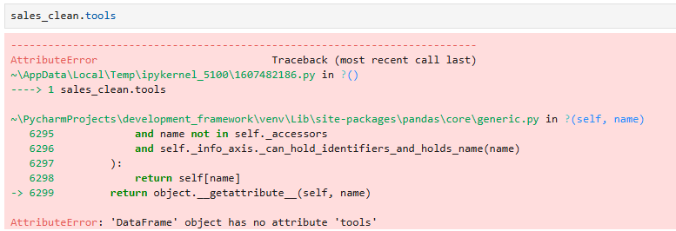

Slide 19
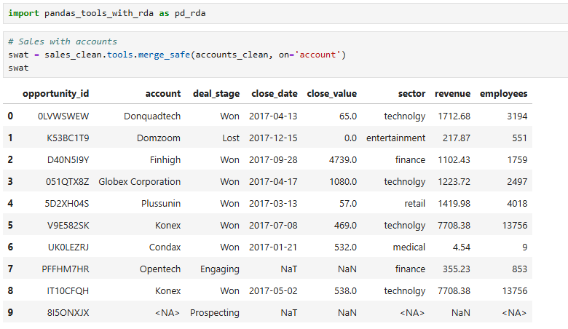
...with RDA

Slide 20
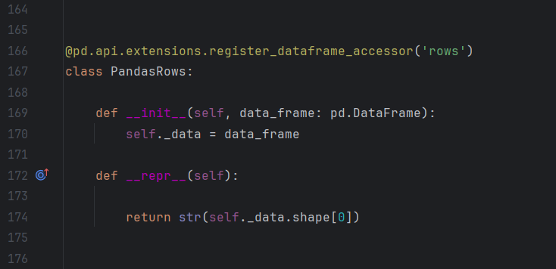
Rows RDA example

Slide 21
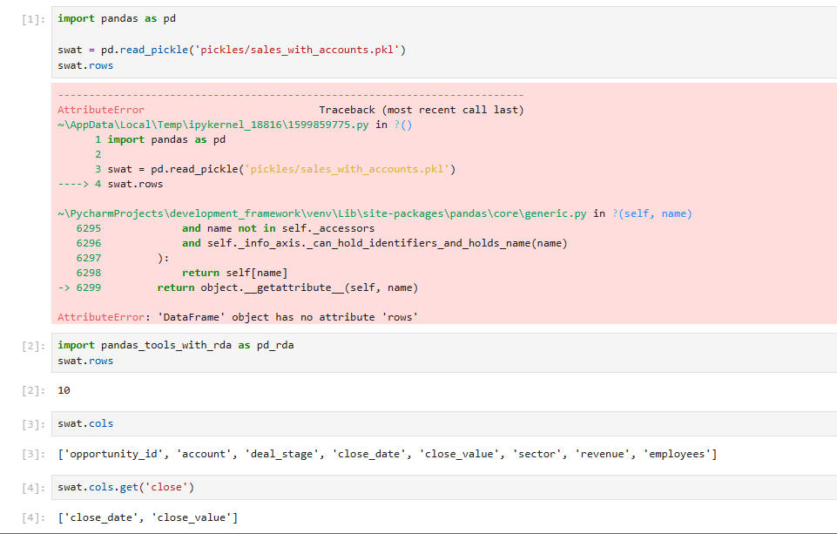
Rows RDA example

Slide 22
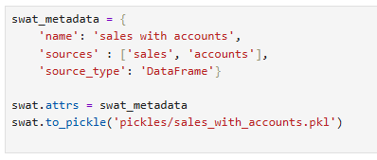
Preparation for next phase

Slide 23
Filtering and updating data with complex criteria

Slide 24
Filtering and .loc

Slide 25
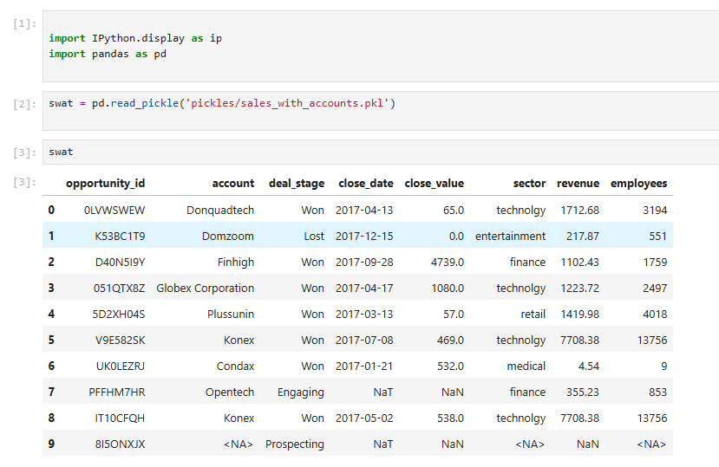
Fixing technology

Slide 26
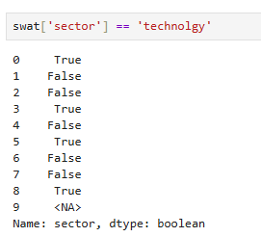
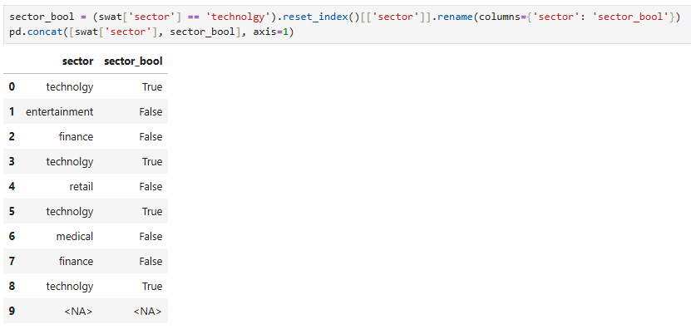
Boolean vector

Slide 27
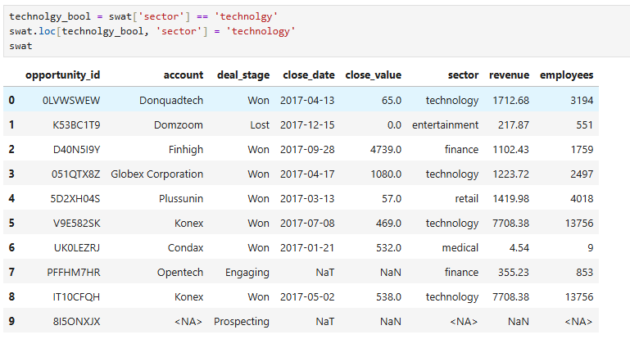
.loc

Slide 28
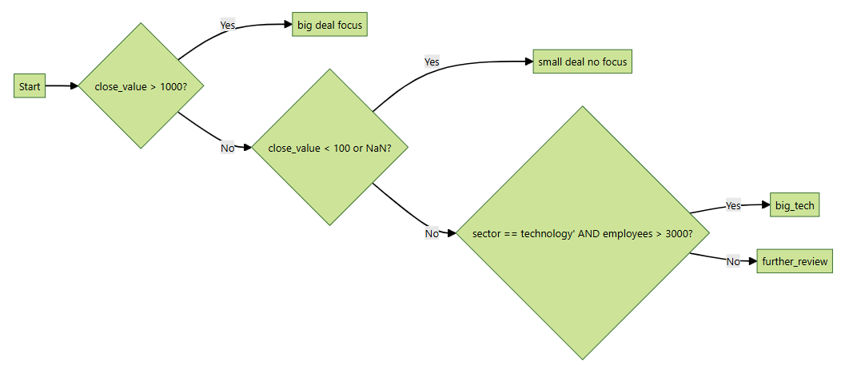
IF...ELSEIF...

Slide 29
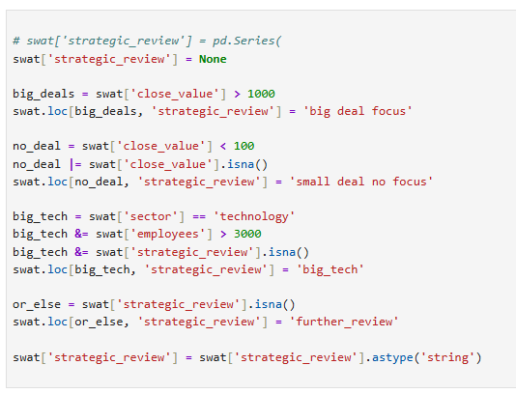
Native filtering

Slide 30
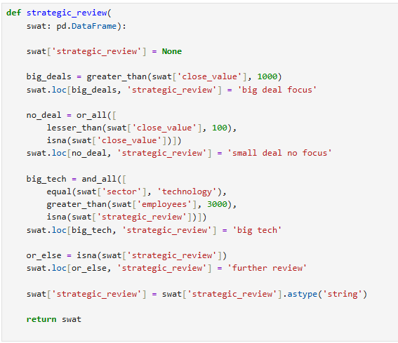
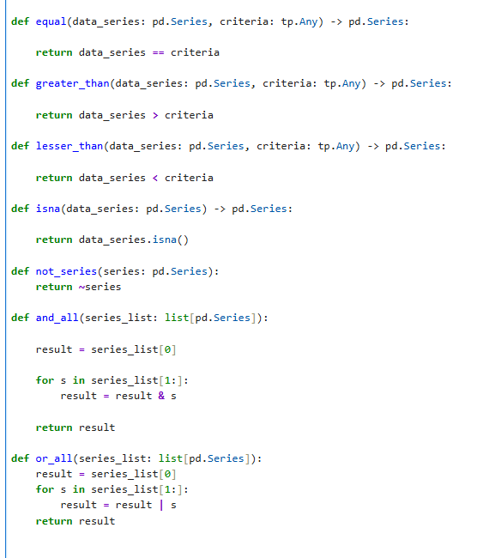
Custom filter functions

Slide 31
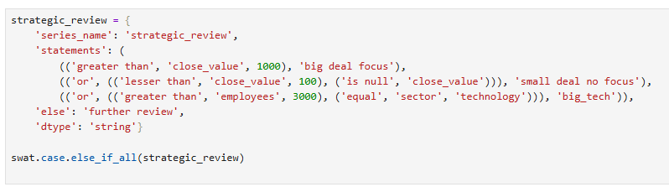
Improved logic

Slide 32
Data lineage and mermaid

Slide 33
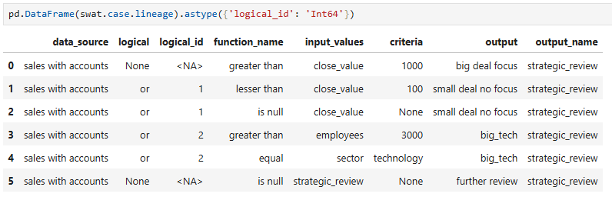
Data lineage

Slide 34
Mermaid
Mermaid markdown is a syntax that uses plain text, similar to Markdown, to describe and automatically generate diagrams and visualizations within a Markdown document. It allows you to create various diagrams, including flowcharts, Gantt charts, and mind maps, by simply writing code in a Markdown file that a Mermaid-compatible renderer can then translate into graphics.
https://mermaid.live/edit
https://jojozhuang.github.io/tutorial/mermaid-cheat-sheet/

Slide 35
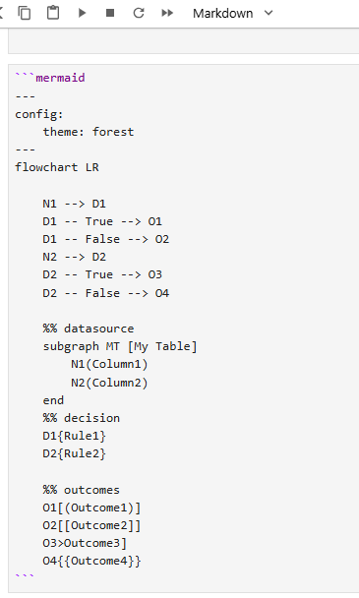
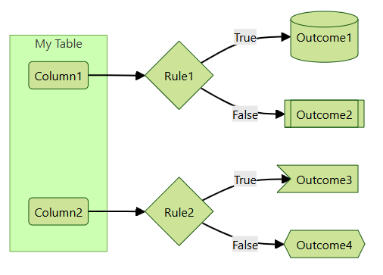
Basic mermaid

Slide 36
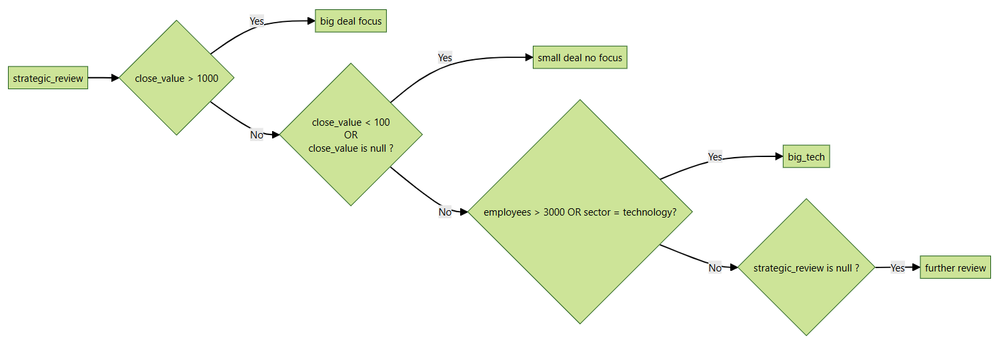
Sales with accounts mermaid flowchart

Slide 37
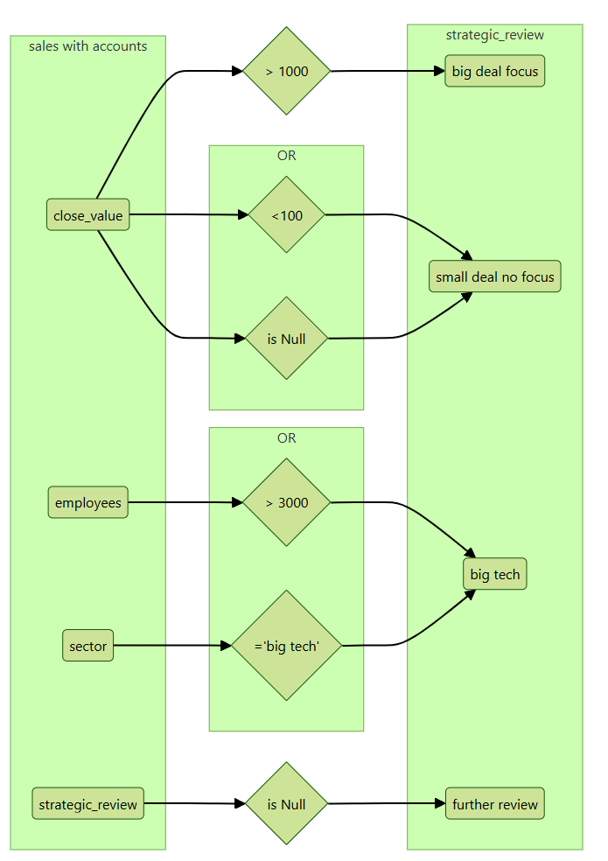
Sales with accounts

Slide 38
Wrapping up...
Helpful custom methods in Pandas
merge_safe
many other examples (.convert.to_category, convert.to_int, cleanup_text, ...)
RDA
Filtering and updating data with complex criteria
incredibly powerful tool
can be made more readeable
Data lineage using Pandas and Mermaid
important for business and traceability

Slide 39
# TODO:
Making one @track_lineage decorator across all functions (would require a lot of conditionals)
Making to_mermaid() converter of case.lineage data

Slide 40
Q&A?

