Slide 1
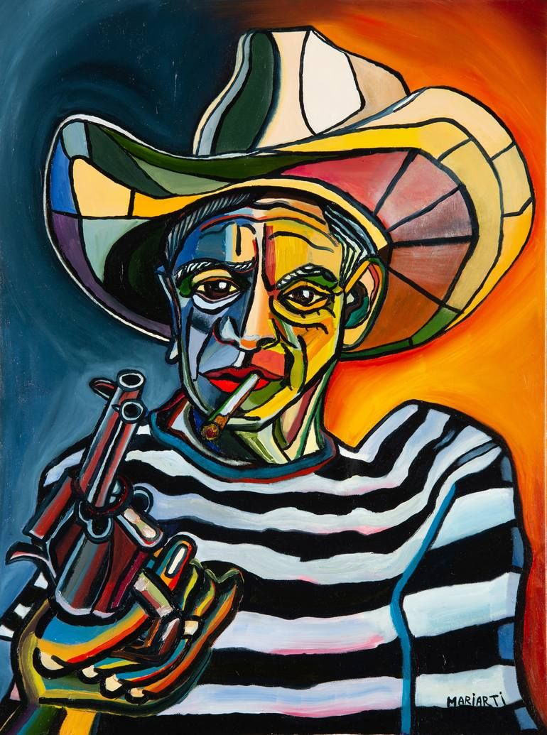
Original Image PNG 140kb
Lossless Compression …..

