Slide 1
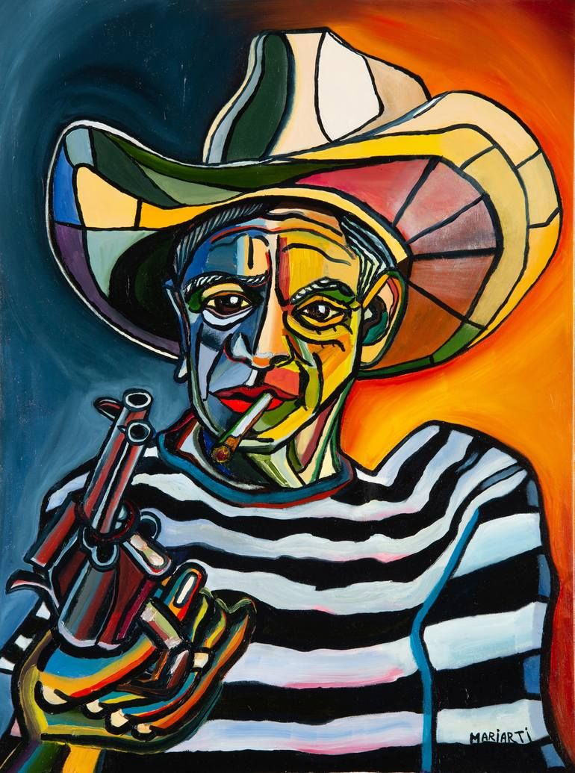

Original Image
Image.png 140kb
Compressed Image
Image.webp 91.3kb

