Slide 1
Obligations
Slides
Export Slides

Slide 2
Problems/Questions
Where to place/anchor obligations?
  As extensions?
  As separate resource?
Differentiation of obligations
Target/Goal of obligations
  Formalize current status
  Give guidelines for „clean/solid“ requirements
Codesystems?
  Simple ones
  As ontology?

Slide 3
Set of Profiles
Standard
derive
Profile
Profile
Profile
Profile
Profile
Profile
independent
Notes:
Filename=profile_set
Links=20
Rechts=30
Oben=10
Unten=200

Slide 4
Profile Hierarchy (for Sender Receiver)
Standard
derive
Base Profile
Sender Profile
Receiver Profile
compatible
Notes:
Filename=profile_interaction
Links=20
Rechts=30
Oben=10
Unten=70

Slide 5
Complete Profile View
Total Set of Obligations on Functions and Data
Workflow 1
Workflow 2
System A
System B
System A
System B
System C
System C
Information Modell
Refers to
Data
Information Modell
Workflow
involves
Actor
has
Functional Requirement
Requirement Level
Node in Hierarchy
Depends on
Activity
Expectation
Direction
Notes:
Filename=profile_view
Links=10
Rechts=10
Oben=10
Unten=10

Slide 6
Consequences
In most cases only some actors needed
With few (1-2) obligations (functional requirements + bound/referenced data)
Data can be referenced for different activities (eg. Store + print) for same actor
  Higher requirement level wins (SHALL store + MAY print => SHALL)
Abstract actor can involve direction-specific actors
  Manager => consumer + response provider (with same or different data)

Slide 7
Obligation Extension
Profile
Actor(s)
Obligation Profile
derive
Notes:
Filename=obligation_extension
Links=10
Rechts=30
Oben=10
Unten=50

Slide 8
Profile Hierarchy with Obligations
logical
technical
Standard
Standard
derive
derive
Profile
Profile
Obligation
Define/add
Obligation
Notes:
Filename=hierarchy_with_obligations
Links=20
Rechts=100
Oben=10
Unten=80

Slide 9
Obligation Resource
Profile
Actor(s)
Obligation(s)
Notes:
Filename=obligation_resource
Links=10
Rechts=30
Oben=10
Unten=50

Slide 10
Obligations and Actors
Generated Profiles
Actor(s)
Profile
Obligation(s)
Main Sender
Sub 1
Sub 2
Sub 3
Receiver 1
Sub 4
Receiver 2
Notes:
Filename=obligation_generated
Links=20
Rechts=20
Oben=10
Unten=20

Slide 11
Profiles and Requirements
Base profile
Creator
Consumer
Function
Function
Data
derived profiles
Data
What to do with the data?
What is the expectation with the data?
What is the expectation with the data?
What to do with the data?
Notes:
Filename=obligation_purpose
Links=20
Rechts=20
Oben=10
Unten=10

Slide 12
Actors, Profiles, and Obligations
Send
Conformant
Compatible
obligation
Profile A
Profile B
Actor 1
Actor 2
Actor ..
Actor ..
Actor n
Profile C
Profile D
Profile E
Profile F
Notes:
Filename=obligation_example1
Links=50
Rechts=20
Oben=10
Unten=40

Slide 13
Profiles and Obligations
Send
Conformant
Compatible
obligation
Profile A1
Profile B1
Actor n
Actor 1
Actor 2
S
R
R
S
R
S
R
S
R
S
R
S
R
S
R
S
Profile A2
Profile B2
Notes:
Filename=obligation_example2
Links=40
Rechts=20
Oben=10
Unten=20

Slide 14
Profile Hierarchy (for Sender Receiver)
Base Profile
All Obligations
splitting
deriving
Sender Profile
Receiver Profile
Sender Obligations
Receiver Obligations
Notes:
Filename=obligation_example3
Links=20
Rechts=30
Oben=10
Unten=100

Slide 15
„Operational Direction“ of Obligations
Base Obligation
Detailed Obligation
S
R
Profile A1
Profile B1
Actor n
Actor 1
Actor 2
b) direct response
d) forward
S
R
R
S
R
S
R
S
a) internal
c) Indirect response
R
S
R
S
R
S
R
S
Profile A2
Profile B2
Notes:
Filename=obligation_operational_direction
Links=20
Rechts=30
Oben=10
Unten=40

Slide 16
Creator / Sender
Creator
Sender
What kind of modification?
From UI
Prepare for creation
Function
How to represent?
From where?
Data
transmission
?
What to do with it?
From storage
Notes:
Filename=actor_sender
Links=20
Rechts=30
Oben=10
Unten=20

Slide 17
Consumer / Receiver
Receiver
Consumer
What kind of modification?
What to consider?
How to get it?
To UI
Extraction
delivery
Function
Data
How is it represented?
What to do with it?
Prepare as response
To storage
What to do with it?
How to react?
Notes:
Filename=actor_receiver
Links=20
Rechts=30
Oben=10
Unten=20

Slide 18
Forwarder
Receiver
Forwarder
Sender
What kind of modification?
What to consider?
Extract from transmission
Transform?
Prepare for creation
delivery
Function
transmission
Data
Data
Notes:
Filename=actor_forwarder
Links=20
Rechts=30
Oben=10
Unten=20

Slide 19
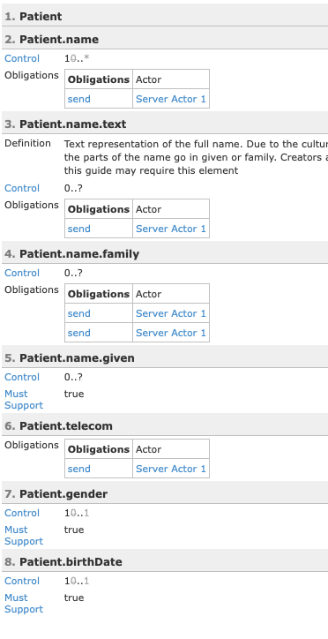
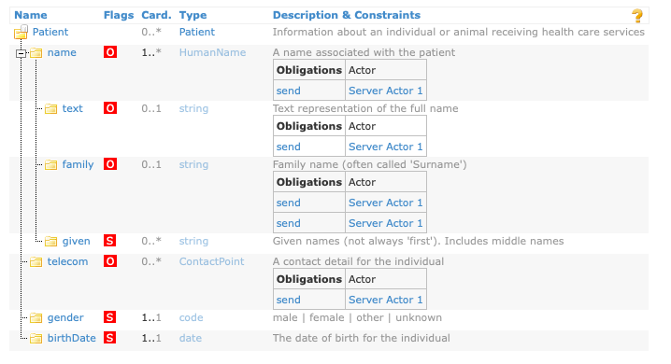

Slide 20
Comparison
Obligation Extension
Obligation Profile
Duplicating obligations,
if not bundled
Bundling obligations

Slide 21
Super Profile
Specialisation for Sender
Specialisation for Receiver A
Specialisation for Receiver B
Sender
Requirements
Receiver A Requirements
Receiver B Requirements

Slide 22
Derivation Hierarchy (Standard)
Base Framework
define
Profiles (with attributes)
Actor (with obligations)
Implementation Guide
constrain
inherit
derive
Profiles
Actor
Implementation Guide

Slide 23
Conformance Constructs
Structure
Data Type
Conformance
Constructs
Usage
Padding
Related
Concepts
Cardinality
Conf. Length
Direct
Length
Truncation
Related
Conformance
Constructs
Vocabulary
Not all standards support all concepts
Standards will use different terms to convey these concepts
Generally a 1-to-1 mapping among standards but not always
If we had to start all over again…
Content
Fixed
Conformance
Statements
Format
Null Values
Default
Data
Semantics
Model
Presence
Encoding
Parsing
Notes:
xfilename=conformance_constructs
xLinks=80
xRechts=80
xOben=30
xUnten=10

Slide 24
Constraint Types
Constraint Types
Constraint Types
Structure
Usage
Cardinality
Length
Content
Data Semantics
Conformance Statement
Type Substitution and Specialization
Restrict
Restrict Range
Restrict Range
Value Set
Fixed
Null Flavors Format
Co-constraints
Refine Narrative or Model
Restrict Keyword
Requirements defined by the conformance constructs in a parent specification are further constrained in accordance to the conformance model of those constructs
Notes:
xFilename=constraint_types
xLinks=70
xRechts=50
xOben=120
xUnten=30

