Slide 1

Recourse
Buyer protection for USDC payments.
Disputes are computed, not decided.
Live on Arc Testnet
Build on Arc · DeFi Track
Solo build · Frank Olien
recourse-arc.vercel.app · github.com/frankolien/recourse

Slide 2
THE PROBLEM
Stablecoin commerce has no safety net.
• Card rails work because buyers can dispute. Chargebacks are why strangers transact with strangers.
• A USDC payment is final the moment it lands. Send first, hope later. That finality is exactly why most people will not use crypto for commerce.
• Merchants have no credible way to promise refunds. A refund policy on a website is a promise, not a mechanism.
• Circle named this problem. Circle Research published the Refund Protocol (April 2025) and listed its open problems publicly. Recourse is a working answer, built on Arc.
WHO DECIDES A DISPUTE?
Card networks the bank decides
Crypto today nobody decides
Recourse the policy decides,
and anyone can recompute it.
Recourse · Build on Arc · DeFi Track
2

Slide 3
THE IDEA
Disputes are computed, not decided.
verdict = f(policy, claim, evidence, attestation, timing)
Immutable policy
A merchant publishes refund rules onchain, once. Every payment escrows USDC under the exact policy hash it was made against. Nothing can change after money moves.
Pure function
First matching rule sets the refund in basis points; the default is zero. No support agent, no platform discretion, no backend able to put a thumb on the scale.
Recomputable by anyone
Every verdict is a deterministic function of public state. Rerun it yourself and you get the same bytes, hash for hash.
Recourse · Build on Arc · DeFi Track
3

Slide 4
HOW IT WORKS
A protected payment, end to end
1
2
3
4
5
Publish policy
Merchant locks refund rules onchain. Immutable from that moment.
Scan and pay
Buyer scans a checkout QR, the phone verifies the hash-bound order, USDC escrows under the policy.
Report a problem
Buyer files a claim in the window with Face ID-signed photo evidence.
Attest the facts
An attestor asserts a narrow fact: delivered or not. Never the outcome.
Verdict settles
The policy engine computes the refund split and moves the funds. Done.
Meanwhile: the settlement vault pays the merchant at T+0, and escrowed funds earn USYC yield for the whole dispute window.
Recourse · Build on Arc · DeFi Track
4

Slide 5
WHY YOU CAN TRUST IT
One verdict function, three independent engines
Solidity
Canonical. The verdict that actually moves funds, computed onchain.
contracts/
TypeScript
Recomputed live in your browser on the public verifier.
engine/
Swift
Recomputed on the buyer's phone inside the iOS app.
mobile/
• 14 golden vectors asserted by forge and vitest in the same commit whenever the engine changes. The three implementations must agree byte for byte.
• The pitch is literal: do not trust the verdict, recompute it. The verifier shows the Solidity hash and the browser hash matching, live at recourse-arc.vercel.app/verify/13.
Recourse · Build on Arc · DeFi Track
5

Slide 6
NOT A MOCK
All three outcomes have already settled on Arc
PAYMENT #13 · $5.20
A buyer got refunded
Disputed as Not delivered from a physical iPhone, attested, rule 0 matched: 100 percent refund. Exactly 5.20 USDC landed back in the buyer's wallet.
resolve 0x6c9eabc8..485351
PAYMENT #15
A bad claim got denied, provably
Wrong item is not covered by its policy. No rule matched, the deterministic default (0 bps) applied. The merchant received the funds plus the yield earned while disputed.
resolve 0x209890e6..5e5408
PAYMENT #14 · $7.00
A merchant got paid at T+0
Escrowed until Aug 7, but the vault advanced $6.93 the same minute (1 percent fee) and took assignment of the escrow claim.
advance 0xa2411d96..4fb1b8
Chain 5042002 · every attestor run and settlement is logged with its hashes in the repo · 17 payments indexed live
Recourse · Build on Arc · DeFi Track
6

Slide 7
THE DEFI ENGINE
A settlement vault turns protection into a yield market
• LPs deposit USDC into the settlement vault and fund instant merchant payouts.
• T+0 advances. The vault pays the merchant net of a 1 percent fee the moment escrow opens, and takes assignment of the escrow claim.
• Productive escrow. While disputed, escrowed funds sit in a USYC-style yield adapter. Yield splits between beneficiary and protocol treasury at settlement.
• Bounded risk. Refund losses are capped by immutable policies and per-merchant exposure caps. Every term is inspectable onchain.
LP RETURN
advance fees + float yield
- refund losses
LIVE, ON ONE BOOKED ADVANCE
Share price 1.000312 → 1.009064
Merchant received $6.93 of $7.00 at T+0; the vault collects the full escrow at settlement.
Recourse · Build on Arc · DeFi Track
7

Slide 8
WHO IT SERVES
A three-sided market, all live today
Buyers
NATIVE SWIFTUI IOS APP
• Secure Enclave device wallet, no seed phrase
• Camera-scannable checkout QRs with verified order review
• Face ID-signed evidence upload
• Receipts whose outcomes are recomputable on the phone
Merchants
IOS + WEB WORKSPACE
• Publish immutable refund policies once
• Checkout QRs with hash-bound order details
• Paid instantly through the vault at T+0
• Buyer keeps the full protection window
Liquidity providers
THE VAULT
• Deposit USDC, fund merchant advances
• Earn advance fees plus USYC float yield
• Losses bounded by policies and exposure caps
• Live TVL and share price on /vault
Recourse · Build on Arc · DeFi Track
8

Slide 9
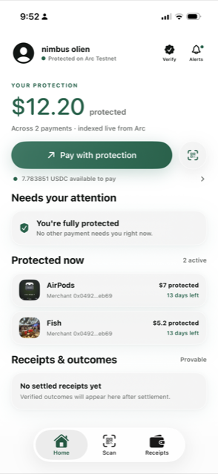
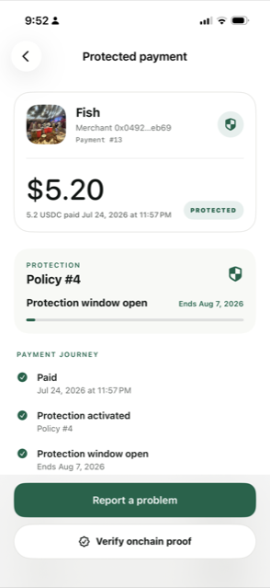
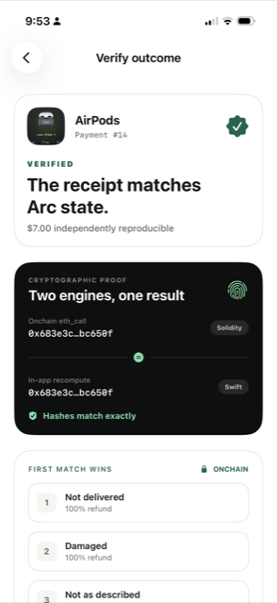
LIVE TODAY
Try it before you judge it
recourse-arc.vercel.app
Landing, merchant workspace, live dashboard
/verify/13 · /verify/15
Public verifier: refund and denial, hashes matching
/vault
LP vault: live TVL, share price, open advances
/litepaper
Full protocol litepaper, v0.1
api.frankolien.com
Rust indexer + read API, holds no business logic
github.com/frankolien/recourse
Contracts, engines, iOS, web, backend, ops log
Recourse · Build on Arc · DeFi Track
9

Slide 10
STATUS
Where it is, and the honest path to production
SHIPPED, SOLO
• Contracts live on Arc testnet: escrow, policy engine + registry, settlement vault, yield adapter
• Verdict engine in Solidity, TypeScript, and Swift with cross-asserted golden vectors
• Native iOS wallet, web workspace, public verifier, Rust indexer
• All three market outcomes settled onchain, hashes logged
KNOWN LIMITS · NEXT
• Single demo attestor today; the design already bounds what any attestor can do. Next: N-of-M delivery oracles
• Yield adapter mocks USYC until Teller access is approved
• Vault needs inflation-attack hardening; contracts are unaudited
• The trust model came first: everything the backend does is reproducible from public state or breaks a hash
recourse-arc.vercel.app · github.com/frankolien/recourse · Frank Olien
Recourse · Build on Arc · DeFi Track
10

