Slide 1
Sotto
Confidential payouts
on a public ledger.
Pay your whole team in one batch — each party sees only their own line, an auditor verifies everything, and it all settles atomically.
● Live on Canton Frank · Build on Canton (ENCODE Club)

Slide 2
THE PROBLEM
Pay your team on-chain, and
you've published the payroll.
Every blockchain payment is public by default. That single fact is why payroll, grants, and token distributions still run off-chain — or leak. Privacy is the thing keeping real money off public rails.

Slide 3
THE INSIGHT
One batch. Four kinds of eyes.
A payout isn't one audience — it's four. Sotto serves all four from one shared batch, and the ledger shows each party only what they're allowed to see.
Payer
Lumen Studio
The whole batch. Runs the payout.
Recipient
Amara Okafor
Only her own line. Nothing else.
Approver
Priya Raman
Only the over-threshold payment.
Auditor
Hale & Co.
Every receipt — read-only.

Slide 4
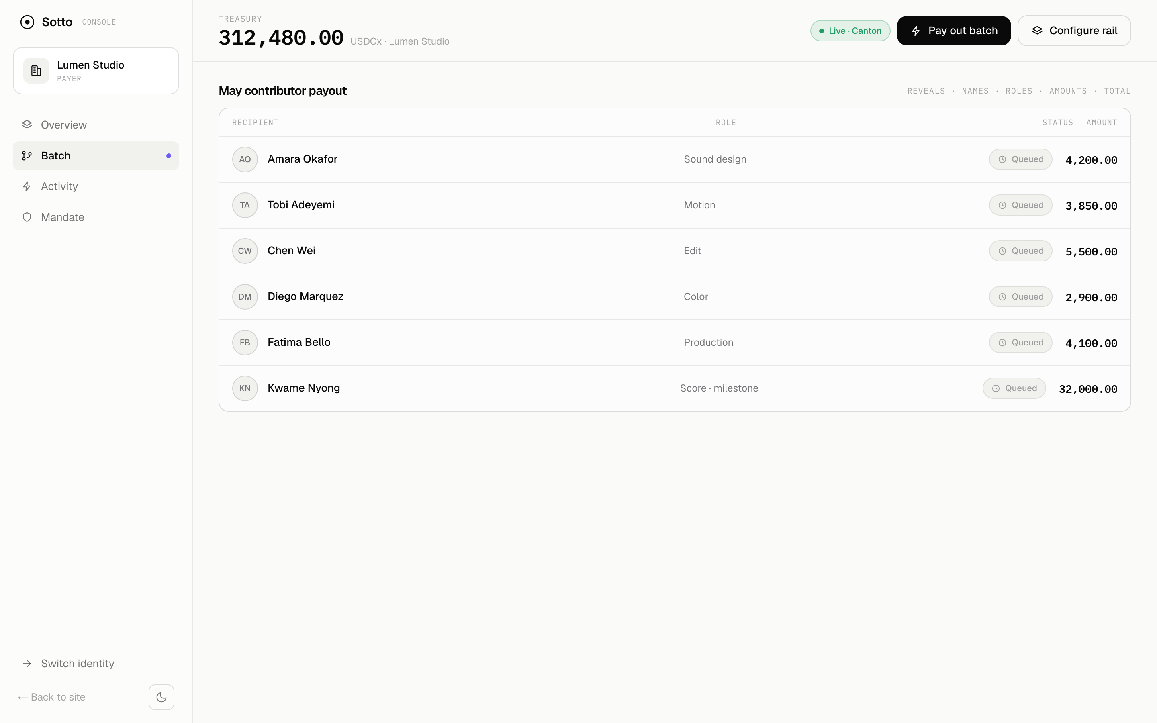
THE PRODUCT
One batch in. Four private views out.

Slide 5
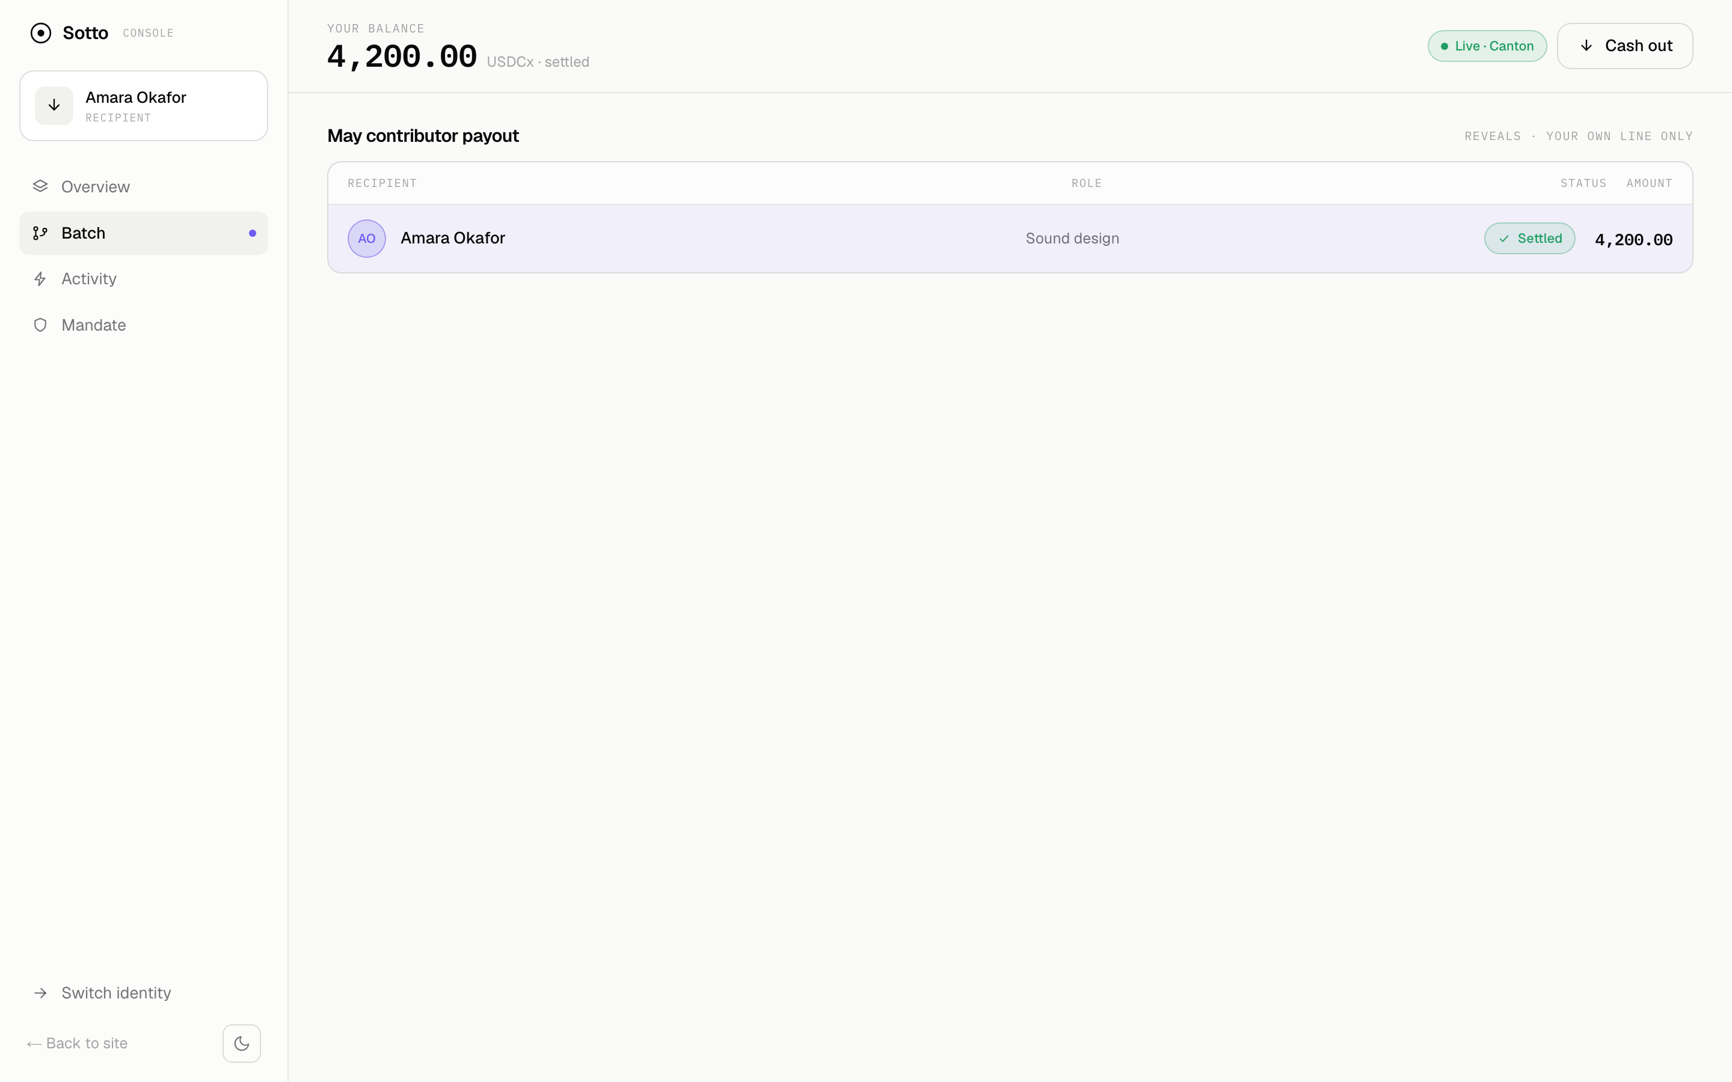
THE WHOLE PITCH, IN ONE FRAME
Same batch. Same instant. Two truths.
PAYER — sees all six
RECIPIENT — sees one
The other five aren't blurred — they never arrived. The ledger never disclosed them to her.

Slide 6
HOW IT WORKS
Privacy isn't a setting. It's the contract.
Daml contract | Who the ledger discloses it to
Holding | issuer + owner only
DisbursementReceipt | its recipient + the auditor
PayoutMandate | payer + auditor (atomic Disburse)
LargePaymentProposal | + approver (maker–checker)
Machine-checked: dpm test asserts each party's visibility — green, before any UI exists.

Slide 7
WHY CANTON
Private and atomic — in one L1.
Most chains make you choose. Canton doesn't.
Public chain (e.g. Ethereum)
Atomic settlement — but every party sees everything. Privacy is a bolt-on: mixers, ZK.
Canton
Sub-transaction privacy AND atomic multi-party settlement, native. Each party sees only their part.

Slide 8
WHAT'S REAL
This isn't a mockup.
It's live on Canton.
✓ Live ledger — the console reads & writes real Canton contracts
✓ Backend — RS256 / JWKS auth · just-in-time wallets
✓ Daml model — privacy proven green in test
Sample data is only the fallback, so the demo can never break.

Slide 9
ONBOARDING
No seed phrase. No wallet to connect.
Users log in with email or SSO. The backend provisions each person's Canton party behind the scenes on first sign-in. The crypto is invisible — the privacy is the only thing you notice.

Slide 10
WHERE IT GOES
Payments & neobanking primary
RWA & tokenized deposits secondary
First wedge: confidential payroll and contractor payouts for orgs that want stablecoin rails but can't expose comp. Then supplier settlement, grants, and tokenized-deposit payouts — anywhere many private payments must settle together and stay auditable.

Slide 11
Sotto
Confidential payouts,
enforced by the ledger.
Pay everyone at once · show each person only their line · let an auditor verify all of it.
🔗 sotto-pay.vercel.app github.com/frankolien/sotto

