Slide 1
Ubuntu in mac steps

Slide 2
1. https://vocus.cc/article/63d11eddfd89780001f3daf4
2. https://www.youtube.com/watch?v=oi8f6hVI2P4
之後新創ubuntu 不需要安裝ubuntu-desktop
Multipass常用指令：https://xenby.com/b/333-%E6%8E%A8%E8%96%A6-%E6%8C%87%E4%BB%A4%E5%BC%8F-ubuntu-%E8%99%9B%E6%93%AC%E6%A9%9F%E5%99%A8%E7%AE%A1%E7%90%86%E5%B7%A5%E5%85%B7-multipass
Gig3 in stall neofetch
Neofetch可以看系統overview

Slide 3
OD-ubuntu-2204
Sudo apt update
Sudo apt upgrade –y
Sudo reboot
sudo apt install python3-pip
Pip3 install Falsk
Pip3 install flask_admin

Slide 4
Docker installation
https://www.youtube.com/watch?v=cqbh-RneBlk
Sudo apt install docker.io
Sudo systemctl enable docker(使開機都會啟動docker)
Sudo systemctl status docker(看docker狀態)
Sudo systemctl start docker(run the service)
Docker加速器：
curl -sSL https://get.daocloud.io/daotools/set_mirror.sh | sh -s http://f1361db2.m.daocloud.io
Ip addr 看ip位置

Slide 5
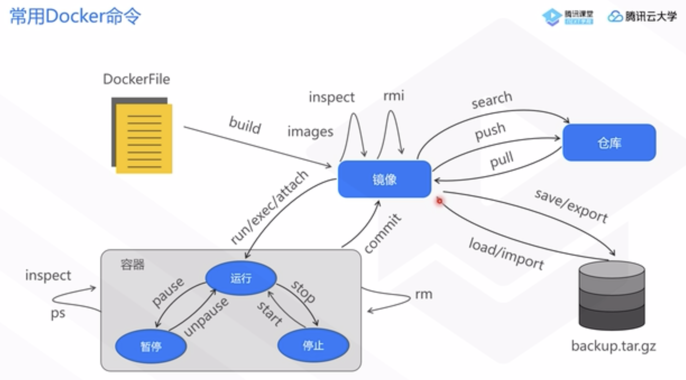
Docker installation

Slide 6
Docker installation
Sudo docker pull python:3.10
Sudo docker images (可以看有的images)
sudo docker inspect python:3.10(可以看pytho版本和pip版本)
sudo docker save python:3.10 > /home/ubuntu/Desktop/python_image_test.tar(將鏡像存成.tar)
sudo docker rmi python:3.10(刪除鏡像)
sudo docker load < /home/ubuntu/Desktop/python_image_test.tar(讀取.tar鏡像)

Slide 7
container
sudo docker run -it --name=c1 python:3.10 bash(創建名為c1的容器，使用python:3.10鏡像)
sudo docker ps –a(查看容器狀態)
sudo docker start c1(啟動容器)
Sudo docker pause c1(暫停容器)
Sudo docker unpause c1
Sudo docker stop c1
Sudo docker exec –it c1 bash (進入到容器)
sudo docker inspect c1(看訊息例如ip)
sudo docker rm c1(要先stop後才可以刪除)

Slide 8
Create network
Sudo docker network create –-subnet=172.18.0.0/16 mynet(定義docker的網段和名稱)
Sudo docker network ls(看網段)
Sudo docker network rm mynet(刪除網段)
sudo docker run -it --name=c1 --net mynet --ip 172.18.0.2 python:3.10 bash(分配固定地址)
Ip addr(創建後看ip)
sudo docker network connect --ip 172.18.0.2 mynet c1(連結原本創建的containe和network)
sudo docker run -it -p 9500:5000 -p 9501:3306 --name=p1 python:3.10 bash(將容器內部端口映射到主機端口)
Sudo docker network ls (可看所有network)
sudo docker network inspect mynet(可看IP)

Slide 9
掛載目錄（目錄映射）（可以使文件同步在主機與容器，雙向的）
sudo docker run --name m1 -p 4360:3306 --net mynet --ip 172.18.0.3 -e MYSQL_ROOT_PASSWORD=FRANKWUfrankwu -v /root/mysql:/var/lib/mysql -d mysql:8.4.0
sudo docker inspect my-container （可以看到掛載的位置）
"Mounts": [
{
"Type": "bind",
"Source": "/host/directory",
"Destination": "/container/directory",
"Mode": "rw",
"RW": true,
"Propagation": "rprivate"
}
]
sudo docker run -it -d --name=p1 -p 9500:5000 -v /home/ubuntu/Desktop/first_deploy:/root/first_deploy --net mynet --ip 172.18.0.2 python:3.10 bash (掛載到p1)

Slide 10
創建容器
sudo docker run –it –d –name=p1 –p 9500:5000 –v /home/ubuntu/Desktop/docker_project –net mynet –ip 172.18.0.2 python:3.10 bash(-d 在後台可以運行)

Slide 11
mySQL
Pip3 install falsk
pip3 install mysql-connector-python
pip3 install sqlalchemy

Slide 12
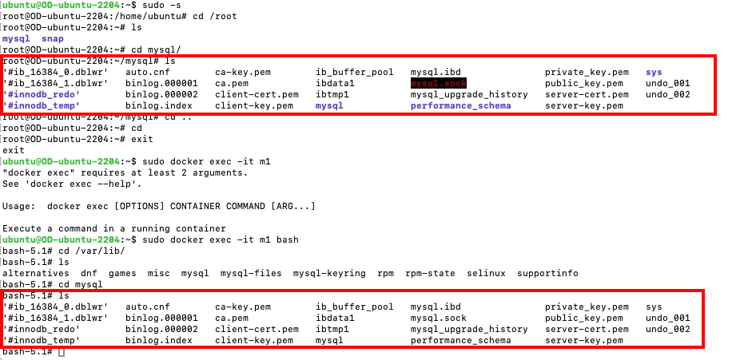
創建Mysql容器
sudo docker pull mysql:8.4.0
sudo docker run --name m1 -p 4360:3306 --net mynet --ip 172.18.0.3 -e MYSQL_ROOT_PASSWORD=FRANKWUfrankwu -d mysql:8.4.0

Slide 13
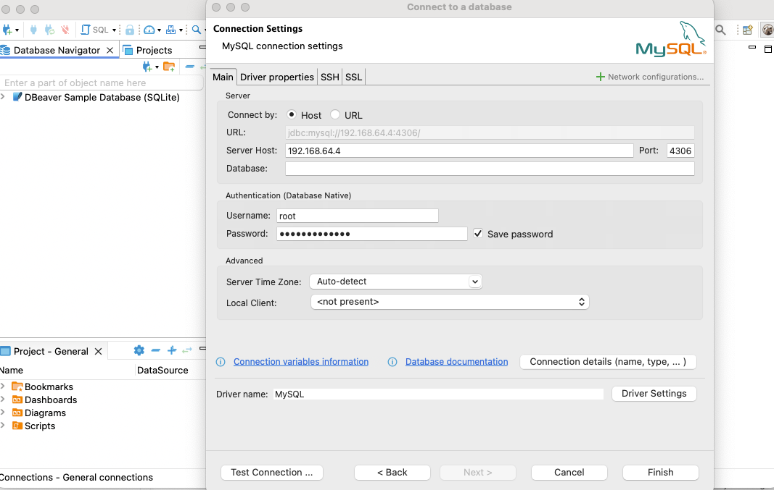
Dbeavor 24.1.0管理數據庫
https://www.cnblogs.com/nigx128/p/Jf4QN.html參考

Slide 14
Dbeaver errors
Public Key Retrieval is not allowed
https://sinyilin.github.io/SQL/20230425/4002286829/#google_vignette
Public Key Retrieval is not allowed
https://blog.csdn.net/ngl272/article/details/70217499

Slide 15
SQL Alchemy
SQLAlchemy是為Python程式語言提供的開源SQL工具包及對象關係對映器（ORM），是在MIT許可證下發行的軟體。
https://zh.wikipedia.org/zh-tw/SQLAlchemy

Slide 16
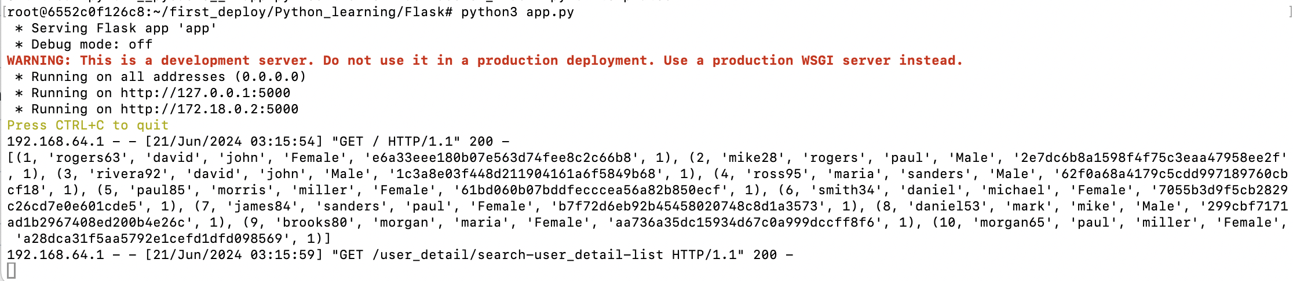
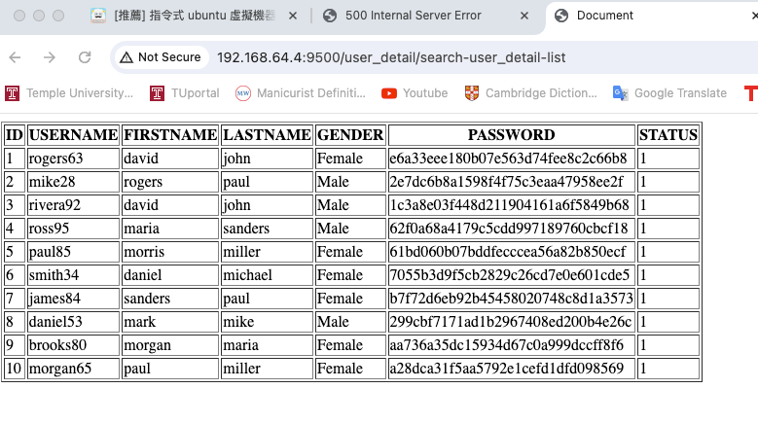
容器打開app.py
Mac端打http://192.168.64.4:9500/user_detail/search-user_detail-list
由192.168.64.4的9500端口對印到172.18.0.2:5000

Slide 17
9500
5000
MacOS
192.168.64.1
Ubuntu docker
192.168.64.4
Python container
172.18.0.2
4360
3306
MYSQL container
172.18.0.3

Slide 18
Pypy
Docker pull pypy:3.10-7.3.16
Docker run –it d –name p2 –net mynet –ip 172.18.0.4 –p 9600:5000 –v /root/pypy:/root/pypy pypy:3.10-7.3.16

Slide 19
ubuntu@OD-ubuntu-2204:~$ sudo docker pull hello-world Using default tag: latest Error response from daemon: error parsing HTTP 408 response body: invalid character '<' looking for beginning of value: "<html><body><h1>408 Request Time-out</h1>\nYour browser didn't send a complete request in time.\n</body></html>\n” 沒辦法pull的問題，可以試試看換網路，云辰外網dlink-Sales會出現error，但手機網路不會

