Slide 1
AMB82 realtek
12.23.2024

Slide 2

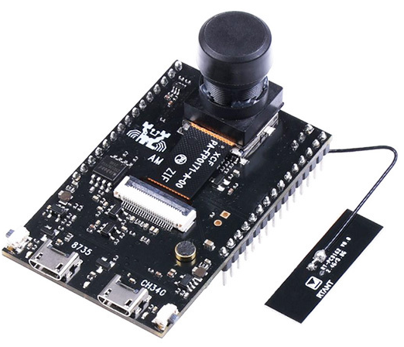
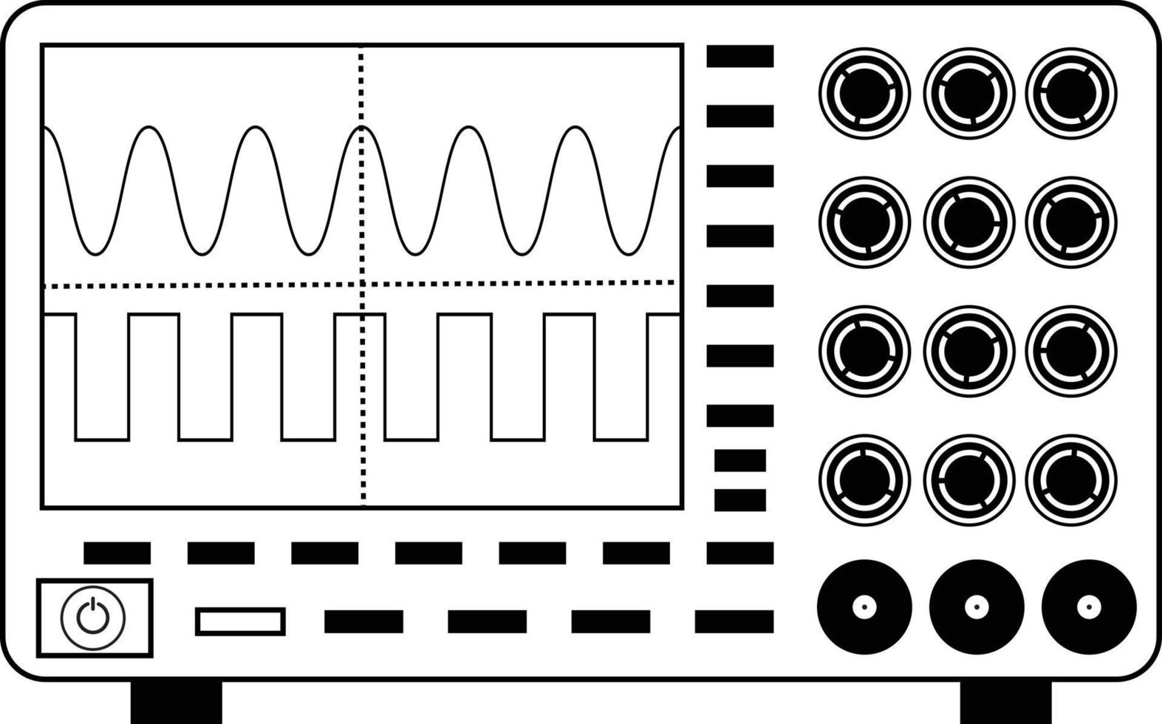

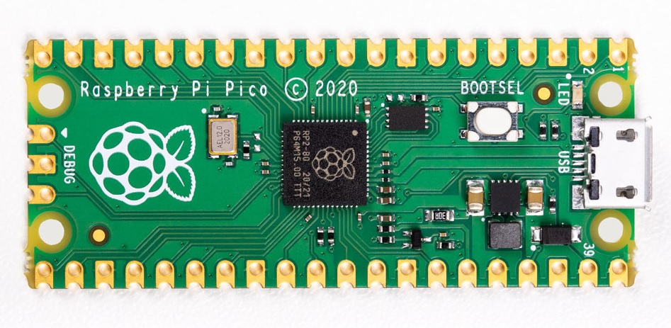
Serial
Serial
Current sensor
DC
I2C

Slide 3
