Slide 1
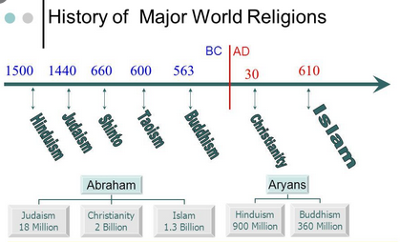
Notes:
https://amazingbibletimeline.com/blog/mohammed-was-born-in-mecca/

Slide 2
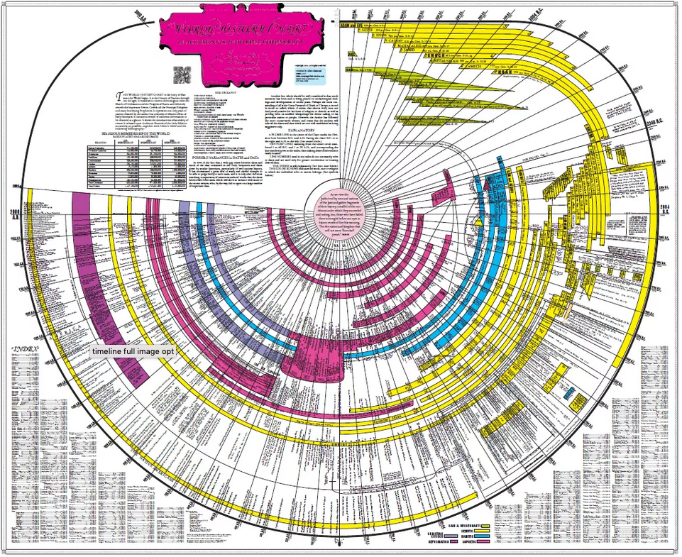
Notes:
https://amazingbibletimeline.com/

Slide 3
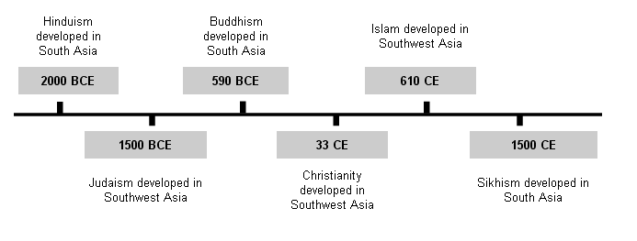

Slide 4
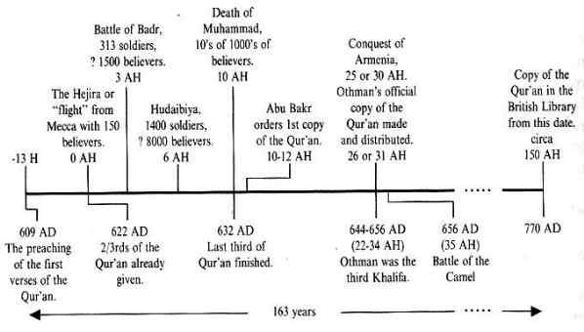

Slide 5
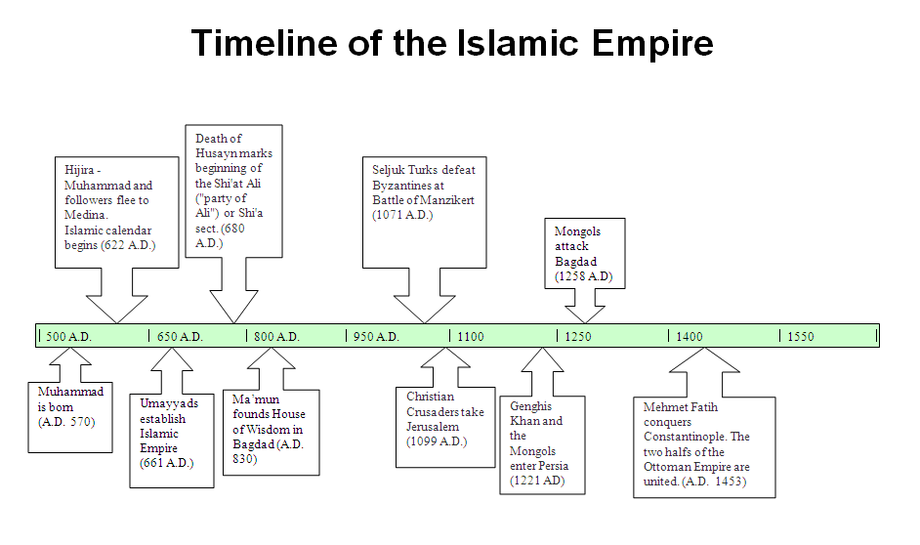

Slide 6
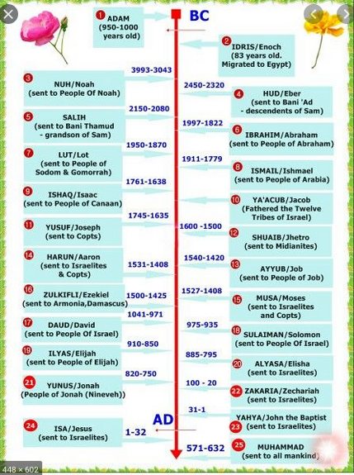
Egypt
Palestine (Isreal)
Babylonian / Arabia (Garden of Edan)
Adam (~1000 yrs old)
Enoch (~83 yrs old)
HUD/Eber (2450-2320)
Noah (3993-3043)
SALIH (2150-2080)
Abraham (1997-1822)
Lot (1950-1870)
Isaac (1761-1638)
Ismael (1911-1779)
Jacob (1700-16??)
Levi’s (Priest)
10 Tribes
Joseph (1745-1635)
Jethro (1600-1500)
Aaron (1531--1408)
Job (1540-1420)
Moses (1527-1408)
Eliajah (910-850)
David (1041-971)
Ezekiel (1500-1425)
Elisha (885-795)
Solomon (975-935)
Zechariah (100-20)
Jonah (820-750)
John the Baptist (31-1)
Jesus (1-32)
Muhammad (571-632)

Slide 7
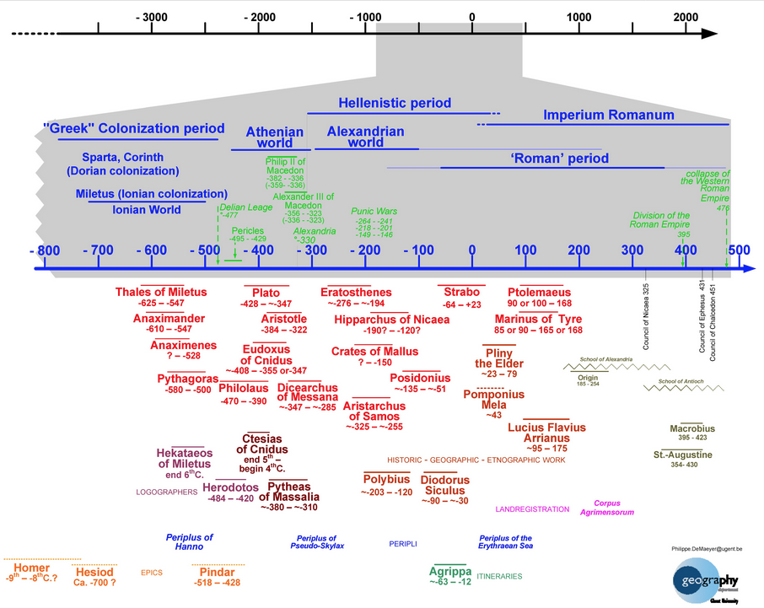
Notes:
https://www.bimcc.org/old/images/cartography_timeline_min800_500.jpg

