Slide 1
Rock it

Slide 2
High level concept of my very original game
“Rock It” is a remix of the classic game Pac Man.
The goal of the game is collect “Whammy Bars” until you have enough to play the final song of the level.
Each level has a game winning song.
Once the final song starts playing, you must still collect enough whammy bars to keep to song playing. You beat the level once the song plays all the way through.
However, once your final song starts playing “auto tunes” randomly appear in the game, hitting to many of these and not enough Whammy Bars will cause the song to stop.

Slide 3
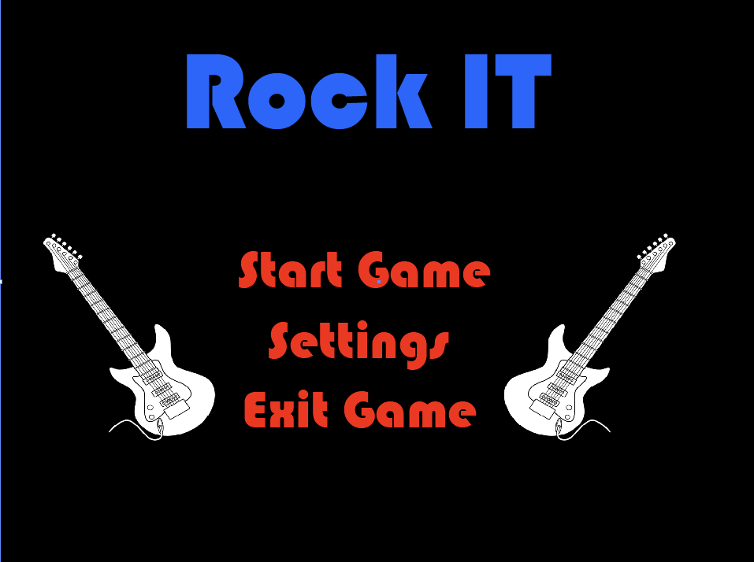

Slide 4
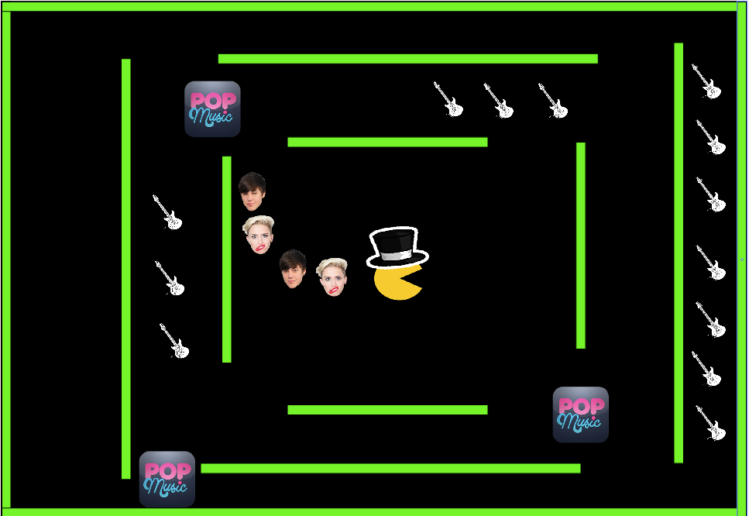

Slide 5
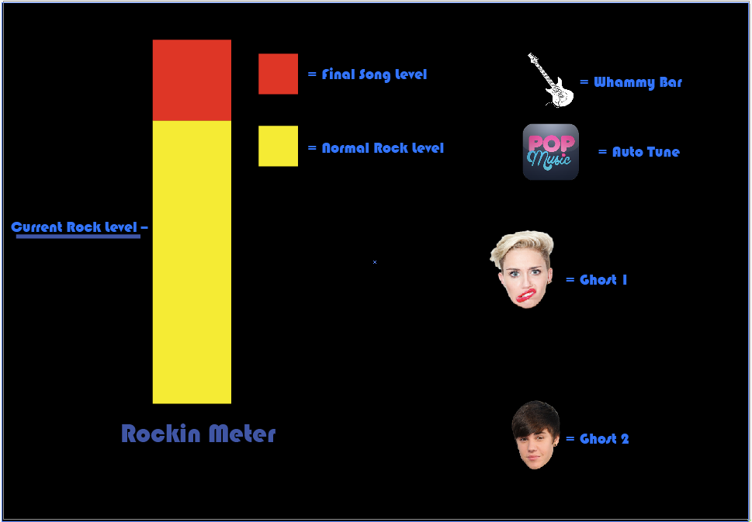

Slide 6
Thats all there is…any questions?

