Slide 1


CS 5810 Data Mining Course Information
Spring 2025
Computer and Information Sciences
Professor: Shebuti Rayana

Slide 2


Course Description
This course covers the fundamental concepts and techniques useful in discovering knowledge hidden in real-world data sets.
Topics include introduction to data mining, data preprocessing, exploratory data analysis, data visualization, frequent pattern matching, association rule, classification, clustering, anomaly/outlier detection, big data frameworks, text mining, time series mining, web data analysis, evaluation, and reporting.
Discusses important real-world applications of data mining.
This course is suitable for CS students and also students from other departments.
The theoretical concepts are motivated and introduced through practical problems with real-world and simulated datasets using Python.
The course emphasizes engaging students in Mining Data through both theory and hands-on programming approaches to learn the fundamentals.
The course final project will be carried out in groups of two.

Slide 3
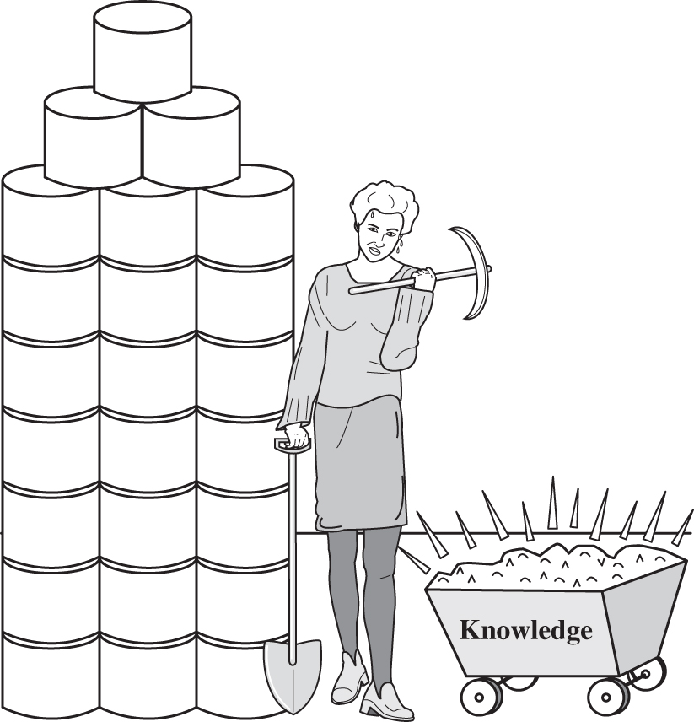
Course Objectives
Ability to analyze and construct knowledge from data
and gain an understanding of what data mining is all about.
Develop skills in using Python for solving practical problems using real-world datasets.
Describe key concepts of data summarization and visualization and how to apply them with Python.
Understand the basic foundations of predictive models (classification) as well as several key descriptive modeling methods like clustering, anomaly detection, and association rules. Also advanced techniques in text, time series, and web data mining.
Describe the problem of model evaluation and selection and be able to apply adequate methods to select a model for a concrete data set.
Develop and apply critical thinking, problem-solving, and decision-making skills by working on the assignments and the final project.
At the end of this course, I would expect students to become interested in doing further studies and pursuing a career in Data Science.

Slide 4
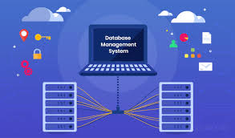

Course Prerequisite
A grade of C or higher is needed in
CS4550, MA3210 or MA2000, ECII

Slide 5
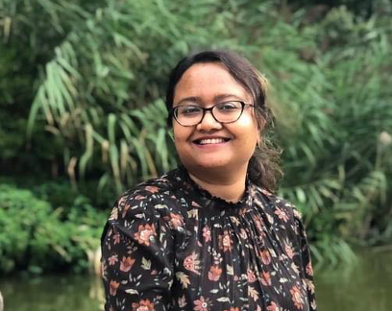
Instructor Information
Professor: Shebuti Rayana
Office Hours:
Tuesday 11:30 AM – 1:30 PM
Thursday 11:30 AM – 1:30 PM
Location: NAB 1016 (or Zoom-ask for link)
Email: rayanas@oldwestbury.edu
Please include “CS5810” in the email subject and your name and student ID in the email body when you contact me. You can also send me message in Discord in case of any emergency. Use your real name in Discord.

Slide 6

Class Information
Lectures and Labs
TuTh 9:50 AM – 11:30 AM Lecture
Location
NAB 3104 for Lectures
Brightspace will be used for lectures, grades, homework assignments, final project and other course materials.

Slide 7

Textbook
Introduction to Data Mining
Second Edition by Pang-Ning Tan,
Michael Steinbach, Anuj Karpatne,
and Vipin Kumar
Pearson
ISBN 978-93-544-9104-7
Link to textbook resources:
https://www-users.cse.umn.edu/~kumar001/dmbook/index.php#new

Slide 8
Chapters from Textbook
Chapter 1: Introduction
Chapter 2: Data
Chapter 3: Classification: Basic Concepts and Techniques
Chapter 4: Classification: Alternative Techniques
Chapter 5: Association Analysis: Basic Concepts and Algorithms
Chapter 7: Cluster Analysis: Basic Concepts and Algorithms
Chapter 8: Cluster Analysis: Additional Issues and Algorithms
Chapter 9: Anomaly Detection
Notes:
Not everything in these chapters are covered check lecture slides for that

Slide 9
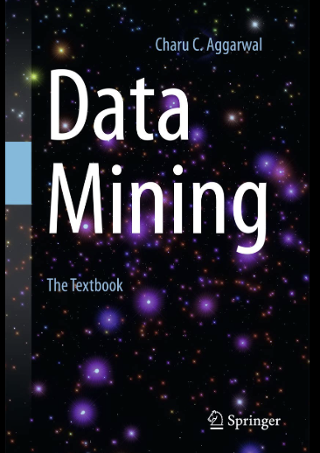
Textbook
Data Mining
by Charu C. Aggarwal
Springer
ISBN 978-3-319-14141-1
Link to textbook resources:
https://charuaggarwal.net/Data-Mining.htm

Slide 10
Chapters from Textbook
Chapter 1: An Introduction to Data Mining
Chapter 2: Data Preparation
Chapter 3: Similarity and Distances
Chapter 4: Association Pattern Mining
Chapter 6: Cluster Analysis
Chapter 8: Outlier Analysis
Chapter 14: Mining Time Series Data
Chapter 18: Mining Web Data

Slide 11



Programming Language and Tools
Programming Language: Python
Editors:
Jupyter Notebook
Google Colab
https://colab.research.google.com/

Slide 12

Exam Dates
Final Exam: 05/15/2025, classtime, in class
Midterm Exam: 03/06/2025, classtime, in class
See the College schedule for the exams.

Slide 13

Exam Rules
It is the responsibility of the student, to know when exams are being given.
No extra time is given if you start your exam late.
Exams that are missed will not be given a makeup unless a valid excuse is given for not being able to take the exam on time
an illness, or
an accident, or
a death in the family
(You will need to supply supporting documentation, such as a doctor’s note for an illness, or an accident report for an accident)
All missed exams will result in a zero for that exam.
Only one make-up exam will be given for a missed exam with a valid reason. There is no make-up for a make-up.

Slide 14

Grading Schema
Midterm: 15%
Final: 25%
Final Project: 20%
Homework: 20%
Quizzes: 10%
Participation Activity: 10%
Extra credits: 5%

Slide 15

Final Project
Project Proposal
Project Progress Report
(intermediate report)
Code
Final Report
Final Presentation
Poster

Slide 16

Grading Information
Final Grade
The final grade you receive in this course will reflect the extent to which you have mastered data mining concepts and their applications using Python
How much someone needs a specific grade or how close they are to the next higher grade will not affect grade
The grades provided at the end of the semester is final, except for situations involving grading errors
Final grade will not be altered for any reason.
So please do NOT ask me to do so!

Slide 17

Homework/Project Submission
Submit homework/project in Brightspace.
Submit your code, report, and/or presentation slides as a single .zip archive. The .zip file name should be in the following format:
< firstname >_< lastname >_< id > _< assignment_name >.zip
For example, if John Doe with student ID 123456789 is submitting the first homework, the submitted file should be named john_doe_123456789_hw1.zip

Slide 18

Late Homework
Don’t turn in late homework/project! If you start the assignments early, you will have enough time and resources (office hours etc.) to finish it.
If you turn in your assignment 1 hour to 24 hours late it’s minus 10% of your grade on that assignment.
If you turn in your assignment 24 hours to 48 hours late, it’s minus 30% of your grade on that assignment.
After that, it’s 0% unless we previously made any arrangements for you to turn in the assignment late.
No Excuses!

Slide 19

Discord: Discussion Channel
You can send instant messages to your peers and your instructor in Discord.
Do not share your work with your peers on Discord.
If you submit similar work, you will be penalized.
There is also a Voice channel which can be useful for group study.
Discord link to join the channel is provided in the syllabus.

Slide 20
Spring 2025 Resources
Important Dates and Deadlines (Add/Drop, Withdrawal, CR/NC)
Spring 2025 Important Dates, Deadlines and General Information | SUNY Old Westbury
Help with courses, tutoring, mentoring, advising
Resources Supporting Student Success
Help with technology or logging into OW accounts
IT Service Request
What is happening in the campus community?
Panther Connect
Connect to the Library
Library at SUNY College at Old Westbury
Assistance with stress, interpersonal, emotional challenges
Counseling & Psychological Wellness Services
Health care services
Student Health Center

Slide 21
Spring 2025 Resources
Struggling with housing or food insecurity
Panther Pantry
Housing Insecurity Risk Form
Off-Campus Housing Search
Students with disabilities
Office of Services for Students with Disabilities
General help using Brightspace
Getting Started in Brightspace-Learners

Slide 22
Instruction on Generative AI Usage
The utilization of AI tools, including ChatGPT, is allowed within this course for students who opt to make use of them. In alignment with our commitment to scholarly principles, it is essential that students provide proper attribution for any AI-generated material that has contributed to their work. This requirement encompasses the incorporation of comments in your code describing which part of the work has been produced by engaging an AI tool, explaining why that was needed, and finally explaining what each line of the code does that was taken from the AI tool. Moreover, for preparing any reports, incorporation of quotes, in-text citations, and comprehensive references in the provided citation list is required. You are not allowed to blindly copy any work from an AI tool.
The approach to AI should mirror that of any other human author whose words are integrated into one's work—handled meticulously by referencing the author's name and the year of publication. A suitable application of AI comes into play during both the research phase of one's paper or project and in the final stages of proofreading personal writing. It is imperative to note that direct copying and pasting of AI-generated text without understanding it, and presenting it as original work, is strictly forbidden. This kind of action represents a blatant instance of academic dishonesty. Permissible usage of AI-generated work is confined to a limited extent, if not stated otherwise in the assignment. It is paramount to remember that the act of plagiarizing AI-generated content, like any other source, constitutes a breach of academic integrity.

Slide 23

Academic Misconduct
The student is expected to complete the coursework on their own.
Handing in someone else’s work and copying of another student’s paper during an exam is a violation of the Student Code of Conduct for the State University of New York at Old Westbury see the syllabus posted on Blackboard for details.

Slide 24

Cheating on Programming Assignments
Do not copy assignment problem solutions!
Basically, you can ask your fellow classmates for high-level help on the assignment. You can talk to them, they can talk to you, you can discuss solutions, and brainstorm ideas together. These practices are allowed and encouraged! But the outcome should come from your team consisting of two members.
Furthermore, feel free to look on the internet for HIGH-LEVEL ideas.
BUT ALL ASSIGNMENT SOLUTIONS MUST BE YOUR TEAMS. IF YOU TURN IN ASSIGNMENTS THAT ISN’T YOUR TEAMS OR YOU GIVE SOME OTHER TEAM YOUR SOLUTION, YOU WILL GET AN F ON THE ASSIGNMENT AS WELL AS OTHER DISCIPLINARY ACTION.
There are tools that check for this, and if I am at all suspicious, I won’t hesitate to use them.
FINALLY, IF YOU RECEIVE HELP FROM A FELLOW STUDENT OTHER THAN YOUR TEAMMATE YOU MUST WRITE WHICH STUDENT HELPED YOU WITH WHAT WHEN YOU SUBMIT THE ASSIGNMENT (In the submission description).

Slide 25
Student Responsibilities
Attend the classes on time. If do not have any plan to attend the classes drop the course.
You are also expected to do all assigned readings; to complete all assignments; to take all required assessments (exams, quizzes) and attend the class prepared to participate in all activities.
While attending a class, students are expected to behave in a manner that is respectful of other students’ right to learn.
Therefore, disruptive behaviors of any kind will not be tolerated, and such behaviors could affect a student’s final grade or result in the student being removed from the class.
If you are sick wear a mask when in the class and maintain social distancing.

Slide 26
ACCOMMODATIONS FOR STUDENTS WITH DISABILITIES:
If you have or suspect you may have a physical, psychological, medical or learning disability that may impact your course work, please contact Stacey DeFelice, Director, The Office of Services for Students with Disabilities (OSSD), NAB 2065, Phone: 516-628-5666 , Email: defelices@oldwestbury.edu .
The office will help you determine if you qualify for accommodations and assist you with the process of accessing them. All support services are free and all contacts with the OSSD are strictly confidential. SUNY/Old Westbury is committed to assuring that all students have equal access to all learning activities and to social activities on campus. https://www.oldwestbury.edu/academics/support/OSSD

Slide 27

Catastrophic Events
Major illness, accident, death in family
Formulate a plan (with your academic advisor and your course instructors) to get back on track
Advice
Once you start running late, it’s really hard to catch up

Slide 28

Welcome and Enjoy!
CS5810

