Slide 1
Hadoop/MapReduce Tutorial
EL9333 Supplemental material for Lab 2

Slide 2
Lab2 Objectives
Understand the MapReduce concept.
Get familiar with the Hadoop framework.
Experience working a small Hadoop cluster with VMs.

Slide 3
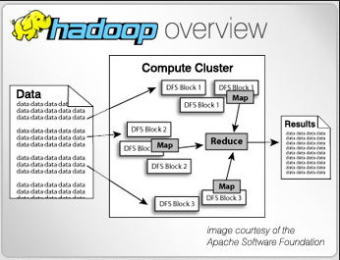
Hadoop
Hadoop is an open source implementation of Google Map-Reduce.
Uses a distributed file system: HDFS
Runs Map-Reduce jobs.
Is developed by Yahoo!

Slide 4
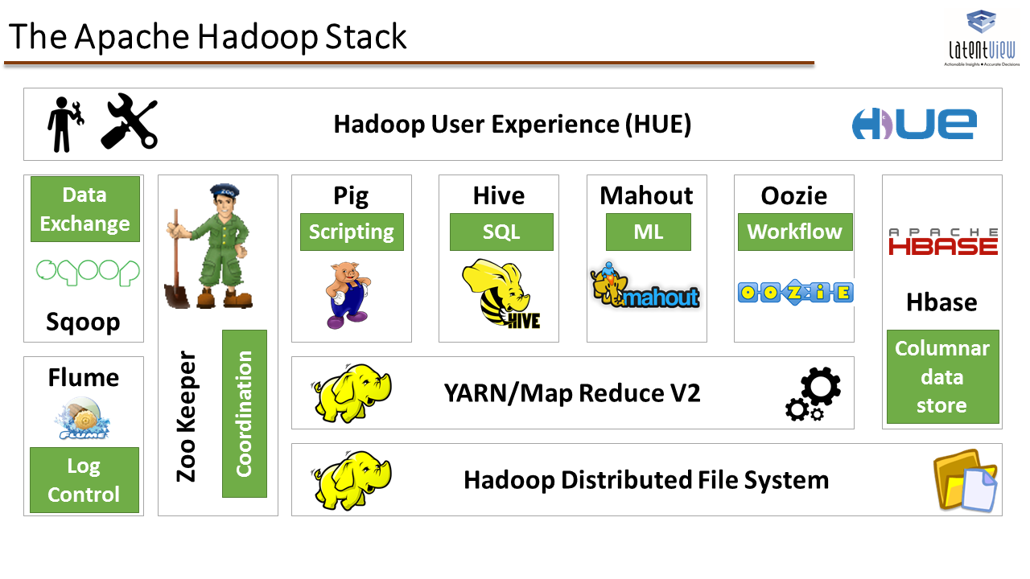
Hadoop Ecosystem

Slide 5
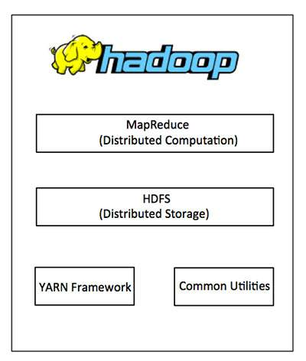
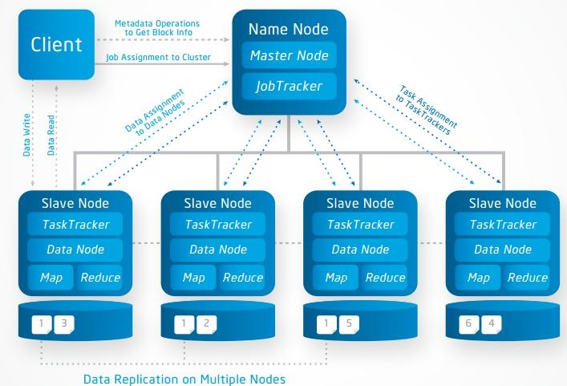
Hadoop Structure

Slide 6
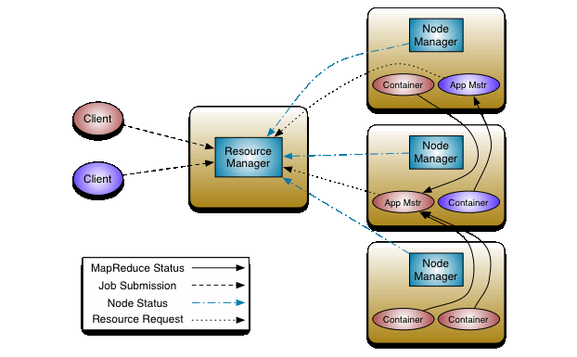
Hadoop job control apps

Slide 7
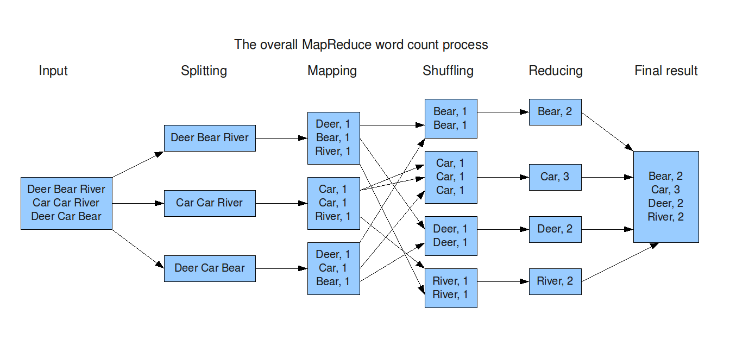
MapReduce – Word Count

Slide 8
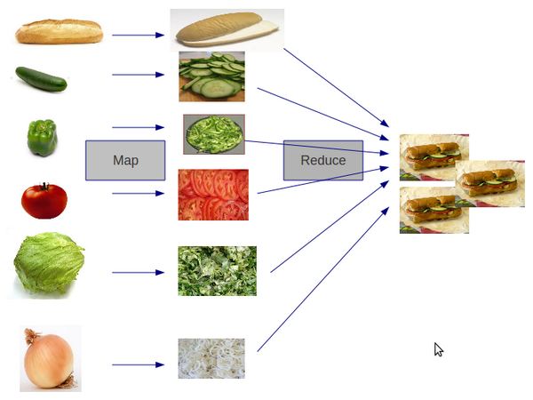
MapReduce – Sandwich

Slide 9
Hadoop on Single Node
Hadoop can be run on a single machine with two modes,
Standalone Operation
Pseudo-Distributed Operation
http://hadoop.apache.org/docs/stable/hadoop-project-dist/hadoop-common/SingleCluster.html
Installation,
source or package from Apache/Hadoop website http://hadoop.apache.org/docs/stable/hadoop-project-dist/hadoop-common/SingleCluster.html
or using VM with Hadoop pre-installed, ex http://www.cloudera.com/content/cloudera/en/documentation/core/v5-2-x/topics/cloudera_quickstart_vm.html

Slide 10
Hadoop on Single Node
Running simple word count program
both Apache/Hadoop and Cloudera provide sample word count program
http://hadoop.apache.org/docs/stable/hadoop-mapreduce-client/hadoop-mapreduce-client-core/MapReduceTutorial.html
you can easily find MapReduce word count program online too
To run the word count program, you need to,
compile the java file
create the jar file
run the application with input and output (in HDFS)

Slide 11
Hadoop in Cluster Mode
Two VMs are needed, one serves as the master node and the other one serves as a slave node
create 2 VMs with either VirtualBox or VMWare
Alternatively, you can also use Docker containers
Enable network between the master and slave VM,
there are different ways to do this, one way to do this in VirtualBox,
In VirtualBox general setting->Network: create a host-only network: vboxnet
for each VM under Setting->Network: enable adapter 2 and attach to the host-only network created
login the VMs and configure the IP addresses,
ex: sudo ifconfig enp0s8 10.0.5.1 netmask 255.255.255.0
test if the VMs can ping each other

Slide 12
Hadoop in Cluster Mode – required installation
You should install the following tools through apt-get install for this lab on each VM (remember to to apt-get update first)
Java
sudo apt-get install default-jre
sudo apt-get install default-jdk
sudo apt-get ssh
sudo apt-get rsync
sudo apt-get vim (or any other text editor you prefer)
Download the pre-compiled Hadoop package from Apache and unzip
http://apache.claz.org/hadoop/common/hadoop-2.7.2/hadoop-2.7.2.tar.gz

Slide 13
Hadoop in Cluster Mode - Configuration
You can use the following references for configuration
http://pingax.com/install-apache-hadoop-ubuntu-cluster-setup/
http://hadoop.apache.org/docs/stable/hadoop-project-dist/hadoop-common/ClusterSetup.html
Files that need to be configured (for both master and slave VMs)
/etc/hosts
hadoop-2.7.2/etc/hadoop/hadoop-env.sh
hadoop-2.7.2/etc/hadoop/core-site.xml
hadoop-2.7.2/etc/hadoop/hdfs-site.xml
hadoop-2.7.2/etc/hadoop/yarn-site.xml
hadoop-2.7.2/etc/hadoop/mapred-site.xml.template
hadoop-2.7.2/etc/hadoop/masters
hadoop-2.7.2/etc/hadoop/slaves

Slide 14
Hadoop in Cluster Mode – start and run
Format the namenode (on master)
hadoop-2.7.2/bin/hdfs namenode -format
Start HDFS daemons and MapReduce daemons (on master)
hadoop-2.7.2/sbin/start-all.sh
Use jps command to check running daemons
on master: NameNode, SecondaryNameNode, Jps, ResourceManager
on slave: Jps, DataNode, NodeManager

Slide 15
Hadoop in Cluster Mode – run MapReduce
Two files are provided to run the MapReduce word count example
WordCount.java: word count MapReduce program
wordCountText.txt: input text file to the WordCount program
Put the text file into HDFS
hadoop-2.7.2/bin/hadoop fs -mkdir /input
hadoop-2.7.2/bin/hadoop fs -put wordCountText.txt /input
Compile WordCount program and produce the jar file
mkdir wordcount_classes
javac -classpath ${HADOOP_CLASSPATH} -d wordcount_classes WordCount.java (you can find out the classpath by issuing hadoop-2.7.2/bin/hadoop classpath )
jar -cvf wc.jar -C wordcount_classes/ .
Run MapReduce with the produced jar file
hadoop-2.7.2/bin/hadoop jar wc.jar WordCount /input /output

