Slide 1

EL9333 – Lab 4

Slide 2
Objectives
Emulate a functional SDN network
Understand and get familiar with OVS
Understand and get familiar with controllers

Slide 3
Writing a Controller
There are many choice for writing the controller,
RYU (I will introduce this)
Beacon
POX
NOX
etc…
When creating a mininet topology, use --controller remote

Slide 4
RYU
Python based framework
Reference:
http://osrg.github.io/ryu/
http://osrg.github.io/ryu-book/en/html/
To install RYU
use pip: pip install RYU (recommended)
from source:
git clone git://github.com/osrg/ryu.git
cd ryu
python ./setup.py install
Read the example provided in the reference to understand how to use RYU
the simple_switch program will help

Slide 5
Task in this Lab
Create the following topology using customized topology file
controller
H2
S2
H1
S1
S3
H3
S4
H4

Slide 6
Task in this Lab
Enforce the following rules
Everything follows shortest path
When there are two shortest paths available
ICMP and TCP packets take the lower/left path
S1-S4-S3 and S2-S1-S4
UDP packets take the upper/right path
S1-S2-S3 and S2-S3-S4
H2 and H4 cannot have HTTP traffic (TCP with port:80)
New connections are dropped with a TCP RST sent back to H2 or H4
To be more specific, when the first TCP packet (SYN) arrives S2 or S4, forwarded it to controller, controller then create a RST packet and send it back to the host.
H1 and H4 cannot have UDP traffic
simply drop packets at switches

Slide 7
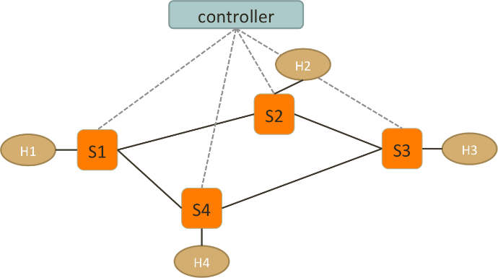
General Rule – ICMP & TCP

Slide 8
General Rule – UDP

Slide 9
Drop HTTP between H2 and H4
HTTP
TCP SYN
HTTP
TCP SYN

Slide 10
Drop HTTP between H2 and H4
TCP RST
TCP RST

Slide 11
Drop UDP between H1 and H4
UDP
drop
drop
UDP

Slide 12
Hint!
Hard-coded ARP table (IP-MAC mapping)
you can use --mac when creating the mininet topology, which may makes easier.
let the controller reply to ARP request
When using addLink in your customized topology file
you can use addLink(H1, S1, 1, 1) to specify the port number
Just assume the controller knows the topology already, and install some static/basic rule during the handshake between OVS and controller:
ICMP and TCP packets on the upper/right path
UDP packets on the lower/left path
drop UDP between H1 to H4
For HTTP between H2 and H4
install a rule on S2/S4 to forward TCP SYN to controller
controller creates a TCP RST packet and send back to S2/S4
S2/S4 sends TCP RST to H2/H4

Slide 13
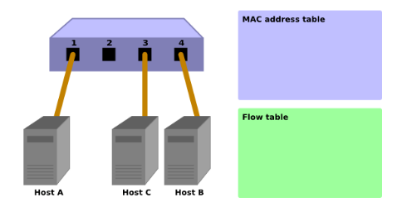
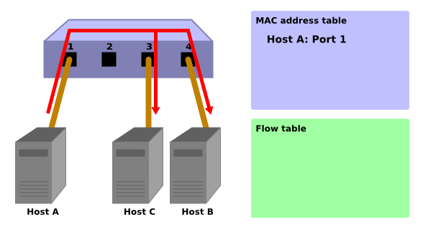
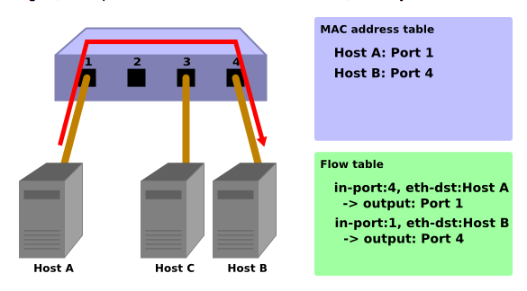
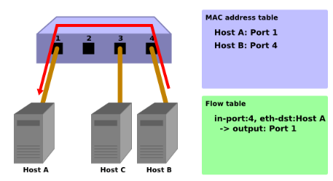
RYU – Simple Learning Switch

Slide 14
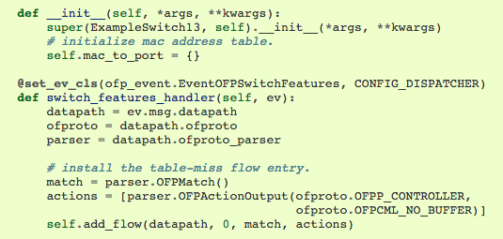
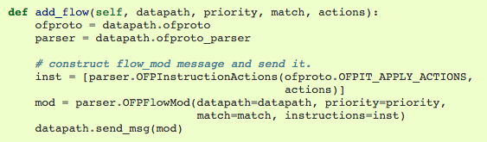
Feature Handler
MAC-Port Mapping
datapath.id : switch ID
empty match
output to controller
define the rule to be installed

Slide 15
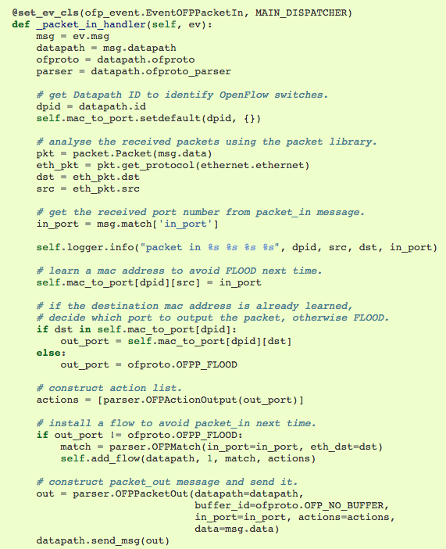
Packet-In
packet header processing
visit the packet library
https://osrg.github.io/ryu-book/en/html/packet_lib.html
(you will need this to generate ARP and TCP RST)
learn and record MAC-Port
decide output port
FLOOD or known port?
install new rule on switch (dpid)
send the packet out (back to switch)

Slide 16
To Run Your Controller
First, start your Mininet with your custom topology
sudo mn --custom your_topo.py --topo mytopo --mac --switch ovsk --controller remote
Configure OpenFlow version on the switch
ex: ovs-vsctl set Bridge s1 protocols=OpenFlow13
set switch 1 to OpenFlow v1.3
Run RYU controller
ryu-manager --verbose your_controller.py
verbose: allow the controller to print out more info

