Slide 1
Black–Scholes Model & the Greek Letters

Slide 2
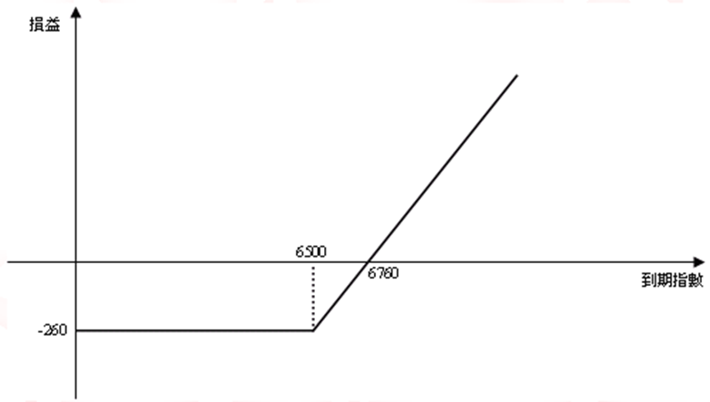
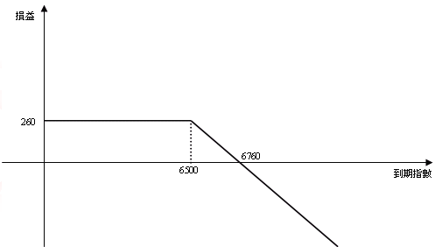
Recap
Call (買權)
 | 買進 | 賣出
情況 | 預期大漲時 | 預期小跌時
圖形 | 買進一口4月到期，履約價為6500，權利金為260點的買權 | 賣出一口4月到期，履約價為6500，權利金為260點的買權

Slide 3
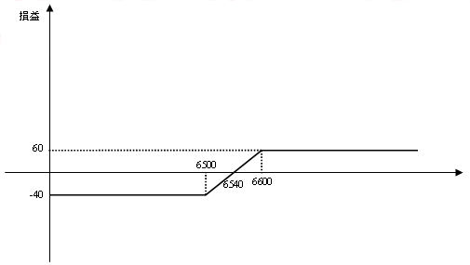
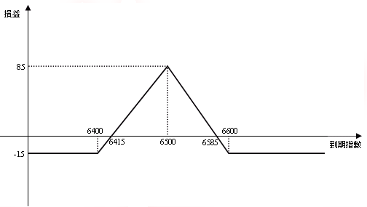
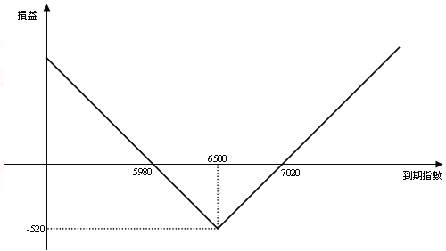
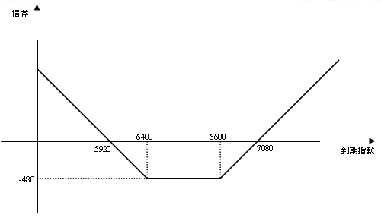
Recap
Spread、Straddle、Strangle

Slide 4
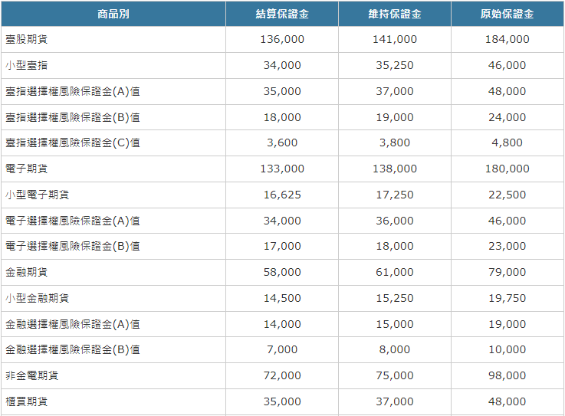
保證金交易

Slide 5
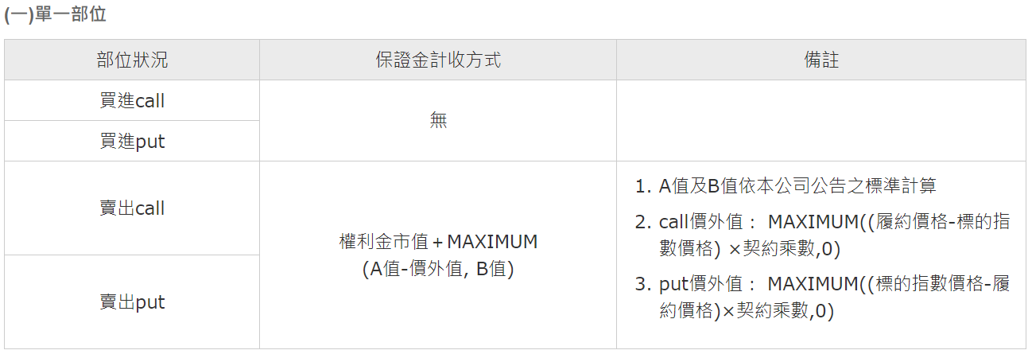
保證金交易

Slide 6
Objectives
The purpose of this lecture is to give students:
an introduction to the Black Scholes (BS) option pricing model;
an introduction to the Greeks;
Learning Outcomes Statements (LOS):
Will have a basic knowledge of the formula of BS Model;
Will have a brief idea of the model’s assumptions, parameters, & features;
Will understand the relationship of the option value with different parameters;
Will understand the factors affect the Greeks.
Will understand how to program the above formulas.
Notes:
Detail learning objectives?

Slide 7
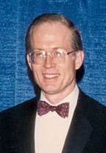


Black-Scholes Model (background)
The Black-Scholes or Black-Scholes-Merton model was a major breakthrough in the pricing of European stock options in the early 1970s.*
An important milestone for finance, risk management that the major contributors, Merton^ and Scholes^, received the 1997 Nobel Memorial Prize in Economic Sciences. (Although ineligible for the prize because of Black’s death in 1995, he was mentioned as a contributor by the Swedish Academy.)
“Robert C. Merton and Myron S. Scholes have, in collaboration with the late Fischer Black, developed a pioneering formula for the valuation of stock options. Their methodology has paved the way for economic valuations in many areas. It has also generated new types of financial instruments and facilitated more efficient risk management in society.” Press Release from The Royal Swedish Academy of Sciences (1997)
*See Black, F., & Scholes, M., 1973, “The Pricing of Options & Corporate Liabilities,” Journal of Political Economy, 81, 637-59; Merton, R.C., 1973, “Theory of Rational Option Pricing,” Bell Journal of Economics & Management Science, 4, 141-83
^Merton & Scholes were principals at LTCM, the hedge fund that was bailout in 1998 and liquidated in 2000.

Slide 8
Black-Scholes Model
The basic model of BS Model.
Assumptions:
European-style options (ie. Only can exercise at expiration).
Percentage changes in the stock prices in a short period of time are normally distributed.
So that, the stock price at a future time T, S_{T}, has a lognormal distribution (Geometric Brownian motion).
Continuously compounded return is used.
No transaction costs, tax.
No dividend is paid (can be relaxed for extended model).

Slide 9

Compounding the Interest
The value of the security with interest depends not only on the interest rate, but also on the frequency in which the interest is compounded.
p.s. assumed reinvested at save rate
P₀ represents the amount of the principal at the initial time t₀, r the interest rate per annum and n the number of years, then the value of the bond by the nth year is given by:
(1.1)
If the frequency of payment of the interest augments, hence increasing the frequency of compounding the interest, say by m > 1 times in a year, the value of P_{n} is
(1.2)

Slide 10
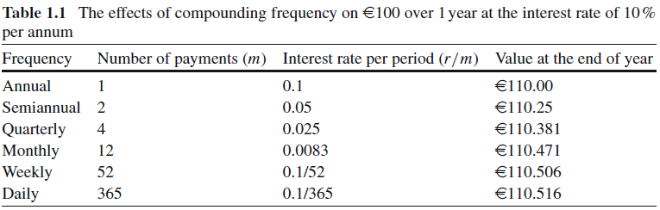
Compounding the Interest
For securities whose value is frequently changing, it is convenient to consider that trading can be done continuously in time.
A risk-free security with a constant interest rate r that is continuously compounded in a period τ > 0, the value
(1.3)
where P_{τ} is the value of the investment that mature from time t0 to time t₀ + τ , and e^{x} is the exponential function.

Slide 11
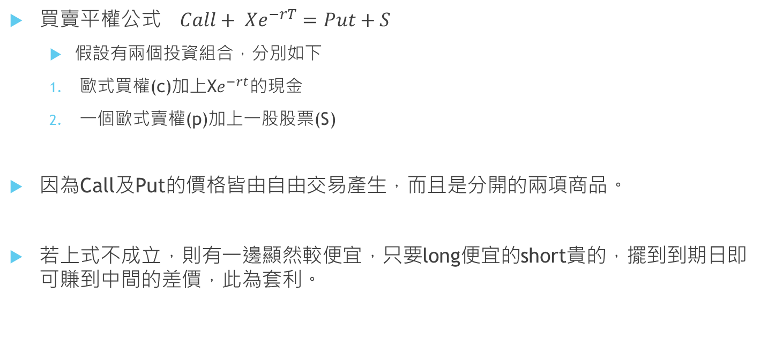
Put-call parity
買賣平權公式$Call+ {Xe}^{−rT}=Put+S$
假設有兩個投資組合，分別如下
歐式買權(c)加上X$e^{−rt}的$現金
一個歐式賣權(p)加上一股股票(S)
因為Call及Put的價格皆由自由交易產生，而且是分開的兩項商品。
若上式不成立，則有一邊顯然較便宜，只要long便宜的short貴的，擺到到期日即可賺到中間的差價，此為套利。

Slide 12

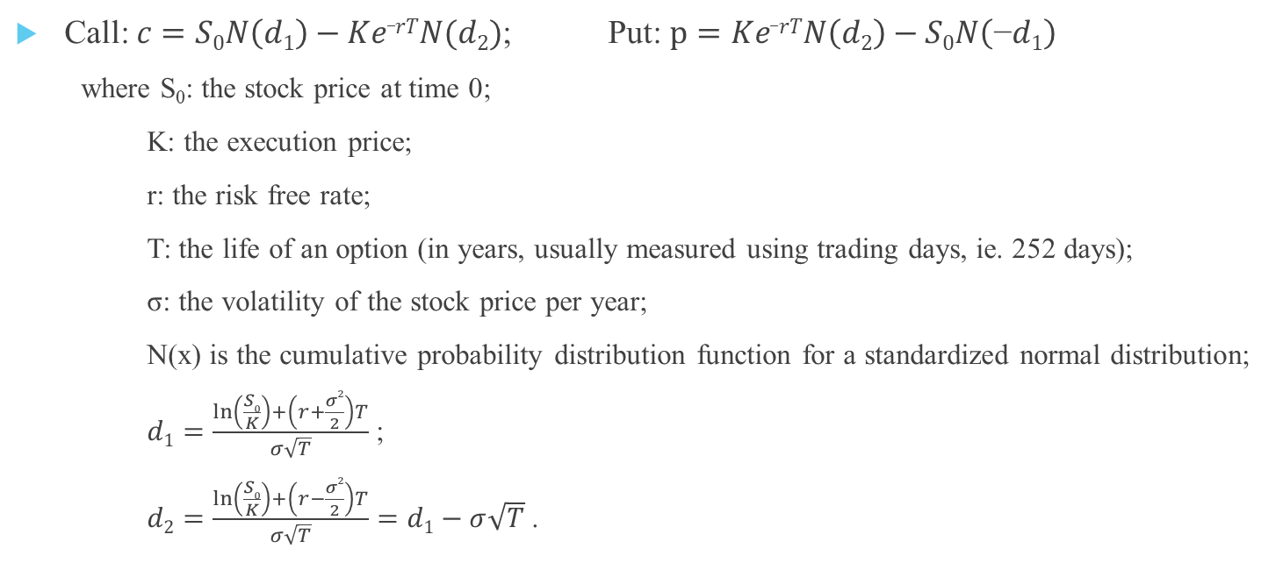
Black-Scholes Formulas
Call: $c=S0N\left(d1\right)−Ke_rTN(d2)$; Put: $p=Ke_rTN\left(d2\right)−S0N\left(\text{−}d1\right)$
where S₀: the stock price at time 0;
K: the execution price;
r: the risk free rate;
T: the life of an option (in years, usually measured using trading days, ie. 252 days);
σ: the volatility of the stock price per year;
N(x) is the cumulative probability distribution function for a standardized normal distribution;
$d1=\frac{\ln\left(\frac{S0}{K}\right)+\left(r+\frac{σ2}{2}\right)T}{σ\sqrt{T}}$ ;
$d2=\frac{\ln\left(\frac{S0}{K}\right)+\left(r−\frac{σ2}{2}\right)T}{σ\sqrt{T}}=d1−σ\sqrt{T}$ .

Slide 13
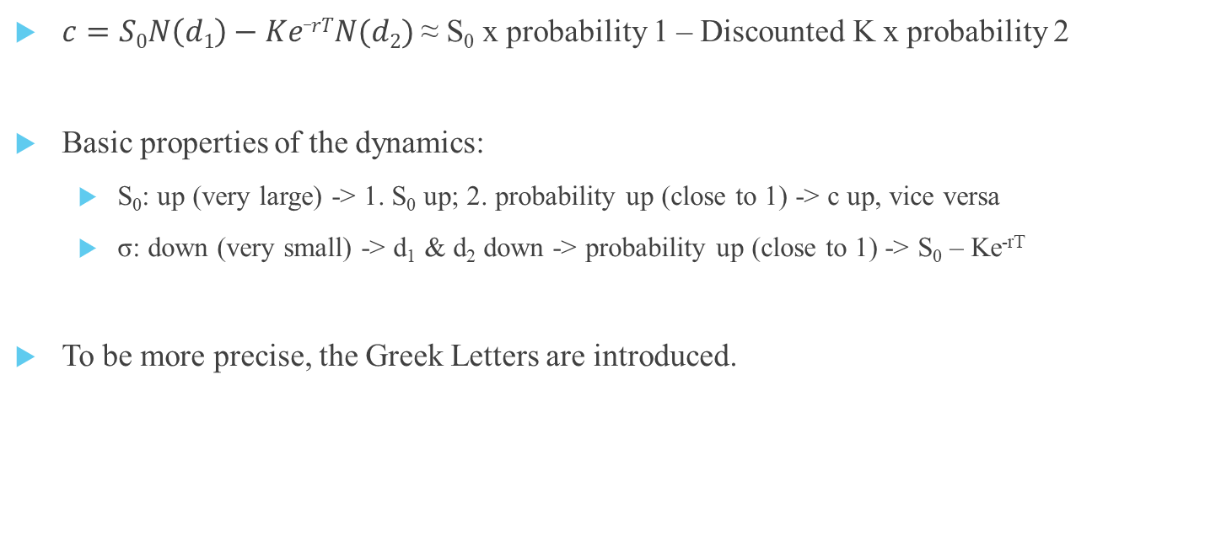
Black-Scholes Formulas (The Properties)
Receive
Pay
$c=S0N\left(d1\right)−Ke_rTN(d2)$ ≈ S₀ x probability 1 – Discounted K x probability 2
Basic properties of the dynamics:
S₀: up (very large) -> 1. S₀ up; 2. probability up (close to 1) -> c up, vice versa
σ: down (very small) -> d₁ & d₂ down -> probability up (close to 1) -> S₀ – Ke^{-rT}
To be more precise, the Greek Letters are introduced.

Slide 14
利用Bi-section求解volatility
選擇權定價是以S₀、K、r、T、volatility來計算call 或 put的價格
其中S₀、K、r、T都可以從合約與當時的市場狀況中得知
Volatility需要估測，可利用歷史波動率及統計來協助
改輸入S₀、K、r、T、當時call price的成交價格，計算volatility
這個問題可改成找最適vol使 bls(S₀,K,r,T ,vol) 近似於 call 的問題
因其他參數都為固定參數，故以f(vol)代替bls(S₀,K,r,T ,vol) – call，找出最適vol使f(vol)近似於0
假設波動率是0~1中間的數字
計算f(0.5)，若f(0)*f(0.5) < 0改找0~0.5間，反之則為0.5~1間
重覆上式持續對半縮減搜尋空間

Slide 15
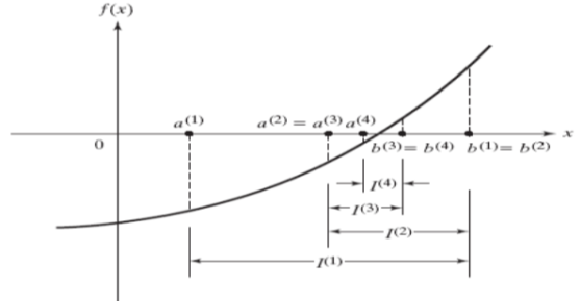
Bi-section

Slide 16
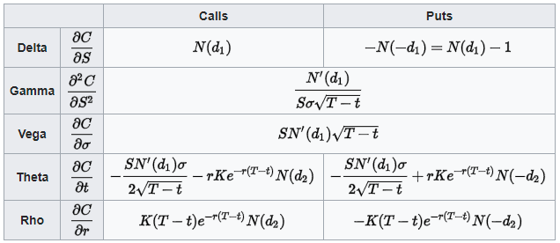
The Greek Letters (Overview)
"The Greeks" measure the sensitivity of the value of an option to the changes in parameter value while holding the other parameters fixed.
Note 1: T-t here means the period from today to the expiration date, ie. the T of BS formula on slide 5; where S is S₀ on slide 5

Slide 17
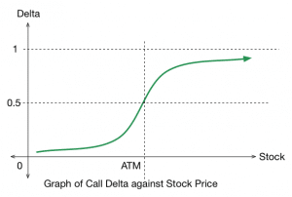
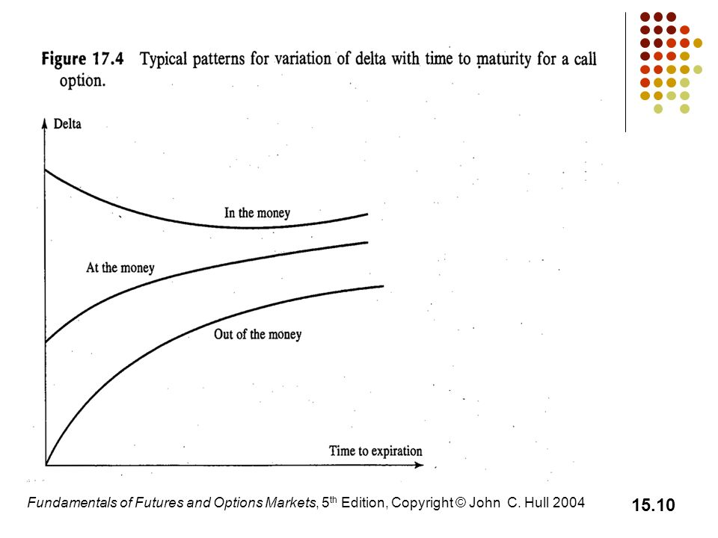
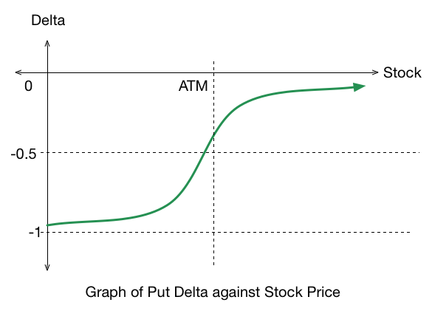
The Greeks (Delta)
Delta: the sensitivity of the option price to a change in the price of the underlying security.

Slide 18
Applications: Delta-Hedging
The idea of Delta-Hedging:
Note: it is impractical to hedge continuously; instead, we hedge periodically. Periodic or discrete hedging but results with some replication error.
portfolio
Rebalance:
(continuously)
always
option + stock
the total delta = 0

Slide 19
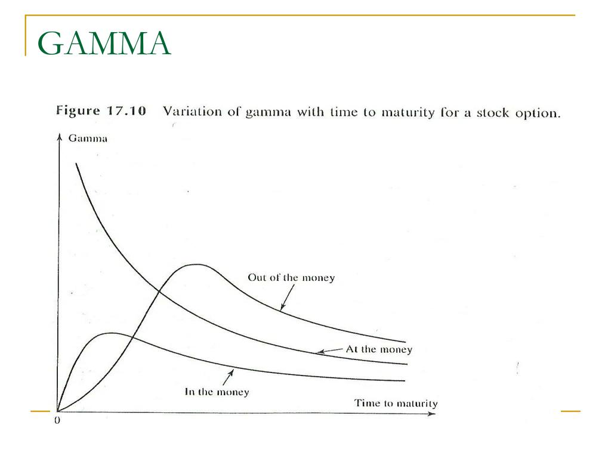
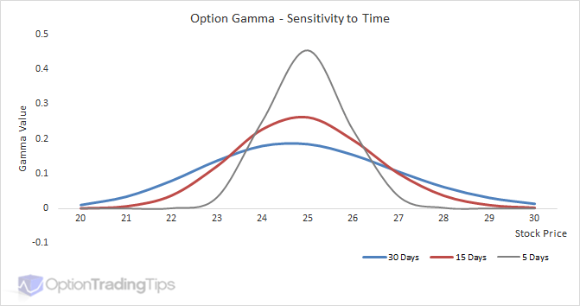
The Greeks (Gamma)
Gamma: the sensitivity of the option's delta to a change in the price of the underlying security.
K

Slide 20
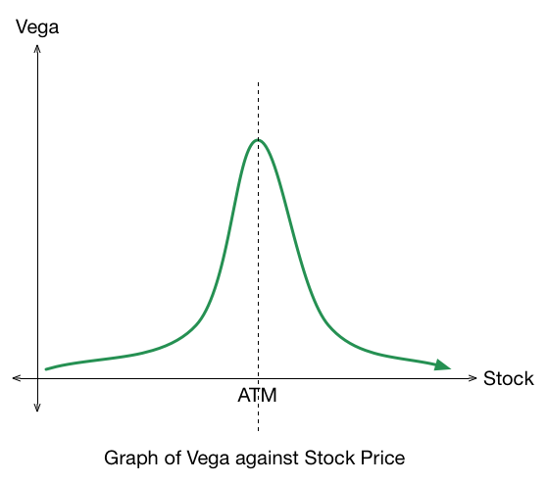
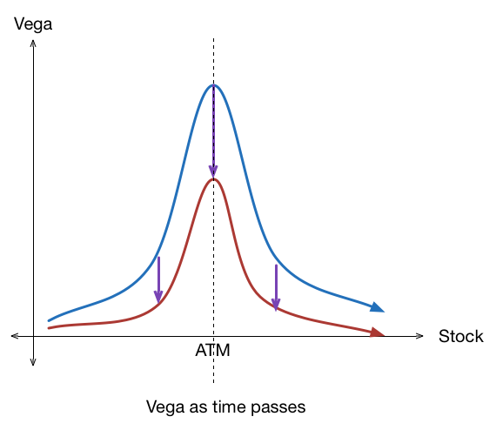
The Greeks (Vega)
Vega: the sensitivity of the option price to a change in volatility.

Slide 21
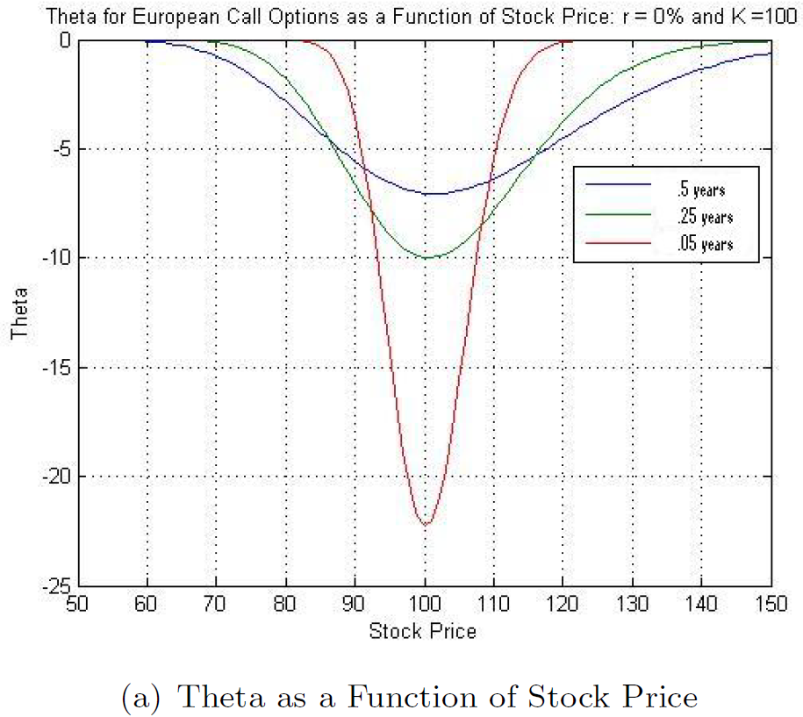
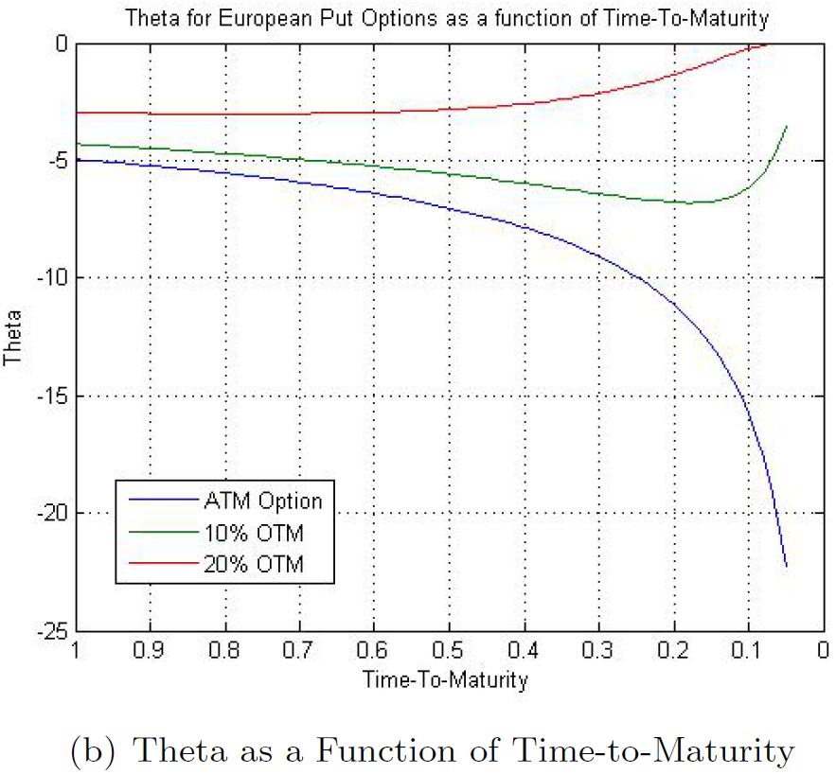
The Greeks (Theta)
Theta: the sensitivity of the option price to a negative change in time-to-maturity (the "time decay".

Slide 22
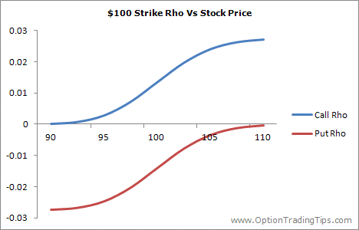
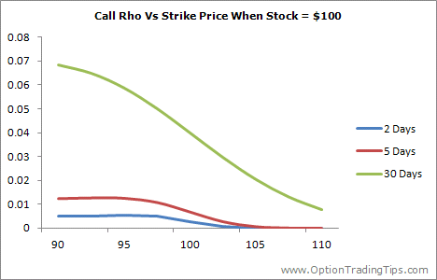
The Greeks (Rho)
Rho: the sensitivity of the option price to the interest rate.

