Slide 1

Midterm Presentation
Frank Vocatura

Slide 2
Overview – CFO
Audit Carbon Emissions and balance cost v emission trade-offs
Build a platform with pre-trained models
Track Emissions, Audit and Optimize Decisions

Slide 3
Quick Explanation
Customize existing AI models
Input IoT sensors/data
Use open-source Vision Transformers to analyze imagery
Create dashboards
Train RL agents to strike balance

Slide 4
Brief Tech Stack
Python for model and backend
SQL managing database
JS/TS frontend

Slide 5
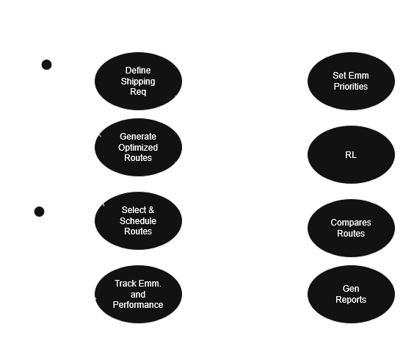
Use Case

Slide 6
Wireframe
https://www.figma.com/proto/Xo5ZwGZhR0lMjVoGqHKCcr/CarbonRoughFigma?node-id=3-2&p=f&t=MMMuxwlZcoOUJAmr-1&scaling=min-zoom&content-scaling=fixed&page-id=0%3A1&starting-point-node-id=3%3A2

Slide 7
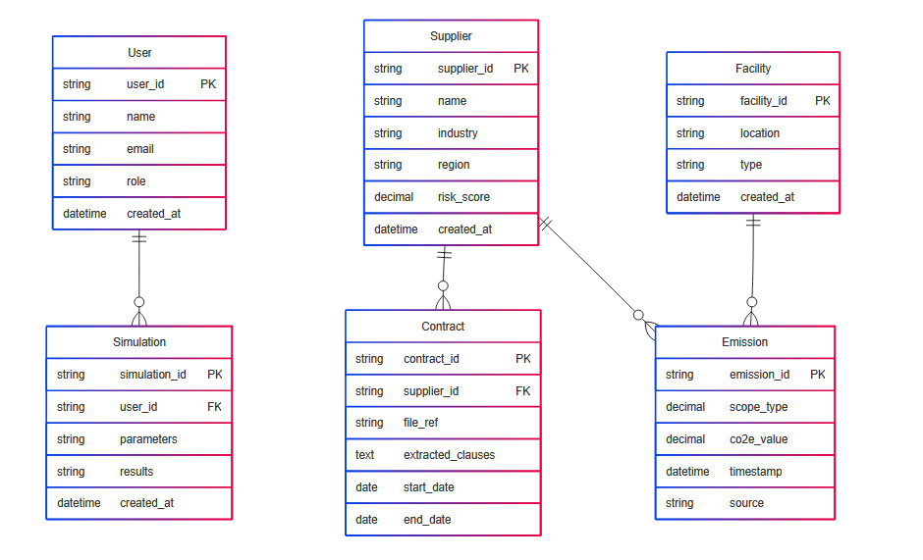
ERD

Slide 8

Thank You

