Slide 1

Final Presentation
Frank Vocatura

Slide 2
Overview – CFO(Carbon Footprint Optimizer)
Web based application that utilizes Google Route API(s) with AI to optimizes delivery routes while also considering carbon emissions, allowing the user to compare multiple routes and track personal impact.
Successfully created a FullStack application with integrated Google Routes API(s) with real-time CO2 calculations, providing users with actionable data to reduce their carbon footprint.

Slide 3
Techstack & Architecture
Frontend:
Next.js with App Router for server-side rendering
TypeScript(TS)
Tailwind CSS for styling
Shadcn/ui component library build on Radix UI
Recharts for analytics
Backend:
Next.js API Routes for serverless backend functions
Prisma ORM for DB queries
JWT Auth with bcrypt
Database Architecture:
PostgreSQL hosted on Supabase
Connection pooling for serverless compatibility
External Services
Google Routes API(s) for all-in-one route optimization
Vercel for deployment and hosting

Slide 4
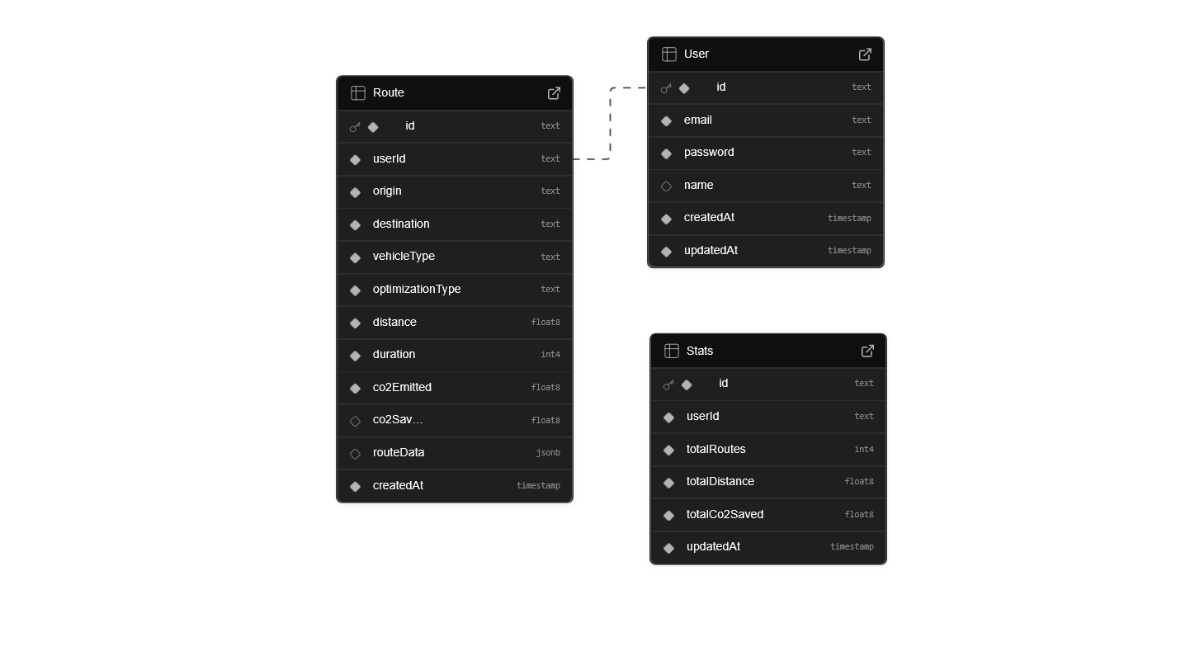
Database Schema Design
Separate stats table for aggregated data(more optimized requests)
JSON field for routeData (optimized for Google Response)
Indexed userId for fast queries

Slide 5
Technical Implementations - Authentication
Utilized JWT stored in HTTP-only cookies
Middleware-based route protection
Token verification on all API calls
Stats are loaded on user creation
Error checking on all fields

Slide 6
Route Optimization/Comparison Implementation
Route Optimization:
User Inputs
Google Route API(s)
Calculate Route/Emissions
User selects
Save to DB
Global stats update
Route Comparison:
Fastest: Optimizes for time
Efficient: Minimizes distance/emissions
Balanced: Google’s recommended route
Each route includes:
Real-time distance/duration
Traffic Conditions
Savings compared to the baseline

Slide 7
Google Cloud Platform
What is it?
GCP is Googles cloud computing service, much like AWS.
Offering tools like computing power, storage, ML services, APIs for various Google services
Created a project that acts as a container for all the resources used
Created an API key with only select ones needed
Restrictions to only be used on this certain domain, and only restrict to select API(s)

Slide 8
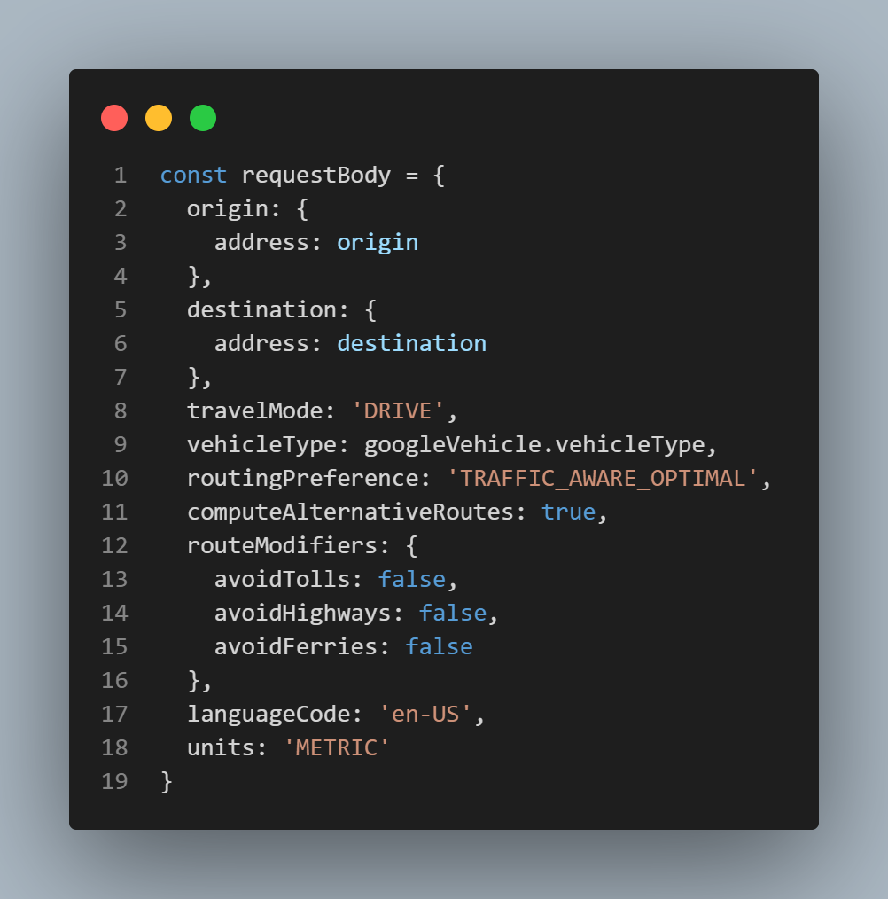
Google Routes API(s) Integration
Request Optimization:
Used fielded masks to reduce the response size
Removed fuel consumption/emission rates and utilized base rates due to compatibility issues with routing preference

Slide 9
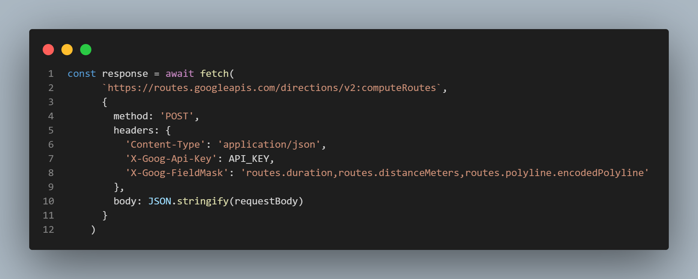
Google Routes API(s) Integration Flow
User inputs required fields → Backend sends HTTPS request to Google → Returns Multiple Routes, processed with data such as km/minutes and CO2 calculations based on vehicle

Slide 10
Google Routes API(s) Integration
Once request is made, model returns 3 alternative routes for user to choose.
Model will identify the fastest (shortest duration) and most efficient (shortest distance).
Calculates CO2 savings by comparing it against the baseline route.
Error Handling:
Very rare but if for some reason API fails it falls back to mock data
API Key validation and environment specific configuration

Slide 11
Google Routes API(s) Integration Challenges
Removed fuel consumption/emission rates and utilized base rates due to compatibility issues with routing preference.
Connection Pooling Conflict. Supabase’s connection pooler conflicted with my Prisma generated statements.
Solution was changing to a transaction pooler for Production, different strings for local and production.

Slide 12
Performance Optimizations
Database Queries
Aggregated stats were stored separately(no recalculation needed)
Indexed FKs for fast lookup
Limit recent routes query for last 10 items
API response caching
Route Comparison data calculated once, reused for display
Stats aggregation happens on save, not on read
Front end Rendering
Responsive containers for charts
Load states prevent a shift in layout
Debounced Form inputs

Slide 13
Key Implements/Features
Public landing page with real-time global stats
Route comparison page for detailed side-by-side analysis
Analytics Dashboard with:
7 day trend
Vehicle Breakdown
Optimization preference tracking
Environmental impact

Slide 14
Challenges & Solutions
Prisma + Serverless solved with connection pooling config
Google Routes API Restrictions: Adapted and configured parameters after discovering issues
Chart Rendering: Maintaining style while also showing relevant data
Use of interfaces for all data structure for Type Safety

Slide 15
Production Deployment
Hosted on Vercel with automatic CI/CD
ENV variables managed with Vercel dashboard
Automatic redeploys with git push
Utilized development and production for pushing new features

Slide 16
Demo
https://cfo-platform.vercel.app/

Slide 18
Takeaways
Long term app development working throughout 20 weeks
Managing frontend/backend tasks
Documenting and designing a project from scratch
Practiced development

