Slide 1

Scorpion Explaining Away Outliers in Aggregate Queries
eugene wu and sam madden
MIT
http://springfieldpunx.blogspot.com/2010/11/mortal-kombat-ninjas-scorpion.html
Notes:
Hey,
I’ll be talking about Scorpion, a data mining metric and search algorithms to explain away outliers in aggregate queries
51

Slide 2
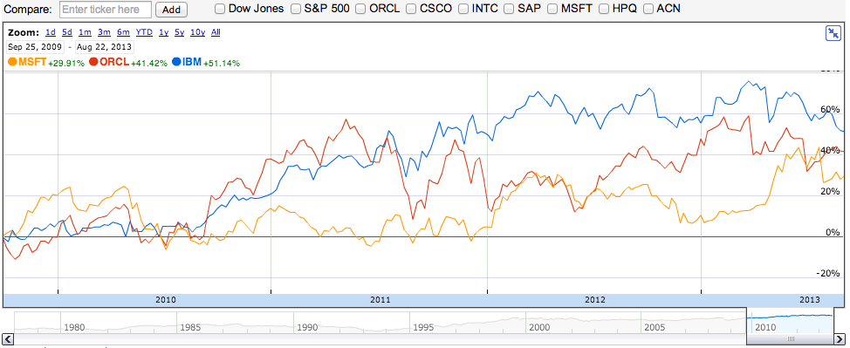
Notes:
Visualizations are the foremost way

Slide 3
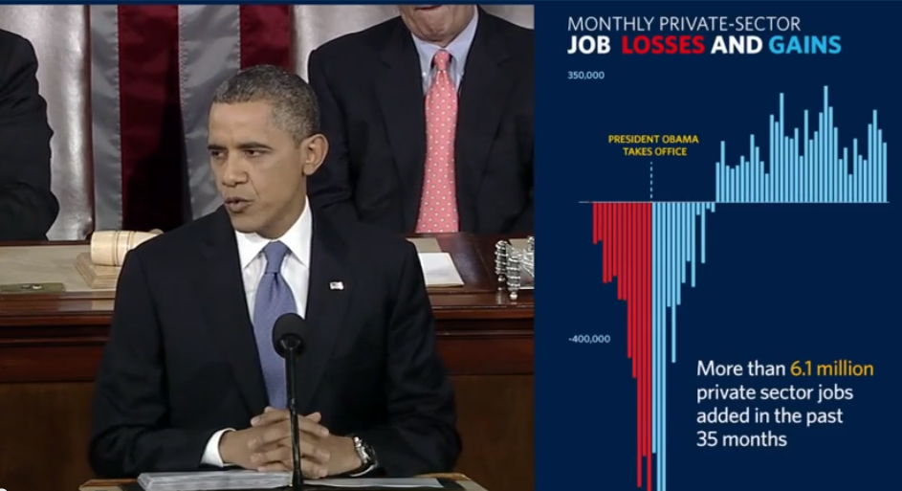
Notes:
That people – both end users

Slide 4
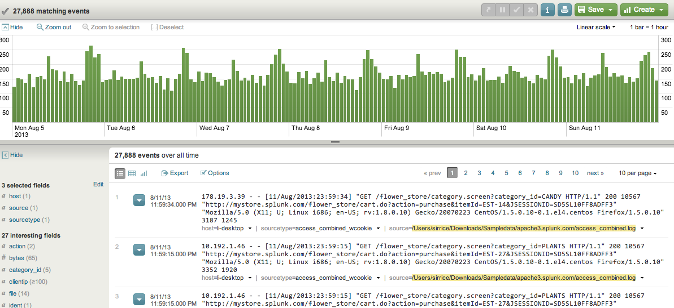
Notes:
And professional analysts

Slide 5
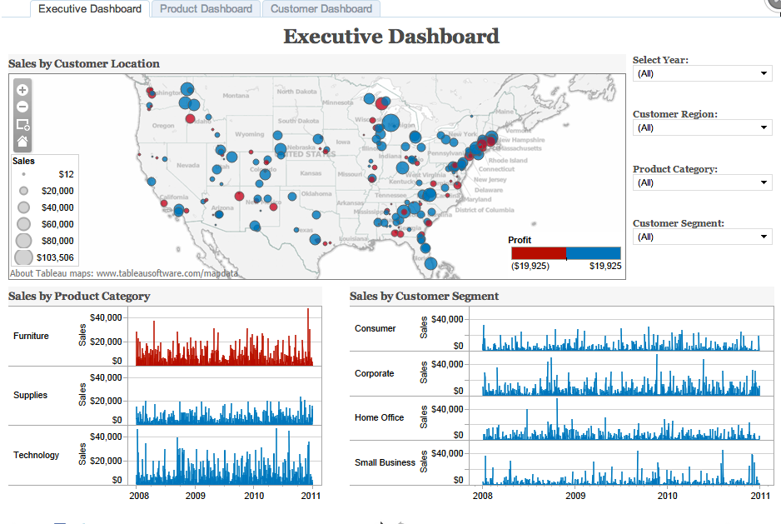
Notes:
interact with

Slide 6
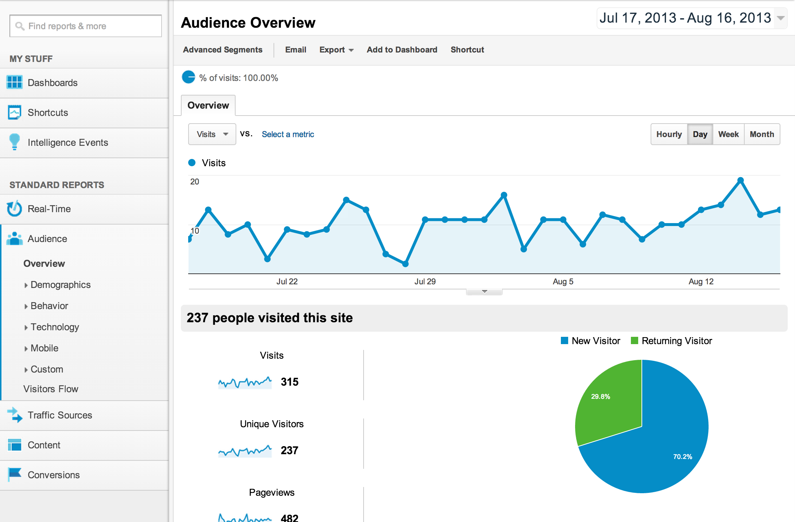
Notes:
And analyze data

Slide 7


Notes:
For the most part, if you look at what structured visualization applications such as tableau and splunk

Slide 8
Table
Split
Aggregate
Visualize
Notes:
Do, they essentially take the input data tables, bin them (for example, by age groups), and compute statistics – think OLAP cubes and provide a visualization front end to these operations.
And so the abstraction is split aggregate visualize

Slide 9
Expenses
USA
China
Italy
SELECT sum(cost)
FROM expenses
GROUPBY country
Notes:
So let’s say you aggregated the total expenses of your business by country.

Slide 10
Expenses
USA
China
Italy
SELECT sum(cost)
FROM expenses
GROUPBY country
Notes:
And you click on china and italy because they seem really high as compared

Slide 11
Expenses
USA
China
Italy
SELECT sum(cost)
FROM expenses
GROUPBY country
Notes:
USA, whose expenses seem normal

Slide 12
Expenses
USA
China
Italy
SELECT sum(cost)
FROM expenses
GROUPBY country
Notes:
Keep in mind that if each bar is an aggregate value. So if we plotted each input tuple’s value by country, it would look like this, where there’s a few really expensive purchase from china, and lots of small purchases from italy

Slide 13
Given
Outlier and normal results
Understand Why
Expenses
USA
China
Italy
SELECT sum(cost)
FROM expenses
GROUPBY country
Notes:
An so, as a user that has noticed outliers in the result
I’d like to understand why this is the case, Some natural questions would be

Slide 14
Given
Outlier and normal results
What input properties
caused the outliers?
most caused the outliers?
caused outliers but didn’t affect normal outputs?
Expenses
USA
China
Italy
SELECT sum(cost)
FROM expenses
GROUPBY country
Notes:
May be wanting to understand properties of the input that
Or what properties of the inputs affected china but not the US
The problem is that current visualization tools don’t have means to answer these types of questions

Slide 15
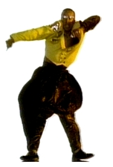
Can’t Touch This
Notes:
So the analyst is essentially allowed to see but not touch.

Slide 16
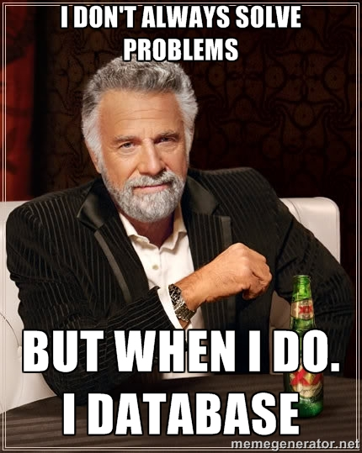
Notes:
But hey. We have database research! This should be a no brainer

Slide 17

Provenance
Data!
Notes:
Why don’t we just track the provenance of the outlier outputs and show the data to the user!

Slide 18
SELECT SUM(cost)
FROM sam’s bank account
Provenance
$$$
Notes:
As an analogy, if I wanted to know why there’s so much money in Sam’s bank account,

Slide 19
SELECT SUM(cost)
FROM sam’s bank account
Provenance
$$$
Notes:
Traditional provenance tools would tell me every single time sam put money into his account

Slide 20

SELECT SUM(cost)
FROM sam’s bank account
Provenance
$$$
Notes:
But we all know that he recently robbed a bank and put that money into his account

Slide 21

SELECT SUM(cost)
FROM sam’s bank account
Provenance
$$$
Darn!
Ya caught me
Notes:
and that’s the single transaction that most influenced his wealth

Slide 22

Provenance
http://weknowmemes.com/2012/04/whats-the-point/
Notes:
Which, you know, We’re not providing any additional information!
Because there isn’t a real concept of degrees of influence or importance in the provenance

Slide 23
SELECT SUM(cost)
FROM sam’s bank account
Provenance
Filter for
“most influential”
Notes:
We’d like a mechanism to filter for these most influential provenace records.
One of our contributions is defining what “most influential” means as a metric

Slide 24
Provenance

Slide 25
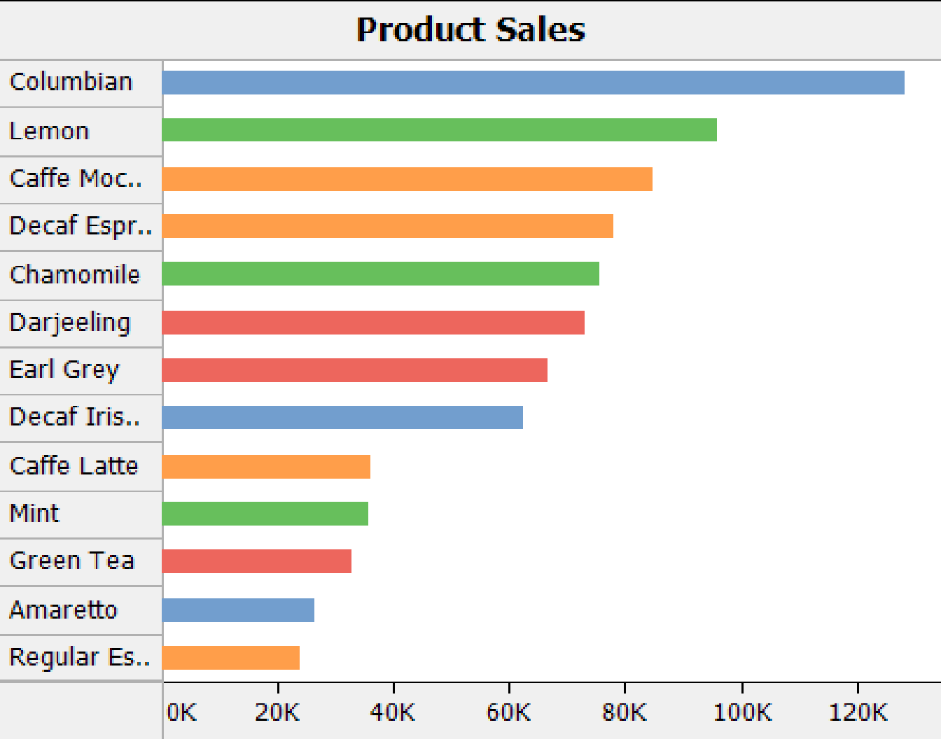
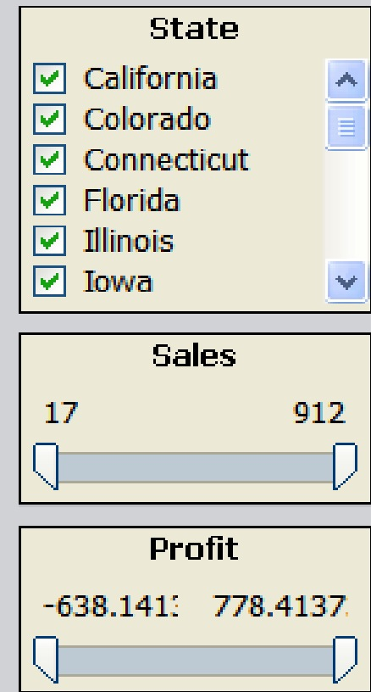
Provenance
Faceting
http://www.perceptualedge.com/articles/Whitepapers/Three_Blind_Men.pdf
Notes:
So what people often resort to is manual faceting.
Consider this visualization on the left. If an analyst wants to understand the top bar, she will need to use the faceting controls on the right to manually, for example remove california from the state dimension, see what happens to the visualization, and repeat.

Slide 26
Provenance
Faceting
http://www.perceptualedge.com/articles/Whitepapers/Three_Blind_Men.pdf
Notes:
So what people often resort to is manual faceting.
Consider this visualization on the left. If an analyst wants to understand the top bar, she will need to use the faceting controls on the right to manually, for example remove california from the state dimension, see what happens to the visualization, and repeat.

Slide 27
Provenance
Faceting
Dimensionality :(
Dealing with multiple outliers?
http://www.perceptualedge.com/articles/Whitepapers/Three_Blind_Men.pdf

Slide 28
Provenance
Faceting

Slide 29
Provenance
Faceting
Scorpion!

Slide 30
Given
Outlier and normal results
Understand Why
Expenses
USA
China
Italy
Notes:
Let’s go back to the expenses example, I’ve opened up the aggregates to also plot the costs of each purchase in each country.
Scorpion replaces the ambiguous “understand why”

Slide 31
Given
Outlier and normal results
Find
Predicates correlated with outliers
Expenses
USA
China
Italy
Desc = “toilets”
Notes:
To Find predicates that are correlated with “causing” these outliers
In this case, the purchase description “toilets” matches the high value purchases in china and a large group of small purchase in italy. Because the department in china bought fancy golden toilets, while the ones in italy really enjoy the bathroom, so bought personal toilets for everyone

Slide 32
Given
Outlier and normal results
Find
Predicates correlated with outliers
Expenses
s.t.
Removing predicate from inputs “fixes” outliers & maintains normal results
USA
China
Italy
Desc = “toilets”
Notes:
Such that…

Slide 33
Given
Outlier and normal results
Find
Predicates correlated with outliers
Expenses
s.t.
Removing predicate from inputs “fixes” outliers & maintains normal results
USA
China
Italy
Desc = “toilets”
Notes:
if we remove the toilet purchases from the dataset

Slide 34
Given
Outlier and normal results
Find
Predicates correlated with outliers
Expenses
s.t.
Removing predicate from inputs “fixes” outliers & maintains normal results
USA
China
Italy
Desc = “toilets”
Notes:
Then re-running the visualization on the modified dataset “fixes” the outliers
DEMO

Slide 35
Formalize “influence” as metric
Predicate search heuristics
Some results
Notes:
So how we

Slide 36
T
Notes:
How is simple version of the influence metric computed for a predicate
Here T is the set of 3 tuples that generate the visualized aggregate output
The green bars are the good input tuples, and the red is the high expense value that causes the outlier

Slide 37
T
p(T)
Desc = “toilet”
Notes:
P is the predicate

Slide 38
T
p(T)
Notes:
When applied to T, matches the bad tuples

Slide 39
T
p(T)
T – p(T)
Notes:
And when we remove the tuple matching the predicate from T, the recomputed output looks good

Slide 40
p(T)
Notes:
The first component

Slide 41
p(T)
Notes:
Is the difference between

Slide 42
Δoutput
p(T)
Notes:
The original and fixed outputs, represented by delta output

Slide 43
Δoutput
p(T)
|p(T)|
Notes:
In addition we also care about the cardinality of the predicate, or number of tuples that satisfy the predicate

Slide 44
Δoutput
p(T)
|p(T)|
Δoutput
Influence
Metric
|p(T)|
Notes:
So the basic influence metric divides the change in output by the predicate cardinality

Slide 45
Δf(x)
Sensitivity
Analysis
Δx
Δoutput
Influence
Metric
|p(T)|
Notes:
It’s worth noting that this is essentially a sensitivity analysis formulation.

Slide 46
ΔOutput
“High vs Low”
|p(T)|
ΔNormal
Multiple Outputs
Δoutput
|p(T)|
Notes:
Of course there were many questions that a user wants to ask,
The paper works through the mechanisms of supporting different variations such as

Slide 47
ΔOutput
“High vs Low”
|p(T)|
ΔNormal
Multiple Outputs
Δoutput
|p(T)|
Δoutput • V
|p(T)|
Notes:
Too high vs too low and thus correcting in a particular direction

Slide 48
ΔOutput
“High vs Low”
|p(T)|
ΔNormal
Multiple Outputs
Δoutput
|p(T)|
Δoutput • V
|p(T)|
Δoutput • V
|p(T)|^{c}
Notes:
Specify how much to penalize the cardinality of the predicate

Slide 49
ΔOutput
“High vs Low”
|p(T)|
ΔNormal
Multiple Outputs
Δoutput
|p(T)|
Δoutput • V
|p(T)|
Δoutput • V
|p(T)|^{c}
-
Δoutlier • V
ΔNormal
|p(T)|^{c}
Notes:
Specify that a particular output is normal and should not be affected

Slide 50
ΔOutput
“High vs Low”
|p(T)|
ΔNormal
Multiple Outputs
Δoutput
|p(T)|
Δoutput • V
|p(T)|
Δoutput • V
|p(T)|^{c}
-
Δoutlier • V
ΔNormal
|p(T)|^{c}
-
mean
Δoutlier • V
max
ΔNormal
outlier
|p(T)|^{c}
normal
Notes:
And multiple outlire and hold-out results

Slide 51
Δoutput
“High vs Low”
|P(T)|
ΔNormal
Multiple Outputs
Δoutlier
|P(T)|
Δoutlier • V
|P(T)|
influence(p)
Δoutlier • V
|P(T)|^{c}
-
Δoutlier • V
ΔHold-out
|P(T)|^{c}
-
mean
Δoutlier • V
max
ΔHold-out
outlier
|P(T)|^{c}
normal
Notes:
And all together this is the influence metric

Slide 52
Formalize “influence” as metric
Predicate search heuristics
Some results

Slide 53
argmax
influence(p)
p* =
p ∈ predicates
Notes:
If we consider the cost of this problem, there’s two very expensive components

Slide 54
argmax
influence(p)
p* =
p ∈ predicates
O(agg(T-p(T)))
Notes:
Computing a predicate’s influence is quite expensive

Slide 55
SUM({1,2,3,4,5}) = 15
argmax
influence(p)
p* =
p ∈ predicates
O(agg(T-p(T)))
Notes:
As a simple example, consider an input of 1-5 and we’re using the sum operator

Slide 56
p
SUM({1,2,3,4,5}) = 15
argmax
influence(p)
p* =
p ∈ predicates
O(agg(T-p(T)))
Notes:
If we’re computing the influence of p that matches 4, 5

Slide 57
p
SUM({1,2,3,4,5}) = 15
-
{4,5}
argmax
influence(p)
p* =
p ∈ predicates
O(agg(T-p(T)))
Notes:
Then we first need to remove 4,5 from the input set

Slide 58
p
SUM({1,2,3,4,5}) = 15
-
{4,5}
SUM({1,2,3}) = 6
argmax
influence(p)
p* =
p ∈ predicates
O(agg(T-p(T)))
Notes:
And re-run sum on the result
Imagine if a billion

Slide 59
argmax
influence(p)
p* =
p ∈ predicates
O(exponential)
O(agg(T-p(T)))
Notes:
In addition, the predicate space is highly exponential, and even the naïve enumeration of trying 1 dimensional, then 2 dimenisonal predicates is very expensive.

Slide 60
Operator
Properties
argmax
influence(p)
p* =
p ∈ predicates
O(exponential)
O(agg(T-p(T)))
Notes:
And so Scorpion relies on three operator properties to speed up both of these components

Slide 61
Operator
Properties
argmax
influence(p)
p* =
p ∈ predicates
O(exponential)
O(agg(p(T)))
Incrementally removable
Notes:
To compute the influence faster, we define the incrementally removable operator property

Slide 62
p
SUM({1,2,3,4,5}) = 15
argmax
influence(p)
p* =
p ∈ predicates
O(exponential)
O(agg(p(T)))
Incrementally removable
Notes:
There exists a function that directly updates the aggregate output from the tuples satisfying the predicate

Slide 63
p
SUM({1,2,3,4,5}) = 15
15 - SUM({ 4,5}) = 6
argmax
influence(p)
p* =
p ∈ predicates
O(exponential)
O(agg(p(T)))
Incrementally removable
Notes:
So in this case, we can directly compute the outptus change by summing the predicate’s 4 and 5, and removing the result from the original 15
Working in conjucnction with the search algorithms, this can reduce the overall cost of recomputing the influences throughout the search

Slide 64
SUM
COUNT
AVG
STDDEV
argmax
influence(p)
p* =
p ∈ predicates
O(exponential)
O(agg(p(T)))
Incrementally removable
Notes:
Some example operators that support this are

Slide 65
MEDIAN
MODE
SUM
COUNT
AVG
STDDEV
argmax
influence(p)
p* =
p ∈ predicates
O(exponential)
O(agg(p(T)))
Incrementally removable
Notes:
Some example operators that support this are

Slide 66
Least
influence
Most
influence
argmax
influence(p)
p* =
p ∈ predicates
O(exponential)
O(agg(p(T)))
Independent
Incrementally removable
Notes:
The first property that enables more efficient search is the independence property
The first is independence

Slide 67
Least
influence
Most
influence
argmax
influence(p)
p* =
p ∈ predicates
O(exponential)
O(agg(p(T)))
Independent
Incrementally removable
Notes:
Which says that the influence that one tuple has on the output is independent from any other tuple’s influence

Slide 68
Least
influence
Most
influence
argmax
influence(p)
p* =
p ∈ predicates
O(exponential)
O(agg(p(T)))
Independent
Incrementally removable
Notes:
This is nice because you can imagine sorting the inputs by their individual infulence

Slide 69
Least
influence
Most
influence
argmax
influence(p)
p* =
p ∈ predicates
O(exponential)
O(agg(p(T)))
Independent
Incrementally removable
Notes:
And constructing t predicates by scanning from most to least influential

Slide 70
argmax
influence(p)
p* =
p ∈ predicates
O(exponential)
O(agg(p(T)))
Top Down Independent
Incrementally removable
Notes:
For independent operators, we use a top down

Slide 71
argmax
influence(p)
p* =
p ∈ predicates
O(exponential)
O(agg(p(T)))
Top Down Independent
Incrementally removable
Notes:
Partitioning approach that iteratively splits

Slide 72
argmax
influence(p)
p* =
p ∈ predicates
O(exponential)
O(agg(p(T)))
Top Down Independent
Incrementally removable
Notes:
partitions along the best dimension

Slide 73
argmax
influence(p)
p* =
p ∈ predicates
O(exponential)
O(agg(p(T)))
Top Down Independent
Incrementally removable

Slide 74
argmax
influence(p)
p* =
p ∈ predicates
O(exponential)
O(agg(p(T)))
Top Down Independent
Incrementally removable
Anti-monotonic
Notes:
The anti-monotonic property

Slide 75
p’⊂p
argmax
influence(p)
p* =
p ∈ predicates
O(exponential)
O(agg(p(T)))
Top Down Independent
Incrementally removable
Anti-monotonic
Notes:
Says that if p’ is a subset of a predicate p

Slide 76
p’⊂p
influence(p’) ≤ influence(p)
argmax
influence(p)
p* =
p ∈ predicates
O(exponential)
O(agg(p(T)))
Top Down Independent
Incrementally removable
Anti-monotonic
Notes:
Then its influence cannot be larger than ps influence. For these we use a bottom up approach similar to subspace clustering

Slide 77
argmax
influence(p)
p* =
p ∈ predicates
O(exponential)
O(agg(p(T)))
Top Down Independent
Incrementally removable
Bottom Up Anti-monotonic
Notes:
You can imagine partitioning the dataset along each dimension individually – here horizontally and vertically

Slide 78
argmax
influence(p)
p* =
p ∈ predicates
O(exponential)
O(agg(p(T)))
Top Down Independent
Incrementally removable
Bottom Up Anti-monotonic
Notes:
Looking for the partitions with high influence

Slide 79
argmax
influence(p)
p* =
p ∈ predicates
O(exponential)
O(agg(p(T)))
Top Down Independent
Incrementally removable
Bottom Up Anti-monotonic
Notes:
And intersecting them, and repeating along higher dimensions

Slide 80
Formalize “influence” as metric
Predicate search heuristics
Some results
Notes:
With these data mining algorithms, they’re pretty tricky to evaluate the correctness, so the paper uses synthetic datasets to identify result quality and performance trends.
We also use two datasets we’ve previously analyzed to show how it empirically works on actual data
Here’s I’ll just talk about one of the performance experiments on synthetic data

Slide 81
SELECT sum(Y) GROUPBY X
Sum(Y)
X
Notes:
Whereas for the outlier, there are clear outlier values

Slide 82
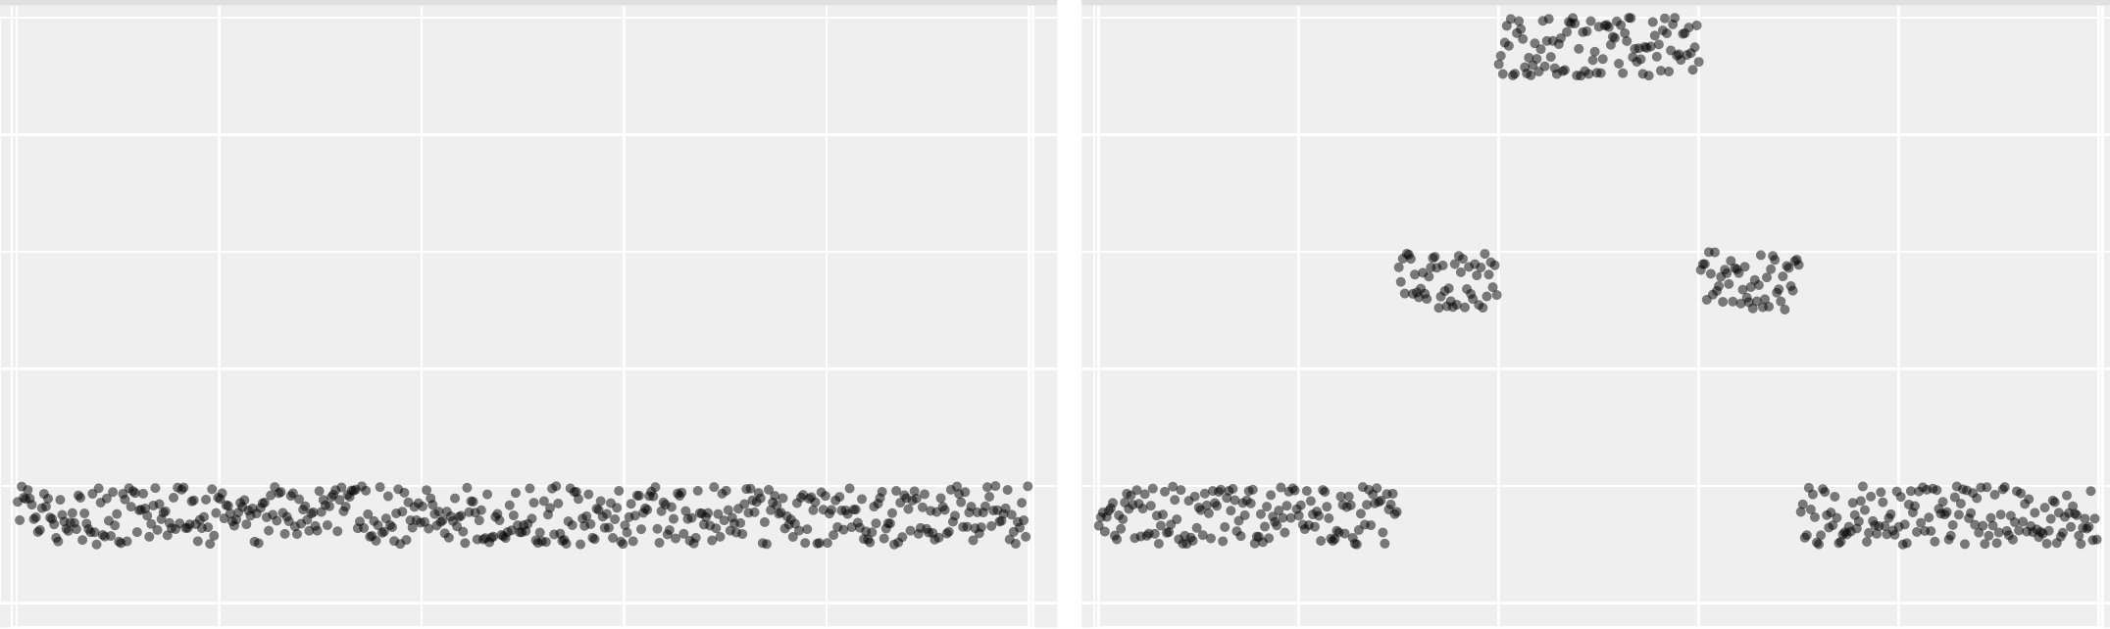
SELECT sum(Y) GROUPBY X
Sum(Y)
X
Y
Z
Notes:
Whereas for the outlier, there are clear outlier values

Slide 83
SELECT sum(Y) GROUPBY X
Sum(Y)
X
Y
Z
Z
Notes:
Whereas for the outlier, there are clear outlier values

Slide 84
SELECT sum(Y) GROUPBY X
Sum(Y)
X
Y
Z
Z
Notes:
Whereas for the outlier, there are clear outlier values

Slide 85
1K
5K
10K
thousand tuples / group
Notes:
Suffice to say that naïve is terrible, and our heuristics are manageable for small to modest data sizes, but are still a ways from interactive speeds. This is where blinkDB type stratefied sampling techniques would be useful.
The other heuristics increase linearly with the number of tuples, and super linearly with the dimensionality

Slide 86
1000
cost seconds
100
10
1K
5K
10K
thousand tuples / group
Notes:
Suffice to say that naïve is terrible, and our heuristics are manageable for small to modest data sizes, but are still a ways from interactive speeds. This is where blinkDB type stratefied sampling techniques would be useful.
The other heuristics increase linearly with the number of tuples, and super linearly with the dimensionality

Slide 87
Naive
1000
cost seconds
100
10
1K
5K
10K
thousand tuples / group
Notes:
We run the naïve enumariton algorithm for up to 40 minutes, and report the time it found the optimal predicate. In these experiments it didn’t find the predicate within 40 minutes, which is why the line is straight.

Slide 88
Naive
1000
cost seconds
Top down
100
10
1K
5K
10K
thousand tuples / group

Slide 89
Naive
1000
cost seconds
Top down
100
Bottom up
10
1K
5K
10K
thousand tuples / group
Notes:
The other heuristics are much faster and increase linearly with the number of tuples, and super linearly with the dimensionality. There are two curves because sum is independent and anti-monotonic.
The main takeaway is that while the problem is highly exponential, we can devise simple heuristics that run well for reasonably size datasets.

Slide 90
influence metric
that is
accessible to end-users
for
Data cleaning
Data exploration
Provenance reduction
Notes:
So to conclude I’ve introduced a new influence metric to explain aggregate outliers that is intended to be accessible to end-users, and can be used in data cleaning, exlporation and provenance reduction applications

Slide 91
scorpion
eugenewu@mit.edu
http://springfieldpunx.blogspot.com/2010/11/mortal-kombat-ninjas-scorpion.html
Notes:
So that’s an overview of scorpion and I’m happy to take questions

Slide 92

scorpion
eugenewu@mit.edu
http://springfieldpunx.blogspot.com/2010/11/mortal-kombat-ninjas-scorpion.html

Slide 93
scorpion
eugenewu@mit.edu
http://springfieldpunx.blogspot.com/2010/11/mortal-kombat-ninjas-scorpion.html
Notes:
Meliou boolean functions
Amol and re probabilistic
Sunita icube – differenc subcubes.
Perfxplain
Mri – optimal cuboid (subcube) for avg() function
Profiler, willet

Slide 94
C-parameter
Δoutput • V
|p(T)|^{c}
Low C
High C
Y
Z
Z

Slide 95
Δoutlier • V
mean
max
ΔNormal
outlier
|p(T)|^{c}
normal

Slide 96
Expenses
USA
China
Italy
Notes:
Such that…

