Slide 1
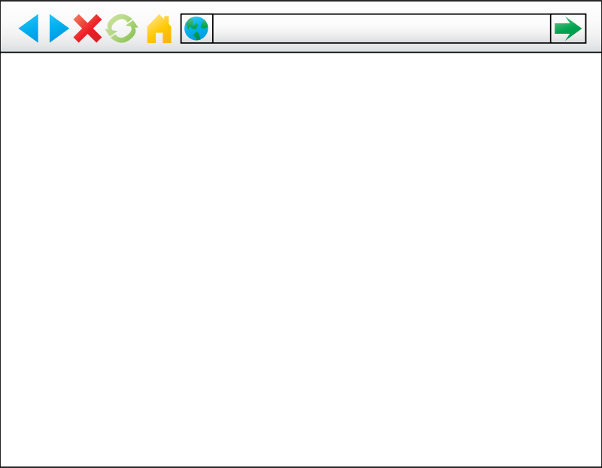
Storage Provider
Retrieve and store user and application data
monitor.com
Monitor Page (CSP)
sieve.js
postMessage()
Sandbox (CSP + iframe)
Installed Application
<html>
<link ref=“stylesheet” type=“text/css” href=…/>
<script src= … > </script>
<img src=…/>
User data
User data
…
…
…
</html>
bootstrap.js

