Slide 1
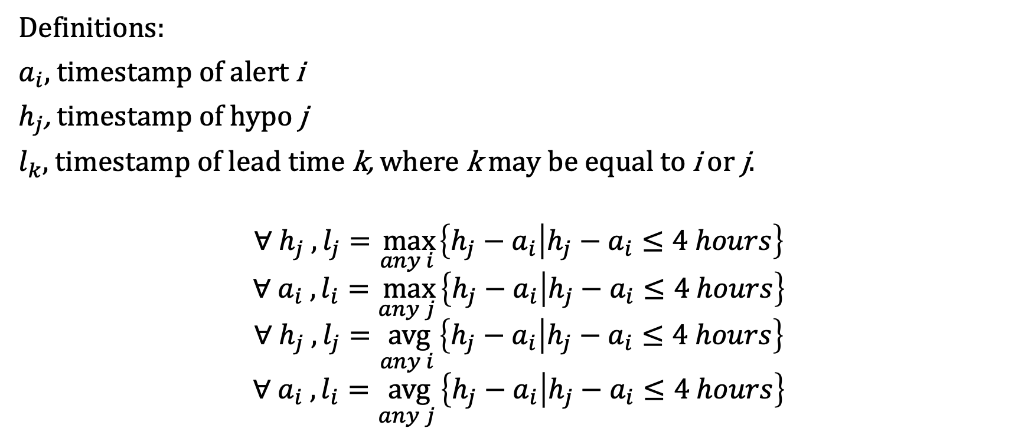
First and repeat alert lead time definitions
Definitions:
$a_{i}$, timestamp of alert i
$h_{j}$, timestamp of hypo j
$l_{k},$ timestamp of lead time k, where k may be equal to i or j.
$$∀ h_{j} , l_{j}=\max_{any i }\left\{h_{j}−a_{i} | h_{j}−a_{i}≤4 hours\right\}$$
$$∀ a_{i} , l_{i}=\max_{any j }\left\{h_{j}−a_{i} | h_{j}−a_{i}≤4 hours\right\}$$
$$∀ h_{j} , l_{j}=\underset{any i }{avg}\left\{h_{j}−a_{i} | h_{j}−a_{i}≤4 hours\right\}$$
$$∀ a_{i} , l_{i}=\underset{any j }{avg}\left\{h_{j}−a_{i} | h_{j}−a_{i}≤4 hours\right\}$$

Slide 2

Alert lead time distribution
$$∀ h_{j} , l_{j}=\max_{any i }\left\{h_{j}−a_{i} | h_{j}−a_{i}≤4 hours\right\}$$

Slide 3

Alert lead time distribution
$$∀ a_{i} , l_{i}=\max_{any j }\left\{h_{j}−a_{i} | h_{j}−a_{i}≤4 hours\right\}$$

Slide 4

Alert lead time distribution
$$∀ h_{j} , l_{j}=\underset{any i }{avg}\left\{h_{j}−a_{i} | h_{j}−a_{i}≤4 hours\right\}$$

Slide 5

Alert lead time distribution
$$∀ a_{i} , l_{i}=\underset{any j }{avg}\left\{h_{j}−a_{i} | h_{j}−a_{i}≤4 hours\right\}$$

