Slide 1
Run | Filter by 30 mins and > 80% 2 hour | Filter by > 70% 4 hour | Minimum inter alert time | Coverage | Hypo with no alert | Lead time | False discovery rate
1 | NA | NA | Current (>= 30mins)
2 | No | No | >= 60 mins
3 | Yes | No | >= 60 mins
4 | Yes | Yes | >= 60 mins
5 | Yes | Yes | >= 90 mins; no alert < 70
6 | Yes | Yes | >= 30 mins; no alert < 70
7 | Yes | No | >= 90 mins; no alert < 70

Slide 2
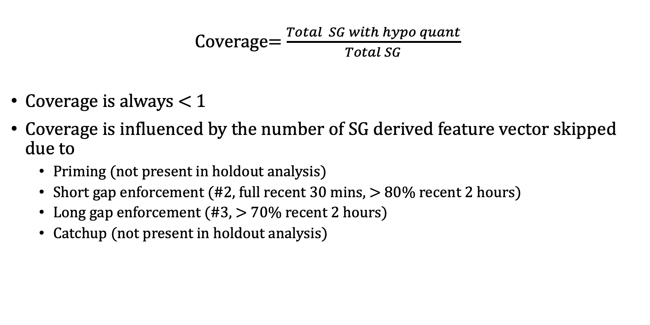
IQCast coverage
Coverage= $\frac{Total SG with hypo quant}{Total SG}$
Coverage is always < 1
Coverage is influenced by the number of SG derived feature vector skipped due to
Priming (not present in holdout analysis)
Short gap enforcement (#2, full recent 30 mins, > 80% recent 2 hours)
Long gap enforcement (#3, > 70% recent 2 hours)
Catchup (not present in holdout analysis)

Slide 3
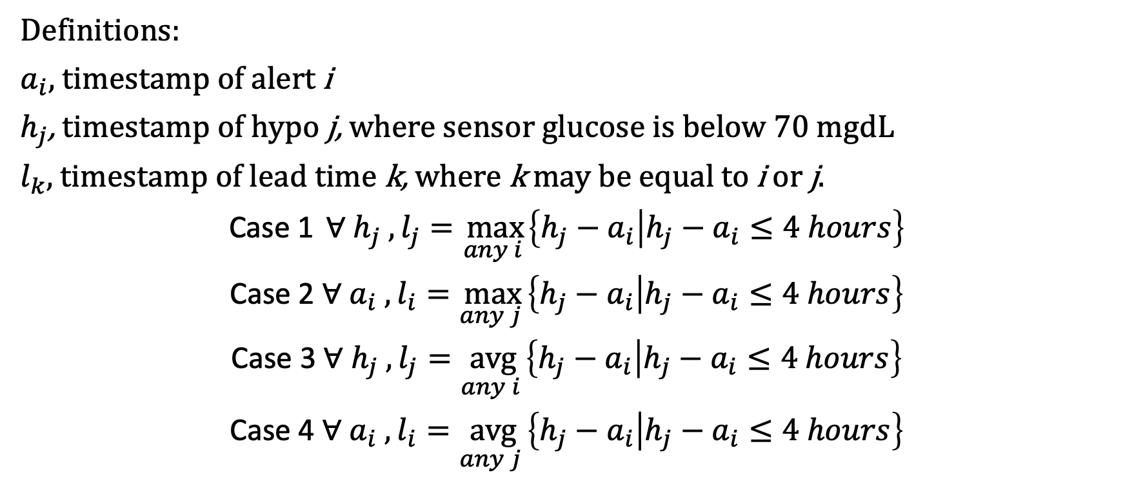
First and repeat alert lead time definitions
Definitions:
$a_{i}$, timestamp of alert i
$h_{j}$, timestamp of hypo j, where sensor glucose is below 70 mgdL
$l_{k},$ timestamp of lead time k, where k may be equal to i or j.
Case 1 $∀ h_{j} , l_{j}=\max_{any i }\left\{h_{j}−a_{i} | h_{j}−a_{i}≤4 hours\right\}$
Case 2 $∀ a_{i} , l_{i}=\max_{any j }\left\{h_{j}−a_{i} | h_{j}−a_{i}≤4 hours\right\}$
Case 3 $∀ h_{j} , l_{j}=\underset{any i }{avg}\left\{h_{j}−a_{i} | h_{j}−a_{i}≤4 hours\right\}$
Case 4 $∀ a_{i} , l_{i}=\underset{any j }{avg}\left\{h_{j}−a_{i} | h_{j}−a_{i}≤4 hours\right\}$

Slide 4
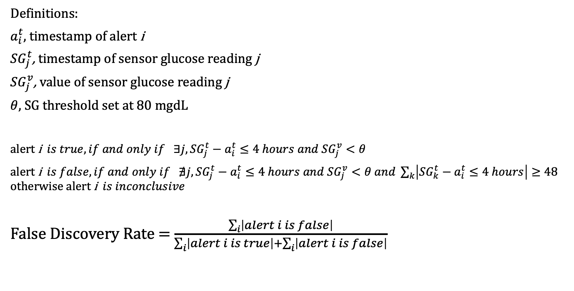
Alert classification and FDR
Definitions:
$a_{i}^{t}$, timestamp of alert i
${SG}_{j}^{t}$, timestamp of sensor glucose reading j
${SG}_{j}^{v}$, value of sensor glucose reading j
$θ$, SG threshold set at 80 mgdL
alert i $is true,if and only if ∃j,{SG}_{j}^{t}−a_{i}^{t}≤4 hours and{ SG}_{j}^{v}<θ$
$\text{alert} \text{i} is false,if and only if ∄j,{SG}_{j}^{t}−a_{i}^{t}≤4 hours and{ SG}_{j}^{v}<θ and \sum_{k}{\left|{SG}_{k}^{t}−a_{i}^{t}≤4 hours\right|}≥48$
$$o\text{therwise} \text{alert} \text{i} is inconclusive$$
False Discovery Rate = $\frac{\sum_{i}{\left|alert i is false\right|}}{\sum_{i}{\left|alert i is true\right|+\sum_{i}{\left|alert i is false\right|}}}$

Slide 5
Density estimation plot
Density estimation is the construction of an estimate, based on observed data, of an unobservable underlying probability density function. The unobservable density function is thought of as the density according to which a large population is distributed; the data are usually thought of as a random sample from that population.
https://en.wikipedia.org/wiki/Density_estimation
By طاها - Own work, CC BY-SA 3.0, https://commons.wikimedia.org/w/index.php?curid=24309466

