Slide 1
Results of R3.0 analysis including smoothing
Findings of the analysis of the R3.0 system performance on 581 Guardian Connect patients (Australian patients using same device) with a total of 16M SG points.
- 80% of the cases have an Alert Lead Time of at least 120 minutes - 89.7% of the cases have an Alert Lead Time of at least 60 minutes
Smoothing logic was tuned to address sudden user SG drop in a single user per request from MDT during UAT. Results:
Before the UAT adjustment ==> FDR (model + smoothing): 25.6%
After the UAT adjustment ==> FDR (model + smoothing): 53.3%*
This is aligned precisely with the graph on page 1 which shows the tradeoff of lead time vs. FDR. There is room to tune this as it is a small change to the Smoothing logic for transitions from L->M and M->H and can be modified after go-live.
*Note: FDR is imprecise as it is impacted by patient behavior and therefore a less good metric than Lead time.

Slide 2
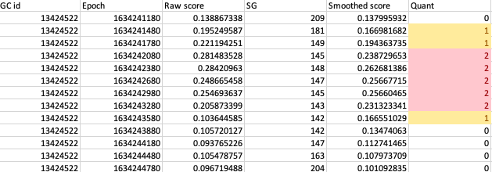
Issue 1: FDR percentage counted by RED labels, not by alerts
False alert in the data, although 40 mgdL jump looks suspicious
One IQCast alert
Five IQCast REDs
The longer the duration, the more false alerts

Slide 3
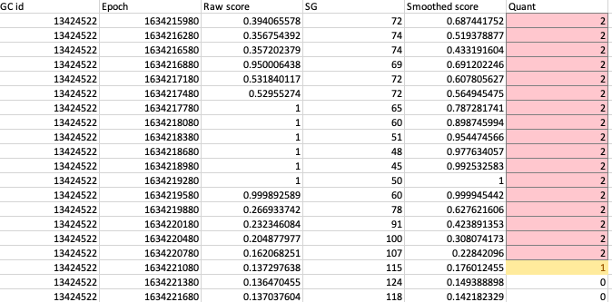
Issue 2: FDR percentage over counted by the tail end of exponential moving average
Valid IQCast alert
Due to moving average, previously high risk scores got carried forward
Starting at SG 78, 91, 100, 107, the four REDs are counted toward false alerts FDR also

Slide 4
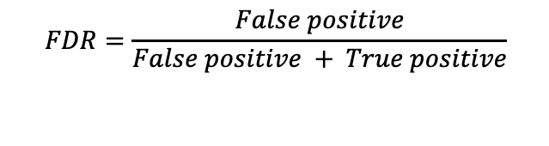
FDR calculation definition
A false alert is found if, starting from a Quant=1 (Yellow) to 2 (Red) transition,
There was no SG < 80 mgdL in the next four hours
A true alert is found if, starting from a Quant=1 (Yellow) to 2 (Red) transition,
There was at least one SG < 80 mgdL in the next four hours
An alert is disqualified, if
There was no SG < 80 mgdL but there were data missing in the next four hours
$$FDR=\frac{False positive}{False positive + True positive}$$

Slide 5
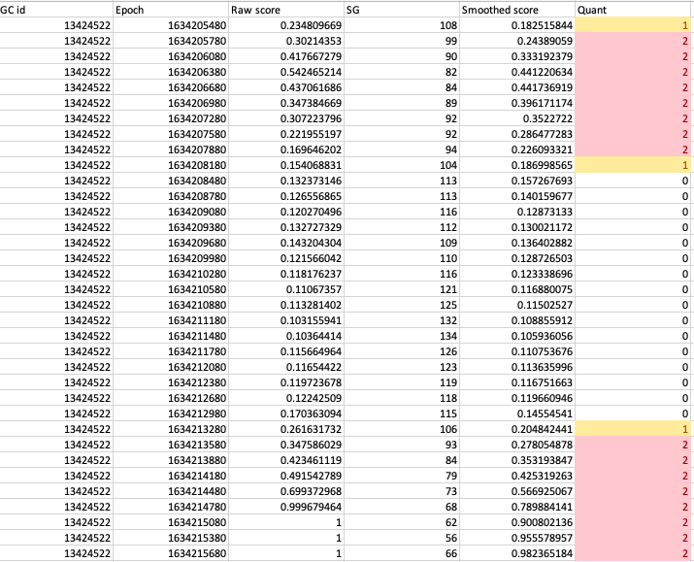
Lead time calculation definition
Lead time is calculated starting with the first SG < 70 mgdL, the elapsed time from the first Quant=2, RED timestamp in the 4-hour window

Slide 6
FDR statistics and distribution

