Slide 1
Machine Learning Concepts for Multiclass Classification
Entropy, Cross-Entropy Loss, ReLU, and Adam Optimizer

Slide 2
Overview
Entropy: Measuring uncertainty in data
Cross-Entropy Loss: Evaluating model predictions
ReLU Activation: Enabling non-linear learning
Adam Optimizer: Efficiently updating model weights
How these concepts work together in our PyTorch model

Slide 3
Entropy

Slide 4


What is Entropy/Information Entropy?
Entropy quantifies the uncertainty/surprise/impurity in a dataset.
Example: You pick a black bird from each data set with a different distribution (event: pick a bird, outcome: a black bird)
dataset 1
dataset 2
dataset 3
If something is very unlikely but happens → big surprise
If something is very likely to happen→ you’re not surprised
high
medium
low
Notes:
what if we pick up a white bird?

Slide 5
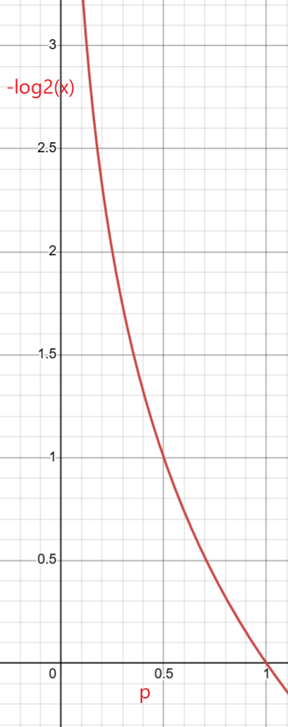
Compute the entropy of an event (picking a black bird with a probability of p)
Entropy _{black} =​log₂​(1/p _{black} ​)
dataset 1
dataset 2
dataset 3
p _{black} =1/8=0.125
Entropy _{black} =​log₂​(1/0.125​)=3
p _{black} =4/8=0.5
Entropy _{black} =​log₂​(1/0.5​)=1
p _{black} =7/8
Entropy _{black} =​log₂​(1/(7/8​)= 0.19
The uncertainty can be encoded by the number of bits
transform a p to entropy

Slide 6
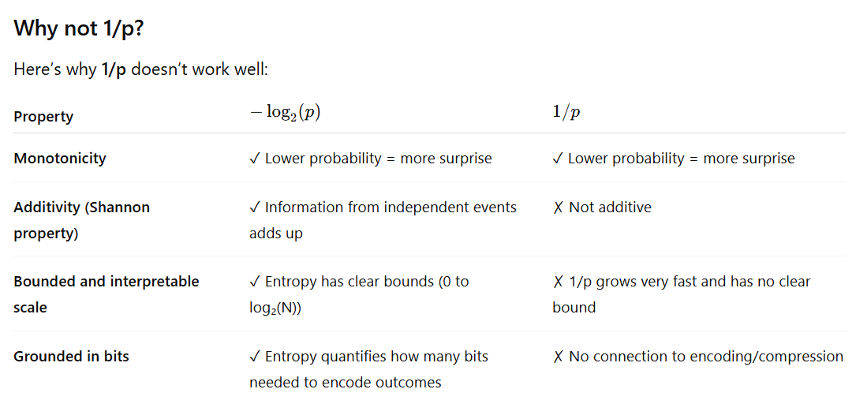
Takeaway: Entropy can be measured in bits, e.g., a 50% outcome can be encoded and represented in 1 bit

Slide 7
Should consider two outcomes: a black or a white bird
Entropy _{black} =​log₂​(1/p _{black} ​)
Entropy _{white} =​log₂​(1/p _{white} ​)
consider weighted entropy for both outcomes
Weighted Entropy _{pick a bird} =​ p _{black} log₂​(1/p _{black} ​) + p _{white} log₂​(1/p _{white} ​)
=​ p _{black} log₂​(1/p _{black} ​) + (1-p _{black} )log₂​(1/p _{black} ​)
Takeaway: We are always interested in Weighted Entropy

Slide 8
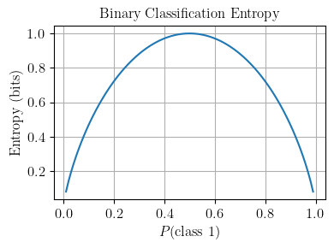
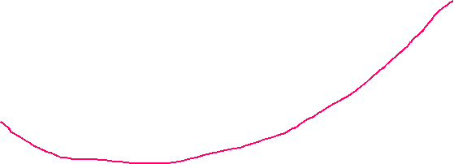

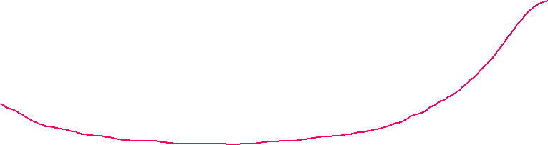

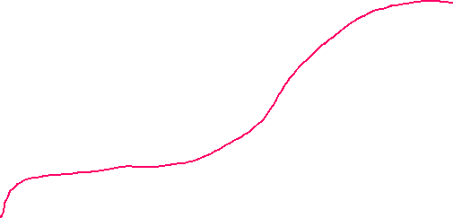

Example: Compute weighted entropy
Entropy _{pick a bird} =​ p _{black} log₂​(1/p _{black} ​) + p _{white} log₂​(1/p _{white} ​)
dataset 1
dataset 2
dataset 3
0.125 log₂​(1/0.125 ​) + 0.875 log₂​(1/0.875 ​) =0.54
0.5 log₂​(1/0.5 ​) + 0.5 log₂​(1/0.5 ​)=1
0.875 log₂​(1/0.875 ​) + 0.125 log₂​(1/0.125 ​) =0.54
Why does dataset 2 have the highest entropy? equal distribution has the highest uncertainty

Slide 9
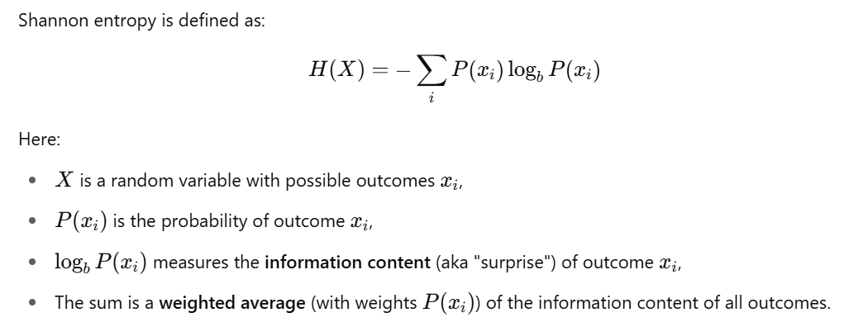
Takeaway: Entropy is the
expected information or average uncertainty associated with a random variable (with probability of all possible outcomes)
the average number of bits we’d need to encode the information (distribution)

Slide 10
Example 1: Entropy (Information Theory) for Data Compression
Calculates the smallest amount of information required to convey a message

Slide 11
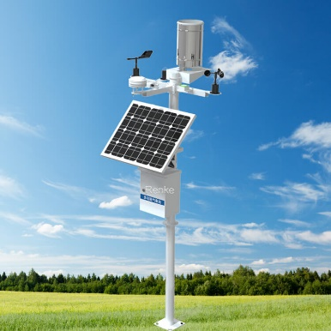

Background: Location A needs to send weather information (Sunny, Cloudy, Windy) to Location B every day.
Question: What is the minimum bits required to transfer weather information for 100 days?
Sunn: 50%
Cloudy: 25%
Windy: 25%
Location A
Location B
Encode Solution | Encoding method | Bits Needed Each Day | Bits Needed 100 Days
1: message | Sunny (1) , Cloudy (2), Windy (3) | 8 | 800
2: bits | Sunny (00) , Cloudy (01), Windy (10) | 2 | 200
3. entropy | next slide | 1 | 100

Slide 12
1. Sort the weather in order of decreasing frequency.
S
C
W
Sunny: 50%
Cloudy: 25%
Windy: 25%
Root
0
1
2. Build a tree structure.
S
0
1
C
W
3. Traverse from root to each weather
S (0)
C (10)
W (11)
4: Bits Needed 100 Days = 50*1+25*2+25*2 =100 (average bit 100 bits/100 day =1 bit per day
Entropy: Average Bits Needed 100 Days = 0.50*(log 1/0.5) +0.25* (log 1/0.25)+0.25*(log 1/0.25) = 1 bit per day

Slide 13
Example 2: Entropy (In ML) for Measuring a model’s Confidence

Slide 14
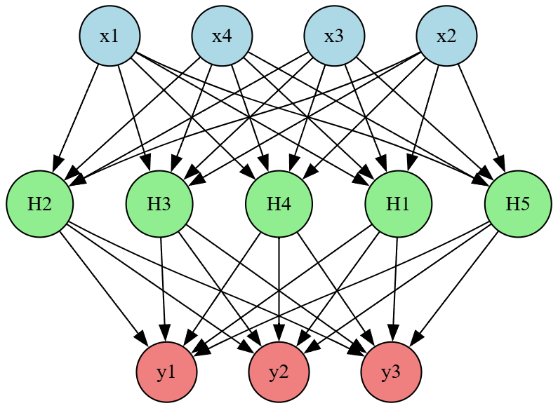
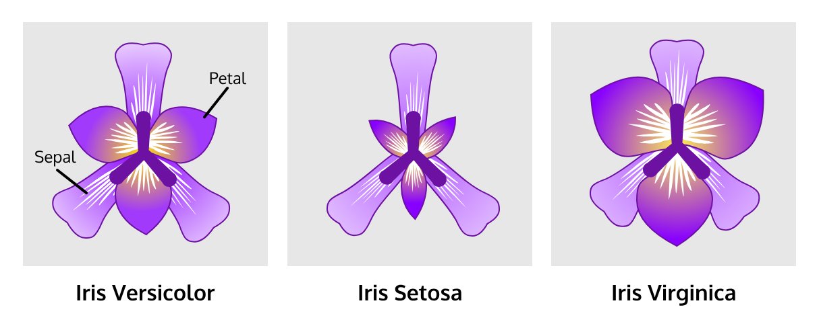
Measure a model’s confidence using entropy
Iris dataset with 3 classes [Setosa, Versicolor, Virginica]
The model is a random variable
with or without training
Model prediction results:
Prediction case 1 : [0.33, 0.33, 0.33] → High entropy → High uncertainty → confidence is low
Prediction case 2: [0.8, 0.1, 0.1] → Low entropy → Low uncertainty → confidence is higher
Prediction case 2: [0.8, 0.1, 0.1]
Takeaway: A trained model should produce low-entropy outputs (e.g., [0.8, 0.1, 0.1]) for accurate classification.
Notes:
digraph NeuralNetwork {
rankdir=TB; // Changed from LR to TB for top-to-bottom layout
splines=true;
nodesep=0.5;
ranksep=1.0;
// Input Layer (4 neurons)
node [shape=circle, style=filled, fillcolor=lightblue];
I1 [label="x3"];
I2 [label="x2"];
I3 [label="x1"];
I4 [label="x4"];
{rank=same; I1; I2; I3; I4}
// Hidden Layer (5 neurons)
node [shape=circle, style=filled, fillcolor=lightgreen];
H1 [label="H5"];
H2 [label="H2"];
H3 [label="H3"];
H4 [label="H4"];
H5 [label="H1"];
{rank=same; H1; H2; H3; H4; H5}
// Output Layer (3 neurons)
node [shape=circle, style=filled, fillcolor=lightcoral];
O1 [label="y1"];
O2 [label="y2"];
O3 [label="y3"];
{rank=same; O1; O2; O3}
// Edges: Input to Hidden Layer
I1 -> {H1, H2, H3, H4, H5};
I2 -> {H1, H2, H3, H4, H5};
I3 -> {H1, H2, H3, H4, H5};
I4 -> {H1, H2, H3, H4, H5};
// Edges: Hidden to Output Layer
H1 -> {O1, O2, O3};
H2 -> {O1, O2, O3};
H3 -> {O1, O2, O3};
H4 -> {O1, O2, O3};
H5 -> {O1, O2, O3};
}

Slide 15

A small Issue: A multiclass classification model produces raw results (e.g., [3.1, 1.01, 1.01]), but calculating entropy needs probabilities
Solution: Softmax- converts raw model outputs (logits) into probabilities
z= [3.1 1.01 1.01]
softmax
sum([0.8, 0.1, 0.1])=1
nn.Softmax()

Slide 16
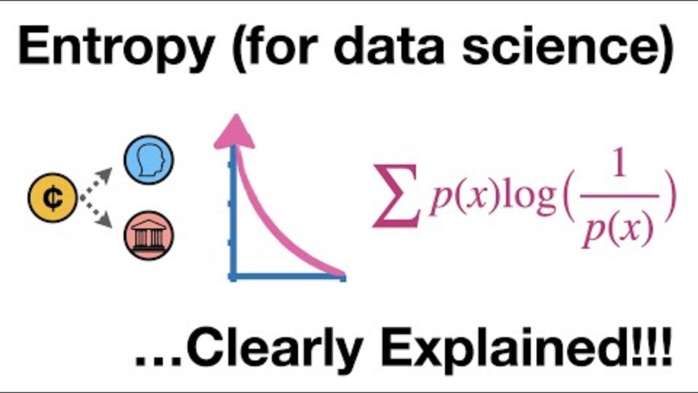

Slide 17
Cross-Entropy

Slide 18
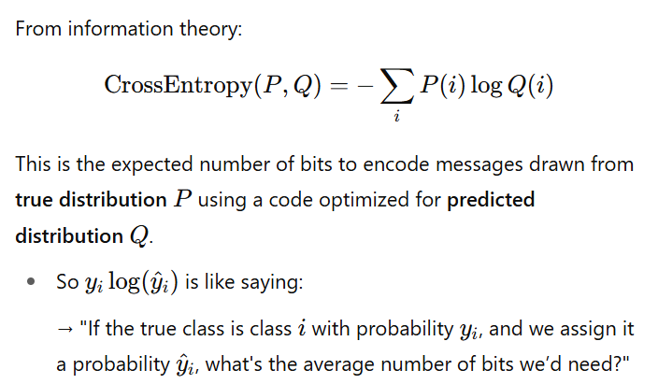
Sunny: 50% ; cloudy: 25%; Windy: 25%
Recall Entropy: Average Bits Needed 100 Days = 0.50*(log 1/0.5) +0.25* (log 1/0.25)+0.25*(log 1/0.25) = 1 bit per day
optimized encoding P
true distribution P
Cross-Entropy: What if we did not optimize encoding?
Cross Entropy: 0.50*(log 1/pre_a) +0.25* (log 1/pre_b)+0.25*(log 1/pre_c) = 1 bit per day
Predicted encoding Q
true distribution P
Notes:
Formula: L = -\sum y_i \log(\hat{y}_i) \\
y_i : \text{True label (1 for correct class, 0 otherwise)}\\
\hat{y}_i : \text{Predicted probability for class ( i )}

Slide 19
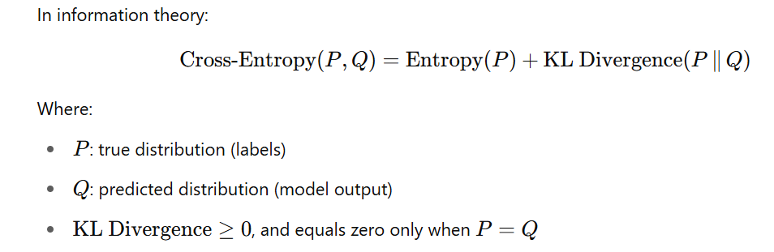
extract bits need to encode information
https://www.youtube.com/watch?v=ErfnhcEV1O8
Notes:
Formula: L = -\sum y_i \log(\hat{y}_i) \\
y_i : \text{True label (1 for correct class, 0 otherwise)}\\
\hat{y}_i : \text{Predicted probability for class ( i )}

Slide 20
Cross-Entropy Loss

Slide 21
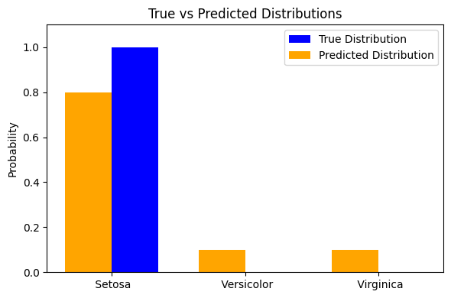
Cross-Entropy loss: Evaluating Predictions
Definition: Measures the difference between two distributions (predicted probabilities and true labels).
0.8
0.1
0.1
1
0
0
Setosa
Versicolor
Virginica
y= true label/ distribution (one-hot encoded)
y’=predicted distribution (after softmax)

Slide 22
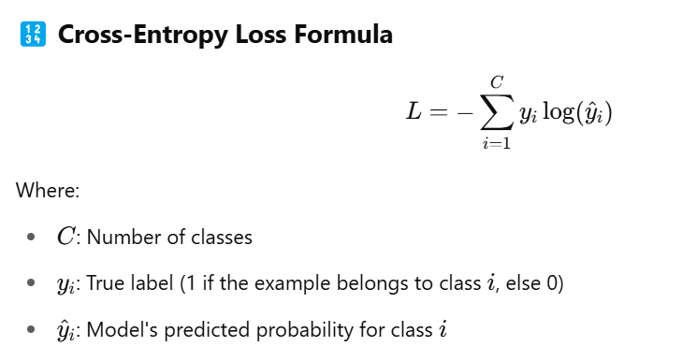
Cross-Entropy loss related to Information Theory (Cross-Entropy)
vs.
https://www.youtube.com/watch?v=ErfnhcEV1O8
Notes:
Formula: L = -\sum y_i \log(\hat{y}_i) \\
y_i : \text{True label (1 for correct class, 0 otherwise)}\\
\hat{y}_i : \text{Predicted probability for class ( i )}

Slide 23
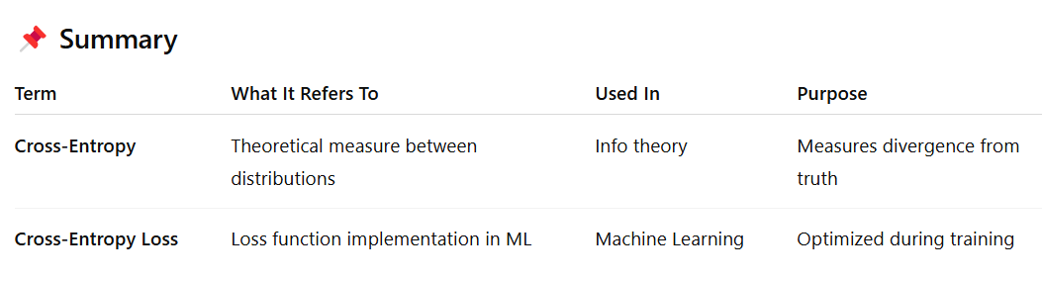

Slide 24





Simplify Cross-Entropy loss
Simplify the Loss function with one-hot encoded true distribution, e.g., y=[1,0,0]
y1* entropy y0’ +
y2* entropy y1’ +
y3* entropy y2’
=
= −log(y​₀​’)
y=[1,0,0]

Slide 25
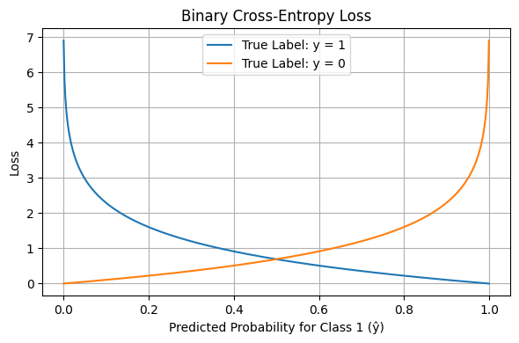
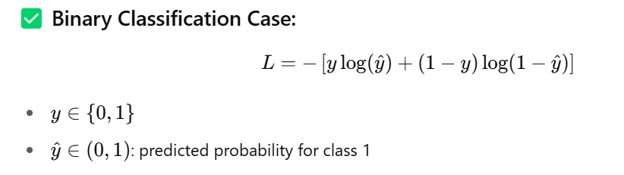
Binary Cross-Entropy Loss is a special case of Cross-Entropy Loss

Slide 26
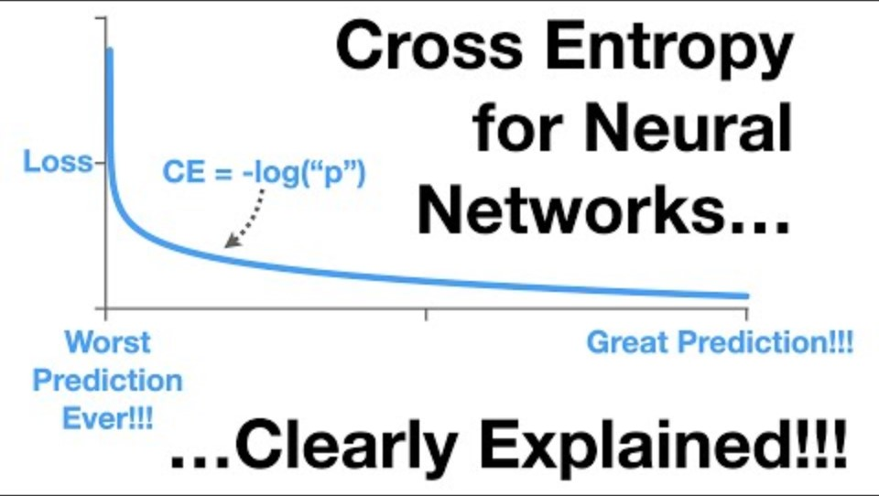

Slide 27
Takeaways: Iris flower Multi-classification
Cross-Entropy

Slide 28
Classify iris flowers into one of three species based on four measured features.
Feature | Description
Sepal length | in centimeters
Sepal width | in centimeters
Petal length | in centimeters
Petal width | in centimeters
sum([0.8, 0.1, 0.1])=1
The target variable (class label) has three categories:
Iris setosa
Iris versicolor
Iris virginica

Slide 29
A small Issue: A multiclass classification model produces raw results (e.g., [3.1, 1.01, 1.01]), but calculating entropy needs probabilities
Solution: Softmax- converts raw model outputs (logits) into probabilities
z= [3.1 1.01 1.01]
softmax
sum([0.8, 0.1, 0.1])=1
nn.Softmax()

Slide 30
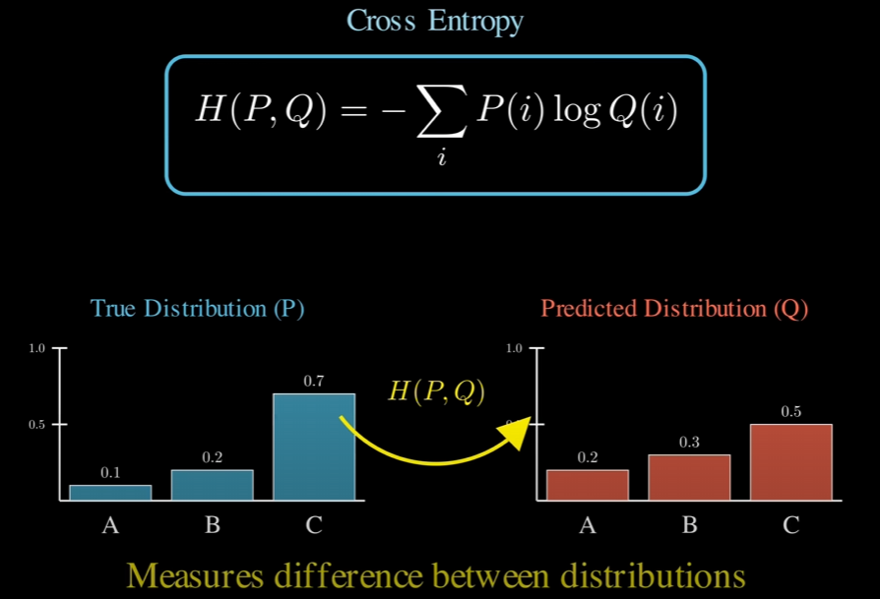
log(1/P(A))
log(1/Q(A))

Slide 31



Ideally, all uncertainty can be encoded using the minimum number of bits corresponding to the true distribution. If we use an incorrect distribution, we must use more bits to represent that uncertainty. Cross-entropy is # min bits + extra bits
log(1/P(A))
log(1/Q(A))

Slide 32
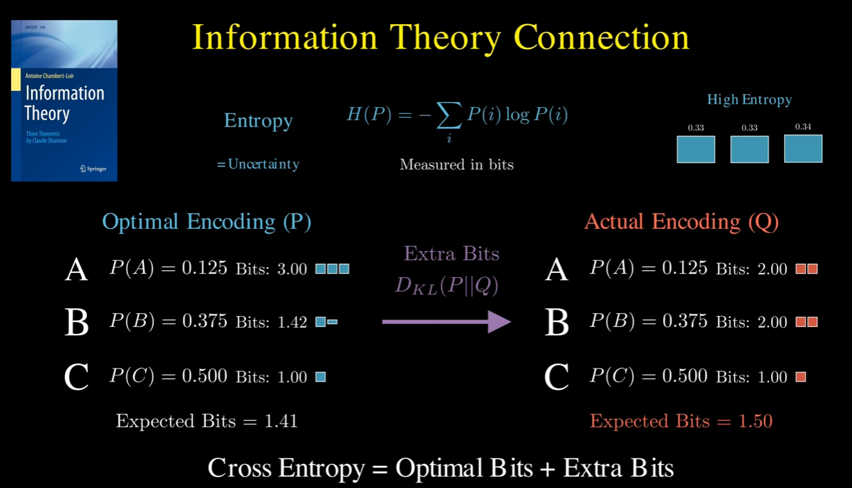


using incorrect encoding
Notes:
https://www.youtube.com/watch?v=Fv98vtitmiA

Slide 33
Cross-Entropy Loss in classification Problem
How far are my predicted probabilities from the true labels? => reduce extra bits wasted due to incorrect encoding
0.8
0.1
0.1
1
0
0
Cat/Setosa
Dog/Versicolor
Rabbit/Virginica
y= true label/ distribution (one-hot encoded)
y’=predicted distribution (after softmax)

Slide 34
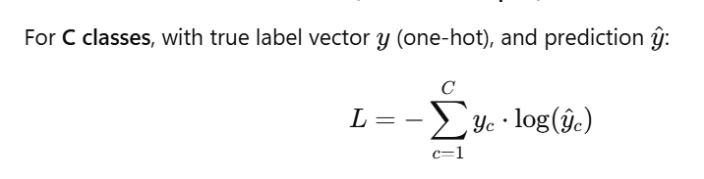
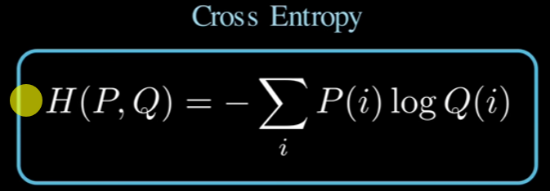




Multi-class Classification (softmax output)
Cross-Entropy loss
0.8
0.1
0.1
1
0
0
loss= 1*log(1/0.8) +0*log(1/0.1)+ 0*log(1/0.1)

Slide 35
Activation Function
Enabling Non-Linear Learning

Slide 36
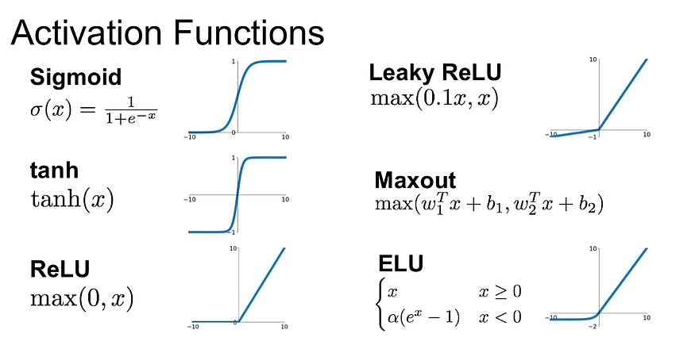
Activation Function: Introduces non-linearity in neural networks
Sigmoid is only used in the output layer (a final neuron) as a binary prediction
ReLU’s simplicity makes training faster (inner layers)

Slide 37
Optimizer

Slide 38
https://community.deeplearning.ai/t/optimization-algorithms/305154/3

Slide 39
Adam Optimizer
Definition: Adaptive Moment Estimation, a gradient-based optimization algorithm
How It Works:
Combines momentum (moving average of gradients) and RMSProp (adaptive learning rates)
Updates weights to minimize cross-entropy loss
In PyTorch Code:
optimizer = optim.Adam(model.parameters(), lr=0.001)
optimizer.step() updates weights after backpropagation
Benefits:
Fast convergence
Adapts to different features (e.g., Iris’s varying scales)

Slide 40
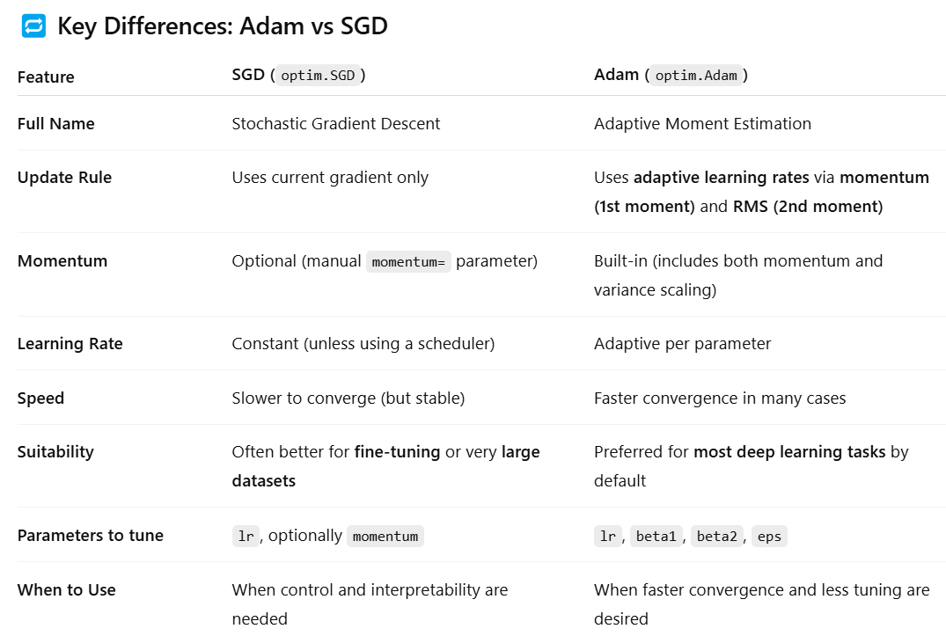

Slide 41
Which optimizer to use
Use Adam when you want good performance quickly and don't want to worry too much about hyperparameter tuning.
Use SGD (with momentum) when training very large models, fine-tuning pre-trained networks, or when you want tighter control over optimization behavior.
Compare both optimizers for Iris training with 100 epochs (150 samples)

Slide 42
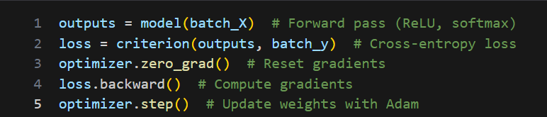
Putting It All Together
Entropy: Measures uncertainty in predictions (goal: low entropy for correct class)
Cross-Entropy Loss: Guides model to reduce uncertainty (criterion)
ReLU: Enables learning complex patterns in Iris features (relu1, relu2)
Adam: Optimizes weights to minimize loss (optimizer)

Slide 43
Summary
Entropy: Quantifies prediction uncertainty
Cross-Entropy Loss: Measures prediction error for multiclass tasks
ReLU: Adds non-linearity for complex patterns
Adam Optimizer: Efficiently minimizes loss
Application: These concepts power our PyTorch model to classify Iris species with high accuracy

