Slide 1
Convolutional Neural Networks
A beginner-friendly guide to CNN fundamentals
https://indoml.com/2018/03/07/student-notes-convolutional-neural-networks-cnn-introduction/

Slide 2
Overview
Introduction to CNNs
MNIST Dataset Overview
Key CNN Concepts
CNN Architecture
Data Preprocessing
Training and Optimization
Evaluation and Visualization
Conclusion

Slide 3
Introduction to CNNs
What are Convolutional Neural Networks?
Neural networks designed for grid-like data (e.g., images)
Automatically learn features like edges, textures, and shapes
Key layers: Convolutional, pooling, fully connected
Why use CNNs for MNIST?
Effective for digit recognition
Reduces manual feature engineering

Slide 4
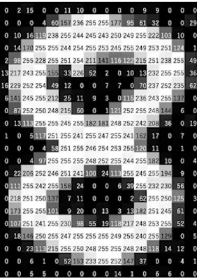
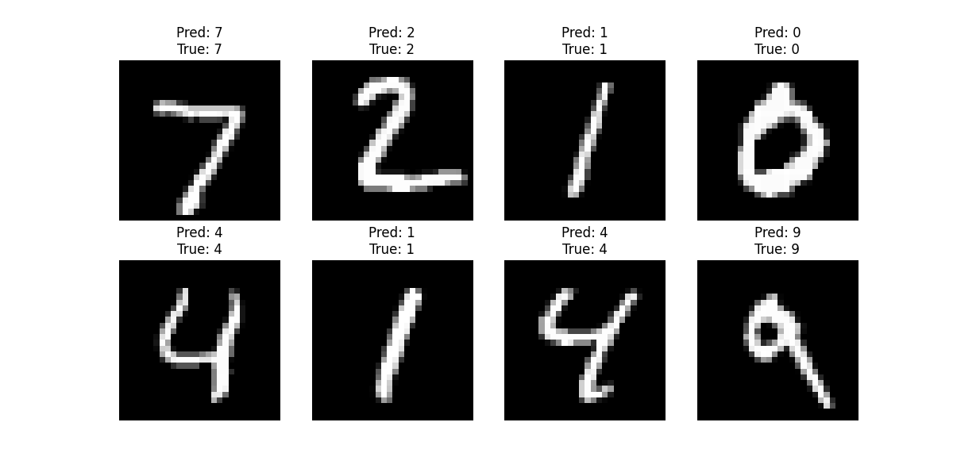
MNIST Dataset Overview
MNIST Dataset
70,000 grayscale images of handwritten digits (0-9)
Image size: 28x28 pixels
Each pixel has an intensity value between 0 and 255
Split: 60,000 training, 10,000 test images
10 classes (one per digit)
Why MNIST?
Simple, well-structured dataset
Ideal for learning CNN basics

Slide 5
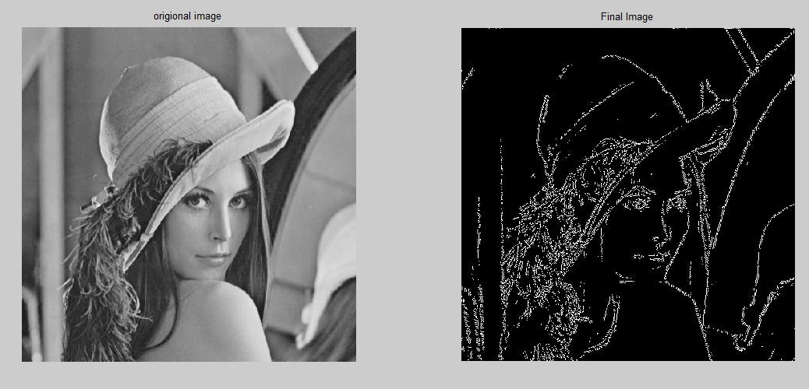
Key CNN Concepts

Slide 6
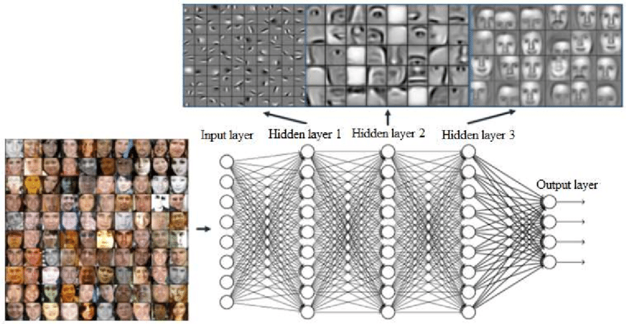
Features at different layers
https://www.researchgate.net/figure/Features-obtained-for-face-recognition-application-in-hidden-layers-of-CNN-9_fig1_355228583

Slide 7
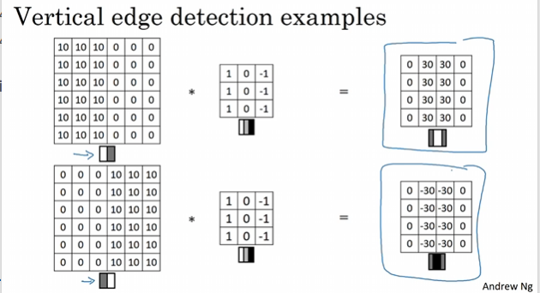
Feature detector with Convolution Operation
filter/kernel
https://www.youtube.com/watch?v=XuD4C8vJzEQ

Slide 8
Basic Convolution Operation
https://medium.com/@alejandro.itoaramendia/convolutional-neural-networks-cnns-a-complete-guide-a803534a1930

Slide 9
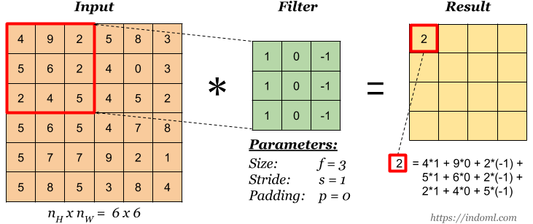
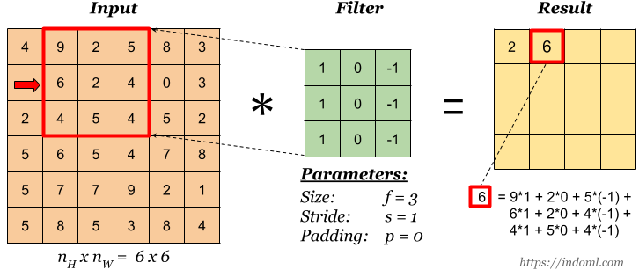
Filter /kernels parameters
https://indoml.com/2018/03/07/student-notes-convolutional-neural-networks-cnn-introduction/

Slide 10
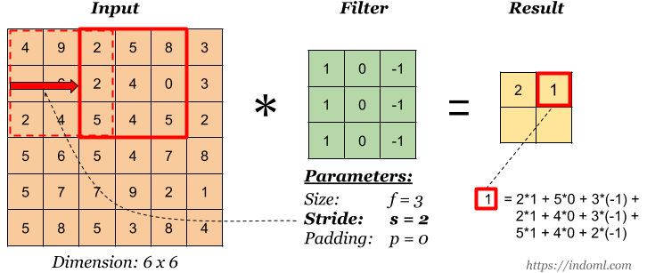
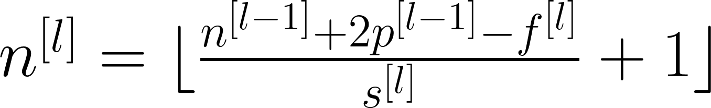
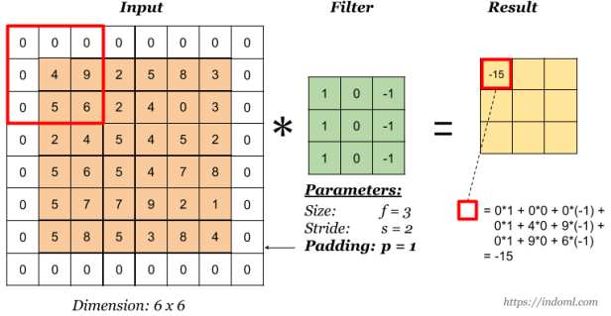
Stride
Calculate output dimension
nn.Conv2d(1, 32, 3, padding=1)
1 input channel (grayscale), 32 output channels, 3x3 filter
Padding

Slide 11
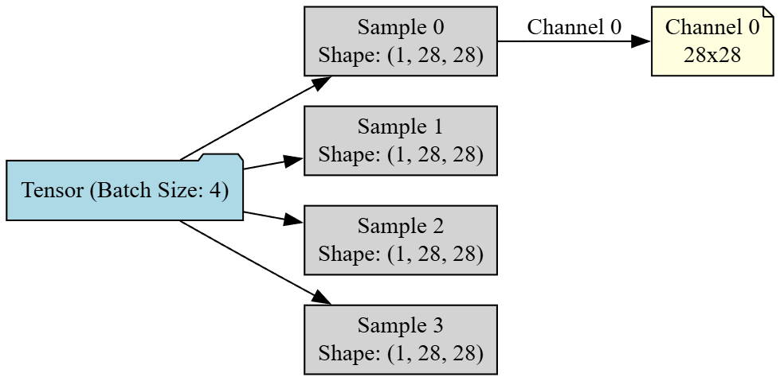
Tensor shape of MNIST images (batch size =4)
For MNIST images with a batch size of 4, the tensor shape is typically: (4, 1, 28, 28)
Here's a breakdown of the dimensions:
4 → batch size (number of images)
1 → number of channels (grayscale image)
28 → height
28 → width
Notes:
digraph MNIST_Tensor { node [shape=box, style=filled, fillcolor=lightgray];
rankdir=LR;
// Batch nodes Batch [label="Tensor (Batch Size: 4)", shape=folder, fillcolor=lightblue];
// Batch elements Batch -> Sample0; Batch -> Sample1; Batch -> Sample2; Batch -> Sample3;
Sample0 [label="Sample 0\nShape: (1, 28, 28)"]; Sample1 [label="Sample 1\nShape: (1, 28, 28)"]; Sample2 [label="Sample 2\nShape: (1, 28, 28)"]; Sample3 [label="Sample 3\nShape: (1, 28, 28)"];
// Detail for Sample0 only Sample0 -> Channel0 [label="Channel 0"]; Channel0 [label="Channel 0\n28x28", shape=note, fillcolor=lightyellow]; }

Slide 12
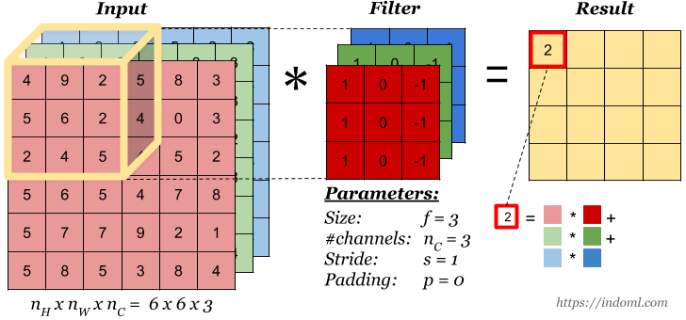
Convolution Operation on Volume

Slide 13
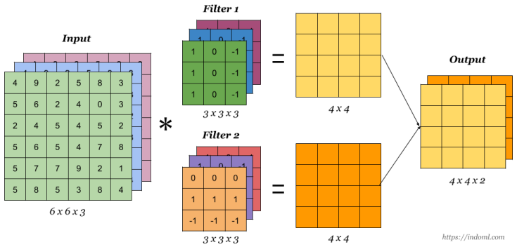
Convolution Operation with Multiple Filters

Slide 14
Purpose of Using Multiple Filters
Extract Diverse Features:
Each filter learns to detect a different feature, such as edges, textures, shapes, or patterns.
For example, one filter might detect vertical edges, another horizontal edges, and another corners or blobs.
Enhance Representational Power:
More filters allow the CNN to create a richer and more expressive representation of the input, which is crucial for complex tasks like object recognition or classification.
Improve Generalization:
By learning a variety of features, the network becomes more robust and better at generalizing to new, unseen data.
Enable Hierarchical Feature Learning:
In deeper layers, filters can combine lower-level features (like edges) into higher-level concepts (like object parts or entire objects), progressively building a meaningful representation.

Slide 15
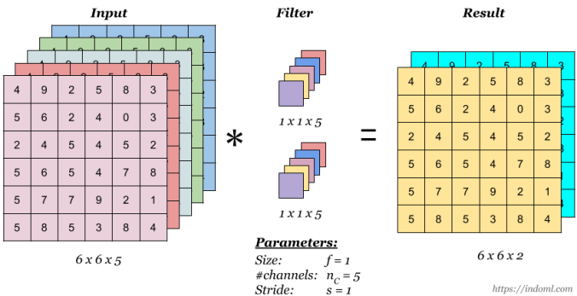
1 x 1 Convolution
flatten or “merge” channels together, which can save computations later in the network:

Slide 16
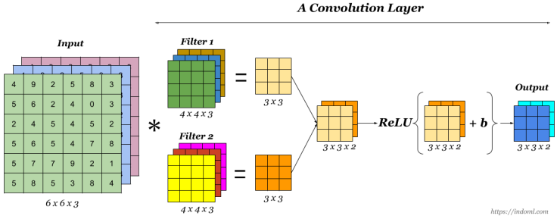
One Convolution Layer
Batch Norm

Slide 17
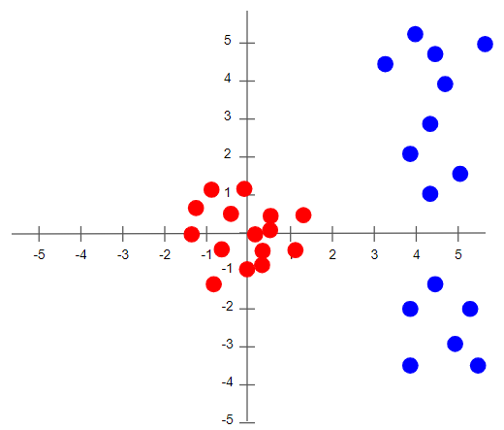
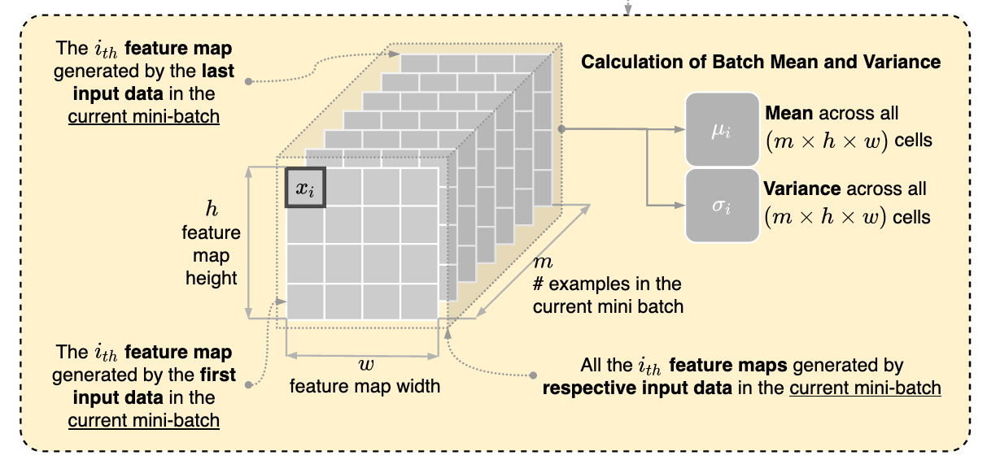
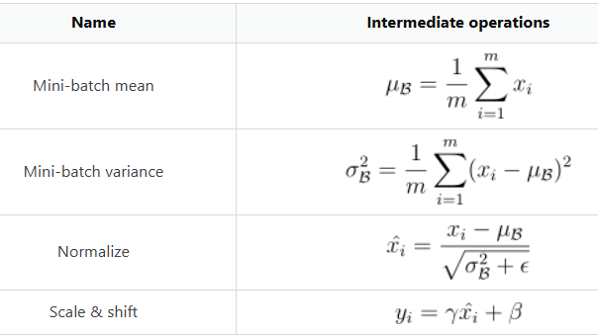
BatchNorm: stabilize training
https://i.sstatic.net/VEQhM.png

Slide 18
Pooling Layer

Slide 19
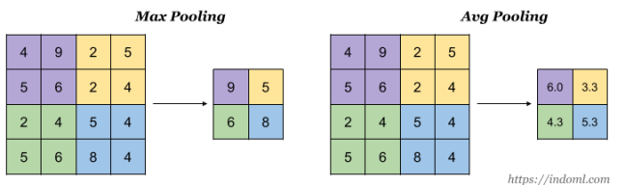
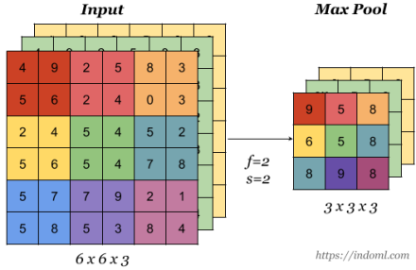
Pooling Layer: reduce the size
can be applied to the input to reduce the height and width

Slide 20
CNN Architectures

Slide 21
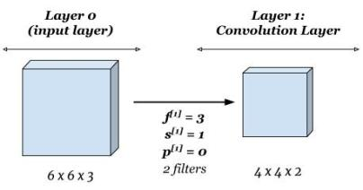
Shorthand Representation

Slide 22
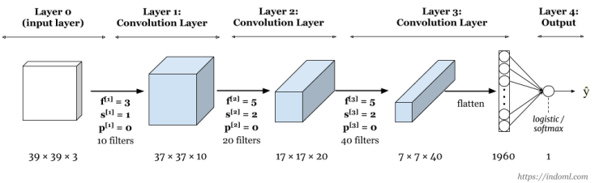

Sample CNN

Slide 23
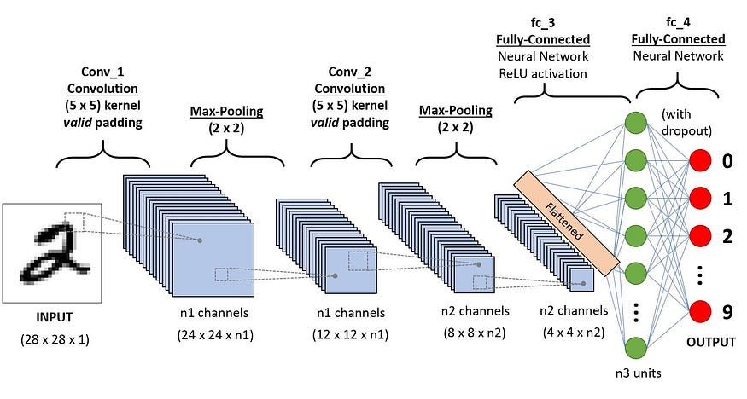
CNN for MNIST
nn.Dropout(0.5)
Troch (1*28*28)
n1= 32
n2= 64
n3= 128
nn.Linear(n2 * 4 * 4, n3)
https://medium.com/@alejandro.itoaramendia/convolutional-neural-networks-cnns-a-complete-guide-a803534a1930

Slide 24
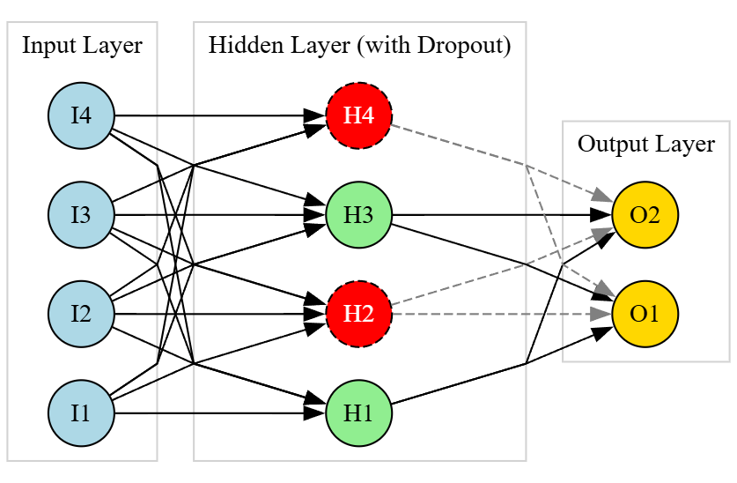
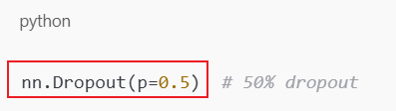
Dropout to Avoid Overfitting
During training, dropout randomly sets a fraction of the input units (neurons) to zero at each update step.
For example, with a dropout rate of 0.5, each neuron has a 50% chance of being "dropped" (ignored) during that training pass.
https://www.mathworks.com/discovery/overfitting.html

Slide 25
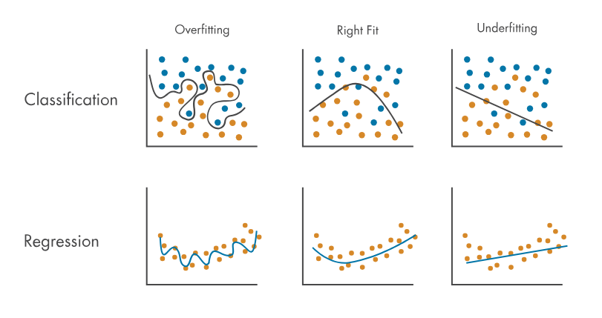
Why Is Dropout Important?
Prevents Overfitting:
By randomly disabling neurons, dropout forces the network to not rely too heavily on any one neuron. This leads to better generalization.
Encourages Redundant Representations
Since any neuron might be dropped, the network learns multiple paths to represent the same concept—making it more robust.
Acts Like Model Averaging
Dropout can be thought of as training an ensemble of many different "thinned" networks and averaging their predictions.
Notes:
digraph Dropout {
rankdir=LR;
splines=polyline;
node [shape=circle, width=0.5, fixedsize=true, style=filled, fontcolor=black];
// Input neurons
subgraph cluster_input {
label="Input Layer";
color=lightgrey;
I1 [label="I1", fillcolor=lightblue];
I2 [label="I2", fillcolor=lightblue];
I3 [label="I3", fillcolor=lightblue];
I4 [label="I4", fillcolor=lightblue];
}
// Hidden layer neurons (some dropped)
subgraph cluster_hidden {
label="Hidden Layer (with Dropout)";
color=lightgrey;
H1 [label="H1", fillcolor=lightgreen];
H2 [label="H2", fillcolor=red, style="filled,dashed", fontcolor=white]; // Dropped
H3 [label="H3", fillcolor=lightgreen];
H4 [label="H4", fillcolor=red, style="filled,dashed", fontcolor=white]; // Dropped
}
// Output layer
subgraph cluster_output {
label="Output Layer";
color=lightgrey;
O1 [label="O1", fillcolor=gold];
O2 [label="O2", fillcolor=gold];
}
// Connections (straight)
I1 -> H1;
I1 -> H2;
I1 -> H3;
I1 -> H4;
I2 -> H1;
I2 -> H2;
I2 -> H3;
I2 -> H4;
I3 -> H1;
I3 -> H2;
I3 -> H3;
I3 -> H4;
I4 -> H1;
I4 -> H2;
I4 -> H3;
I4 -> H4;
H1 -> O1;
H1 -> O2;
H2 -> O1 [style=dashed, color=gray];
H2 -> O2 [style=dashed, color=gray];
H3 -> O1;
H3 -> O2;
H4 -> O1 [style=dashed, color=gray];
H4 -> O2 [style=dashed, color=gray];
}

Slide 26
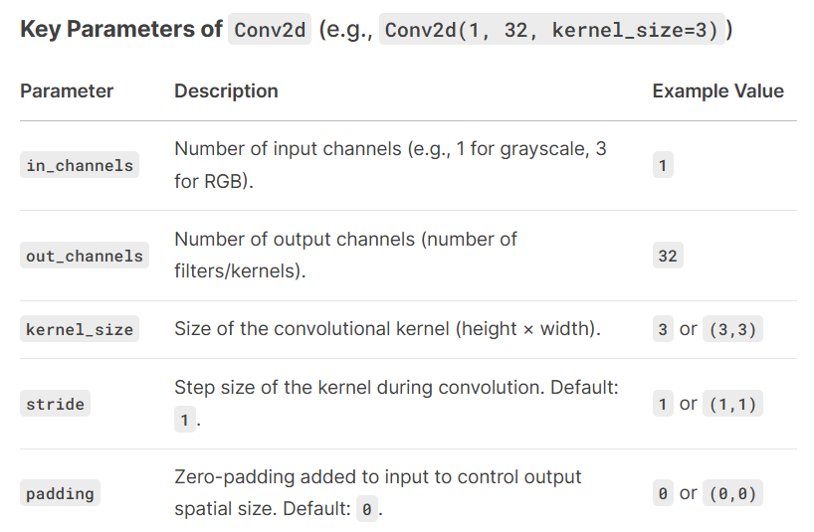
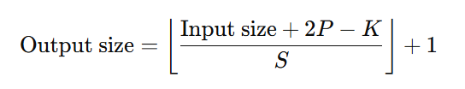
Model Structure Implementation
nn.Conv2d doesn’t specify image dimensions (28*28) because PyTorch dynamically computes output shapes based on the input tensor’s height and width at runtime.
Conv2d (1->32, 5x5) -> BatchNorm -> ReLU -> MaxPool (2x2)
nn.Conv2d(1, 32, 5, padding=0)
nn.BatchNorm2d(32)
nn.MaxPool2d(2, 2)
Conv2d (32->64, 5x5) -> BatchNorm -> ReLU -> MaxPool (2x2)
nn.Conv2d(32, 64, 5, padding=0)
nn.BatchNorm2d(64)
Flatten (64*4*4) -> Linear (128) -> ReLU -> Dropout (0.5)
nn.Linear(64 * 4 * 4, 128)
nn.Dropout(0.5)
Linear (10) for classification
nn.Linear(128, 10)
Note: We only need to match downstream layers (e.g., nn.Linear(64 * 4 * 4, 128) is related to 28*28 input image pixels

Slide 27
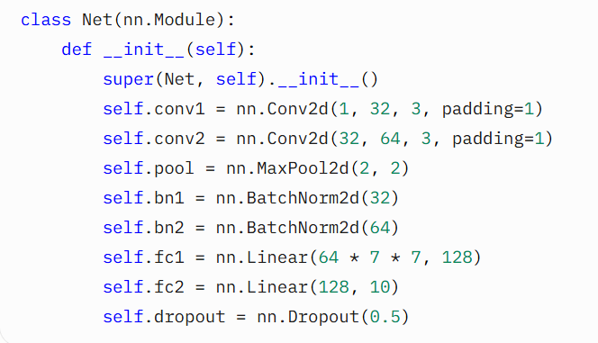

Slide 28
Classic Network Architectures

Slide 29
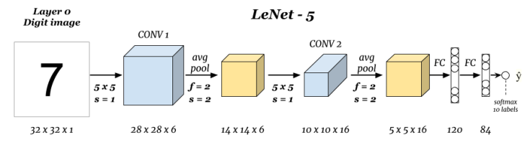
LeNet – 5
Gradient-Based Learning Applied to Document Recognition paper by Y. Lecun, L. Bottou, Y. Bengio and P. Haffner (1998)

Slide 30
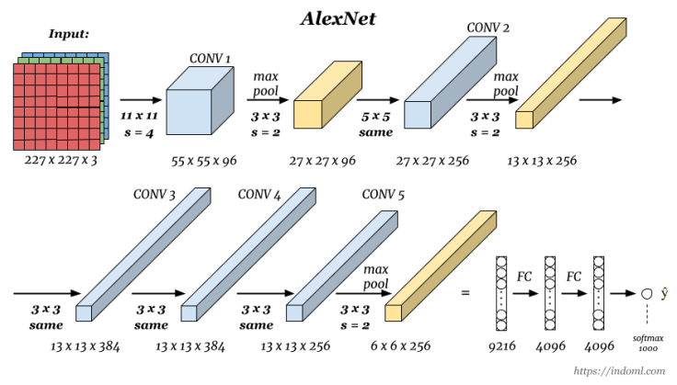
AlexNet
ImageNet Classification with Deep Convolutional Neural Networks paper by Alex Krizhevsky, Geoffrey Hinton, and Ilya Sutskever (2012).

Slide 31
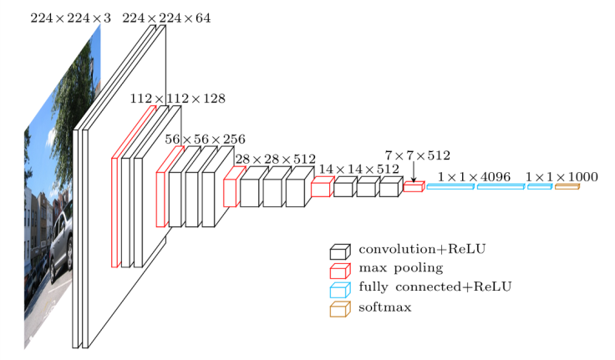
VGG-16
The strength is in the simplicity: the dimension is halved and the depth is increased on every step (or stack of layers)
Very Deep Convolutional Networks for Large-Scale Image Recognition paper by Karen Simonyan and Andrew Zisserman (2014).

Slide 32
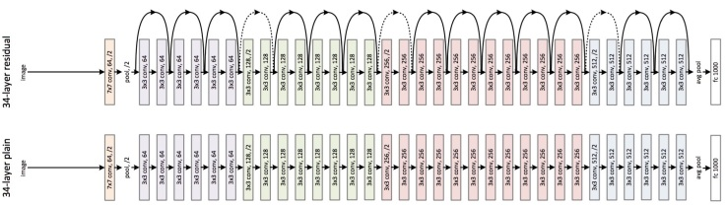
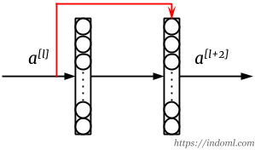
ResNet
Problem
The training error starts to rise again once the number of layers reaches a certain number,
Exploding and vanishing gradients problem.
Solution: Add a skip connection where output from one layer is fed to a layer deeper in the network:
Deep Residual Learning for Image Recognition (2015) proposed by He in

Slide 33
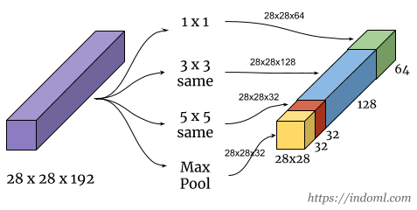
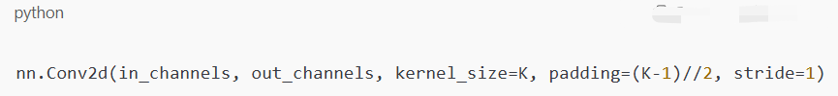
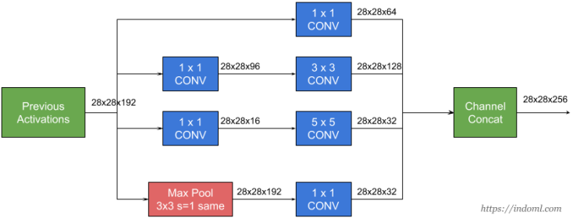
Inception: let the network decide the best filter size
issue: need to keep the same size 28*28
Solution: Apply padding
Using 1 x 1 convolution will reduce the computation to about 1/10 of the above. Why?

Slide 34
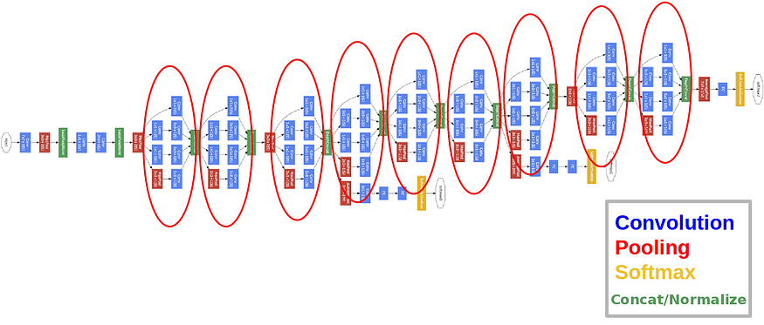
GoogLeNet- multiple inception
Going Deeper with Convolutions paper by Szegedy et al (2014), which has 9 inception modules:

Slide 35
MNIST

Slide 36
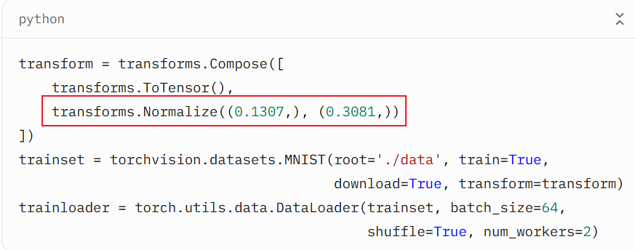
MNIST Preprocess – Normalize
Preprocess tasks
Convert images to tensors
Normalize: Mean=0.1307, Std=0.3081
Normalize: makes the data distribution (all pixels) more suitable for neural network training
Stabilizes gradient updates.
Speeds up convergence.
Reduces sensitivity to weight initialization.

Slide 37
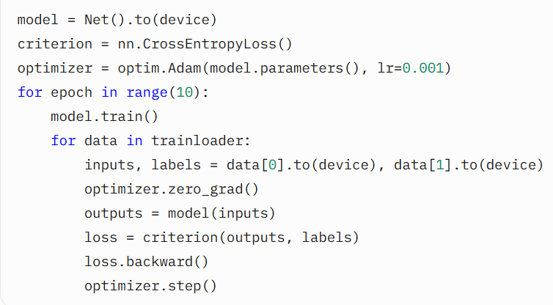
Training and Optimization
Forward pass: Compute predictions
Loss: CrossEntropyLoss for multi-class
Backward pass: Compute gradients
Optimizer: Adam, updates weights
Key Parameters:
Epochs: 10
Batch size: 64
Learning rate: 0.001 Code

Slide 38
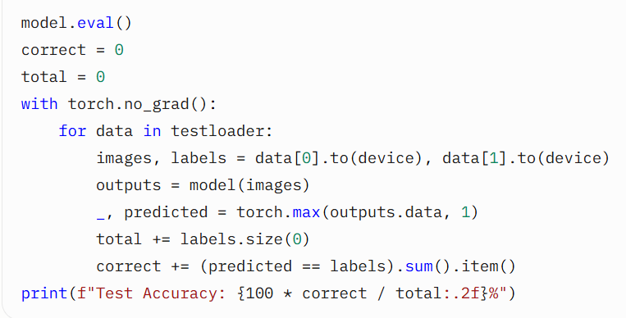
Evaluation
Compute accuracy on 10,000 test images
Disable gradients for efficiency

Slide 39
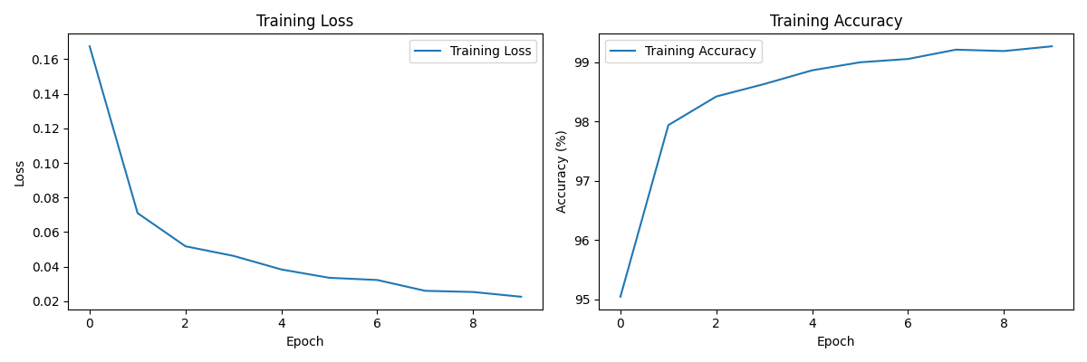
Visualization - Training Metrics
Loss vs. epoch
Accuracy vs. epoch Purpose: Monitor model learning and convergence

Slide 40
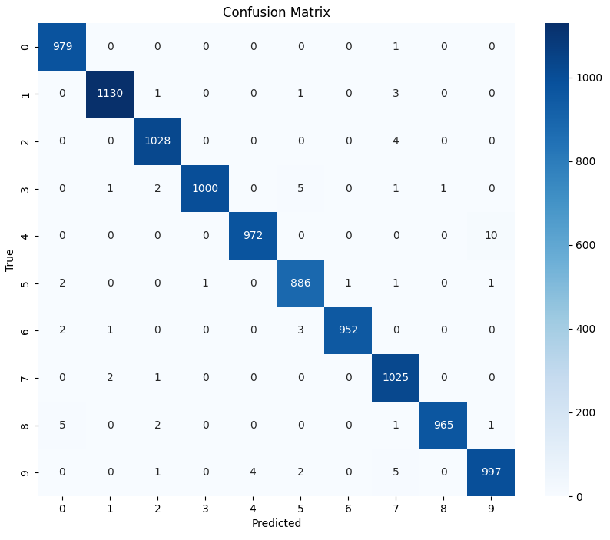
Visualization - Confusion Matrix
Shows correct and incorrect predictions per class
Helps identify problematic classes

Slide 41
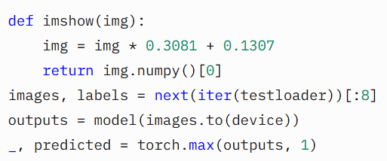
Visualization - Sample Predictions

Slide 42
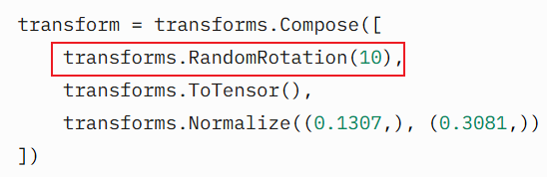
Improving the Model
Data Augmentation
Random rotations, translations
Deeper Architecture
Additional convolutional layers
Learning Rate Scheduling
Reduce learning rate over time
Advanced Optimizers
Try SGD with momentum

Slide 43
Conclusion
CNNs excel at image classification tasks like MNIST
Core concepts: Convolution, pooling, activation, normalization
PyTorch simplifies model building and training
Visualization aids in understanding model performance Next Steps:
Experiment with other datasets (e.g., CIFAR-10)
Explore advanced architectures (e.g., LeNet, ResNet) Q&A: Any questions?

Slide 44
References
MNIST Dataset: http://yann.lecun.com/exdb/mnist/
PyTorch Documentation: https://pytorch.org
Goodfellow, I., Bengio, Y., & Courville, A. (2016). Deep Learning. MIT Press.
PyTorch Tutorials: https://pytorch.org/tutorials
https://www.youtube.com/watch?v=aircAruvnKk&t=846s

