Slide 1
Word Embeddings and BERT
https://airbyte.com/data-engineering-resources/sentence-word-embeddings

Slide 2
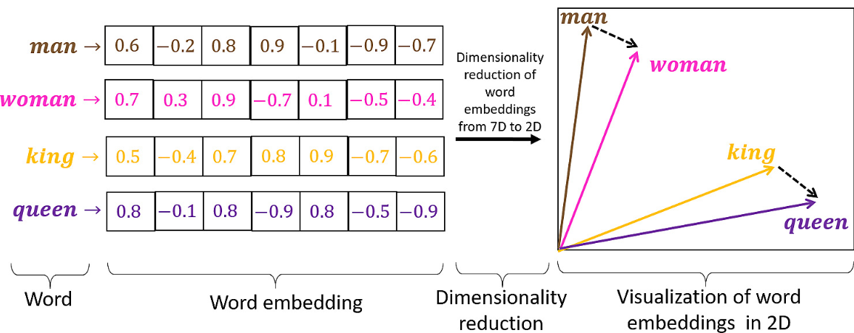
Embeddings
Word embeddings turn words into numbers (features) that computers understand
Words with similar meanings are positioned closer together
Why it matters: Embeddings power search engines, chatbots, and more

Slide 3
BERT Model for Computing Embeddings
BERT (Bidirectional Encoder Representations from Transformers)
is a pre-trained language model developed by Google in 2018
revolutionized natural language processing (NLP).
It's designed to understand the context of a word in both directions (left and right)
the context of a word = word embedding
makes it very powerful for understanding the meaning of text.
Notes:
https://jalammar.github.io/illustrated-bert/

Slide 4
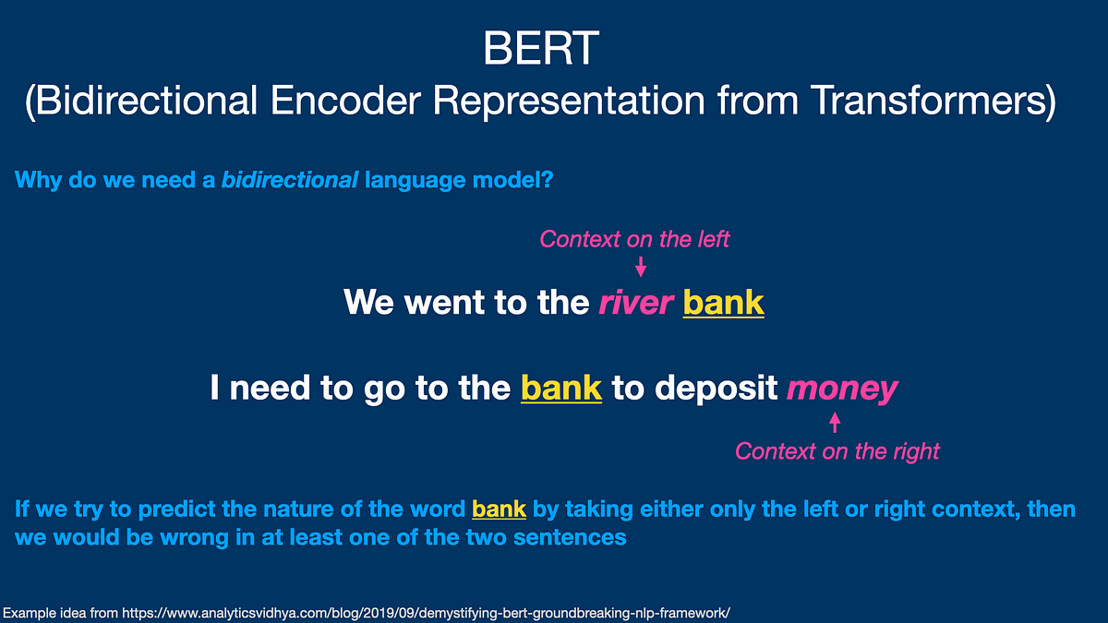

Slide 5
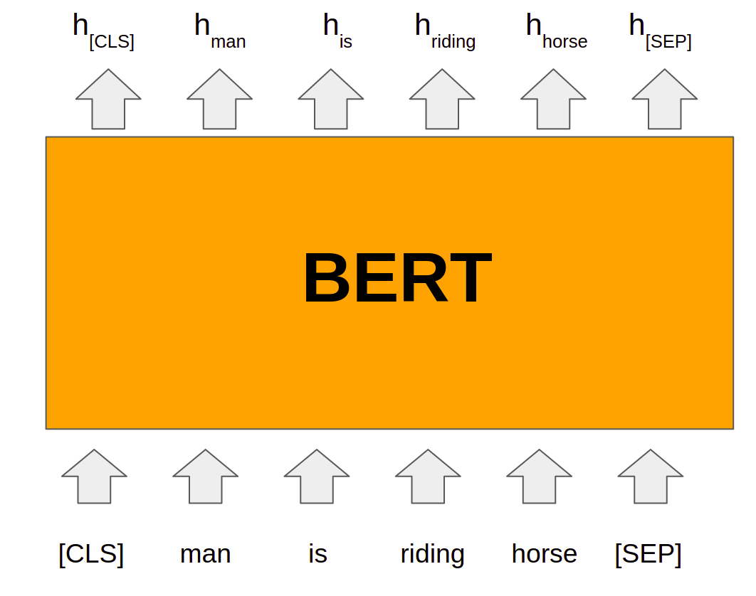
After Training BERT
https://www.analyticsvidhya.com/blog/2021/05/all-you-need-to-know-about-bert/

Slide 6
Train BERT Model

Slide 7
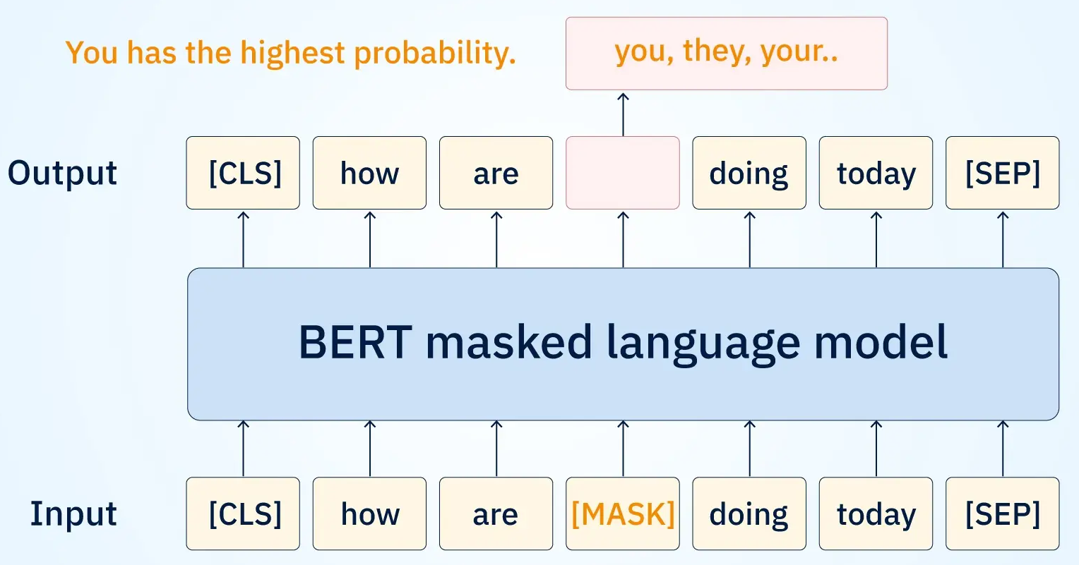
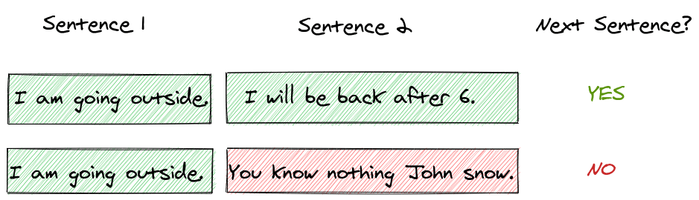
Train BERT Model (MLM+NSP)
Masked Language Model (MLM): randomly mask words in document and try to predict them based on the surrounding context.
Next Sentence Prediction (NSP): Predict if sentence 2 follows sentence 1
https://www.searchunify.com/sudo-technical-blogs/context-is-key-the-transitional-impact-of-bert-on-enterprise-search-results/
https://amitness.com/posts/albert-visual-summary

Slide 8
BERT input tokenization
Tokenization splits text into small pieces called tokens
Tokens are usually words (e.g., “today") or special markers (e.g., [CLS])
Purpose: Prepares text for the BERT model to process
BERT’s tokenizer (a component of the BERT pipeline)
Adds [CLS] at the start, [SEP] at the end
"playing" → ["play", "##ing"]
Another example: "The king rules the kingdom" becomes multiple tokens
Original text: The king rules the kingdom
Tokens: ['[CLS]', 'the', 'king', 'rules', 'the', 'kingdom', '[SEP]’]
Token IDs: [101, 1996, 2332, 3513, 1996, 2983, 102]

Slide 9
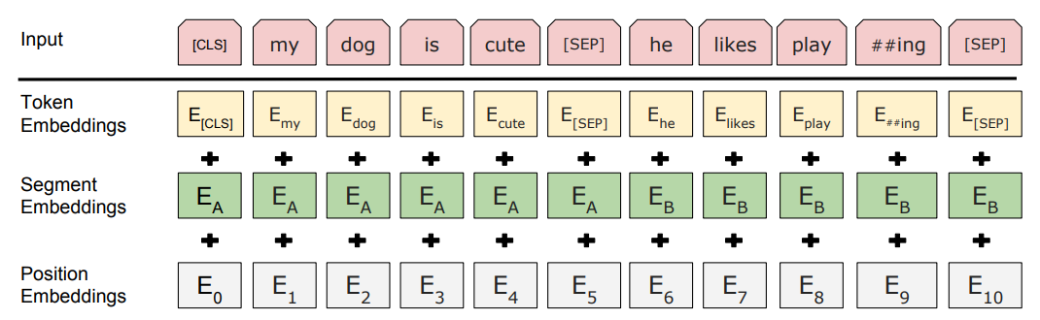
BERT input representation
Token Embedding: Encodes subword/token meaning
Position Embedding: Encodes token order
Segment Embedding: Encodes sentence distinction
The input embeddings are the sum of three embeddings

Slide 10
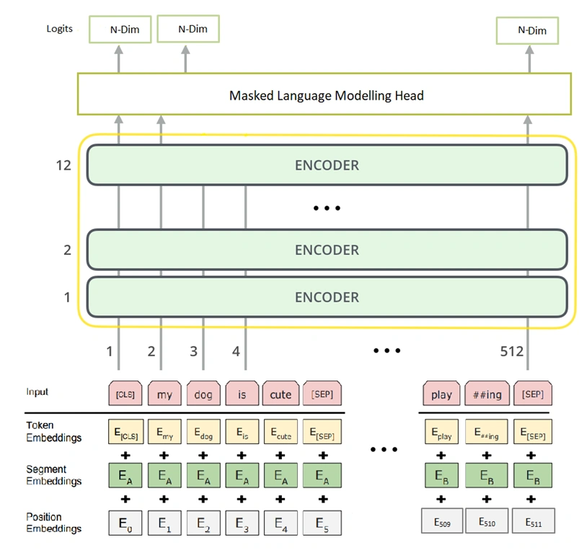

Slide 11
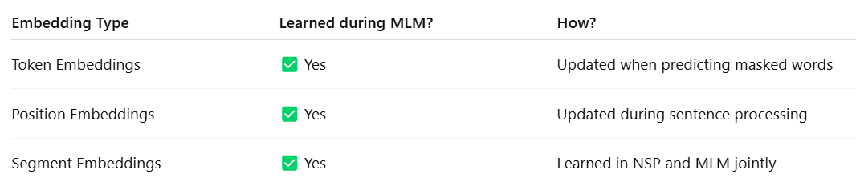
Embeddings are trainable during training
The token embeddings, position embeddings, and segment embeddings are all learned during MLM training.
These embeddings are adjusted using backpropagation based on how well the model predicts the masked words.

Slide 12
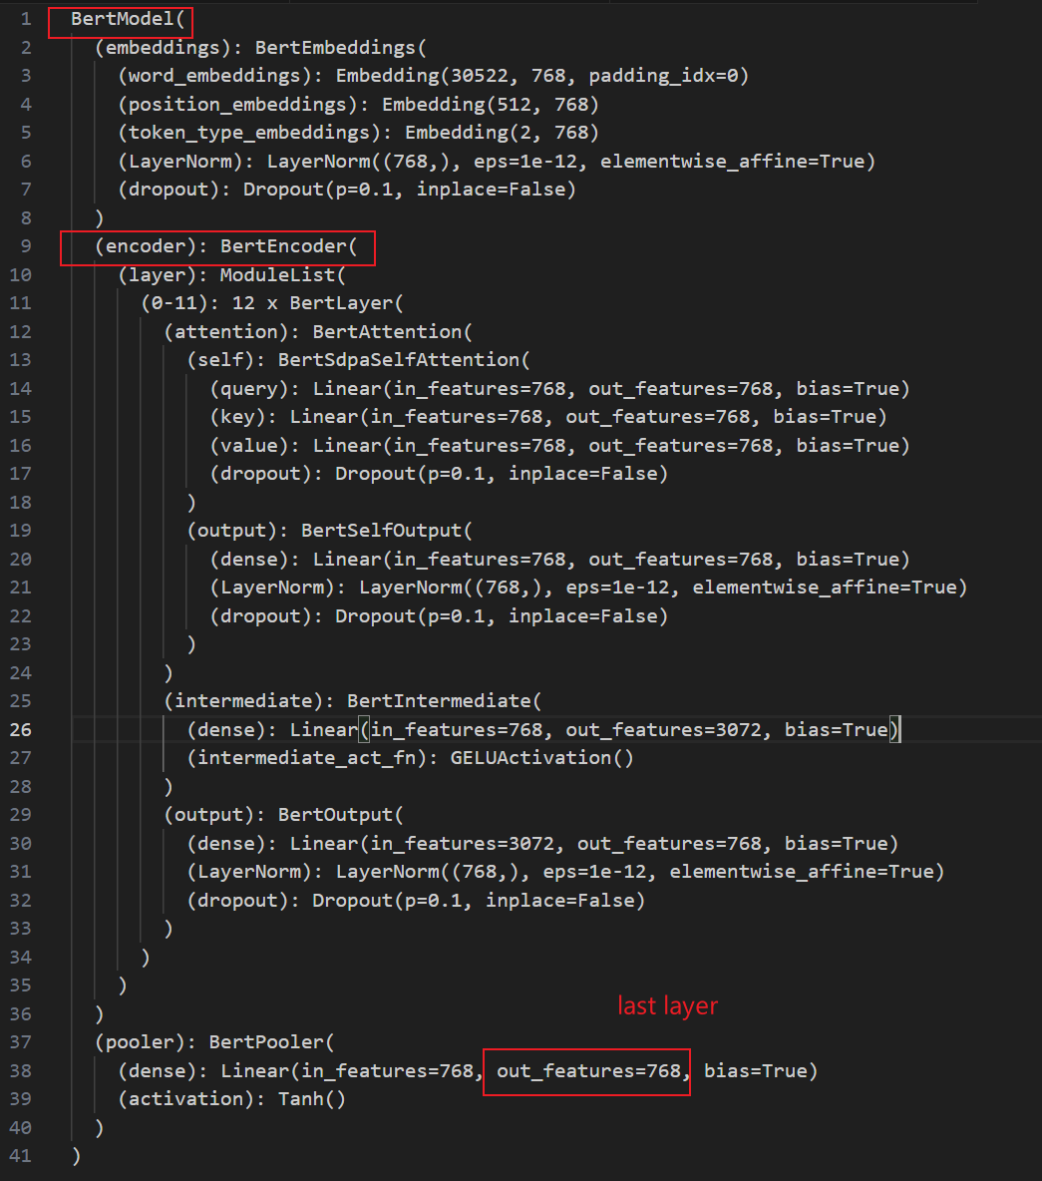

Slide 13
Use a Pre-Trained BERT Model for Embedding

Slide 14
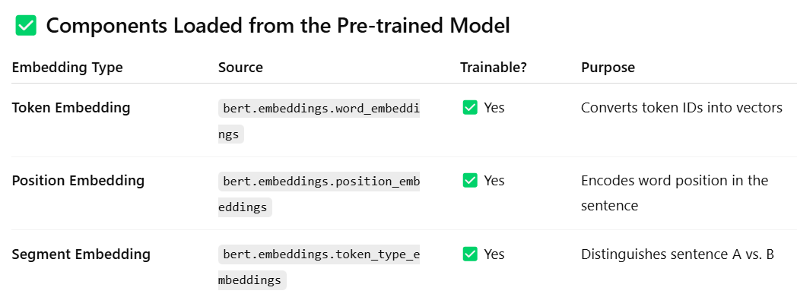
Load Pre-Trained BERT Model
BERT uses learned position embeddings, not sinusoidal.
The sine/cosine version was used in the original Transformer model, not in BERT.

Slide 15
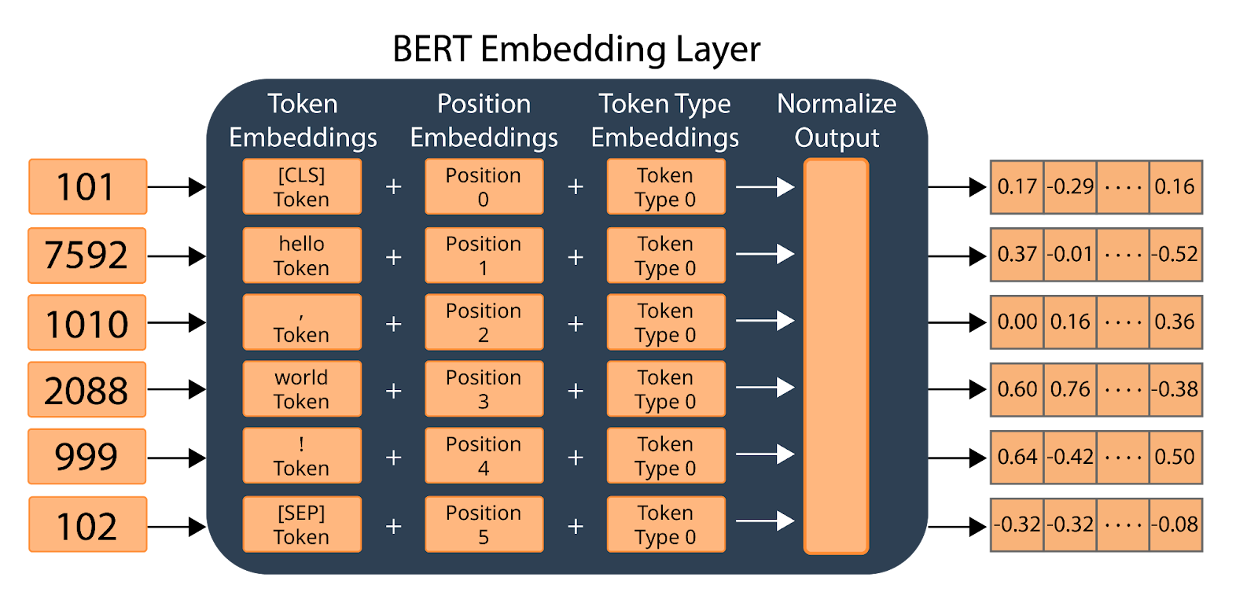
Calculates the embeddings for the string “hello, world”
Note: all embeddings are tensors
pre-trained BERT
token ID
https://airbyte.com/data-engineering-resources/bert-vector-embedding

Slide 16
Token Embedding
Token embeddings are lists of numbers (vectors) for each token
Each vector has 768 numbers in BERT, capturing token meaning
Contextual embeddings: Vectors change based on the sentence
Example: In "The king rules the kingdom and the queen governs":
The three "the"s get different vectors
"King" and "queen" have similar but distinct vectors

Slide 17
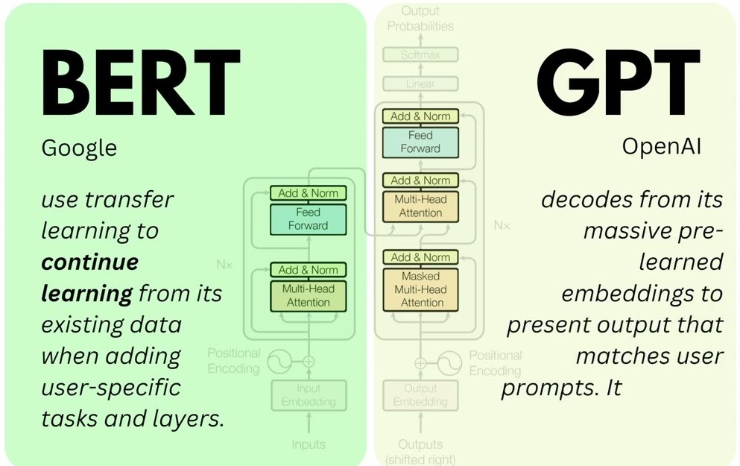

BERT is an Encoder of the Transformer
encoder only transformer
decoder
https://sushant-kumar.com/blog/bert
Notes:
https://jalammar.github.io/illustrated-bert/

Slide 18
Example: Use Pre-Trained BERT model “bert-base-uncased”

Slide 19
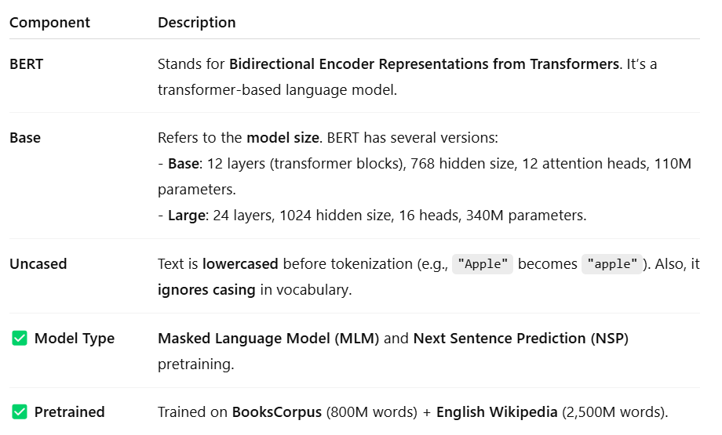
Pre-trained “bert-base-uncased”
Commonly used for downstream NLP tasks like classification, NER, and QA

Slide 20
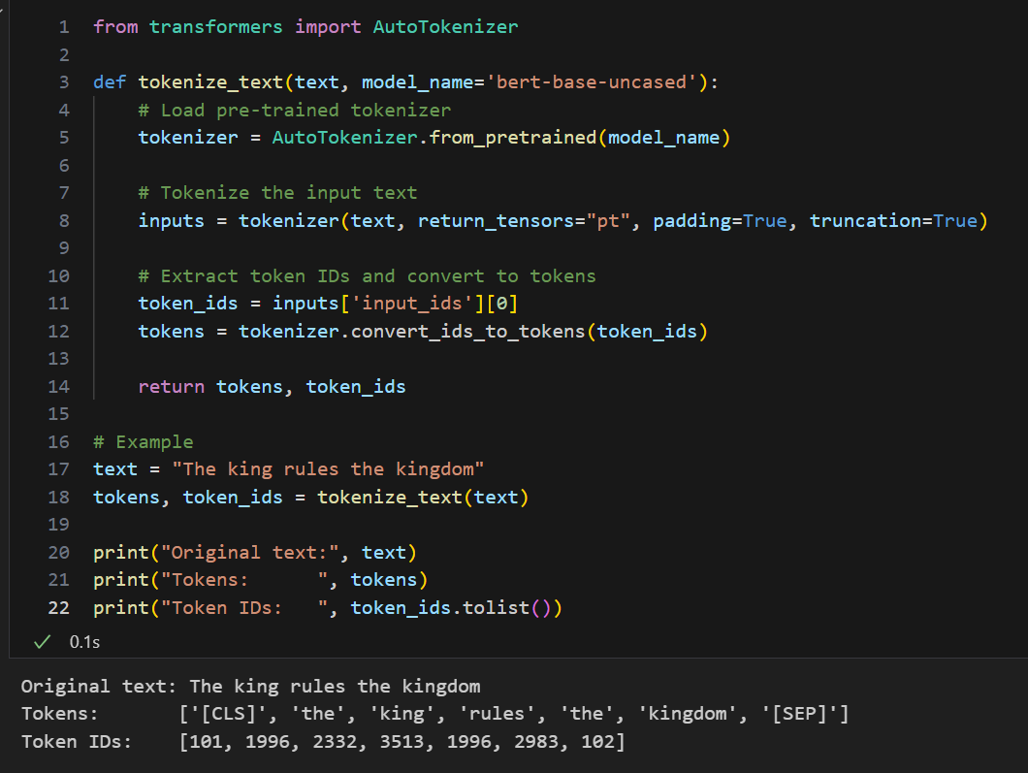
Tokens information

Slide 21
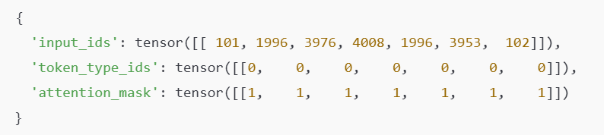
“inputs” is Dictionary with Tensors
IDs of tokens from the model’s vocabulary.
segment IDs: used when BERT is fed two sentences
Tells the model which tokens to pay attention to (1 = real token, 0 = padding). This is important when batching sequences of different lengths. BERT should ignore padded values.

Slide 22
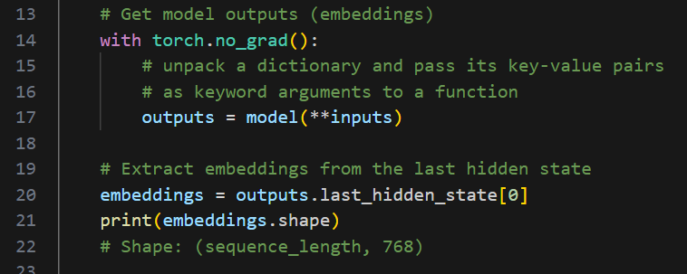
Inputs, Bert model, and output

Slide 23
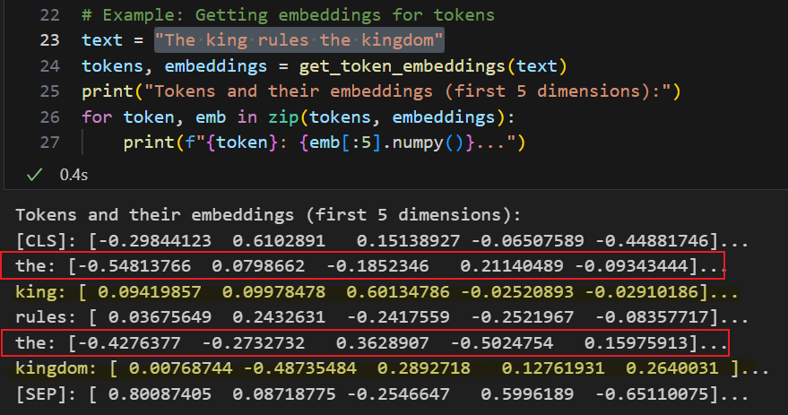
"The king rules the kingdom"
First “the” and second "the" vectors differ due to context

Slide 24
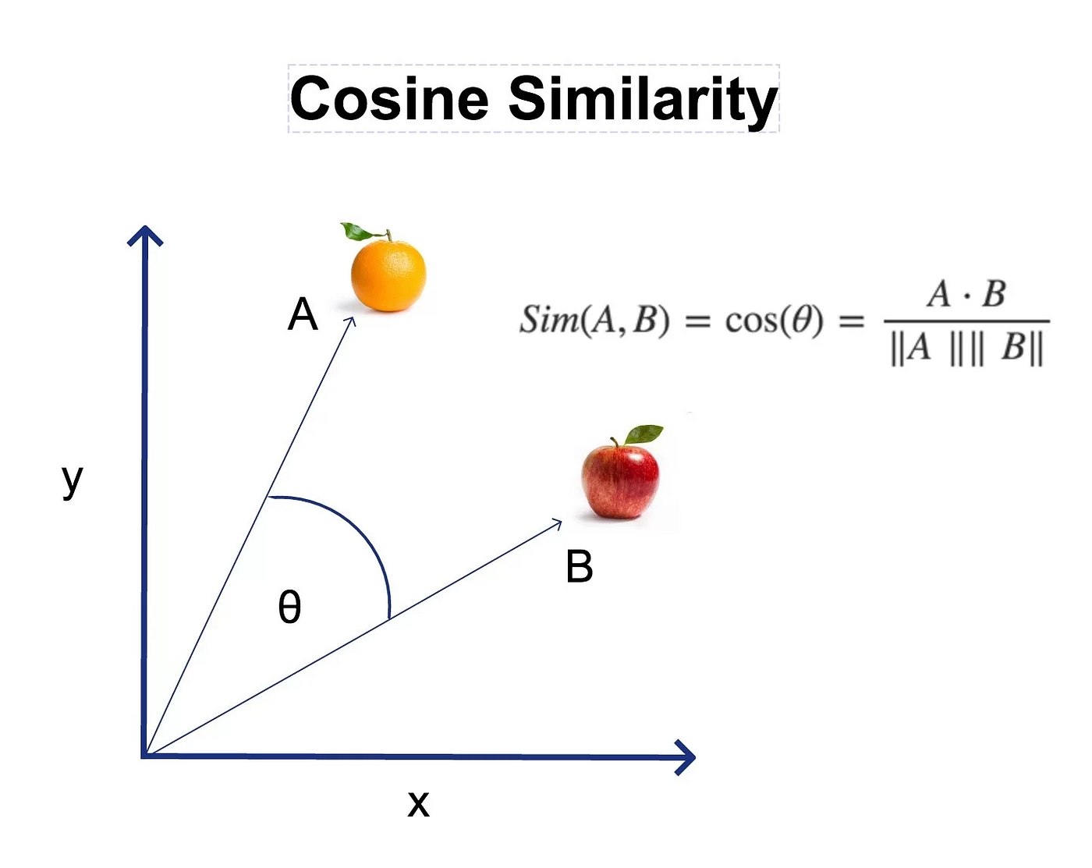

Cosine Similarity between words
Cosine similarity focuses on the orientation (the angle) of vectors and not their magnitude because its formula normalizes the vectors
Two people with two features: Height and Weight
Person A: A=[170,70]
Person B: B=[180,80]

Slide 25
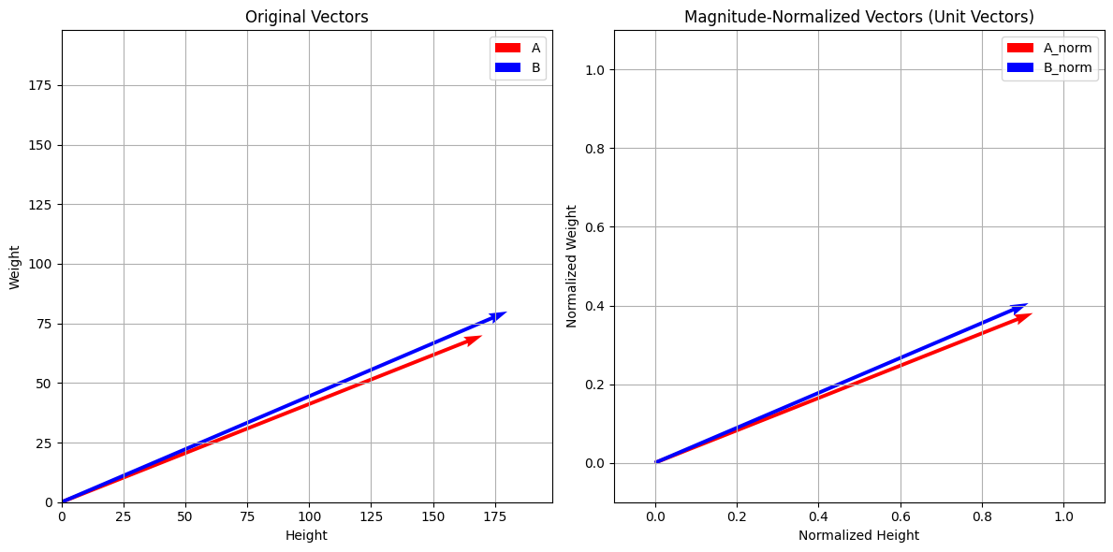
Are two people similar (Height and Weight)
Before Magnitude Normalization
Person A: A=[170,70]
Person B: B=[180,80]
After Magnitude Normalization
Person A: A=[0.9246,0.3807]
Person B: B=[0.9138,0.4061]

Slide 26
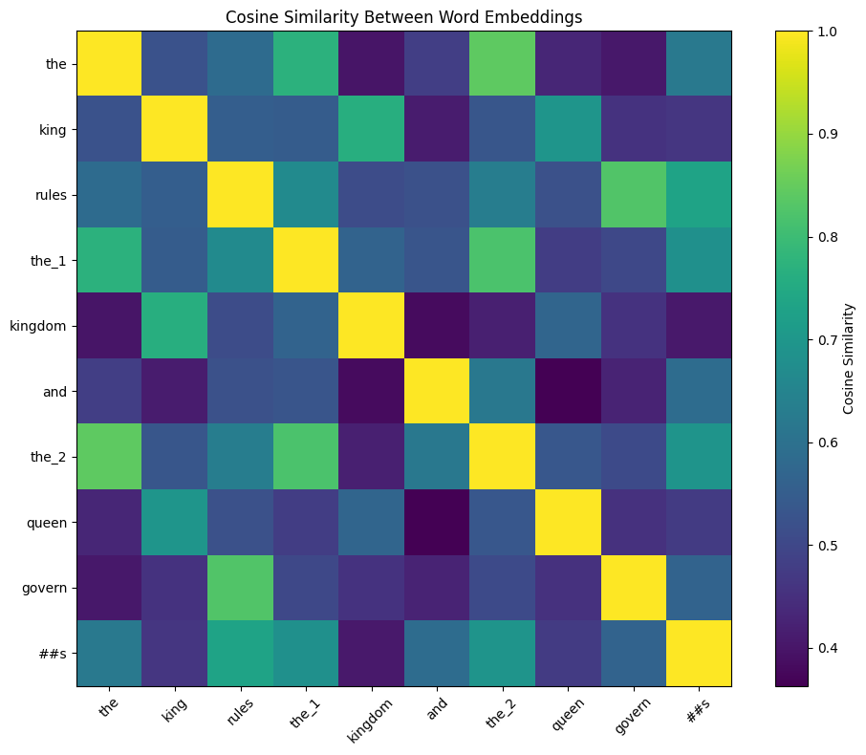
Cosine Similarity Between Word Embeddings

Slide 27
Word Analogy - Understanding the Concept Content
Analogy: Finding word relationships using math
Example: "king is to queen as man is to woman"
How it works:
Compute vector: king - man + woman
Check if it’s close to "queen"’s vector
Cosine similarity measures closeness
Purpose: Show embeddings capture deep relationships
Our goal: Test the analogy with BERT embeddings

Slide 28
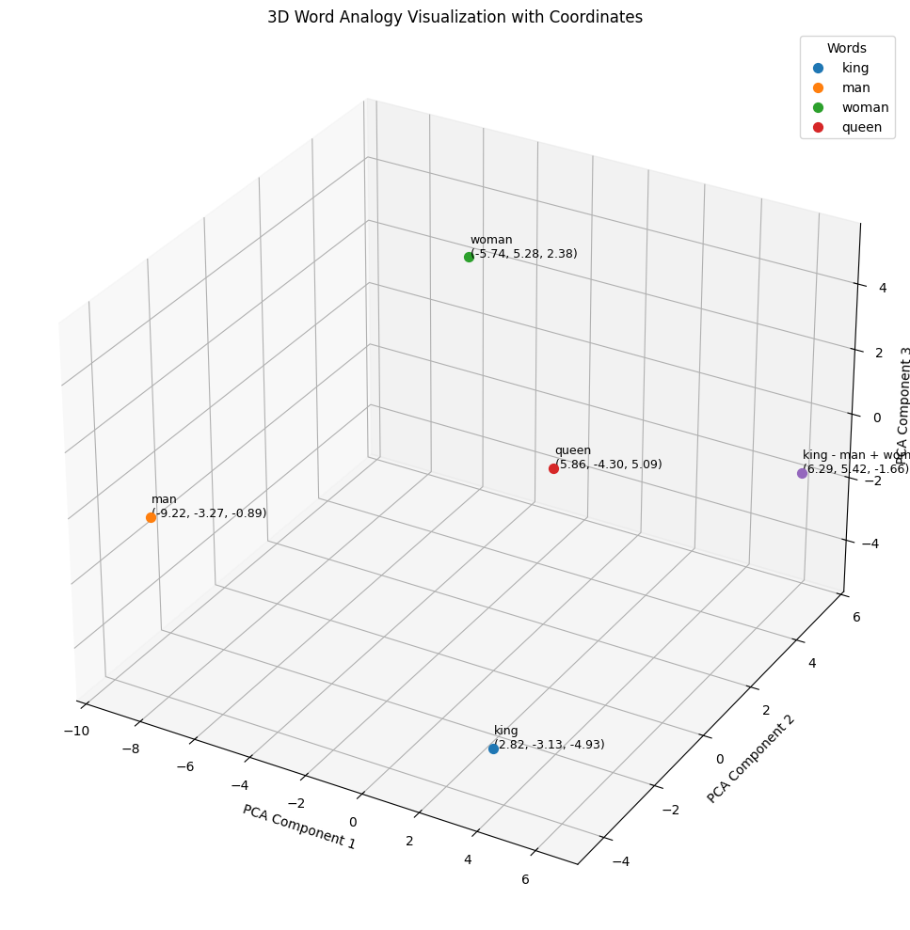

Slide 29
Summary
Tokenize text into pieces
Create contextual embeddings with BERT
Select word embeddings, compute similarities
Visualize similarities with a heatmap

