Slide 1
Transformer model

Slide 2
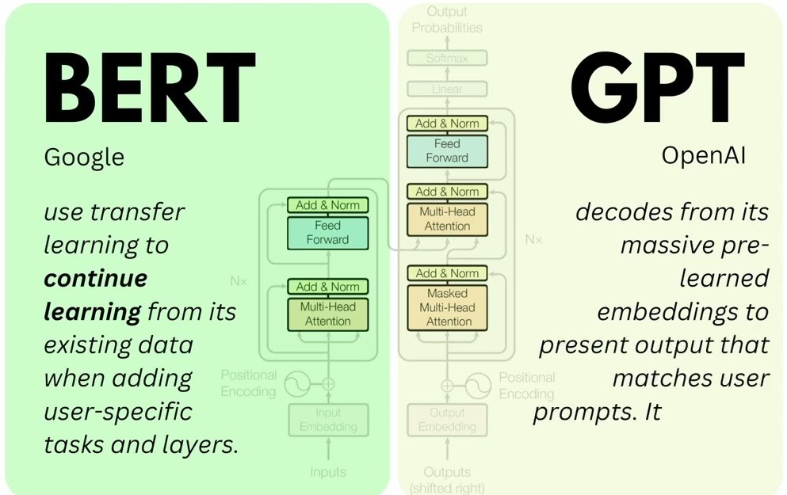

encoder only transformer
decoder
https://sushant-kumar.com/blog/bert
Notes:
https://jalammar.github.io/illustrated-bert/

Slide 3
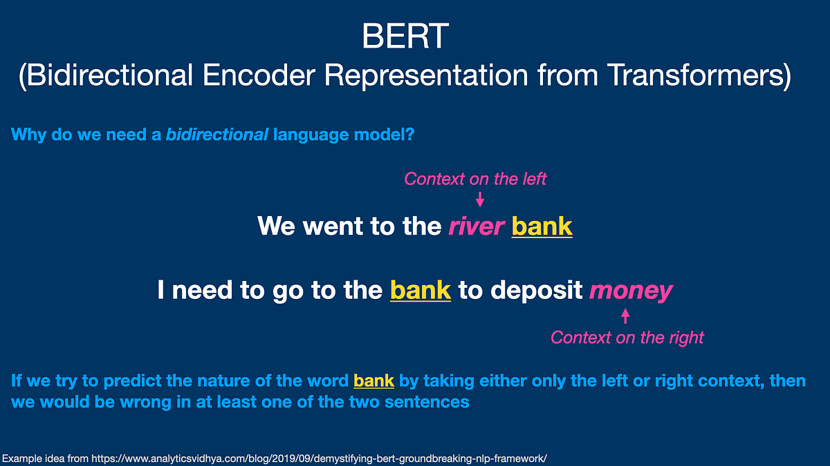
The Core Idea: Self-Attention
BERT attends to all other words in the sequence in both directions (left and right context) to understand the relationships between them

Slide 4
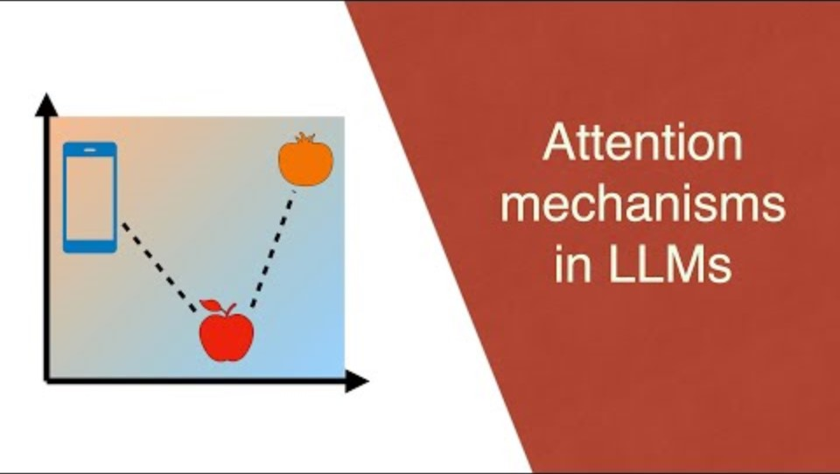

Slide 5
Reference
https://medium.com/@govindarajpriyanthan/self-attention-mechanism-in-transformers-1e46af9e1afb
https://jalammar.github.io/illustrated-transformer/
https://www.jeremyjordan.me/transformer-architecture/
https://poloclub.github.io/transformer-explainer/
https://www.comet.com/site/blog/explainable-ai-for-transformers/

