Slide 1
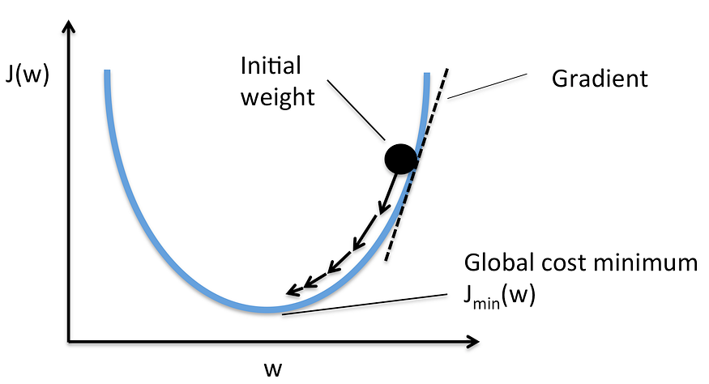
Autogradient
Automatic Differentiation

Slide 2
Review: How Humans Learn to Predict (observation)
# bedrooms x | House Price y=f(x)
1 | 2
2 | 4
3 | 6
4 | 8
5 | ?
5
?

Slide 3
Review: How Humans Learn to Predict (more formal)
# bedrooms x | House Price y=f(x)
1 | 2
2 | 4
3 | 6
4 | 8
5 | ?
5
Step 1: linear?
y=wx
Step 2: How to pick up w
try a few values for w
?

Slide 4
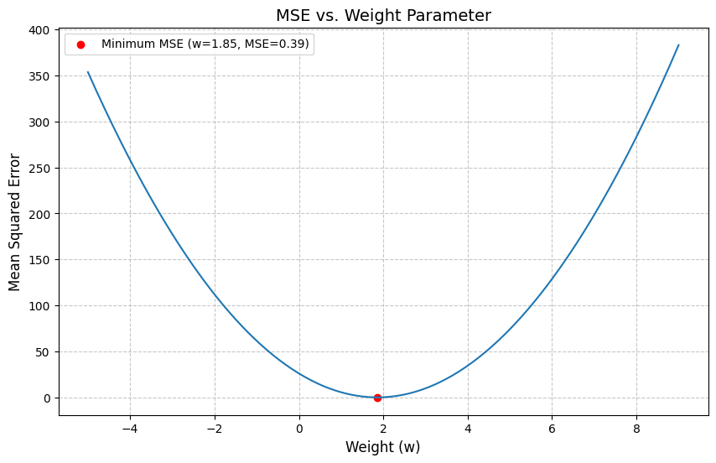
Review: How Machine Learn to Predict (simple)
Step 1: need a function (model)
mapping an input value x to y=f(x)
Step 2:
humans will provide a model, y = wx
humans provide evaluation criteria (loss function), for what the best model is, MSE
Step 3: pick up many w
for each w, compute MSE using loss function, J(w)
Step 4: pick the w with the smallest MSE
x=5
function(x) or f(x)
model
y=?

Slide 5
Review: How Machine Learn to Predict (simple+)
Step 1: need a function (model)
mapping an input value x to y=f(x)
Step 2:
humans will provide a model, y = wx
humans provide evaluation criteria (loss function) for what the best model is, MSE
Step 3: pick up some w
for each w, compute MSE using loss function, J(w)
Step 4: pick the w with the smallest MSE
x=5
function(x) or f(x)
model
y=?

Slide 6
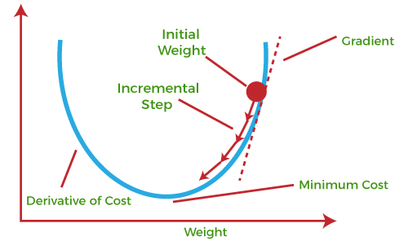

Slide 7
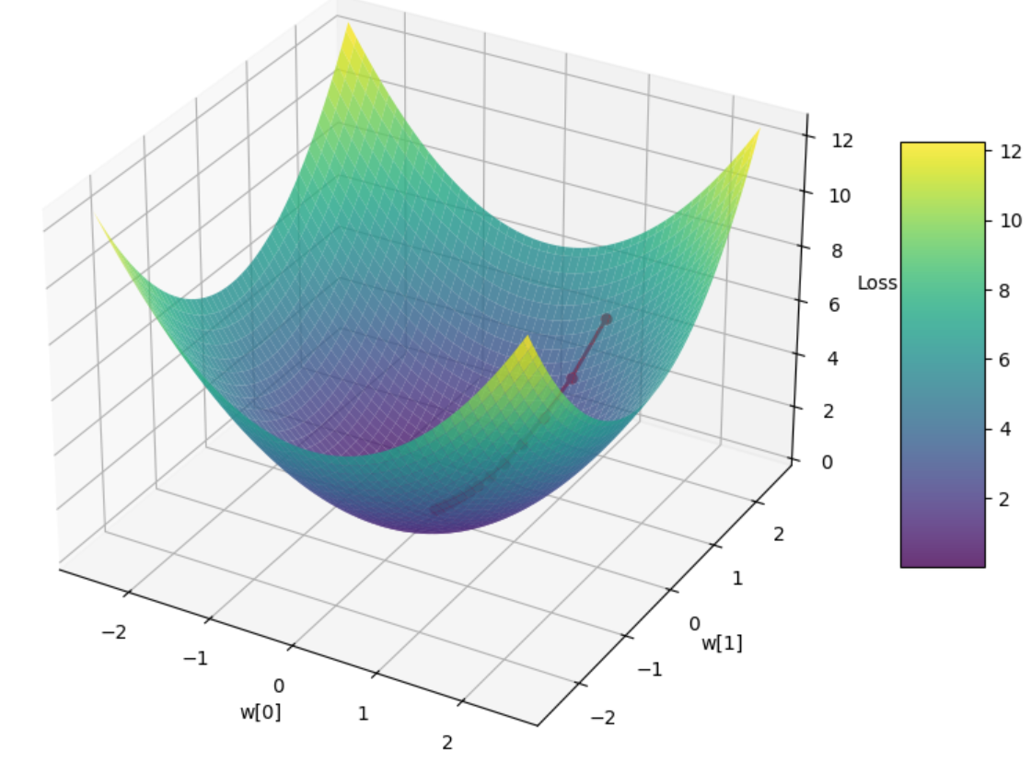
Linear regression with two learning parameters
# bedrooms x0 | Total sq k ft x1 | House Price y=f(x0,x1)
1 | 0.2 | 2
2 | 0.5 | 4
3 | 0.5 | 6
4 | 0.7 | 8
5 | 0.8 | ?
#bd
#sqft
f(x0, x1) =
w0 x0+w1 x1+b
price

Slide 8
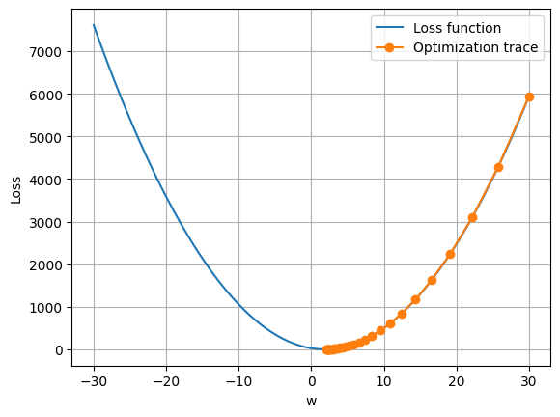

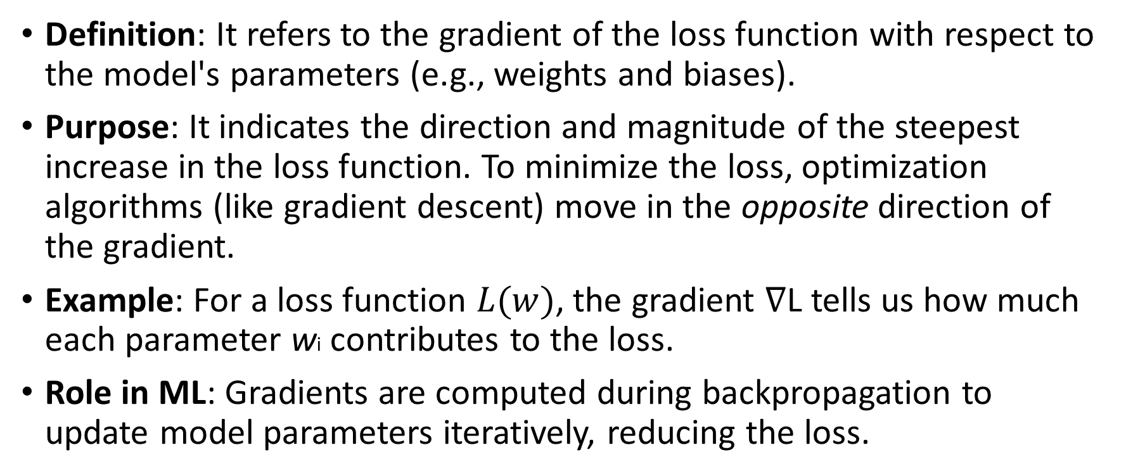
Recall gradient
Definition: It refers to the gradient of the loss function with respect to the model's parameters (e.g., weights and biases).
Purpose: It indicates the direction and magnitude of the steepest increase in the loss function. To minimize the loss, optimization algorithms (like gradient descent) move in the opposite direction of the gradient.
Example: For a loss function $L(w)$, the gradient ∇L tells us how much each parameter wi contributes to the loss.
Role in ML: Gradients are computed during backpropagation to update model parameters iteratively, reducing the loss.

Slide 9
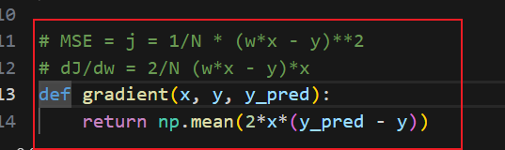
Need to implement the gradient for different cost functions
Different cost functions are required for different tasks
Regression: The goal is to predict continuous values. MSE is common because it penalizes larger errors more (quadratic penalty). Example: Predicting house prices.
Classification: The goal is to predict discrete labels or probabilities. Cross-Entropy Loss is used because it measures the difference between predicted probabilities and true labels, encouraging the model to output correct class probabilities. Example: Spam email detection.
Ranking: Tasks like search engine optimization use ranking losses (e.g., Pairwise Ranking Loss) to focus on the relative order of items rather than exact predictions.

Slide 10
Autogradient
Definition: Autogradient, often called autograd, is a computational technique used by ML frameworks (e.g., PyTorch, TensorFlow, JAX) to automatically compute gradients of functions.
It applies the chain rule to differentiate complex operations in a model's computational graph.
Purpose: It eliminates the need to manually derive and code gradients, making it easier to implement complex models.
Example: In PyTorch, if you define a loss function and call loss.backward(), autograd computes the gradients of the loss with respect to all parameters marked as requires_grad=True.

Slide 11
Key Differences: Gradient vs. Autograd
Gradient is the mathematical concept (the result of differentiation).
Autograd is the algorithmic tool that computes gradients automatically.

Slide 12
Steps for computing gradient descent after Autograd
Initialize Parameters: Start with initial values for the parameters (e.g., random values for w0 and w1).
Compute the Loss: Evaluate the loss function (e.g., loss = z.sum() ).
Compute Autograd: Calculate the gradients of the loss with respect to each parameter (e.g., ∂loss/∂w0 and ∂loss/∂w1, stored in w0.grad and w1.grad after loss.backward() ).
Update Parameters: Adjust the parameters using the update rule
parameter = parameter - learning_rate * gradient
Repeat: Iterate steps 2–4 until the loss converges (stops decreasing significantly) or a set number of iterations is reached.

Slide 13
Goal
Pytorch tutorial
Rewrite linear regression tutorial with Pytorch

