Slide 1
Binary Classification

Slide 2
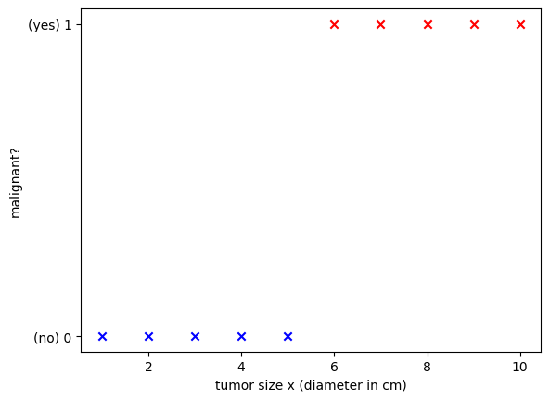
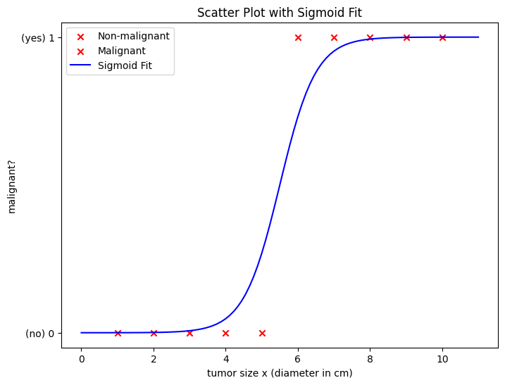
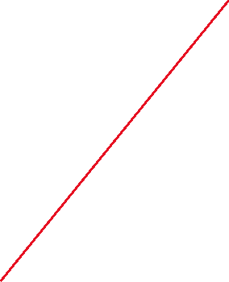
Motivation
Which shape is better?

Slide 3
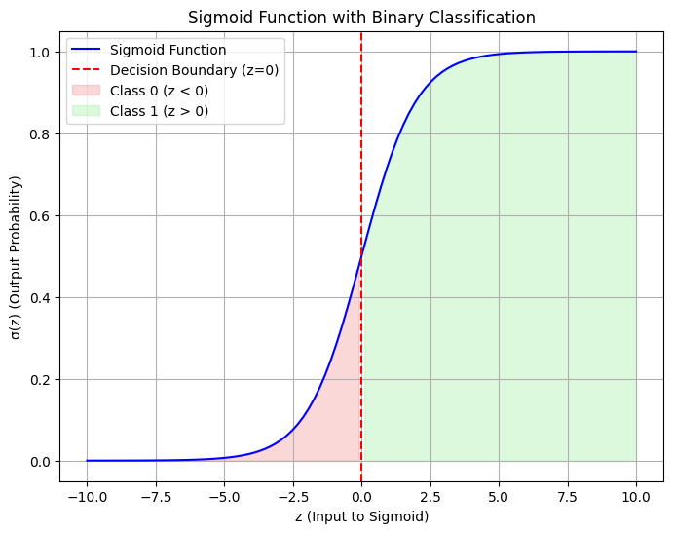
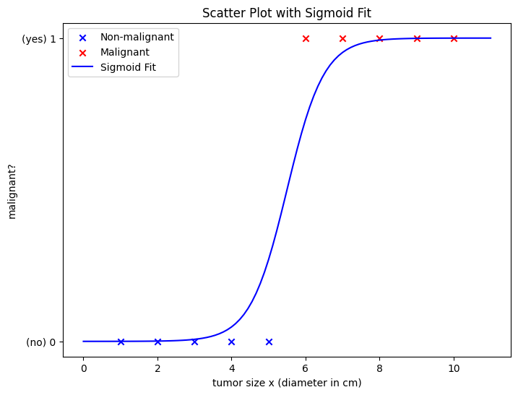
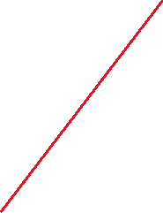
Solution: Sigmoid (activation) function
map input values into a bounded range, typically between 0 and 1
z=wx+b
Adjust w and b
σ(z)=1/(1+e ^{-z})
for z>0, σ(z)>0.5 => predict non-malignant
for z=0, σ(z)=0.5 => ?
for z<1, σ(z)<0.5 => predict malignant

Slide 4
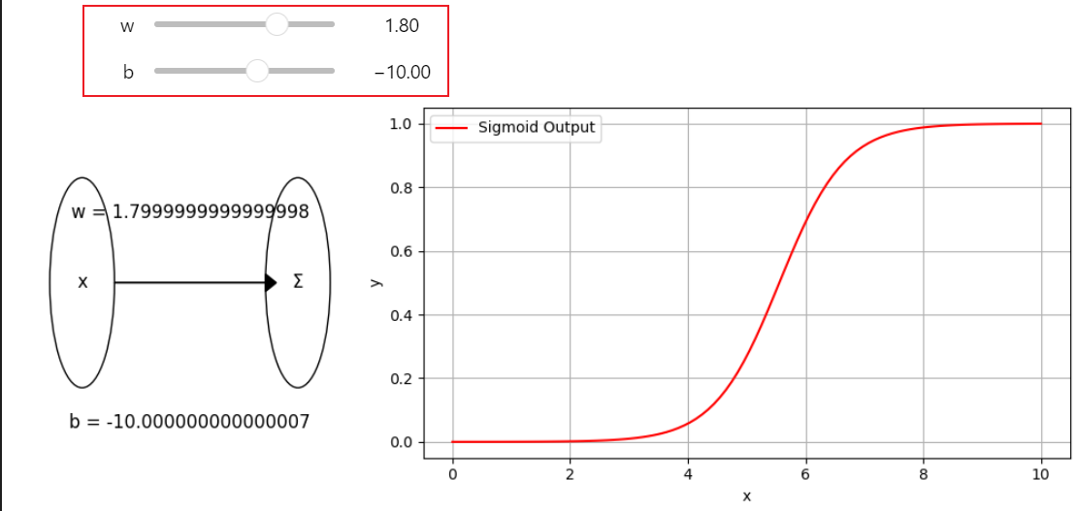
Live demo
adjust w and b to observe the s-curve

Slide 5
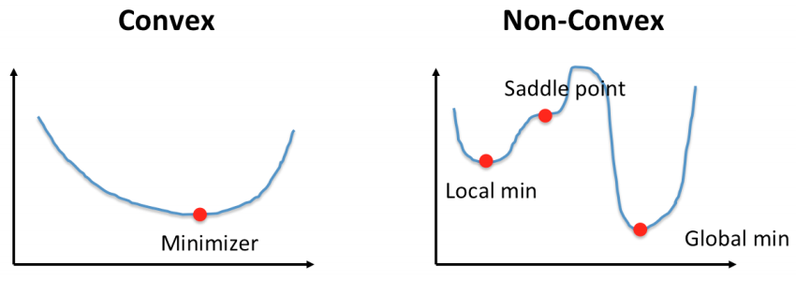
MSE does not work with Logistic Regression
Linear regression: MSE
Logistic Regression: MSE

Slide 6
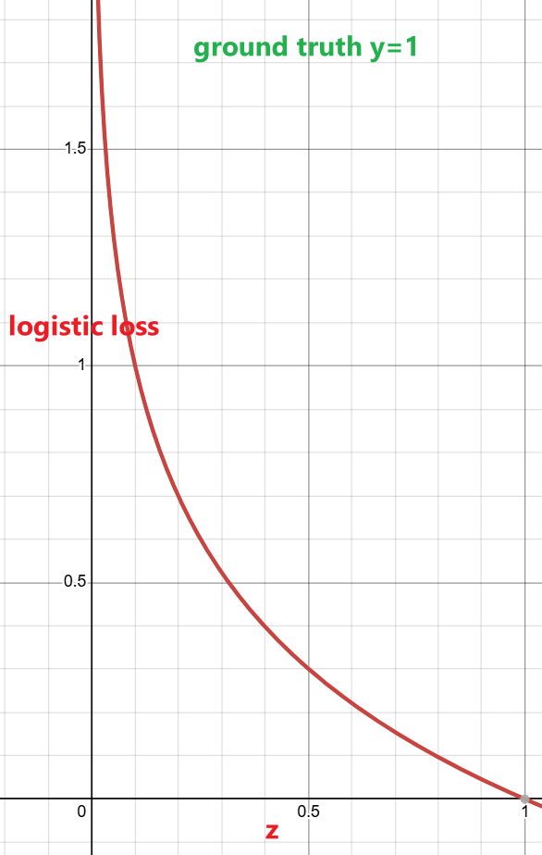
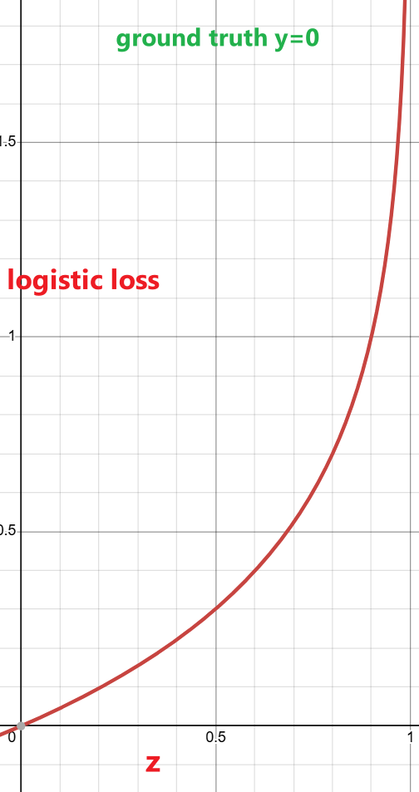
Binary Cross-Entropy Loss is convex
-log(σ(z)) if y=1
loss (σ(z), y)=
-log(σ(1-z)) if y=0
-log(σ(z)) + (1-y) - log(σ(1-z))
σ(
)
σ(
)

