Slide 1
Word Embeddings and BERT
https://airbyte.com/data-engineering-resources/sentence-word-embeddings

Slide 2
Introduction
Human talks Machine

Slide 3

Motivation: Human talks Machine
The ultimate goal is to bridge human language and machine understanding, enabling NLP systems to process, analyze, and generate language effectively.
Numbers provide a universal format for algorithms to learn patterns and relationships in text.

Slide 4
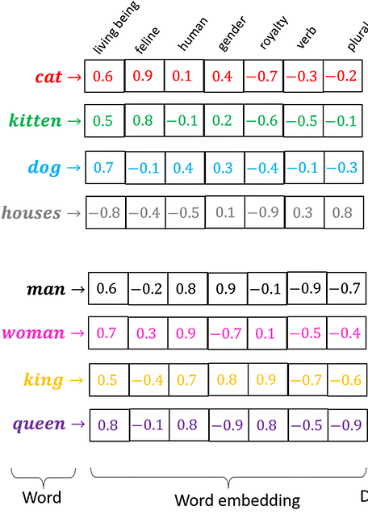
?
https://medium.com/@hari4om/word-embedding-d816f643140

Slide 5
Brief History of One-Hot Encoding to Word Embeddings
One-Hot Encoding (Pre-2000s)
Transition to Dense Representations (Early 2000s)
Word Embeddings (2010s)

Slide 6
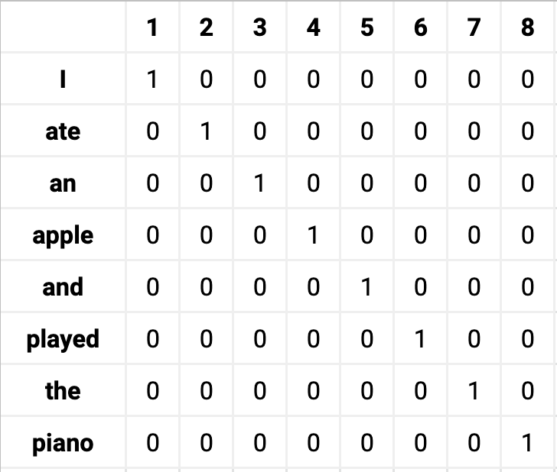
One-Hot Encoding (sparse vector)

Slide 7
One-Hot Encoding (sparse vector)
What: One-hot encoding represented words as sparse binary vectors, with a unique index for each word in the vocabulary (e.g., [1, 0, 0, ..., 0] for "cat").
Use: Common in early NLP for tasks like text classification and information retrieval.
Limitations: High-dimensional vectors (one dimension per word) were computationally expensive, lacked semantic information, and treated words as unrelated (e.g., "cat" and "dog" had no similarity).
Motivation for Change: The need for scalable, meaningful representations drove research beyond sparse encodings, as one-hot vectors failed to capture word relationships or generalize across similar terms.

Slide 8
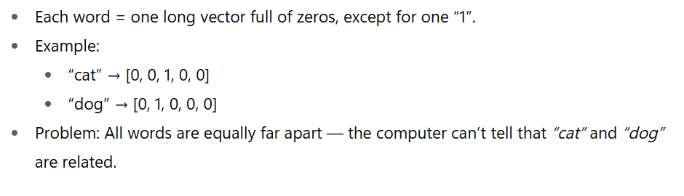
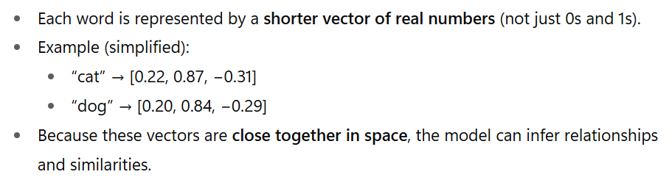


Transition to Dense Representations
sparse vector
Dense Representations

Slide 9
Transition to Dense Representations
Context: The rise of neural networks and distributional semantics (words in similar contexts have similar meanings) inspired new approaches.
Key Development: Bengio et al. (2003) proved that dense vectors could capture word meanings.
Limitations: It was computationally costly, less scalable, and not optimized for general use.
Motivation: To reduce dimensionality, capture semantic relationships (e.g., "cat" and "dog" being closer in vector space), and enable generalization in NLP tasks like language modeling.

Slide 10
Word Embeddings
Breakthrough: Word2Vec (Mikolov et al., 2013) popularized word embeddings with efficient algorithms (CBOW and Skip-gram) to learn dense vectors from large corpora.
Advancements: GloVe (2014) and fastText (2016) further refined embeddings by incorporating global co-occurrence statistics and subword information, respectively.
Purpose: Embeddings mapped words to continuous vector spaces where semantic similarities (e.g., "king" - "man" + "woman" ≈ "queen") could be computed, enabling better performance in tasks like machine translation, sentiment analysis, and question answering.

Slide 11
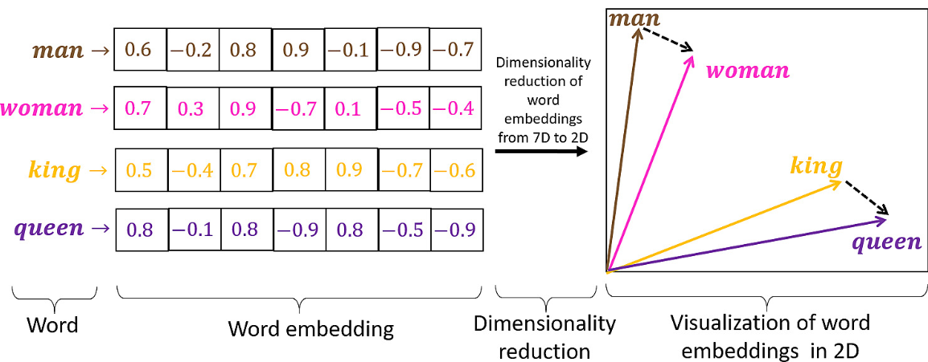
Visualize Embeddings
Word embeddings turn words into numbers (features) that computers understand
Words with similar meanings are positioned closer together

Slide 12
BERT Model for Computing Embeddings
BERT (Bidirectional Encoder Representations from Transformers)
is a pre-trained language model developed by Google in 2018
revolutionized natural language processing (NLP).
It's designed to understand the context of a word in both directions (left and right)
the context of a word = word embedding
makes it very powerful for understanding the meaning of text.
Notes:
https://jalammar.github.io/illustrated-bert/

Slide 13
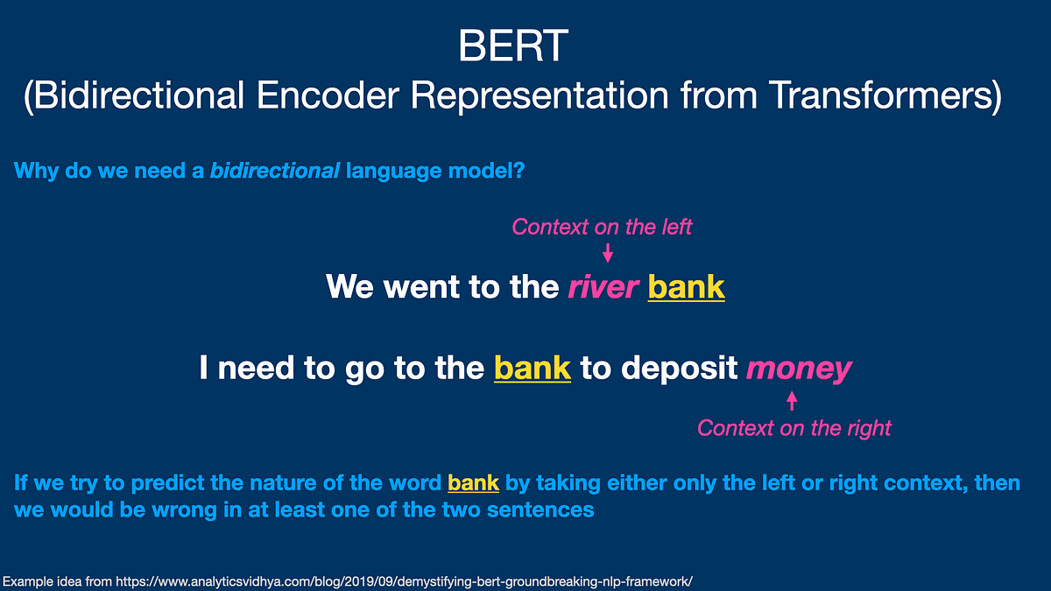

Slide 14
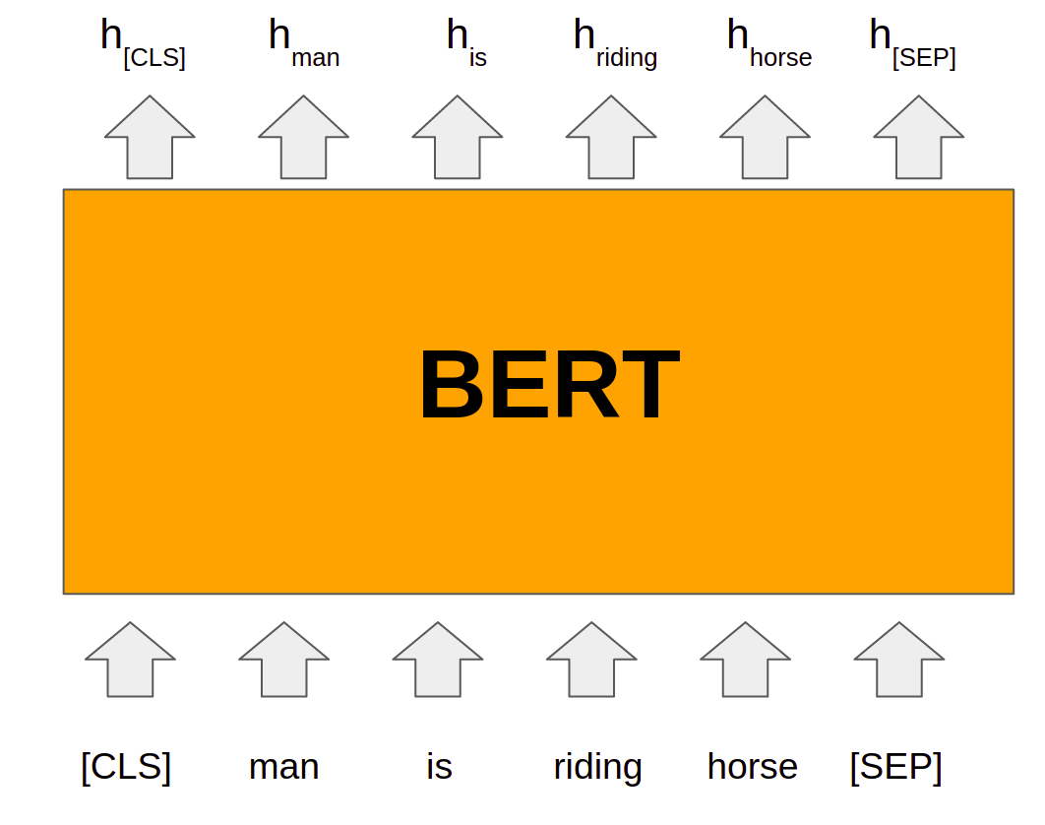
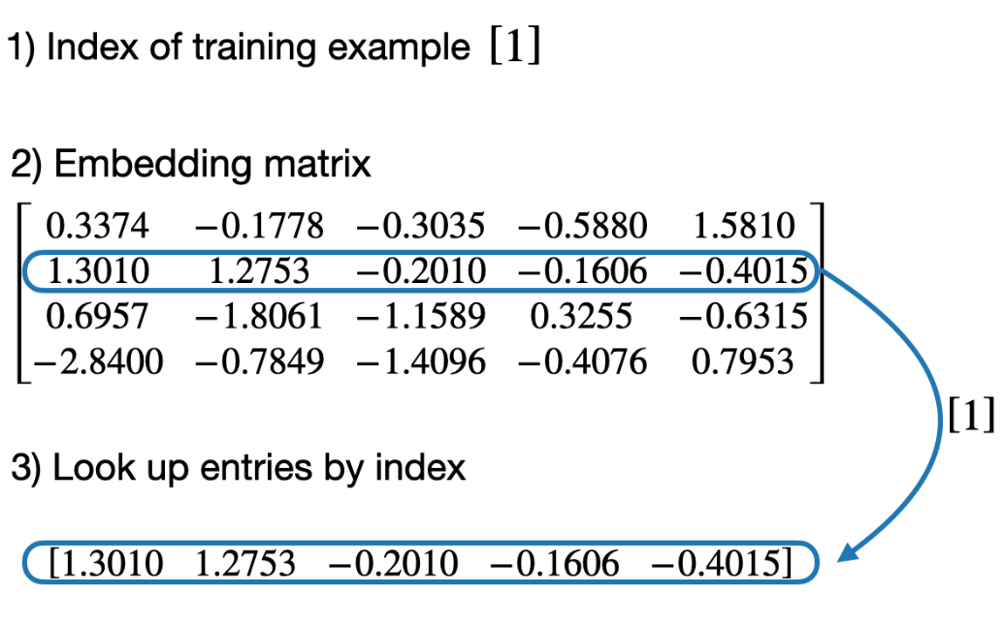
Trained BERT embedding layer
https://www.analyticsvidhya.com/blog/2021/05/all-you-need-to-know-about-bert/
https://github.com/rasbt/LLMs-from-scratch/blob/main/ch02/03_bonus_embedding-vs-matmul/embeddings-and-linear-layers.ipynb

Slide 15
Train BERT Model

Slide 16
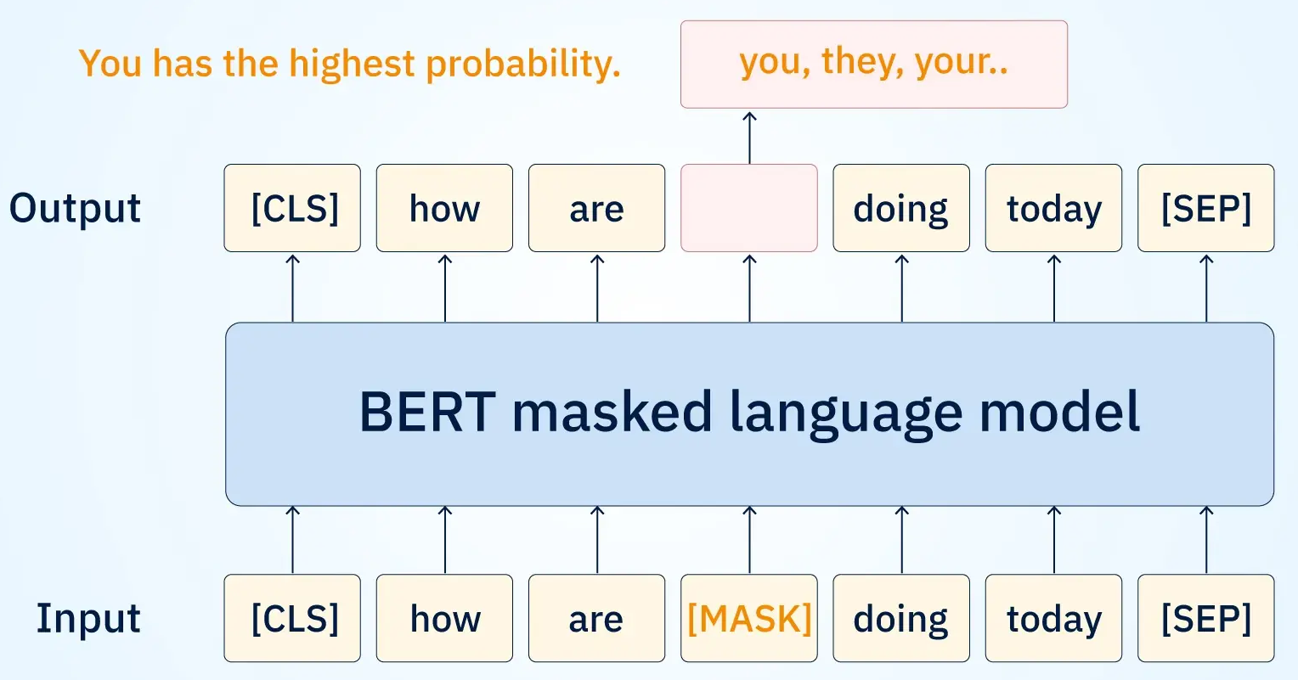
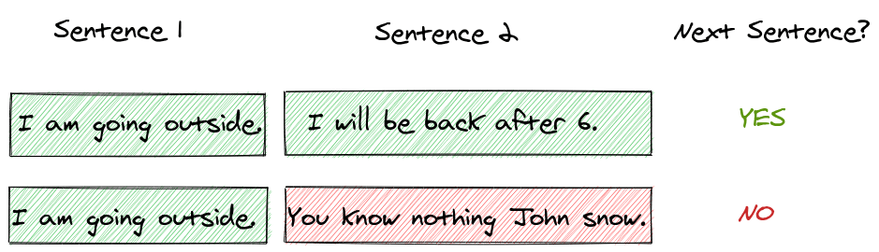
Train BERT Model (MLM+NSP)
Masked Language Model (MLM): randomly mask words in document and try to predict them based on the surrounding context.
Next Sentence Prediction (NSP): Predict if sentence 2 follows sentence 1
https://www.searchunify.com/sudo-technical-blogs/context-is-key-the-transitional-impact-of-bert-on-enterprise-search-results/
https://amitness.com/posts/albert-visual-summary

Slide 17
BERT input tokenization
Tokenization splits text into small pieces called tokens
Tokens are usually words (e.g., “today") or special markers (e.g., [CLS])
Purpose: Prepares text for the BERT model to process
BERT’s tokenizer (a component of the BERT pipeline)
Adds [CLS] at the start, [SEP] at the end
"playing" → ["play", "##ing"]
Another example: "The king rules the kingdom" becomes multiple tokens
Original text: The king rules the kingdom
Tokens: ['[CLS]', 'the', 'king', 'rules', 'the', 'kingdom', '[SEP]’]
Token IDs: [101, 1996, 2332, 3513, 1996, 2983, 102]

Slide 18
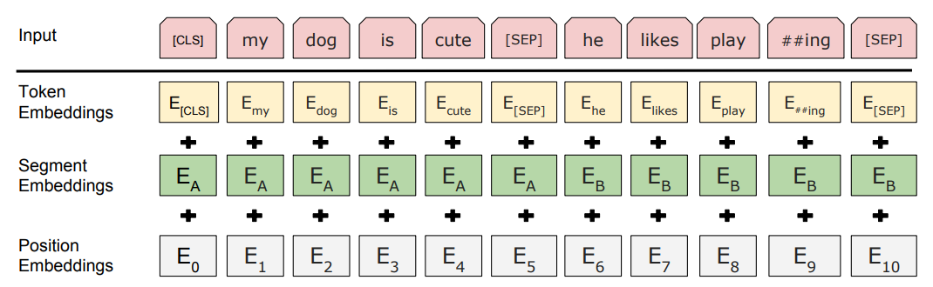
BERT input representation
Token Embedding: Encodes subword/token meaning
Position Embedding: Encodes token order
Segment Embedding: Encodes sentence distinction
The inputs are converted to the sum of three embeddings
embedding matrix shape (30522,768)

Slide 19
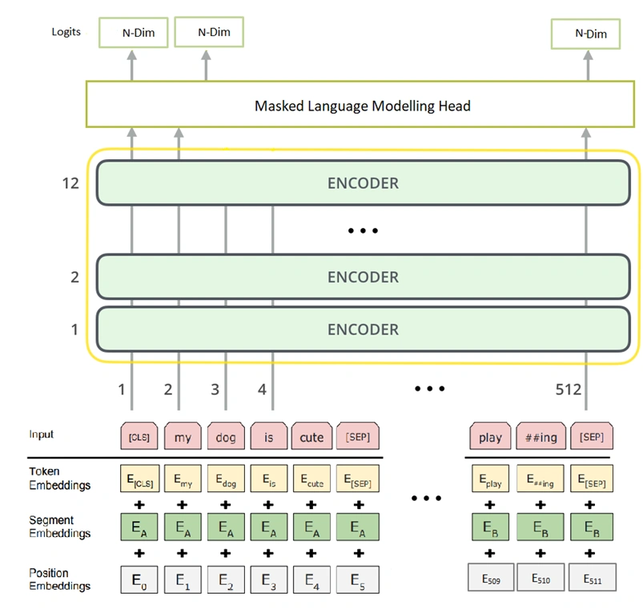
SoftMax to predict the word “Bank”
update embedding

Slide 20
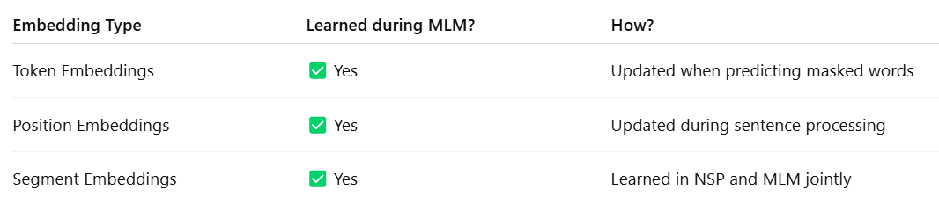
Embeddings are trainable during training
The token embeddings, position embeddings, and segment embeddings are all learned during MLM training.
These embeddings are adjusted using backpropagation based on how well the model predicts the masked words.
A single loss function is used to update all the learnable parameters

Slide 21
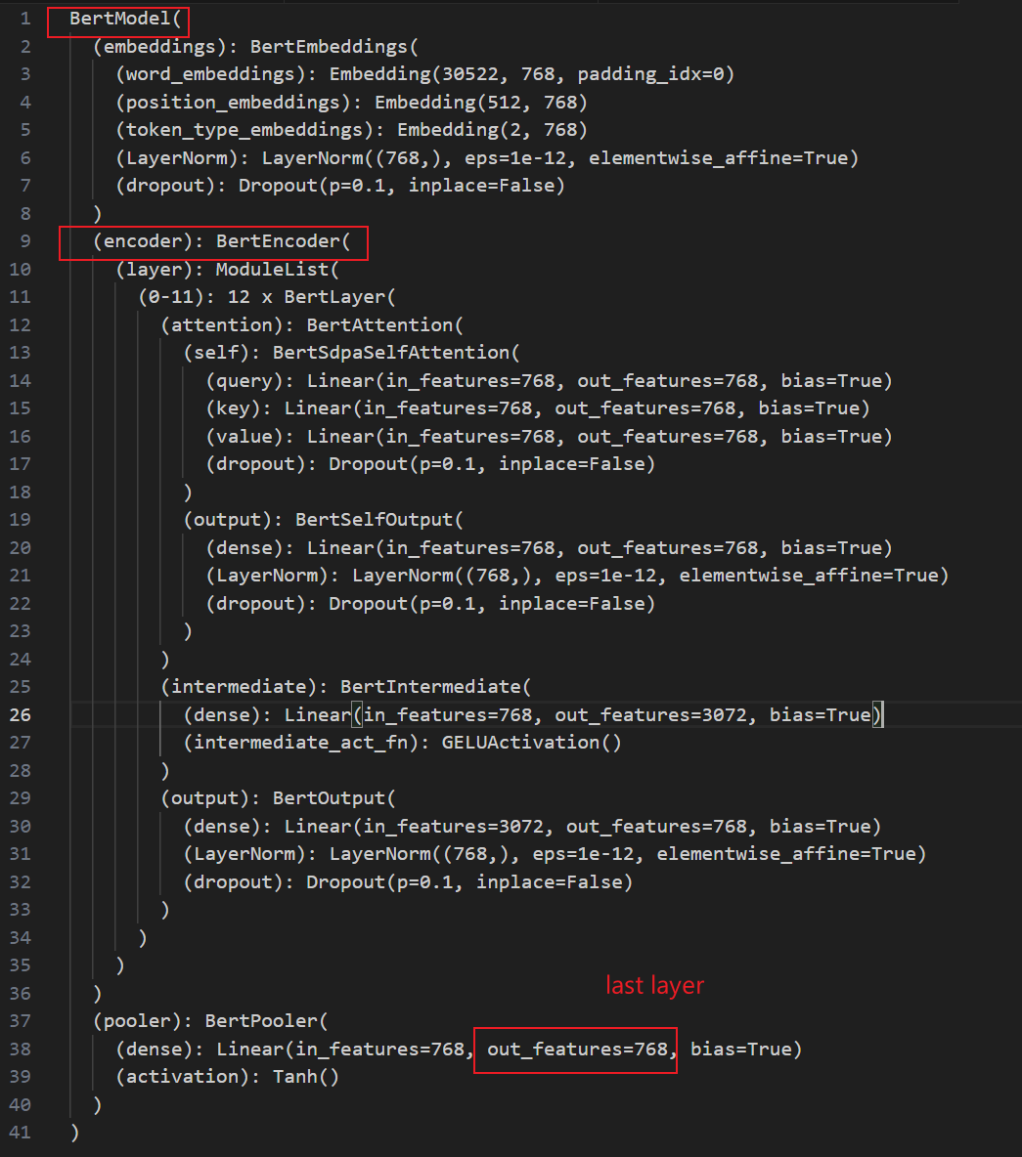

Slide 22
Use a Pre-Trained BERT Model for Embedding

Slide 23
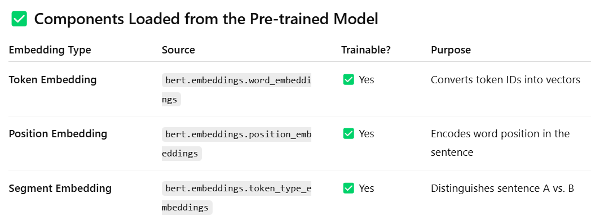
Load Pre-Trained BERT Model
BERT uses learned position embeddings, not sinusoidal.
The sine/cosine version was used in the original Transformer model, not in BERT.

Slide 24
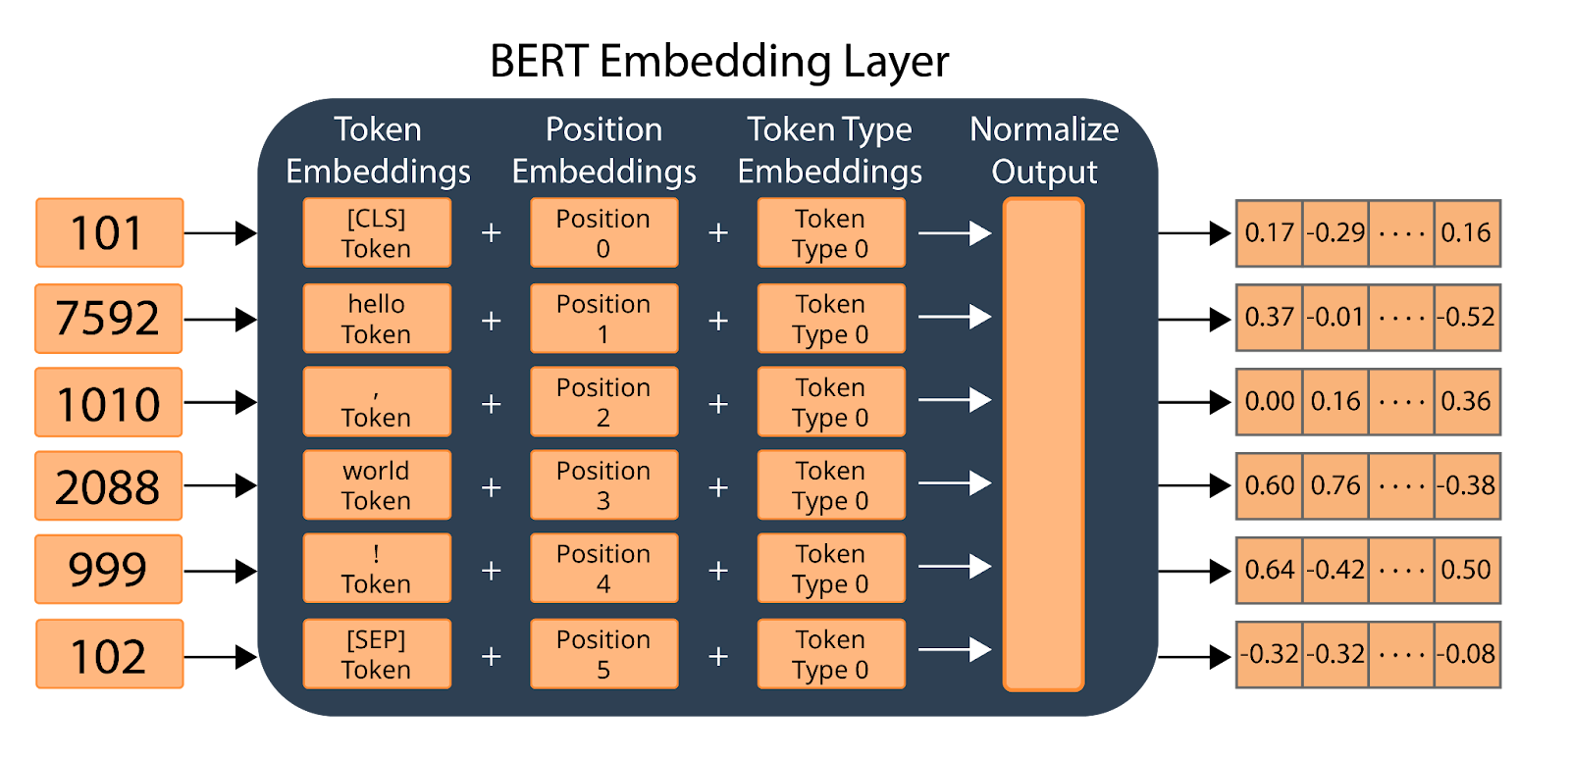
Calculates the embeddings for the string “hello, world”
Note: all embeddings are tensors
pre-trained BERT
token ID
https://airbyte.com/data-engineering-resources/bert-vector-embedding

Slide 25
Token Embedding
Token embeddings are lists of numbers (vectors) for each token
Each vector has 768 numbers in BERT, capturing token meaning
Contextual embeddings: Vectors change based on the sentence
Example: In "The king rules the kingdom and the queen governs":
The three "the"s get different vectors
"King" and "queen" have similar but distinct vectors

Slide 26
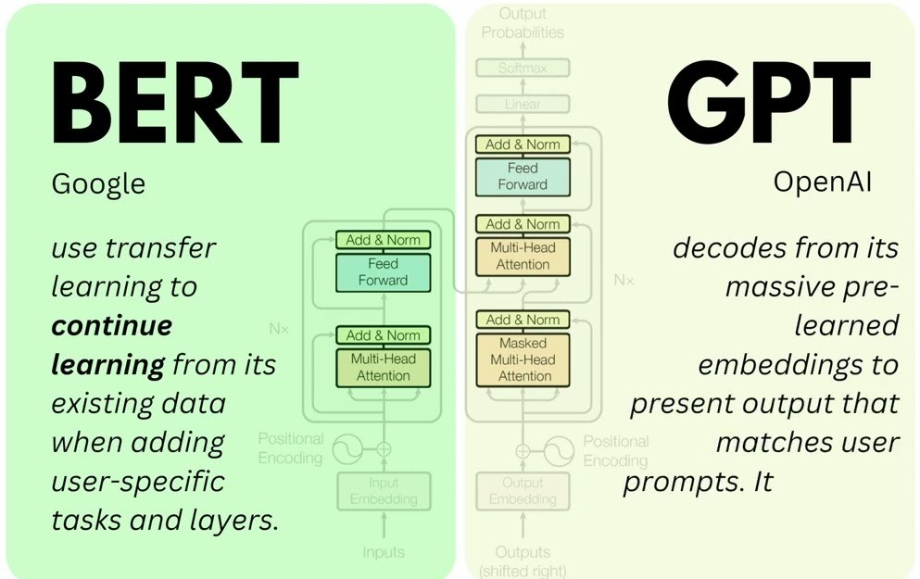


BERT is an Encoder of the Transformer
interesting reading
encoder only transformer
decoder
https://sushant-kumar.com/blog/bert
Notes:
https://jalammar.github.io/illustrated-bert/

Slide 27
Example: Use Pre-Trained BERT model “bert-base-uncased”

Slide 28
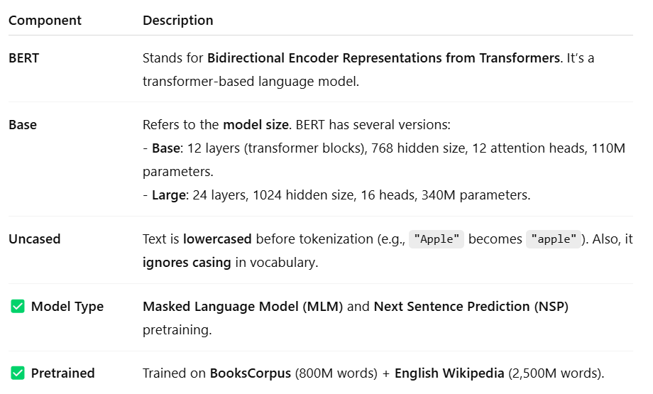
Pre-trained “bert-base-uncased”
Commonly used for downstream NLP tasks like classification, NER, and QA

Slide 29
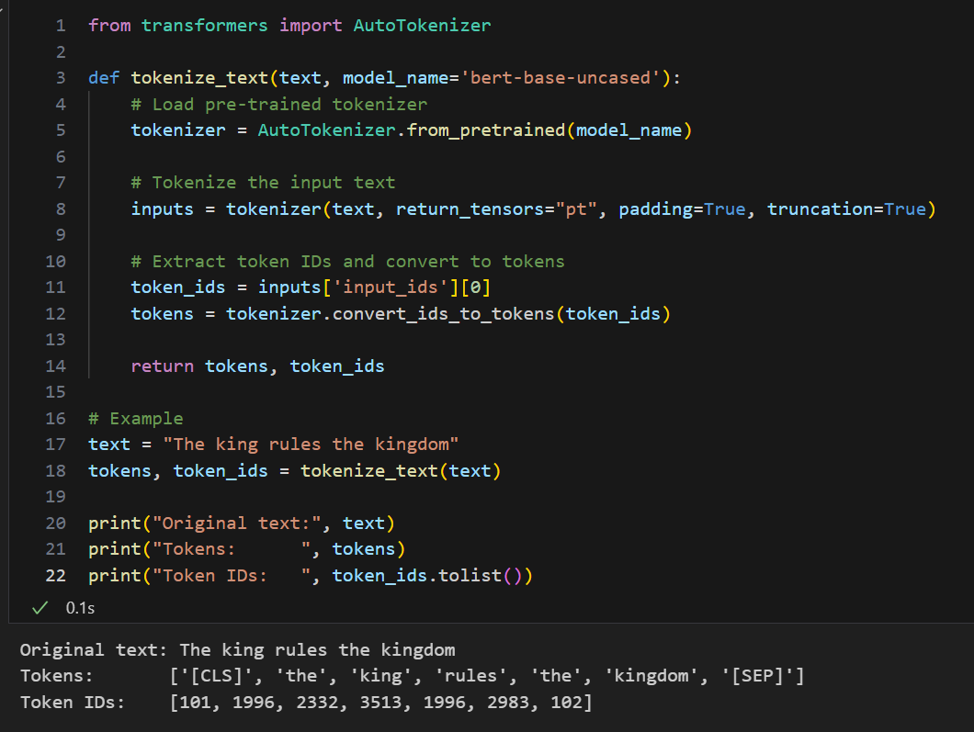
Tokens information

Slide 30
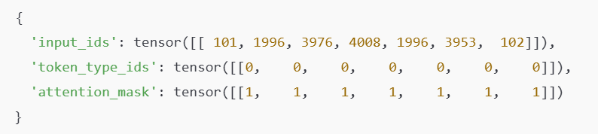
“inputs” is Dictionary with Tensors
IDs of tokens from the model’s vocabulary.
segment IDs: used when BERT is fed two sentences
Tells the model which tokens to pay attention to (1 = real token, 0 = padding). This is important when batching sequences of different lengths. BERT should ignore padded values.

Slide 31
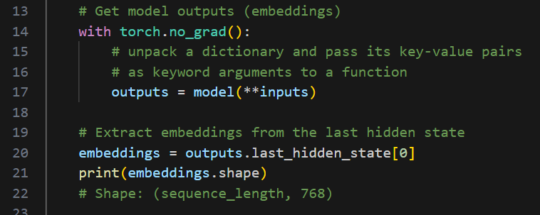
Inputs, Bert model, and output

Slide 32
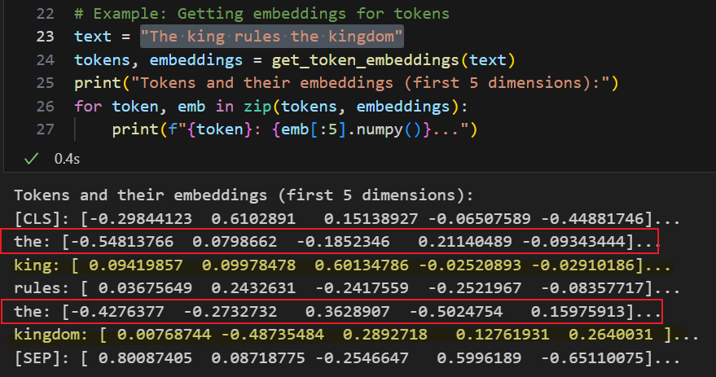
"The king rules the kingdom"
First “the” and second "the" vectors differ due to context

Slide 33
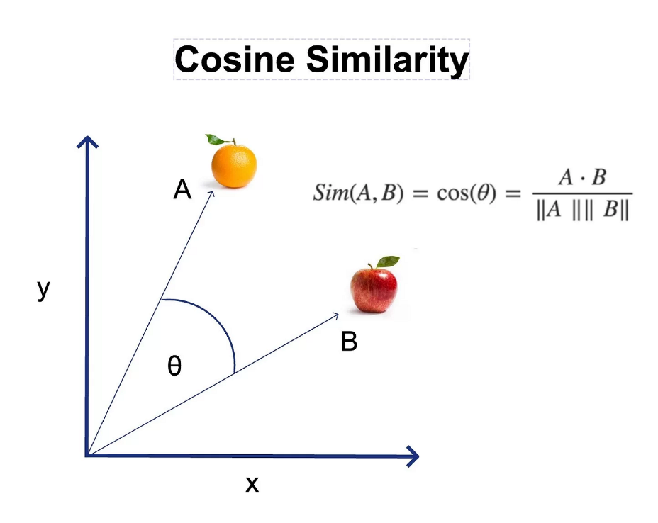

Cosine Similarity between words
Cosine similarity focuses on the orientation (the angle) of vectors and not their magnitude because its formula normalizes the vectors
Two people with two features: Height and Weight
Person A: A=[170,70]
Person B: B=[180,80]

Slide 34
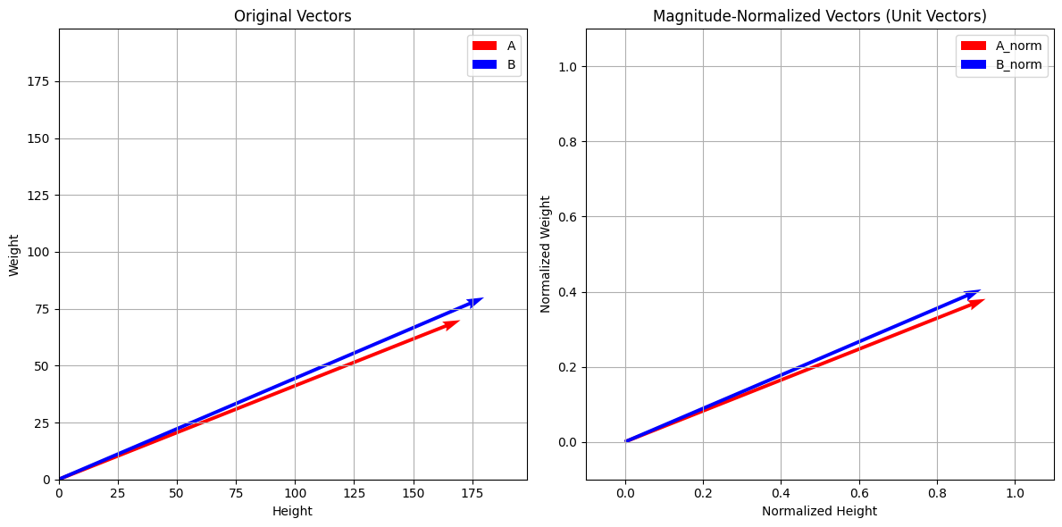
Are two people similar (Height and Weight)
Before Magnitude Normalization
Person A: A=[170,70]
Person B: B=[180,80]
After Magnitude Normalization
Person A: A=[0.9246,0.3807]
Person B: B=[0.9138,0.4061]

Slide 35
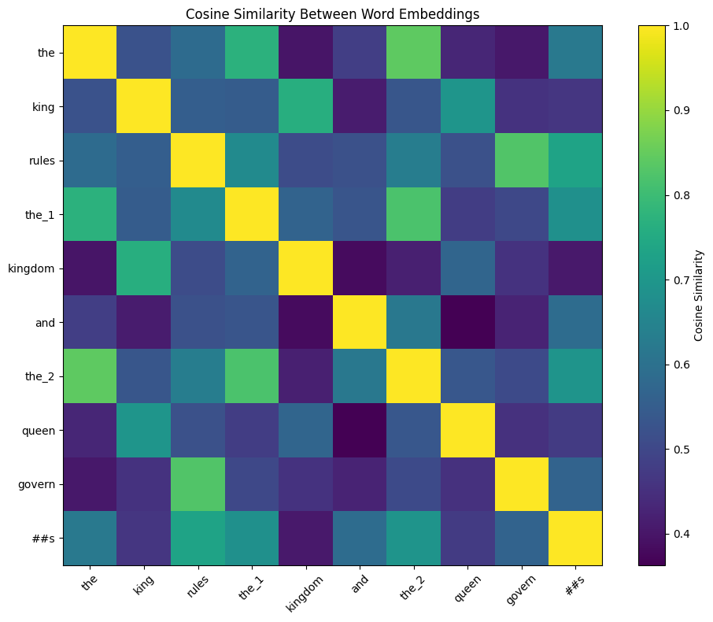
Cosine Similarity Between Word Embeddings

Slide 36
Word Analogy - Understanding the Concept Content
Analogy: Finding word relationships using math
Example: "king is to queen as man is to woman"
How it works:
Compute vector: king - man + woman
Check if it’s close to "queen"’s vector
Cosine similarity measures closeness
Purpose: Show embeddings capture deep relationships
Our goal: Test the analogy with BERT embeddings

Slide 37
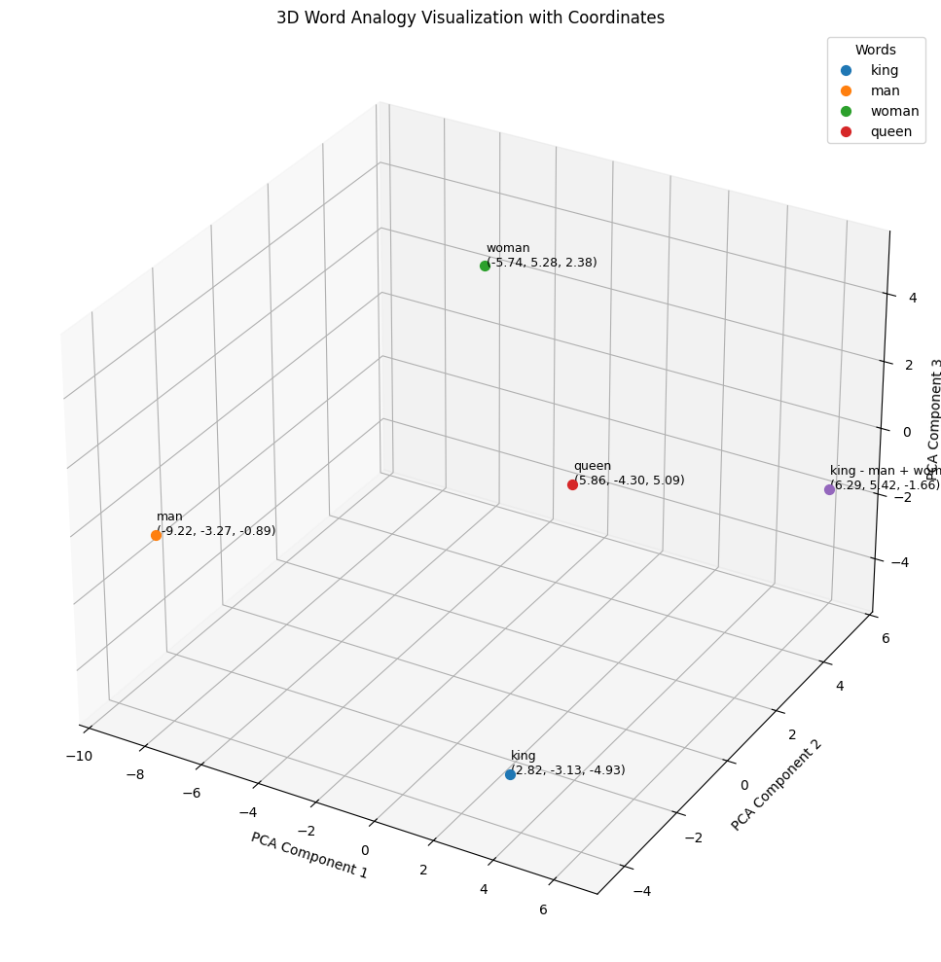

Slide 38
Summary
Tokenize text into pieces
Create contextual embeddings with BERT
Select word embeddings, compute similarities
Visualize similarities with a heatmap

