Slide 1
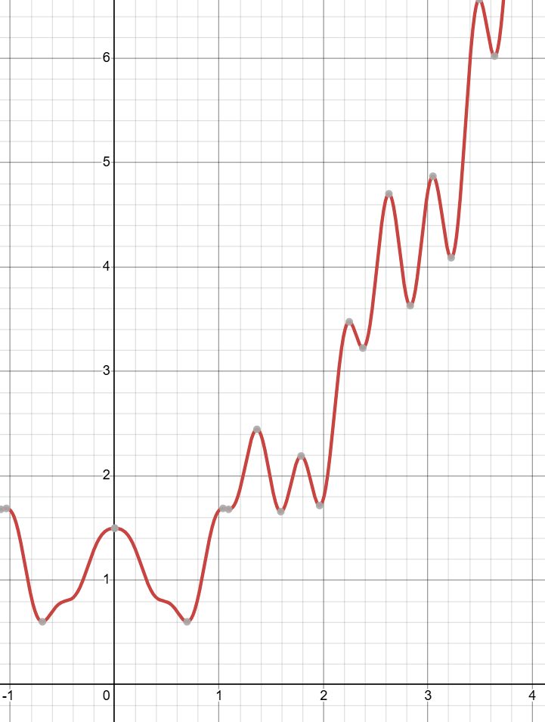
Universal Approximation Theorem for neural networks
Neurons can approximate any function
http://neuralnetworksanddeeplearning.com/chap4.html

Slide 2
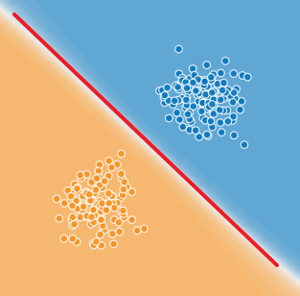
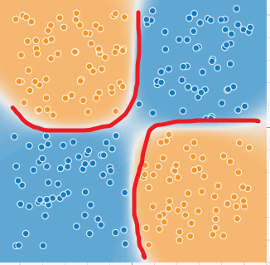
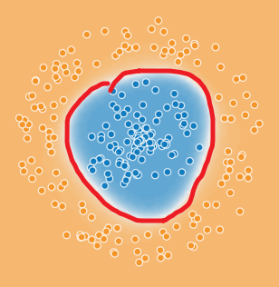
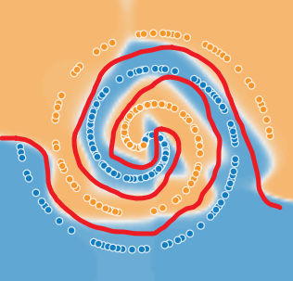
Key Takeaways
Classifications use lines or curves to separate data
Lines and curves represent mathematical functions
Neurons can approximate any function

Slide 3
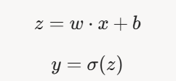
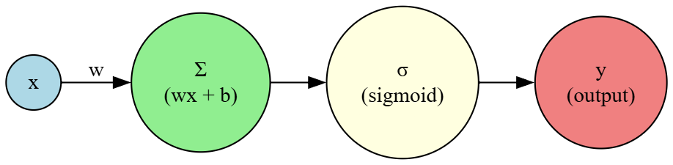
An artificial neuron
Definition: The simplest artificial neuron with a sigmoid function has one input (x), one weight (w), and usually a bias (b). Its computation is:

Slide 4
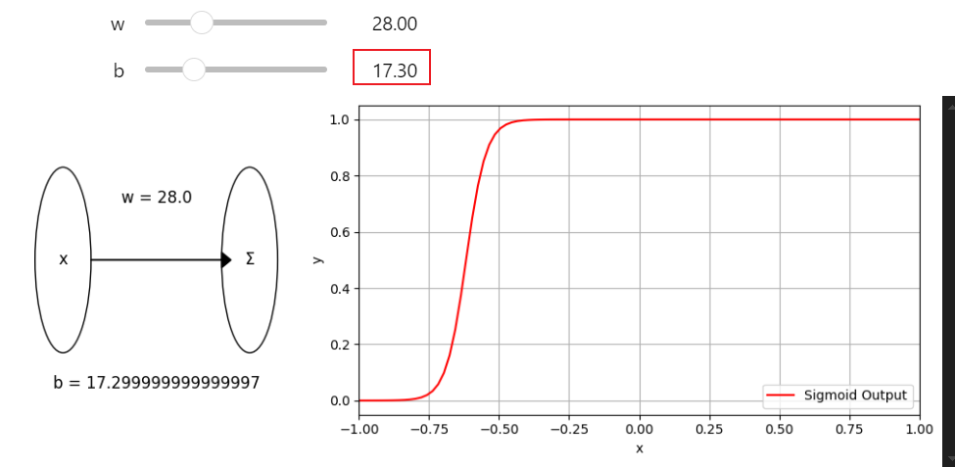
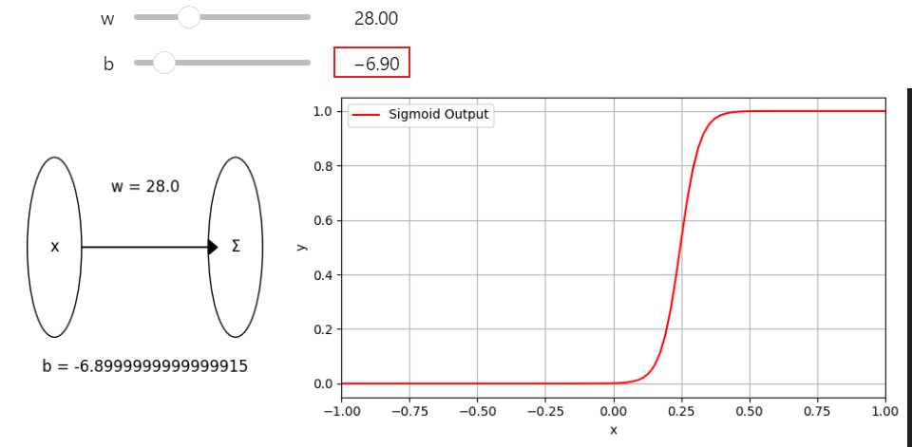
Limitation of one neuron
The simplest artificial neuron with a sigmoid activation function approximates an S-shaped curve (sigmoid curve)
http://neuralnetworksanddeeplearning.com/chap4.html

Slide 5
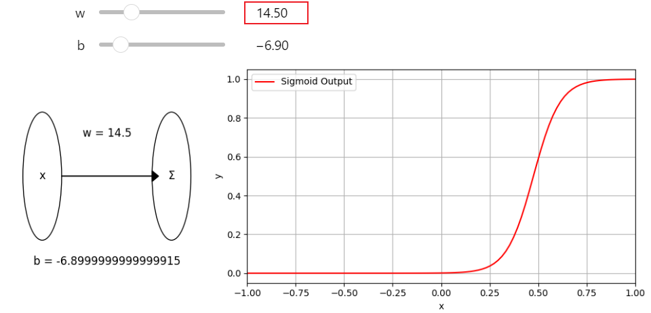
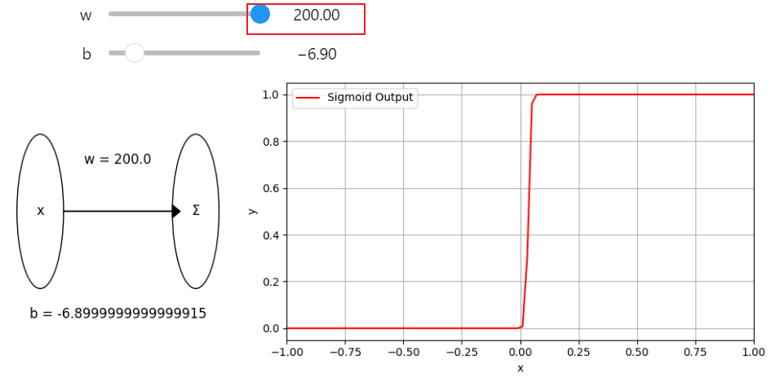
if /then statement

Slide 6

Can a neural network approximate this function?
Yes. This is the Universal Approximation Theorem (UAT) for neural networks
Notes:
y=1+0.4x^{2}+0.2x\sin(15x)+0.5\cos(5x)

Slide 7
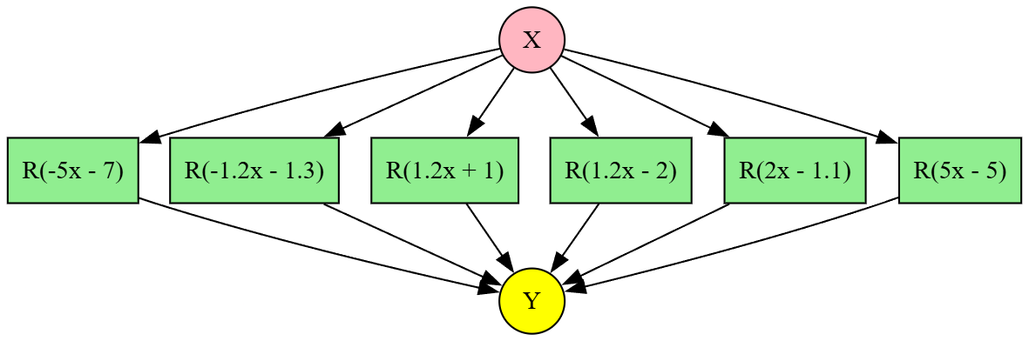
What is UAT in AI?
The Universal Approximation Theorem (UAT) in the context of AI, specifically neural networks, states that
a feedforward neural network with a single hidden layer and a sufficient number of neurons R(x,b)=wx+b can approximate any continuous function to any degree of accuracy, given a non-linear activation function.
We can approximate (train) a neural network (shown on the left), where y=f(x), and
Notes:
digraph Neural_Network { // Graph settings rankdir=LR
// Input node
X [label="X", shape=circle, style=filled, fillcolor=lightpink]
// Hidden layer neurons
// Hidden layer neurons
H1 [label="R(-5x - 7)", shape=rectangle, style=filled, fillcolor=lightgreen]
H2 [label="R(-1.2x - 1.3)", shape=rectangle, style=filled, fillcolor=lightgreen]
H3 [label="R(1.2x + 1)", shape=rectangle, style=filled, fillcolor=lightgreen]
H4 [label="R(1.2x - 2)", shape=rectangle, style=filled, fillcolor=lightgreen]
H5 [label="R(2x - 1.1)", shape=rectangle, style=filled, fillcolor=lightgreen]
H6 [label="R(5x - 5)", shape=rectangle, style=filled, fillcolor=lightgreen]
// Output node
Y [label="Y", shape=circle, style=filled, fillcolor=yellow]
// Edges from input to hidden layer
X -> H1
X -> H2
X -> H3
X -> H4
X -> H5
X -> H6
// Edges from hidden layer to output
H1 -> Y
H2 -> Y
H3 -> Y
H4 -> Y
H5 -> Y
H6 -> Y
// Group hidden neurons in the same rank for vertical alignment
{rank=same; H1; H2; H3; H4; H5; H6}
}

Slide 8
Why is UAT important?
All problems can be described in functions.
This theorem is a cornerstone of neural network theory, providing a theoretical foundation for their ability to solve complex problems

Slide 9
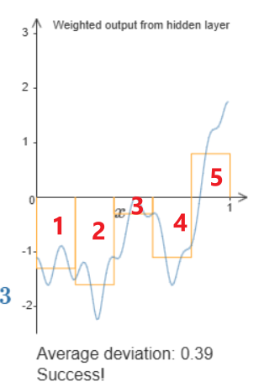
Visual approach to prove UAT
Create many “bumps” (5 in the example)
Each bump should minimize the error
More “bumps”, fewer errors
Each bump results from two neurons and one linear neuron (a neuron without a sigmoid function)
http://neuralnetworksanddeeplearning.com/chap4.html

Slide 10
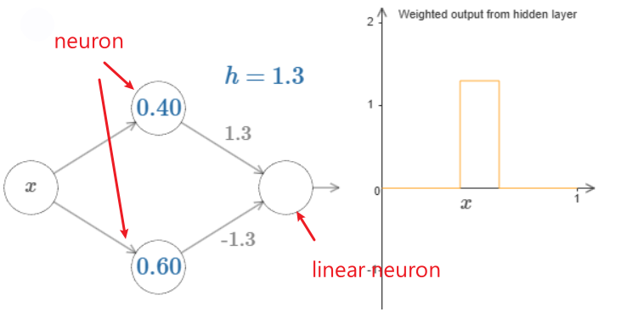
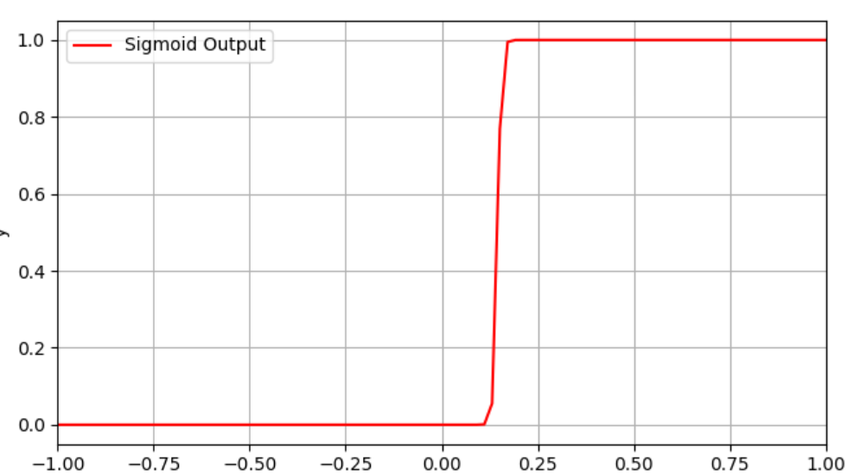



A “bump” with two neurons and one linear neuron
s=−b/w
demo on http://neuralnetworksanddeeplearning.com/chap4.html

Slide 11
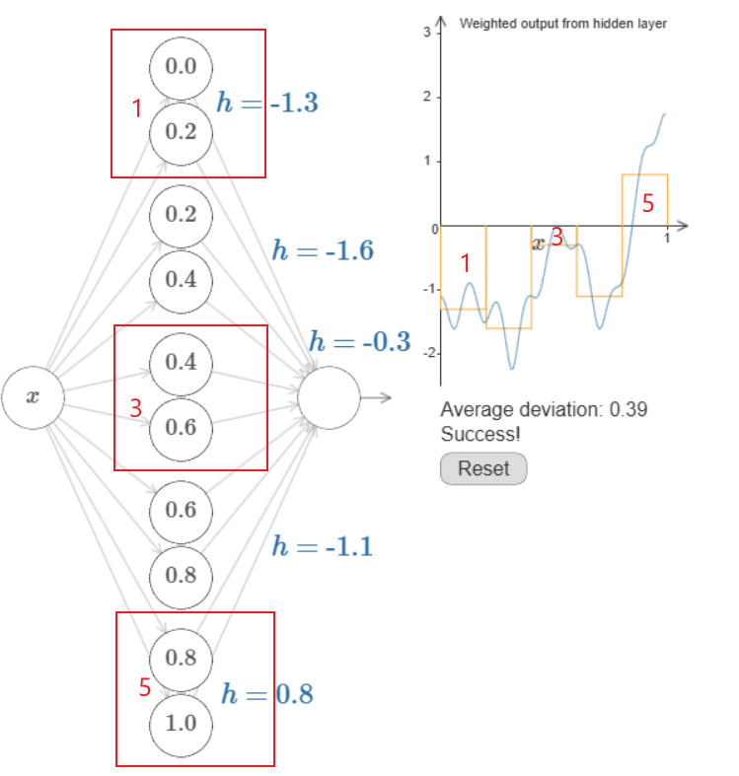
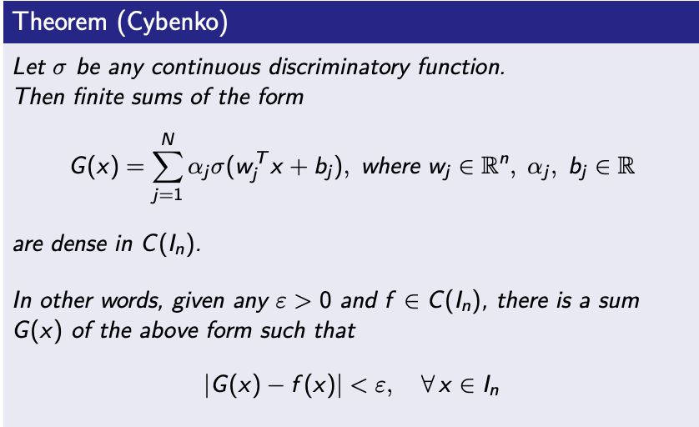
Approximating with 5 bumps
G(x)
https://medium.com/@ML-STATS/understanding-the-universal-approximation-theorem-8bd55c619e30
DEMO http://neuralnetworksanddeeplearning.com/chap4.html

Slide 12
UAT works with any numbers of inputs and outputs (n to n)

Slide 13
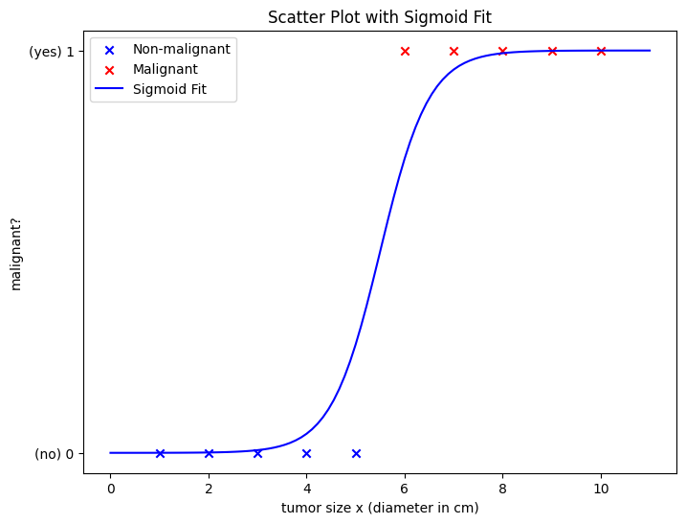
1 to 1
Real-World Example: File Timestamp Anomaly Detection
Application: Detecting whether a file's timestamp has been manipulated in a digital forensic investigation.
Context: In digital forensics, file timestamps (e.g., creation, modification, or access times) are critical for reconstructing timelines of events in cybercrime investigations, such as data theft or malware deployment. Attackers may manipulate timestamps to obscure their actions, making anomaly detection vital.
Input: A single feature, such as the file's modification timestamp (normalized to a numerical value, e.g., seconds since epoch).
Output: A single value indicating the likelihood of the timestamp being manipulated (e.g., a probability between 0 and 1, where 1 suggests manipulation).
Use Case: A forensic investigator analyzes a suspect's computer to determine if critical files (e.g., logs or evidence files) have altered timestamps that don't align with system activity. A 1-to-1 neural network can be trained to flag suspicious timestamps based on historical data.
Size of tumor -> tumor malignant?

Slide 14
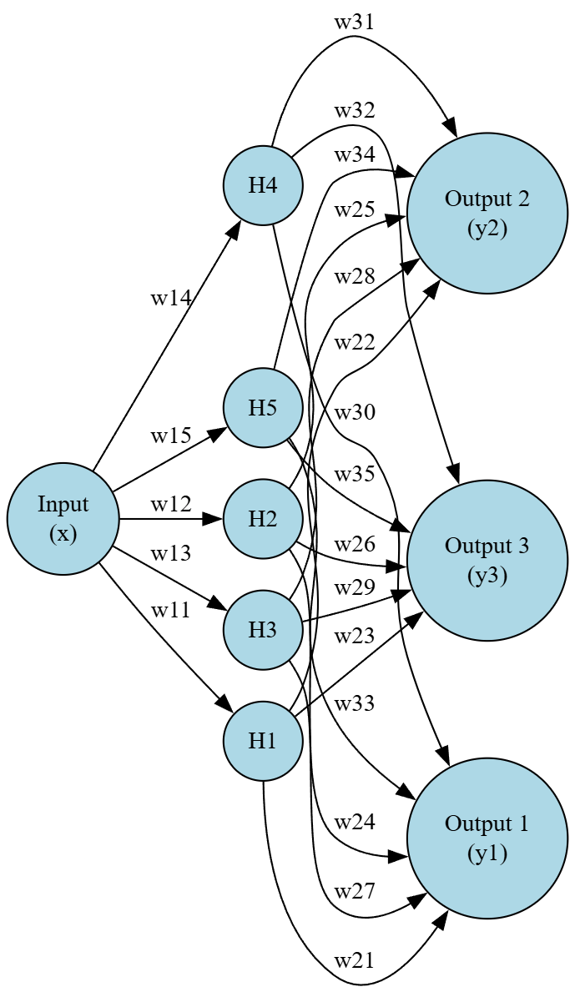
1 to n
Real-World Example: File Type Misidentification Detection
Application: Determining the likelihood that a file’s extension has been deliberately altered to hide its true type during a digital forensic investigation.
Context: In digital forensics, cybercriminals often change a file’s extension to evade detection (e.g., renaming a malicious .exe file to .jpg). Investigators need to identify such discrepancies to uncover hidden malware, contraband, or other evidence. A 1-to-N neural network can analyze a single feature, such as the file’s entropy (a measure of randomness in the file’s content), to predict the likelihood of the file belonging to various file type categories.
Input: A single value, the file’s entropy (a numerical value, typically between 0 and 8 for byte-level entropy).
Outputs (N): Probabilities for N possible file types (e.g., “Executable,” “Image,” “Document,” “Audio,” “Compressed”). For example, N=5 for five file type categories.
Use Case: During a forensic investigation, an analyst processes files from a suspect’s device using a tool like The Sleuth Kit or EnCase. The 1-to-N network flags files with mismatched extensions (e.g., a .jpg file with high entropy likely being an executable) for further scrutiny.
Notes:
digraph NeuralNetwork {
rankdir=LR; // Left-to-right layout
node [shape=circle, style=filled, fillcolor=lightblue];
edge [color=black];
// Input neuron
I1 [label="Input\n(x)"];
// Hidden layer (5 neurons)
H1 [label="H1"];
H2 [label="H2"];
H3 [label="H3"];
H4 [label="H4"];
H5 [label="H5"];
// Output neurons (3 neurons)
O1 [label="Output 1\n(y1)"];
O2 [label="Output 2\n(y2)"];
O3 [label="Output 3\n(y3)"];
// Connections: Input to Hidden
I1 -> H1 [label="w11"];
I1 -> H2 [label="w12"];
I1 -> H3 [label="w13"];
I1 -> H4 [label="w14"];
I1 -> H5 [label="w15"];
// Connections: Hidden to Output
H1 -> O1 [label="w21"];
H1 -> O2 [label="w22"];
H1 -> O3 [label="w23"];
H2 -> O1 [label="w24"];
H2 -> O2 [label="w25"];
H2 -> O3 [label="w26"];
H3 -> O1 [label="w27"];
H3 -> O2 [label="w28"];
H3 -> O3 [label="w29"];
H4 -> O1 [label="w30"];
H4 -> O2 [label="w31"];
H4 -> O3 [label="w32"];
H5 -> O1 [label="w33"];
H5 -> O2 [label="w34"];
H5 -> O3 [label="w35"];
// Organize layers
{rank=same; H1; H2; H3; H4; H5;}
{rank=same; O1; O2; O3;}
}

Slide 15
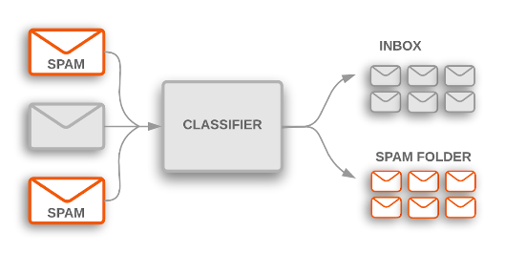
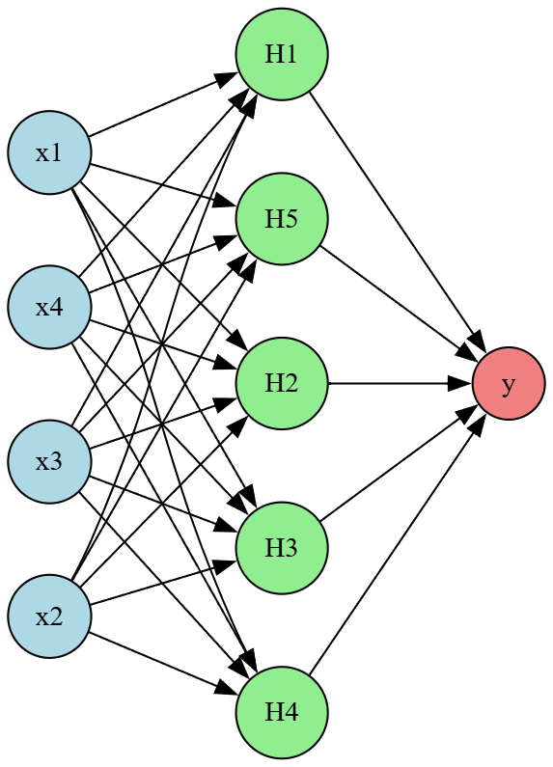
n to 1
Application: Predicting whether a file is malicious (e.g., malware) based on multiple metadata features extracted during a digital forensic investigation.
Context: In digital forensics, investigators often analyze files on a suspect’s device to identify malware, such as viruses, ransomware, or spyware. File metadata—such as size, entropy, creation timestamp, and permission flags—can provide clues about a file’s nature. An N-to-1 neural network can combine these features to predict the probability that a file is malicious.
Inputs (N): Multiple features, such as:
File entropy (measure of randomness, high for executables/encrypted files).
File size (in bytes, normalized).
Timestamp age (time since creation, normalized).
Permission flags (e.g., executable bit, binary 0 or 1). For example, N=4 for these four features.
Output: A single value representing the probability that the file is malicious (e.g., a value between 0 and 1, where 1 indicates high likelihood of malware).
Use Case: A forensic analyst uses a tool like The Sleuth Kit or Autopsy to extract metadata from files on a seized device. The N-to-1 network processes these features to flag potentially malicious files for deeper analysis, prioritizing investigation efforts.
Notes:
digraph NeuralNetwork {
rankdir=LR; // Left to right layout
splines=true; // Use splines for edges
nodesep=0.5; // Space between nodes
ranksep=1.0; // Space between layers
// Input Layer (4 neurons)
node [shape=circle, style=filled, fillcolor=lightblue];
I1 [label="x3"];
I2 [label="x2"];
I3 [label="x1"];
I4 [label="x4"];
{rank=same; I1; I2; I3; I4}
// Hidden Layer (5 neurons)
node [shape=circle, style=filled, fillcolor=lightgreen];
H1 [label="H5"];
H2 [label="H2"];
H3 [label="H3"];
H4 [label="H4"];
H5 [label="H1"];
{rank=same; H1; H2; H3; H4; H5}
// Output Layer (1 neuron)
node [shape=circle, style=filled, fillcolor=lightcoral];
O1 [label="y"];
{rank=same; O1}
// Edges: Input to Hidden Layer
I1 -> {H1, H2, H3, H4, H5};
I2 -> {H1, H2, H3, H4, H5};
I3 -> {H1, H2, H3, H4, H5};
I4 -> {H1, H2, H3, H4, H5};
// Edges: Hidden to Output Layer
H1 -> O1;
H2 -> O1;
H3 -> O1;
H4 -> O1;
H5 -> O1;
}

Slide 16
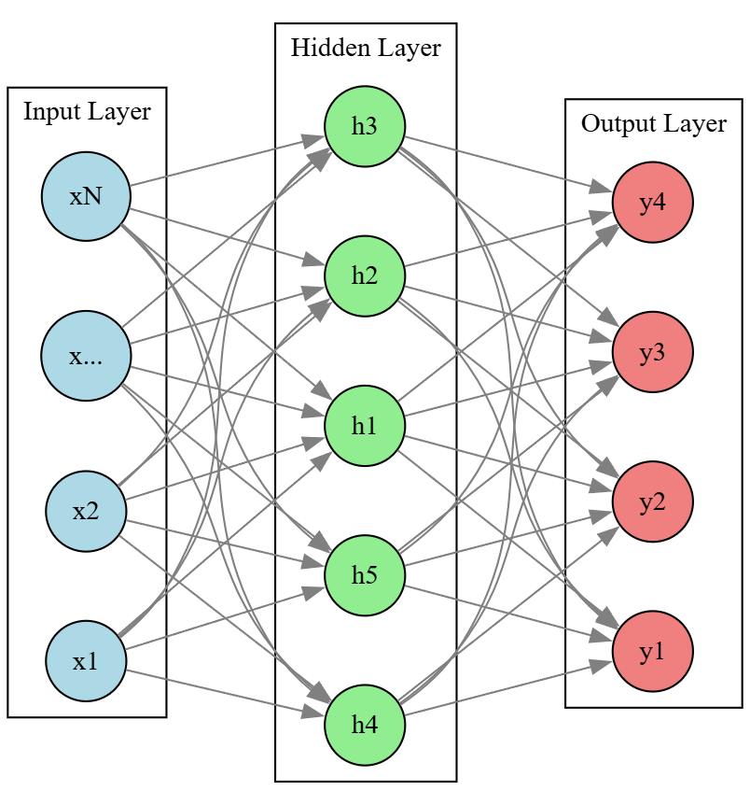
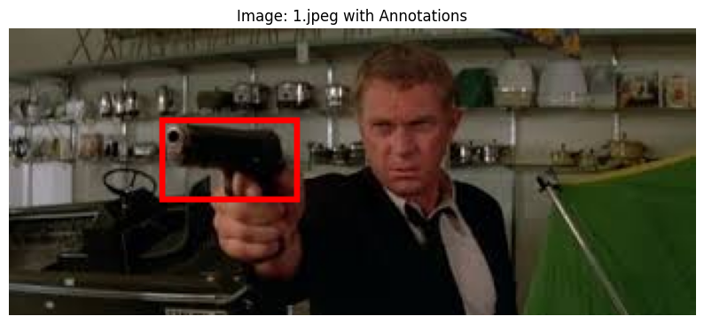
n to n
(x,y)
w
h
Input: 200*400 pixels
Output: x, y, weight, height

Slide 17
UAT limitation
The theorem doesn't specify how many neurons are needed, only that a sufficient number exists.
It focuses on approximation, not exact representation, meaning the network might not perfectly match the function, but will be very close.
The theorem doesn't address the practical aspects of training and finding the optimal network architecture, which require experimentation and learning.

Slide 18
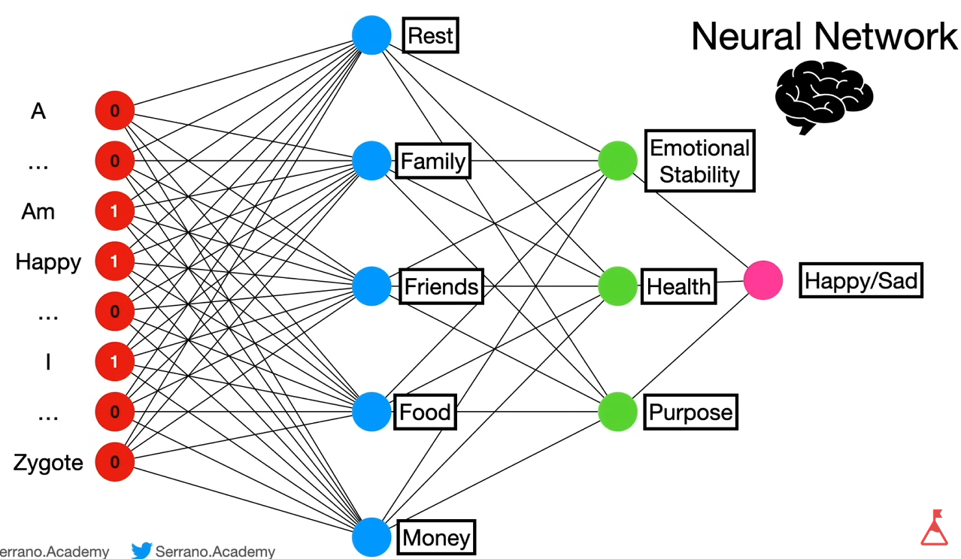
Multi-Layer Perceptron (MLP): Neurons have fictional labels

Slide 19
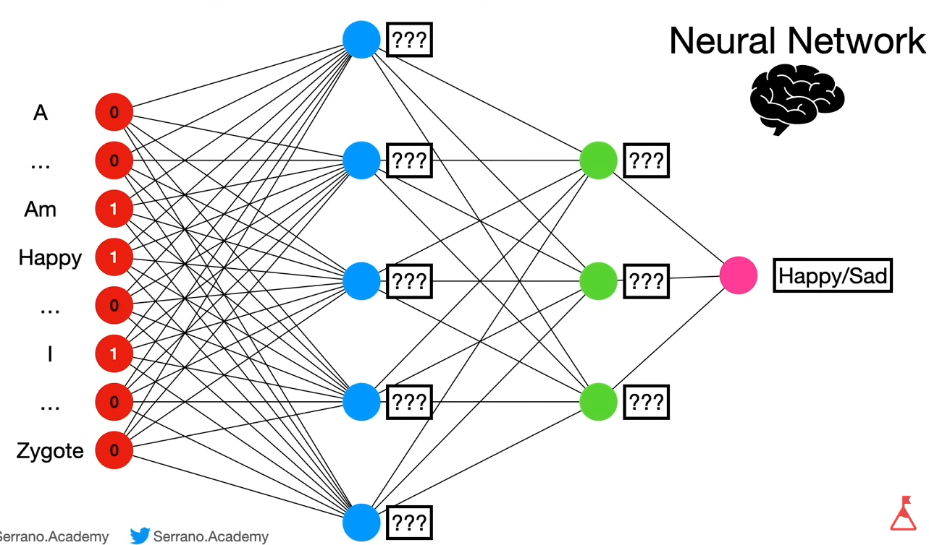
Multi-Layer Perceptron (MLP): Neurons have no meaningful labels

Slide 20
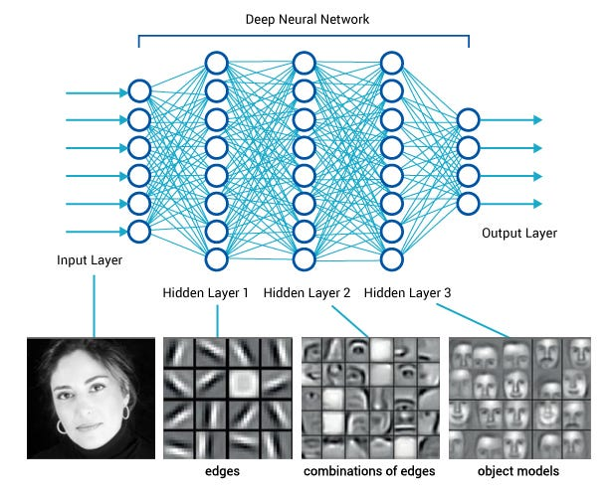
Multi-Layer Perceptron (MLP)
https://medium.com/diaryofawannapreneur/deep-learning-for-computer-vision-for-the-average-person-861661d8aa61

Slide 21
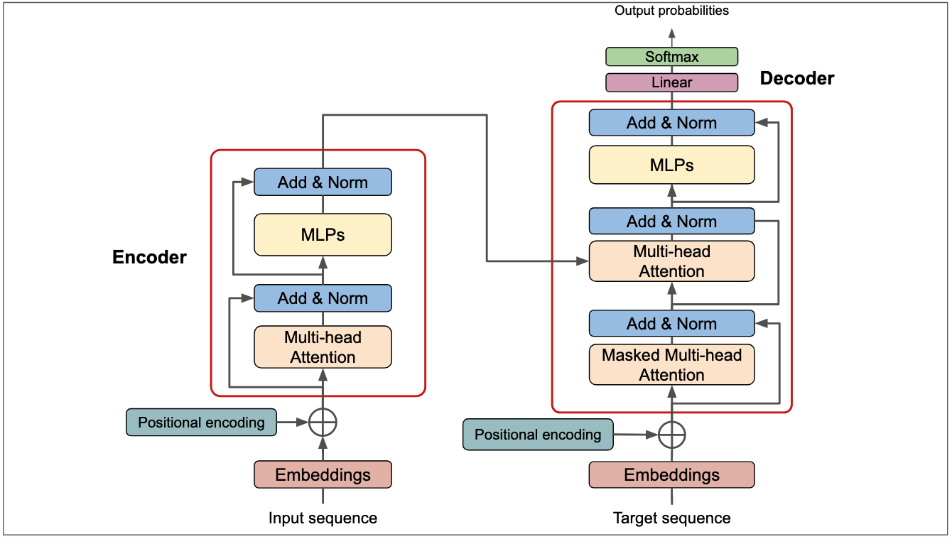
Transformer Architecture

Slide 22
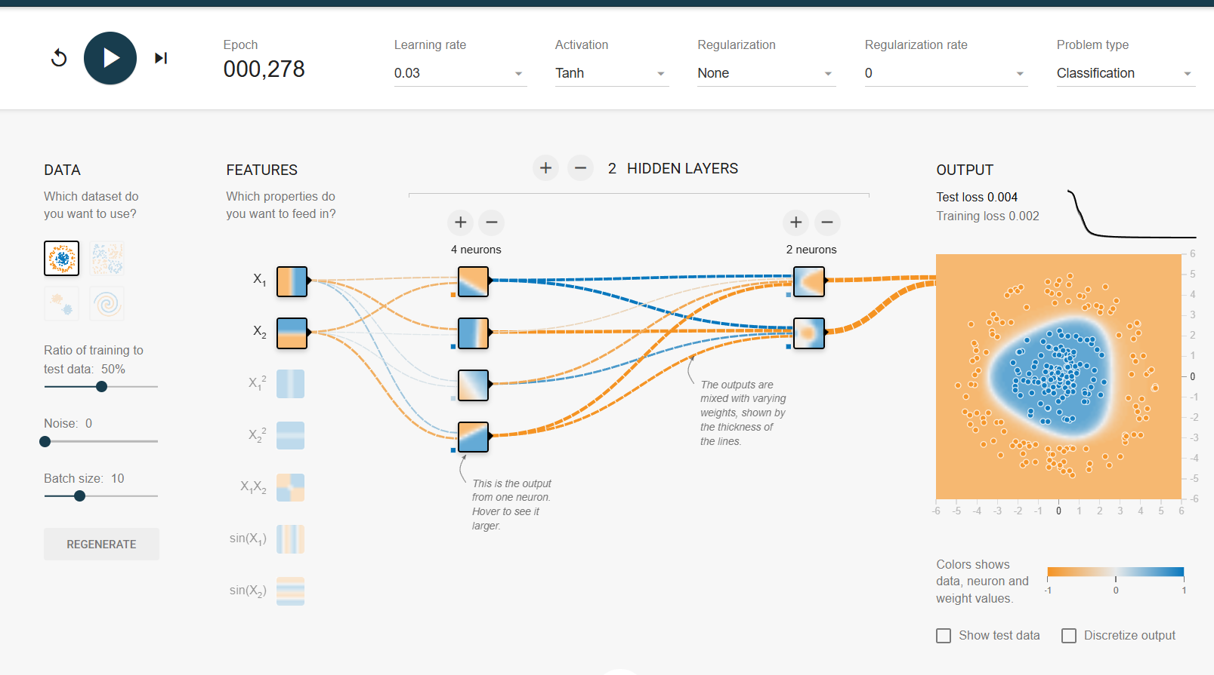
UAT Demo
https://playground.tensorflow.org

Slide 23
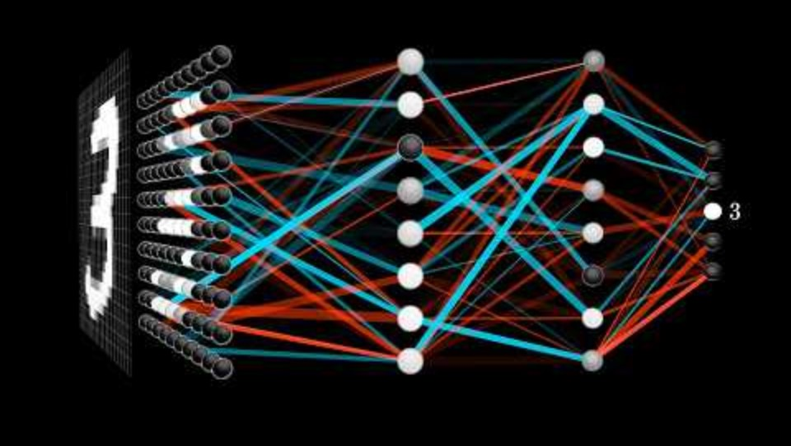
Neural network YouTube tutorial

Slide 24
Video tutorials
https://www.youtube.com/watch?v=Ijqkc7OLenI
https://www.youtube.com/watch?v=wen3221_3gU

Slide 25
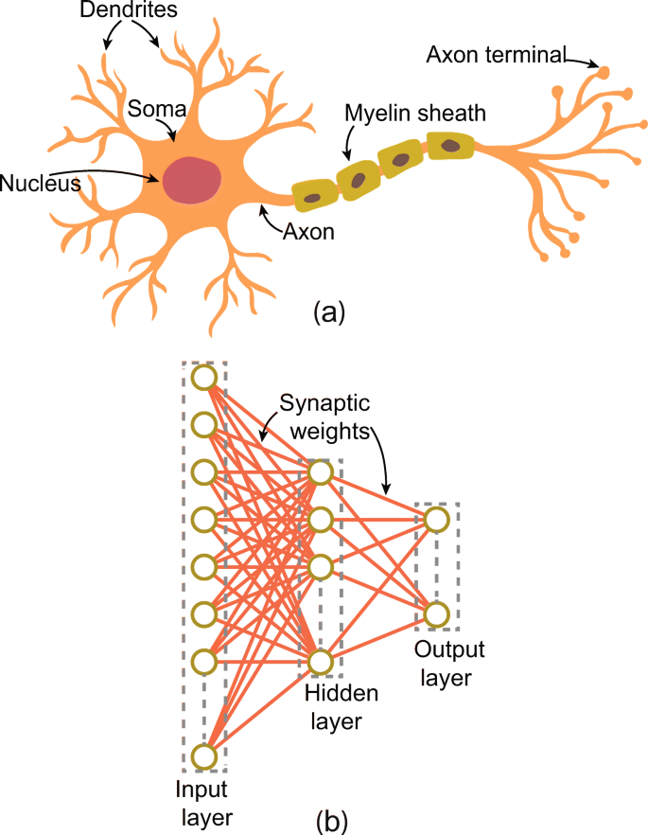
Summary
The UAT is a key reason why neural networks are so powerful and versatile in various AI applications, such as image recognition, natural language processing, and machine translation.
Schematics of (a) biological neuron and (b) single-layer feed-forward neural network (SLFN)
https://link.springer.com/article/10.1007/s10489-022-03783-y

