Slide 1
Transfer Learning
Introduction to Reusing Pre-trained Model

Slide 2
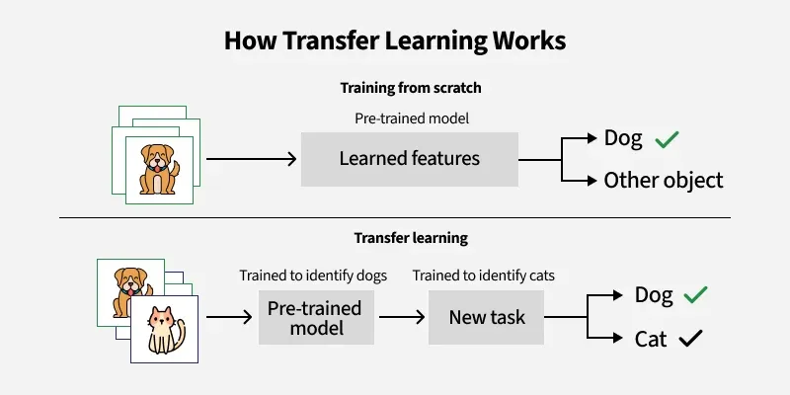
What is Transfer Learning?
Transfer Learning is a machine learning technique where knowledge gained from one task is applied to another related task.
Learning to ride a bike helps with learning to ride a motorcycle
Data with a task → Knowledge (pre-trained model) → a similar new Task
https://www.geeksforgeeks.org/ml-introduction-to-transfer-learning/

Slide 3
Why Transfer Learning?
Saves time and resources
Useful when you have limited data for your task
Pre-trained models are often trained on huge datasets (e.g., ImageNet, GPT, BERT)
List key benefits:
Faster training
Better performance with small datasets
Reduced computational costs

Slide 4
Transfer Learning in Different Domains
Transfer Learning in Computer Vision
Use of pre-trained CNNs: VGG16, ResNet, Inception
Example: Image classification with few cat images
Visual: Architecture with "frozen" layers and new output layer
Transfer Learning in NLP
Use of pre-trained models: BERT, RoBERTa, GPT
Tasks: Sentiment analysis, Named Entity Recognition, Text Classification
Hugging Face Transformers Library

Slide 5
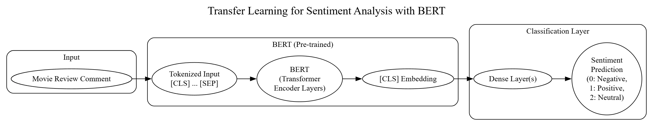
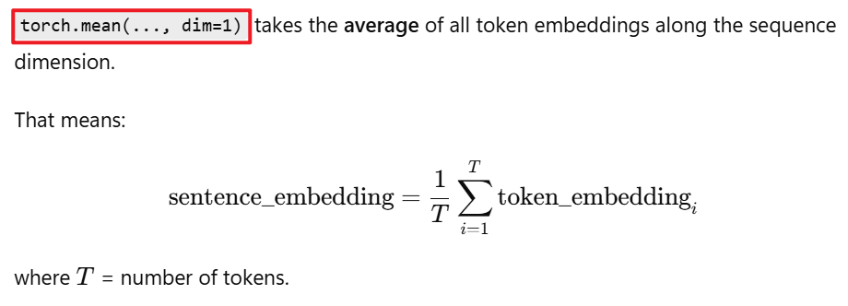
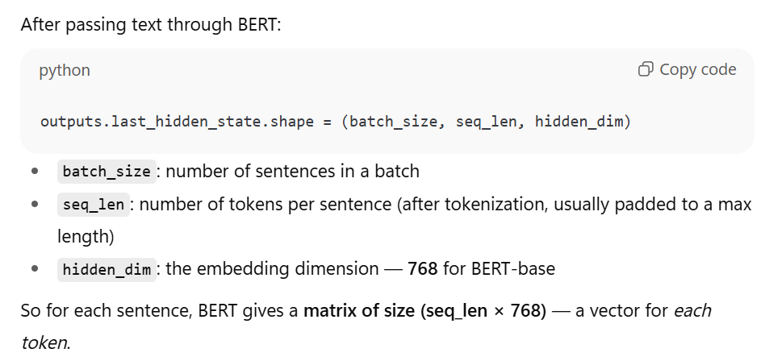
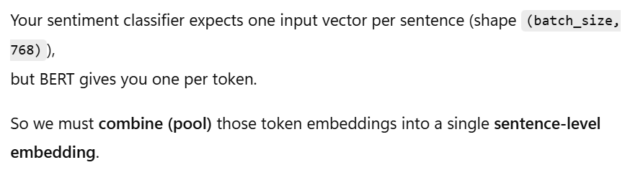



Notes:
digraph TransferLearningSentimentAnalysis {
rankdir=LR;
// Nodes
subgraph cluster_input {
label="Input";
style=rounded;
MovieReview [label="Movie Review Comment"];
}
subgraph cluster_bert {
label="BERT (Pre-trained)";
style=rounded;
BERT_Input [label="Tokenized Input\n[CLS] ... [SEP]"];
BERT_Model [label="BERT\n(Transformer\nEncoder Layers)"];
BERT_Output [label="[CLS] Embedding"];
}
subgraph cluster_classification {
label="Classification Layer";
style=rounded;
DenseLayer [label="Dense Layer(s)"];
Output [label="Sentiment\nPrediction\n(0: Negative,\n 1: Positive,\n 2: Neutral)"];
}
// Edges
MovieReview -> BERT_Input;
BERT_Input -> BERT_Model;
BERT_Model -> BERT_Output;
BERT_Output -> DenseLayer;
DenseLayer -> Output;
// Styling (Optional)
{
node [shape=box, style=filled, fillcolor=lightblue];
MovieReview;
Output;
}
{
node [shape=box, style=filled, fillcolor=lightyellow];
BERT_Input;
BERT_Output;
DenseLayer;
}
{
node [shape=box, style=filled, fillcolor=lightgreen];
BERT_Model;
}
// Notes
label = "Transfer Learning for Sentiment Analysis with BERT";
labelloc = "t";
fontsize = 20;
}

Slide 6
Case Study: Sentiment Analysis
Dataset: 50 reviews for "The Matrix" (48 for prediction)
20 positive, 20 negative, 8 neutral
Example: "The Matrix is great, revolutionary sci-fi! #mindblown“
Task: Predict sentiment (positive, negative, neutral)
Tools:
Frozen BERT: Extracts review embeddings
Custom layer: Classifies embeddings into sentiments
Program: 3 steps (tokenization, embeddings, prediction)

Slide 7
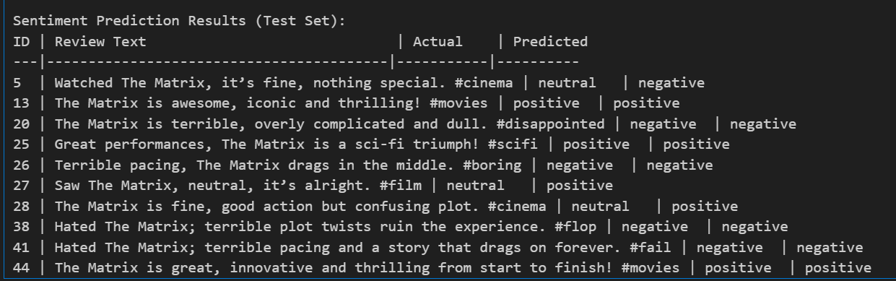
Results
Test Set: 10 reviews (20% of 48)

Slide 8
Some applications of BERT in NLP
Sentiment Analysis
Language Translation
Question Answering
Google Search
Text Summarization
Text Matching and Retrieval
Paragraph Highlighting.

Slide 9
Summary
Transfer learning enables NLP with small datasets
Feature extraction: Frozen BERT + custom layer
Simple, efficient, and effective for sentiment analysis
Applications:
Review classification, chatbots, text analysis
Extends to other tasks: Question answering, translation
Try It: Experiment with new reviews or layer designs

