Slide 1
Machine Learning Concepts for Multiclass Classification
Entropy, Cross-Entropy Loss, ReLU, and Adam Optimizer

Slide 2
Overview
Entropy: Measuring uncertainty in data
Cross-Entropy Loss: Evaluating model predictions
ReLU Activation: Enabling non-linear learning
Adam Optimizer: Efficiently updating model weights
How these concepts work together in our PyTorch model

Slide 3
Entropy

Slide 4


What is Entropy/Information Entropy?
Entropy quantifies the uncertainty/surprise/impurity in a dataset.
Example: You pick a black bird from each data set with a different distribution (event: pick a bird, outcome: a black bird)
dataset 1
dataset 2
dataset 3
If something is very unlikely but happens → big surprise
If something is very likely → you’re not surprised
high
medium
low
Notes:
what if we pick up a white bird?

Slide 5
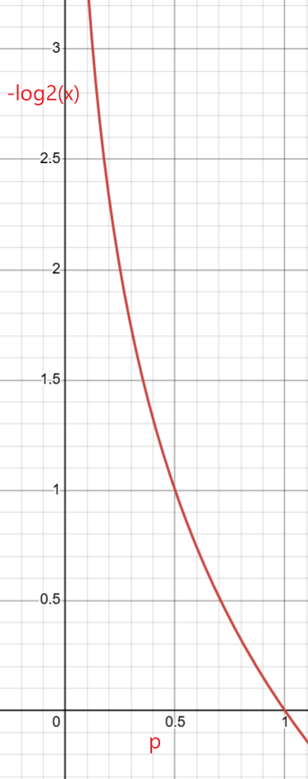
Compute the entropy of an event (picking a black bird with a probability of p)
Entropy _{black} =​log₂​(1/p _{black} ​)
dataset 1
dataset 2
dataset 3
p _{black} =1/8=0.125
Entropy _{black} =​log₂​(1/0.125​)=3
p _{black} =4/8=0.5
Entropy _{black} =​log₂​(1/0.5​)=1
p _{black} =7/8
Entropy _{black} =​log₂​(1/(7/8​)= 0.19
The uncertainty can be encoded by the number of bits
transform a p to entropy

Slide 6
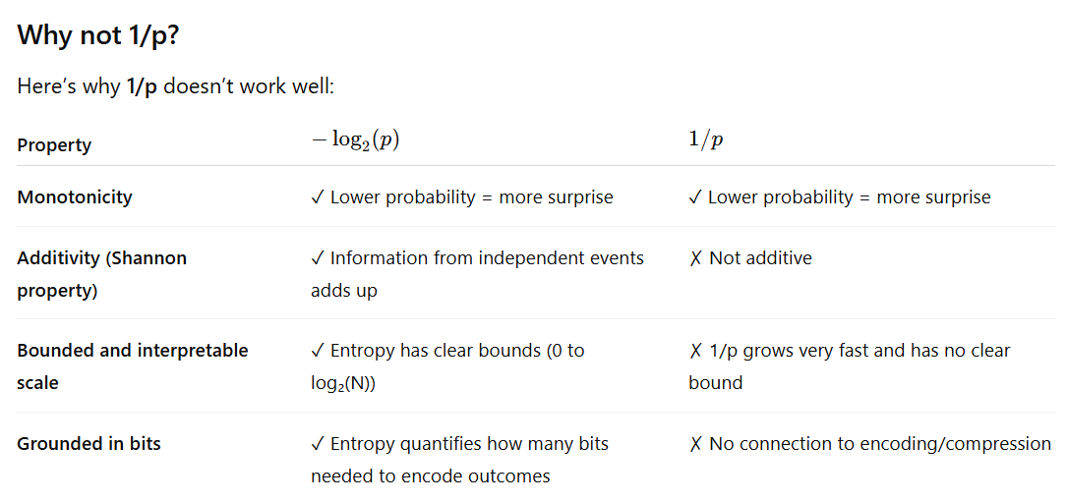
Takeaway: Entropy can be measured in bits, e.g., a 50% outcome can be encoded and represented in 1 bit

Slide 7
Should consider two outcomes: a black or a white bird
Entropy _{black} =​log₂​(1/p _{black} ​)
Entropy _{white} =​log₂​(1/p _{white} ​)
consider weighted entropy for both outcomes
Weighted Entropy _{pick a bird} =​ p _{black} log₂​(1/p _{black} ​) + p _{white} log₂​(1/p _{white} ​)
=​ p _{black} log₂​(1/p _{black} ​) + (1-p _{black} )log₂​(1/p _{black} ​)
Takeaway: We are always interested in Weighted Entropy

Slide 8
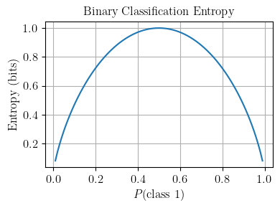
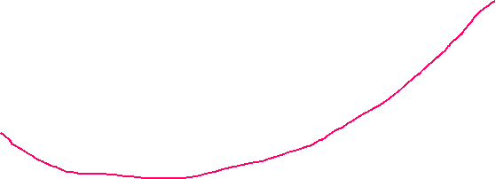

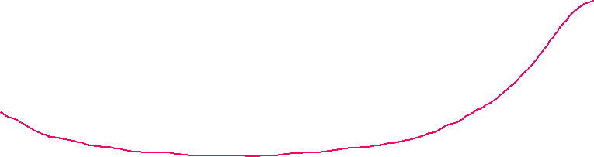

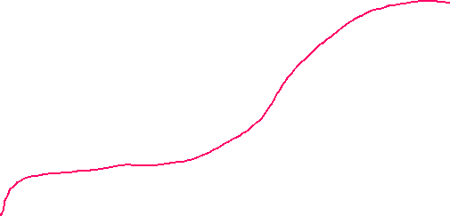

Example: Compute weighted entropy
Entropy _{pick a bird} =​ p _{black} log₂​(1/p _{black} ​) + p _{white} log₂​(1/p _{white} ​)
dataset 1
dataset 2
dataset 3
0.125 log₂​(1/0.125 ​) + 0.875 log₂​(1/0.875 ​) =0.54
0.5 log₂​(1/0.5 ​) + 0.5 log₂​(1/0.5 ​)=1
0.875 log₂​(1/0.875 ​) + 0.125 log₂​(1/0.125 ​) =0.54
Why does dataset 2 have the highest entropy? equal distribution has the highest uncertainty

Slide 9
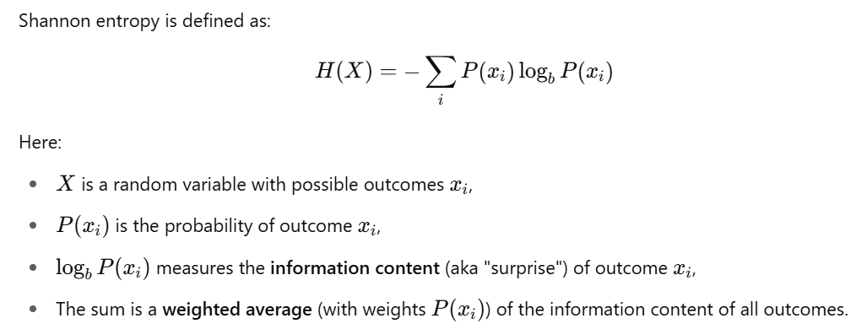
Takeaway: Entropy is the
expected information or average uncertainty associated with a random variable (with probability of all possible outcomes)
the average number of bits we’d need to encode the information (distribution)

Slide 10
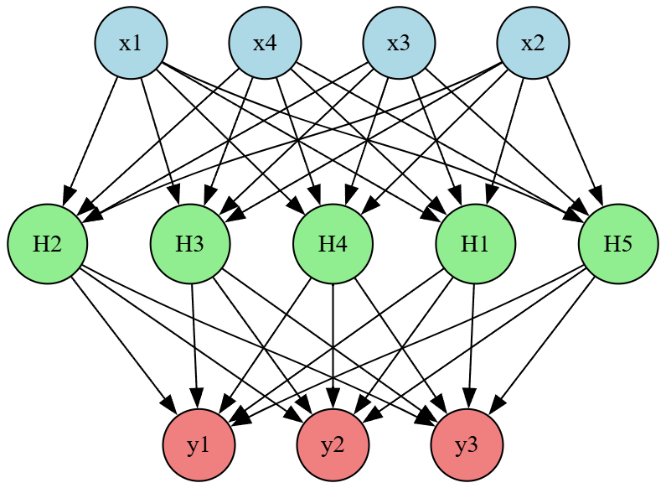
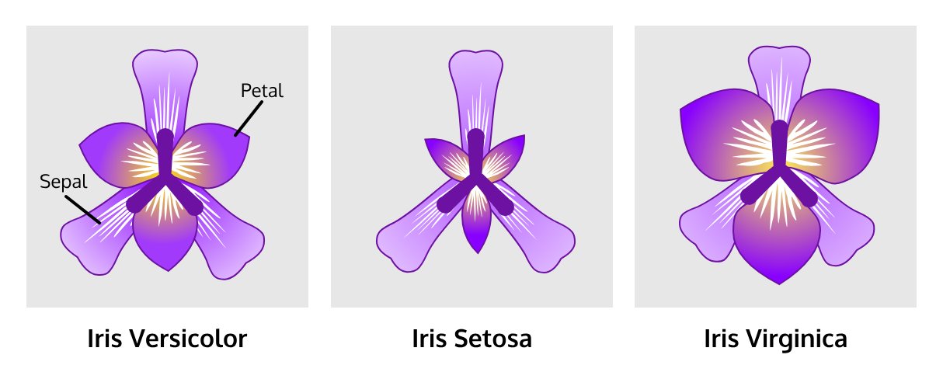
Measure a model’s confidence using entropy
Iris dataset with 3 classes [Setosa, Versicolor, Virginica]
The model is a random variable
with or without training
Model prediction results:
Prediction case 1 : [0.33, 0.33, 0.33] → High entropy → High uncertainty → confidence is low
Prediction case 2: [0.8, 0.1, 0.1] → Low entropy → Low uncertainty → confidence is higher
Prediction case 2: [0.8, 0.1, 0.1]
Takeaway: A trained model should produce low-entropy outputs (e.g., [0.8, 0.1, 0.1]) for accurate classification.
Notes:
digraph NeuralNetwork {
rankdir=TB; // Changed from LR to TB for top-to-bottom layout
splines=true;
nodesep=0.5;
ranksep=1.0;
// Input Layer (4 neurons)
node [shape=circle, style=filled, fillcolor=lightblue];
I1 [label="x3"];
I2 [label="x2"];
I3 [label="x1"];
I4 [label="x4"];
{rank=same; I1; I2; I3; I4}
// Hidden Layer (5 neurons)
node [shape=circle, style=filled, fillcolor=lightgreen];
H1 [label="H5"];
H2 [label="H2"];
H3 [label="H3"];
H4 [label="H4"];
H5 [label="H1"];
{rank=same; H1; H2; H3; H4; H5}
// Output Layer (3 neurons)
node [shape=circle, style=filled, fillcolor=lightcoral];
O1 [label="y1"];
O2 [label="y2"];
O3 [label="y3"];
{rank=same; O1; O2; O3}
// Edges: Input to Hidden Layer
I1 -> {H1, H2, H3, H4, H5};
I2 -> {H1, H2, H3, H4, H5};
I3 -> {H1, H2, H3, H4, H5};
I4 -> {H1, H2, H3, H4, H5};
// Edges: Hidden to Output Layer
H1 -> {O1, O2, O3};
H2 -> {O1, O2, O3};
H3 -> {O1, O2, O3};
H4 -> {O1, O2, O3};
H5 -> {O1, O2, O3};
}

Slide 11

A small Issue: A multiclass classification model produces raw results (e.g., [3.1, 1.01, 1.01]), but calculating entropy needs probabilities
Solution: Softmax- converts raw model outputs (logits) into probabilities
z= [3.1 1.01 1.01]
softmax
sum([0.8, 0.1, 0.1])=1

Slide 12
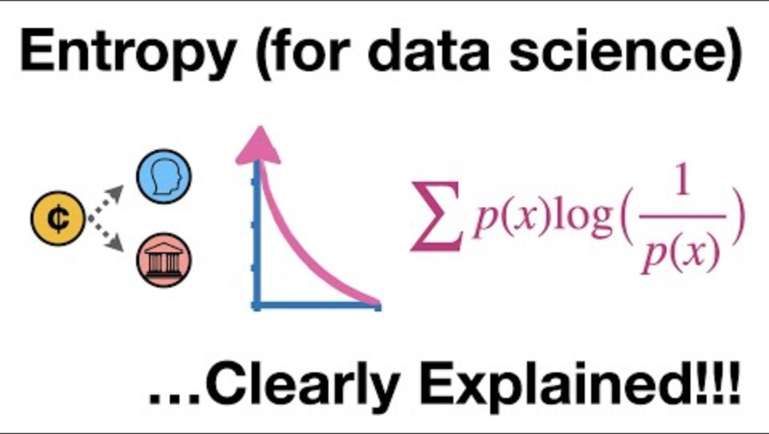

Slide 13
Cross-Entropy

Slide 14
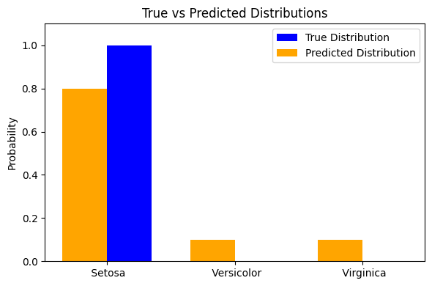
Cross-Entropy: Evaluating Predictions
Definition: Measures the difference between two distributions (predicted probabilities and true labels).
0.8
0.1
0.1
1
0
0
Setosa
Versicolor
Virginica
y= true label/ distribution (one-hot encoded)
y’=predicted distribution (after softmax)

Slide 15
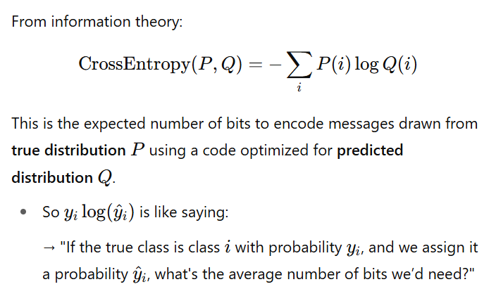
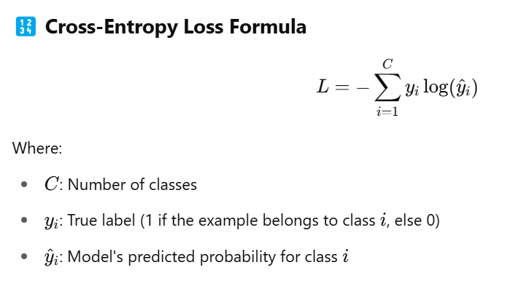
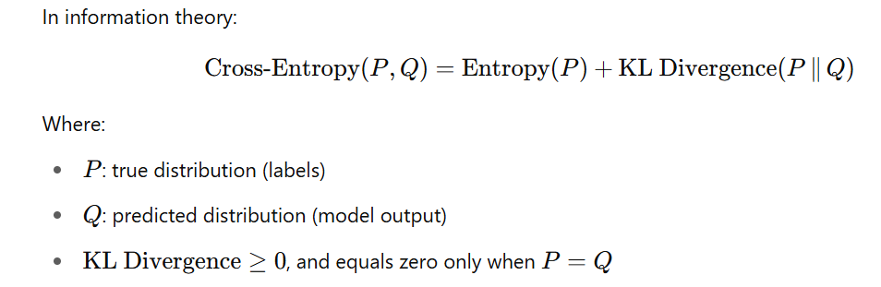
Cross-Entropy loss related to Information Theory (Cross-Entropy)
- Entropy of y
omitted due to the minimax problem
vs.
extract bits need to encode information
https://www.youtube.com/watch?v=ErfnhcEV1O8
Notes:
Formula: L = -\sum y_i \log(\hat{y}_i) \\
y_i : \text{True label (1 for correct class, 0 otherwise)}\\
\hat{y}_i : \text{Predicted probability for class ( i )}

Slide 16
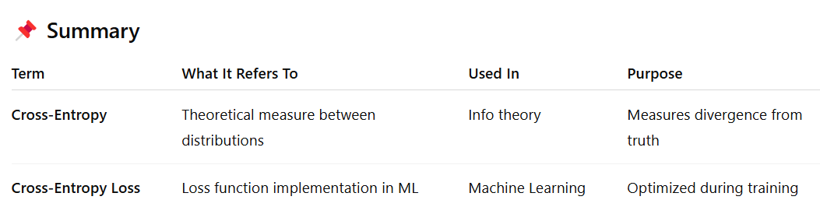

Slide 17





Simplify Cross-Entropy loss
Simplify the Loss function with one-hot encoded true distribution, e.g., y=[1,0,0]
y=[1,0,0] as a mask
=
= −log(y​₂​’)
y=[1,0,0]

Slide 18
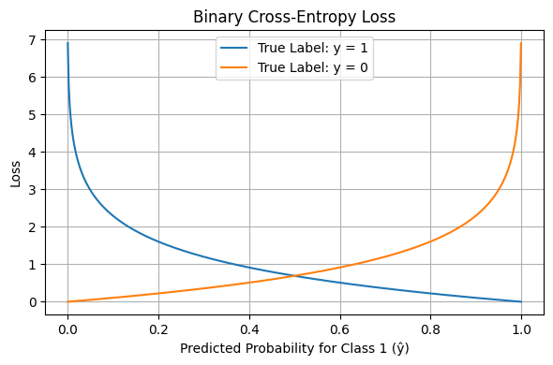
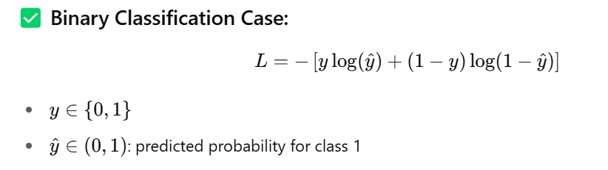
Binary Cross-Entropy Loss is a special case of Cross-Entropy Loss

Slide 19
