Slide 1
Open Source Models with Hugging Face

Slide 2
Introduction

Slide 3
What is Hugging Face?
Hugging Face is an open-source platform for machine learning, focusing on natural language processing (NLP), computer vision, and more.
Founded in 2016 by Clément Delangue, Julien Chaumond, and Thomas Wolf.
Known as the "GitHub for Machine Learning" for hosting models, datasets, and applications.
Community-driven, with contributions from researchers and developers worldwide.

Slide 4
Goals and Objectives
Goal: Democratize AI by making state-of-the-art models accessible to everyone.
Objectives:
Provide free, open-source tools and models for AI development.
Foster collaboration among researchers, developers, and organizations.
Simplify the process of building, deploying, and sharing ML models.
Promote ethical and responsible AI development.

Slide 5
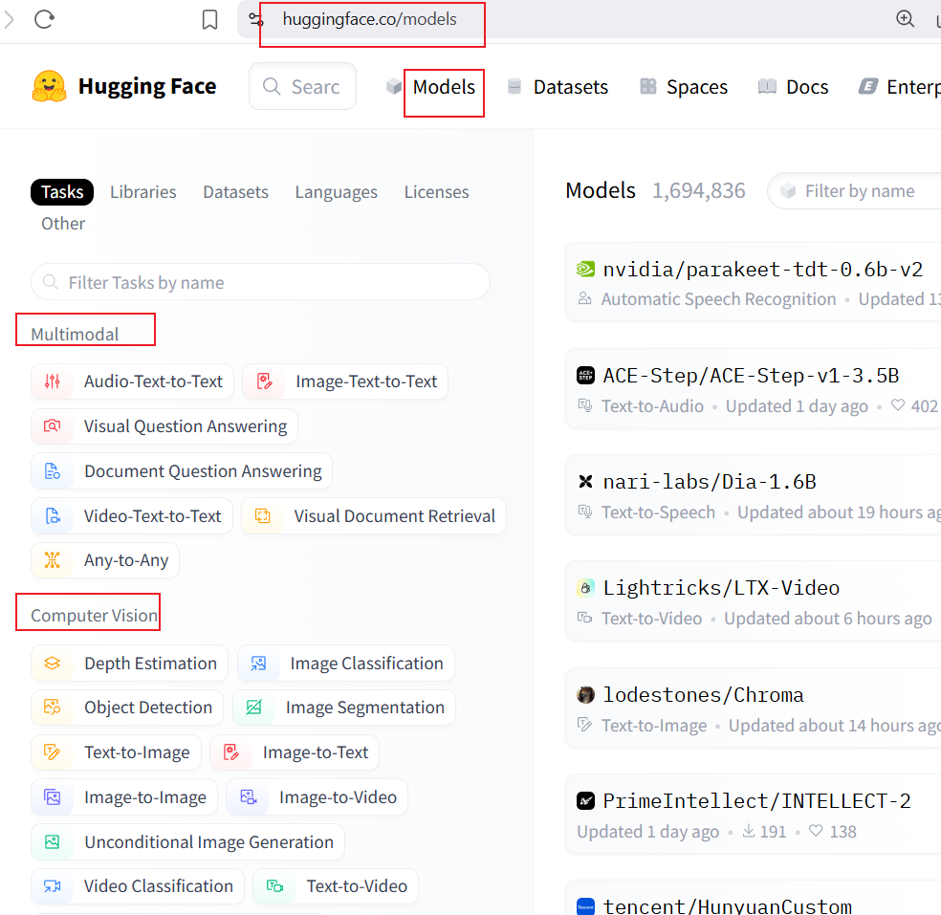
Key Functions of Hugging Face
Model Hub: Repository of 500,000+ pre-trained models for NLP, vision, audio, etc.
Datasets Library: Access to 100,000+ datasets for training and evaluation.
Transformers Library: Python library for easy model training and inference.
Spaces: Platform to create and share ML applications (e.g., demos, web apps).
AutoML Tools: Tools like AutoTrain for automated model training.
Inference API: Run models via API for quick prototyping.

Slide 6
Popular Models on Hugging Face
BERT: Bidirectional transformer for text understanding (e.g., sentiment analysis).
GPT-2/GPT-Neo: Text generation models for creative writing or chatbots.
T5: Text-to-text transformer for summarization, translation, etc.
DistilBERT: Lightweight, faster version of BERT.
Stable Diffusion: Text-to-image model for generating artwork.
Whisper: Speech-to-text model for transcription.

Slide 7
Cybersecurity & Forensics Models
Lily-Cybersecurity-7B-v0.2: Mistral-based model fine-tuned with 22,000 cybersecurity data pairs for tasks like threat analysis and incident response.
ZySec-7B: Zephyr-based model for cybersecurity guidance, covering attack surface threats, cloud security, and compliance.
Foundation-Sec-8B: Llama 3.1-based model for cybersecurity tasks, excelling in CTF challenges and threat intelligence.
SecureBERT: NLP model for Cyber Threat Intelligence (CTI) automation, trained on cybersecurity text

Slide 8
Example Application - Sentiment Analysis
Task: Analyze customer reviews to determine sentiment (positive/negative).
Model: Use DistilBERT from Hugging Face's Model Hub.
Steps:
Install Transformers: pip install transformers
Load model: from transformers import pipeline
Initialize pipeline: sentiment_analyzer = pipeline("sentiment-analysis")
Analyze text: result = sentiment_analyzer("I love this product!")
Output: {'label': 'POSITIVE', 'score': 0.999}
Use Case: Businesses use this for customer feedback analysis.

Slide 9
Example Application - Text-to-Image
Task: Generate images from text prompts.
Model: Stable Diffusion.
Steps:
Install diffusers: pip install diffusers
Load model: from diffusers import StableDiffusionPipeline
Initialize pipeline: pipe = StableDiffusionPipeline.from_pretrained("runwayml/stable-diffusion-v1-5")
Generate image: image = pipe("A futuristic city at sunset").images[0]
Save image: image.save("city.png")
Use Case: Artists and designers create visual content.

Slide 10
Example Application - Cybersecurity Q&A
Task: Answer cybersecurity queries (e.g., explaining evil twin attacks).
Model: Lily-Cybersecurity-7B-v0.2.
Steps:
Install Transformers: pip install transformers
Load model: from transformers import pipeline
Initialize pipeline: qa = pipeline("text-generation", model="segolilylabs/Lily-Cybersecurity-7B-v0.2")
Query: qa("How do evil twin wireless attacks work?")
Output: Explains how attackers mimic legitimate Wi-Fi access points to steal data.
Use Case: SOC teams use this for real-time threat education.

Slide 11
Example Application - CTI Automation
Task: Extract actionable insights from Cyber Threat Intelligence reports.
Model: SecureBERT.
Steps:
Install Transformers: pip install transformers
Load model: from transformers import pipeline
Initialize pipeline: nlp = pipeline("ner", model="SecureBERT")
Process text: nlp("New ransomware targets financial sector")
Output: Identifies entities like "ransomware" and "financial sector" for automated alerts.
Use Case: Automates threat analysis for faster incident response.

Slide 12
Impacts of Hugging Face
Accessibility: Enables small teams and individuals to use advanced AI without massive resources.
Innovation: Accelerates research by providing pre-trained models and datasets.
Community: Over 100,000 contributors share models, fostering collaboration.
Education: Free resources help students and educators learn AI.
Industry: Companies like Microsoft and Meta use Hugging Face for AI solutions.
Ethical AI: Promotes transparency and open-source standards.
Challenges: Malicious models (e.g., Pickle-based attacks) require vigilance

Slide 13
Security Considerations
Risks:
Malicious models: Over 100 models with backdoors found (e.g., PyTorch models using Pickle serialization).
Pickle vulnerabilities: Can execute arbitrary code during deserialization.
Supply chain attacks: Compromised models can affect millions of downloads.
Mitigations:
Hugging Face’s security: Malware, Pickle, and secrets scanning.
Safetensors format: Safer alternative to Pickle.
Developer caution: Verify sources and use isolated environments.

Slide 14
Getting Started with Hugging Face
Step 1: Visit huggingface.co and create a free account.
Step 2: Explore the Model Hub and Datasets.
Step 3: Install the Transformers library: pip install transformers
Step 4: Try a demo in Spaces or use the Inference API.
Step 5: Join the community on Discord or GitHub to collaborate.
Resources: Docs (huggingface.co/docs), Tutorials, and Blog.

Slide 15
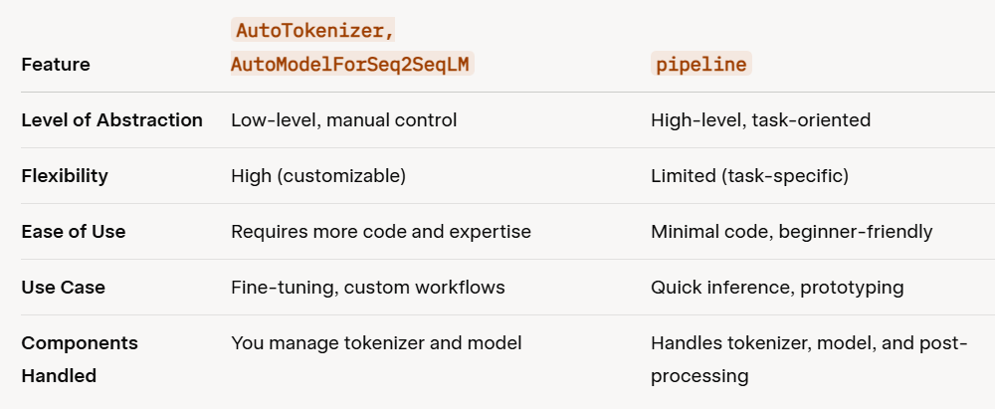
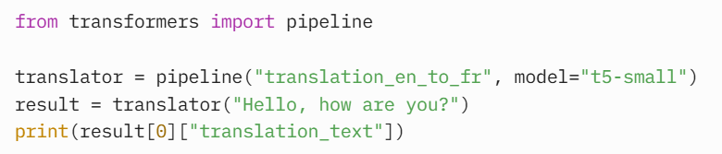
Two different methods to load models

Slide 16
Challenges and Future Directions
Challenges:
Model bias and ethical concerns in AI outputs.
Compute resources needed for large models.
Managing the scale of community contributions.
Future Directions:
Improve model efficiency (e.g., smaller, faster models).
Expand support for multimodal AI (text, image, audio).
Enhance tools for responsible AI development.

Slide 17
Conclusion
Hugging Face is a game-changer for open-source AI, making advanced models accessible.
Its ecosystem (Models, Datasets, Transformers, Spaces) empowers developers and researchers.
Real-world applications range from sentiment analysis to creative art generation.
Join the Hugging Face community to build the future of AI!

Slide 18
Video tutorial
https://learn.deeplearning.ai/courses/open-source-models-hugging-face/lesson/g7rmo/selecting-models

Slide 19
Homework
Hands-on work

