Slide 1
Prediction with Linear Regression

Slide 2
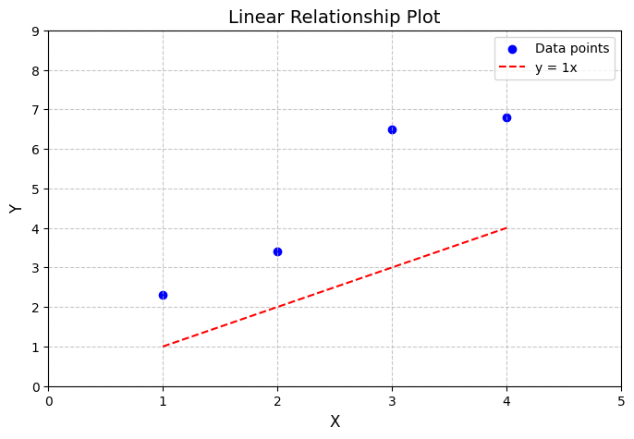
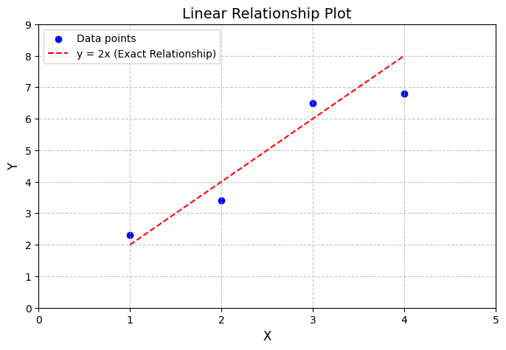
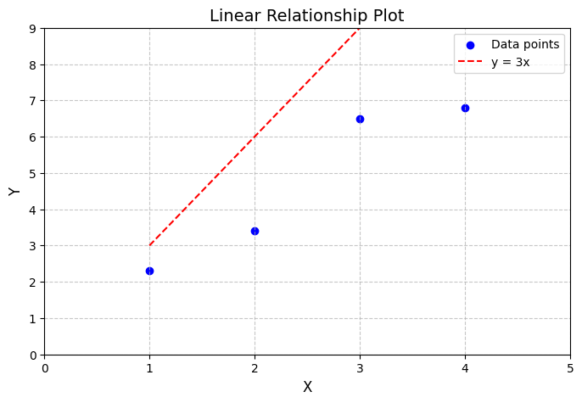
Training dataset
Features (x) | Target (y)
1 | 2.3
2 | 3.4
3 | 6.5
4 | 6.8
Our goal is to find the best fit line (with the least error): y’=wx+b (b=0)

Slide 3
Measure error with cost/loss function
Mean Square Error (MSE) = (y’ –y)² /# number of training data
y=1x+0
f(x)=2x+0
f(x)=3x+0
y’= predicted y
w₁= 1, MSE=5.935
w₁= 2, MSE=0.5
w₁= 3, MSE=10.1
Which w is better?

Slide 4
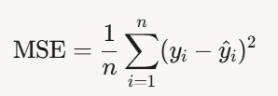
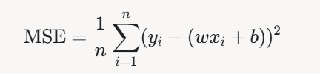
Compute MSE with w₁= 1
Predicted values (ŷ = 1·x): [1.0, 2.0, 3.0, 4.0]
Errors (y - ŷ):
2.3 - 1.0 = 1.3 3.4 - 2.0 = 1.4 6.5 - 3.0 = 3.5 6.8 - 4.0 = 2.8
Mean square errors:
(1.3)² = 1.69 (1.4)² = 1.96 (3.5)² = 12.25 (2.8)² = 7.84
Sum of squared errors:
1.69 + 1.96 + 12.25 + 7.84 = 23.74
MSE calculation:
MSE = 23.74 / 4 = 5.935
y=1x+0
y’= predicted y

Slide 5
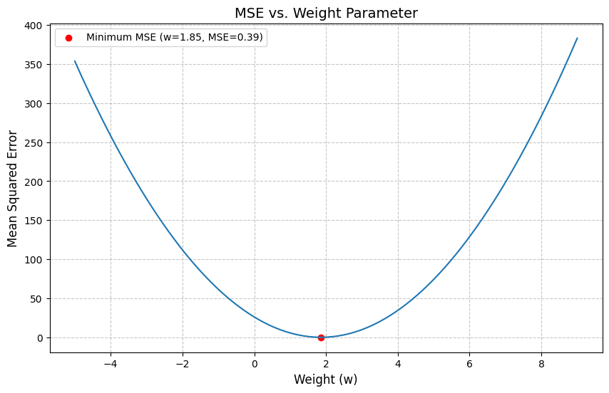
Draw each pair (MSE, w)
the goal is to find w

Slide 6
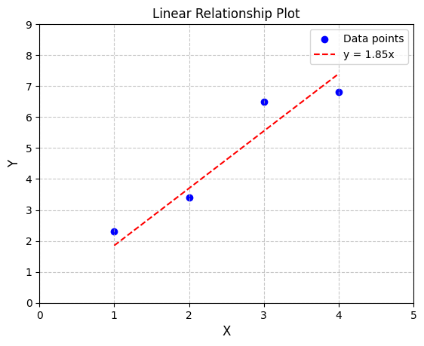
Prediction with w=1.8

